Slide 1
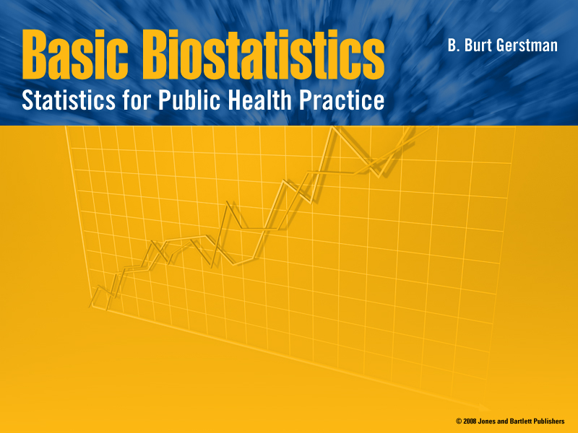
Chapter 9:
Basics of Hypothesis Testing

Slide 2

In Chapter 9:
9.1 Null and Alternative Hypotheses
9.2 Test Statistic
9.3 P-Value
9.4 Significance Level
9.5 One-Sample z Test
9.6 Power and Sample Size
Notes:
Chapter 9
Basic Biostat

Slide 3

Terms Introduce in Prior Chapter
Population ≡ all possible values
Sample ≡ a portion of the population
Statistical inference ≡ generalizing from a sample to a population with calculated degree of certainty
Two forms of statistical inference
  Hypothesis testing
  Estimation
Parameter ≡ a characteristic of population, e.g., population mean µ
Statistic ≡ calculated from data in the sample, e.g., sample mean ( )
Notes:
Chapter 9
Basic Biostat
Hypothesis testing is one of the two common forms of statistical inference. This slide reviews some of the terms that form the basis of statistical inference, as introduced in the prior chapter. Make certain you understand these basics before proceeding.

Slide 4
Distinctions Between Parameters and Statistics (Chapter 8 review)
 | Parameters | Statistics
Source | Population | Sample
Notation | Greek (e.g., μ) | Roman (e.g., xbar)
Vary | No | Yes
Calculated | No | Yes
Notes:
Chapter 9
Basic Biostat
This slide address an other foundation of statistical inference: the difference between parameters and statistics. Parameters and statistics are related, but are not the same thing.
Over the years teaching statistics, I have derived a hypothesis that explains why some students have difficulty with statistical inference: they fail to distinguish between statistics and parameter. When a student calculates a statistic such as a sample mean, it seems so tangible and real that they view it as a constant. I think they would be better off if they recognized a statistic as merely one example of what might have been had they done the study or experiment at a different time.

Slide 5
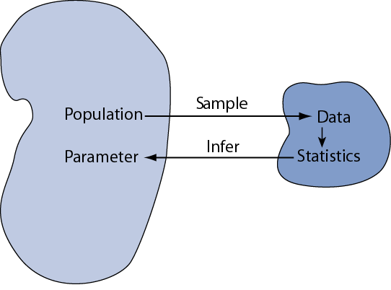

Slide 6
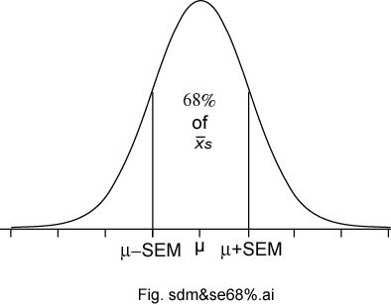
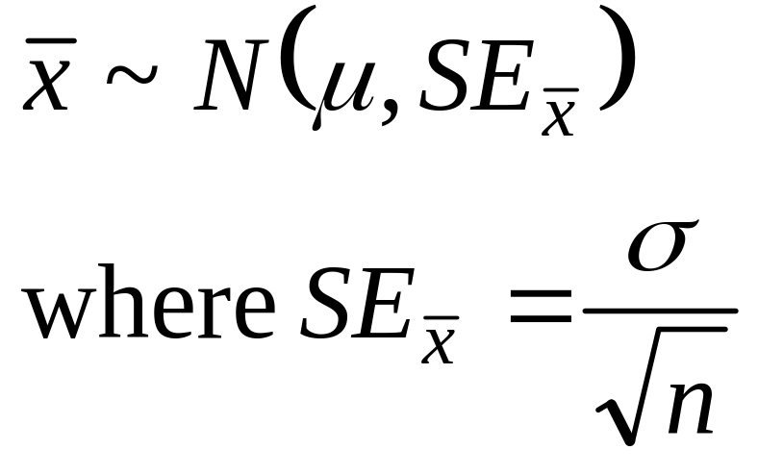
Sampling Distributions of a Mean (Introduced in Ch 8)
The sampling distributions of a mean (SDM) describes the behavior of a sampling mean
Notes:
Chapter 9
Basic Biostat
This slide summarize what we’ve learned about the sampling distribution of a mean from a large sample. It is based no three important sampling postulates: the central limit theorem, the law of large numbers (unbiased nature of the sample mean), and square root law. Based on these well established statistical theorems we can say that means based on large samples (and means based in Normal populations) will have a Normal sampling distribution with an expectation equal to the population mean with a standard deviation equal to the standard deviation of the population divided by the square root of the sample size n.

Slide 7
Hypothesis Testing
Is also called significance testing
Tests a claim about a parameter using evidence (data in a sample
The technique is introduced by considering a one-sample z test
The procedure is broken into four steps
Each element of the procedure must be understood
Notes:
Chapter 9
Basic Biostat
Hypothesis testing (also called significance testing) uses a quasi-deductive procedure to judge claims about parameters. Before testing a statistical hypothesis it is important to clearly state the nature of the claim to be tested. We are then going to use a four step procedure (as outlined in the last bullet) to test the claim.

Slide 8
Hypothesis Testing Steps
  Null and alternative hypotheses
  Test statistic
  P-value and interpretation
  Significance level (optional)

Slide 9
§9.1 Null and Alternative Hypotheses
Convert the research question to null and alternative hypotheses
The null hypothesis (H₀) is a claim of “no difference in the population”
The alternative hypothesis (H_{a}) claims “H₀ is false”
Collect data and seek evidence against H₀ as a way of bolstering H_{a} (deduction)
Notes:
Chapter 9
Basic Biostat
The first step in the procedure is to state the hypotheses null and alternative forms. The null hypothesis (abbreviate “H naught”) is a statement of no difference. The alternative hypothesis (“H sub a”) is a statement of difference. Seek evidence against the claim of H₀ as a way of bolstering H_{a.}
The next slide offers an illustrative example on setting up the hypotheses.

Slide 10
Illustrative Example: “Body Weight”
The problem: In the 1970s, 20–29 year old men in the U.S. had a mean μ body weight of 170 pounds. Standard deviation σ was 40 pounds. We test whether mean body weight in the population now differs.
Null hypothesis H_{0:} μ = 170 (“no difference”)
The alternative hypothesis can be either H_{a:} μ > 170 (one-sided test) or
H_{a:} μ ≠ 170 (two-sided test)
Notes:
Chapter 9
Basic Biostat
In the late 1970s, the weight of U.S. men between 20- and 29-years of age had a log-normal distribution with a mean of 170 pounds and standard deviation of 40 pounds. As you know, the overweight and obese conditions seems to be more prevalent today, constituting a major public health problem. To illustrate the hypothesis testing procedure, we ask if body weight in this group has increased since 1970. Under the null hypothesis there is no difference in the mean body weight between then and now, in which case μ would still equal 170 pounds.
Under the alternative hypothesis, the mean weight has increased Therefore, H_{a:} μ > 170. This statement of the alternative hypothesis is one-sided. That is, it looks only for values larger than stated under the null hypothesis.
There is another way to state the alternative hypothesis. We could state it in a “two-sided” manner, looking for values that are either higher- or lower-than expected. For the current illustrative example, the two-sided alternative is H_{a:} μ ≠ 170. Although for the current illustrative example, this seems unnecessary, two-sided alternative offers several advantages and are much more common in practice.

Slide 11
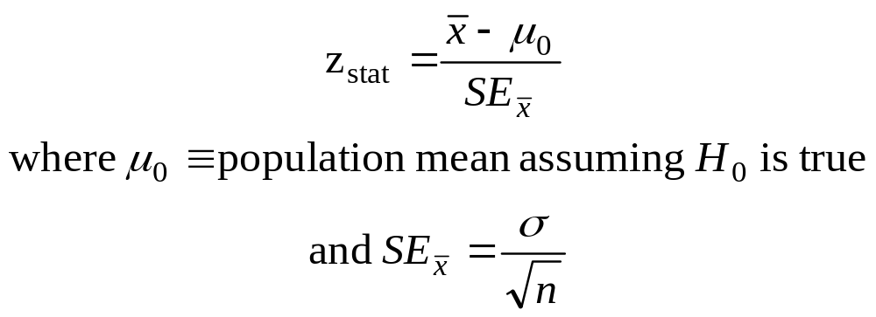
§9.2 Test Statistic
This is an example of a one-sample test of a mean when σ is known. Use this statistic to test the problem:
Notes:
Chapter 9
Basic Biostat

Slide 12
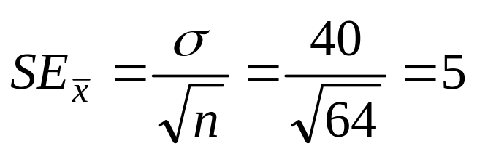
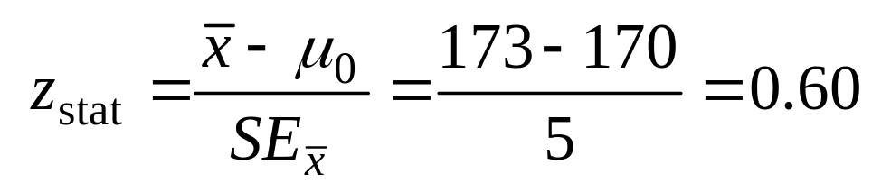
Illustrative Example: z statistic
For the illustrative example, μ₀ = 170
We know σ = 40
Take an SRS of n = 64. Therefore
If we found a sample mean of 173, then

Slide 13
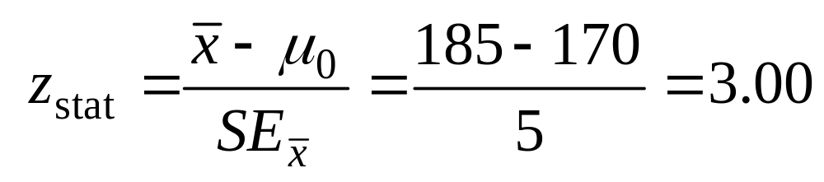
Illustrative Example: z statistic
If we found a sample mean of 185, then

Slide 14
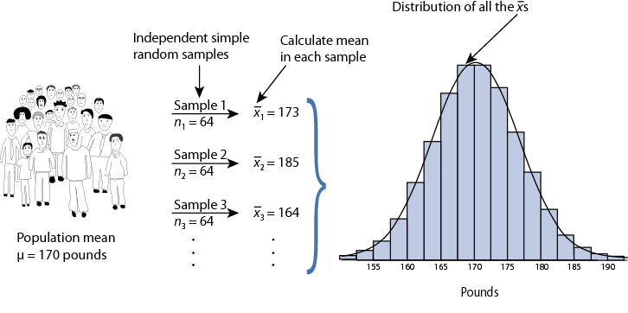
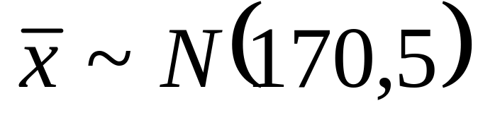
Reasoning Behinµz_{stat}
Sampling distribution of xbar under H₀: µ = 170 for n = 64 ⇒

Slide 15
§9.3 P-value
The P-value answer the question: What is the probability of the observed test statistic or one more extreme when H₀ is true?
This corresponds to the AUC in the tail of the Standard Normal distribution beyond the z_{stat.}
Convert z statistics to P-value :
  For H_{a}: μ > μ₀ ⇒ P = Pr(Z > z_{stat}) = right-tail beyond z_{stat}
  For H_{a}: μ < μ₀ ⇒ P = Pr(Z < z_{stat}) = left tail beyond z_{stat}
  For H_{a}: μ ≠ μ₀ ⇒ P = 2 × one-tailed P-value
Use Table B or software to find these probabilities (next two slides).

Slide 16
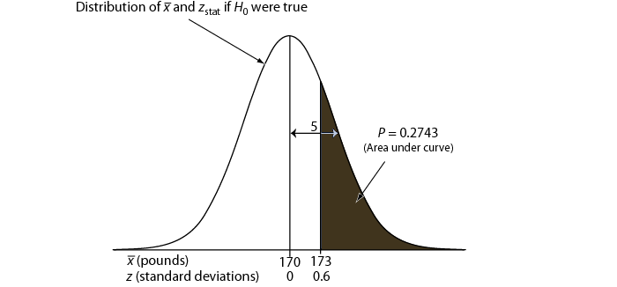
One-sided P-value for z_{stat} of 0.6

Slide 17
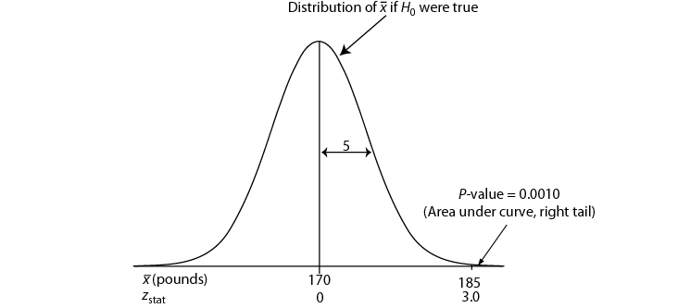
One-sided P-value for z_{stat} of 3.0

Slide 18
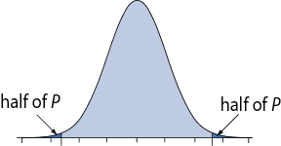
Two-Sided P-Value
One-sided H_{a} ⇒ AUC in tail beyond z_{stat}
Two-sided H_{a} ⇒ consider potential deviations in both directions ⇒ double the one-sided P-value
Examples: If one-sided P = 0.0010, then two-sided P = 2 × 0.0010 = 0.0020. If one-sided P = 0.2743, then two-sided P = 2 × 0.2743 = 0.5486.

Slide 19
Interpretation
P-value answer the question: What is the probability of the observed test statistic … when H₀ is true?
Thus, smaller and smaller P-values provide stronger and stronger evidence against H₀
Small P-value ⇒ strong evidence

Slide 20
Interpretation
Conventions*
P > 0.10 ⇒ non-significant evidence against H₀
0.05 < P ≤ 0.10 ⇒ marginally significant evidence
0.01 < P ≤ 0.05 ⇒ significant evidence against H₀
P ≤ 0.01 ⇒ highly significant evidence against H₀
Examples
  P =.27 ⇒ non-significant evidence against H₀
  P =.01 ⇒ highly significant evidence against H₀
* It is unwise to draw firm borders for “significance”

Slide 21
α-Level (Used in some situations)
Let α ≡ probability of erroneously rejecting H₀
Set α threshold (e.g., let α = .10, .05, or whatever)
Reject H₀ when P ≤ α
Retain H₀ when P > α
Example: Set α = .10. Find P = 0.27 ⇒ retain H₀
Example: Set α = .01. Find P = .001 ⇒ reject H₀

Slide 22
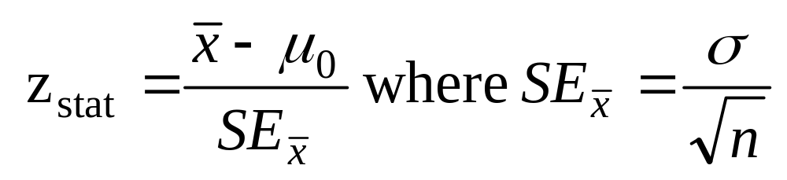
(Summary) One-Sample z Test
Hypothesis statements
H₀: µ = µ₀ vs.
H_{a}: µ ≠ µ₀ (two-sided) or
H_{a}: µ < µ₀ (left-sided) or
H_{a}: µ > µ₀ (right-sided)
Test statistic
P-value: convert z_{stat} to P value
Significance statement (usually not necessary)

Slide 23
§9.5 Conditions for z test
σ known (not from data)
Population approximately Normal or large sample (central limit theorem)
SRS (or facsimile)
Data valid

Slide 24
The Lake Wobegon Example
“where all the children are above average”
Let X represent Weschler Adult Intelligence scores (WAIS)
Typically, X ~ N(100, 15)
Take SRS of n = 9 from Lake Wobegon population
Data ⇒ {116, 128, 125, 119, 89, 99, 105, 116, 118}
Calculate: x-bar = 112.8
Does sample mean provide strong evidence that population mean μ > 100?

Slide 25
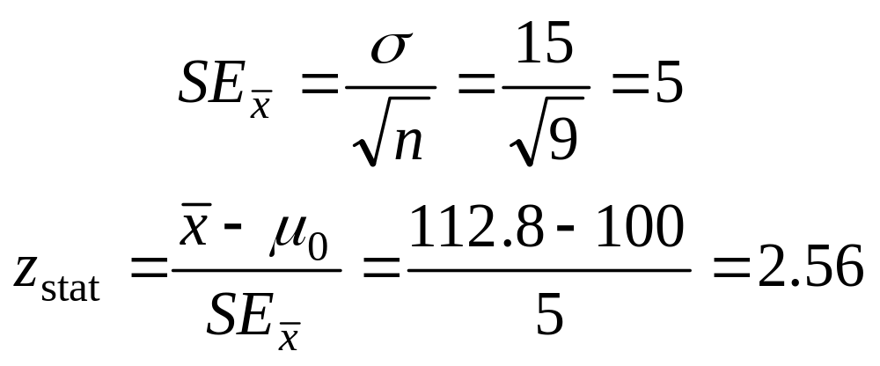
Example: “Lake Wobegon”
Hypotheses:
H₀: µ = 100 versus
H_{a}: µ > 100 (one-sided)
H_{a}: µ ≠ 100 (two-sided)
Test statistic:

Slide 26
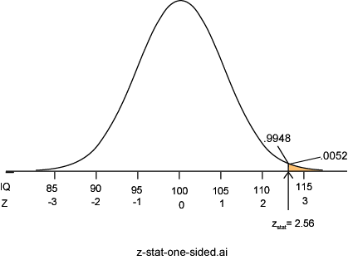
C. P-value: P = Pr(Z ≥ 2.56) = 0.0052
P =.0052 ⇒ it is unlikely the sample came from this null distribution ⇒ strong evidence against H₀

Slide 27
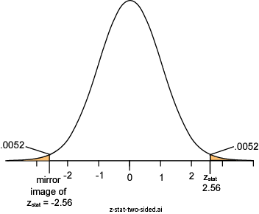
Two-Sided P-value: Lake Wobegon
H_{a}: µ ≠100
Considers random deviations “up” and “down” from μ₀ ⇒tails above and below ±z_{stat}
Thus, two-sided P
= 2 × 0.0052
= 0.0104

Slide 28
§9.6 Power and Sample Size
Two types of decision errors:
Type I error = erroneous rejection of true H₀
Type II error = erroneous retention of false H₀
 | Truth
Decision | H₀ true | H₀ false
Retain H₀ | Correct retention | Type II error
Reject H₀ | Type I error | Correct rejection
α ≡ probability of a Type I error
β ≡ Probability of a Type II error

Slide 29
Power
β ≡ probability of a Type II error
  β = Pr(retain H₀ | H₀ false)
  (the “|” is read as “given”)
1 – β = “Power” ≡ probability of avoiding a Type II error
1– β = Pr(reject H₀ | H₀ false)

Slide 30
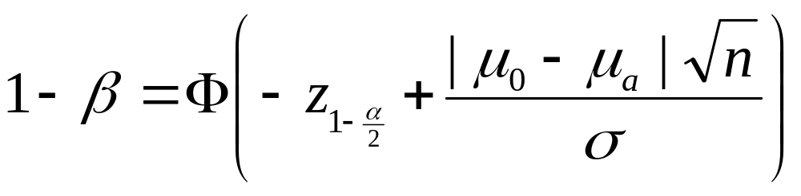


Power of a z test
where
Φ(z) represent the cumulative probability of Standard Normal Z
μ₀ represent the population mean under the null hypothesis
μ_{a} represents the population mean under the alternative hypothesis
with
.

Slide 31
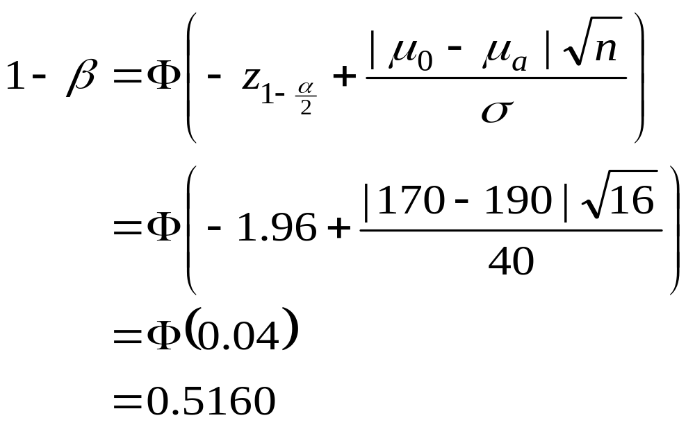
Calculating Power: Example
A study of n = 16 retains H₀: μ = 170 at α = 0.05 (two-sided); σ is 40. What was the power of test’s conditions to identify a population mean of 190?

Slide 32
Reasoning Behind Power
Competing sampling distributions
  Top curve (next page) assumes H₀ is true
  Bottom curve assumes H_{a} is true
  α is set to 0.05 (two-sided)
We will reject H₀ when a sample mean exceeds 189.6 (right tail, top curve)
The probability of getting a value greater than 189.6 on the bottom curve is 0.5160, corresponding to the power of the test

Slide 33
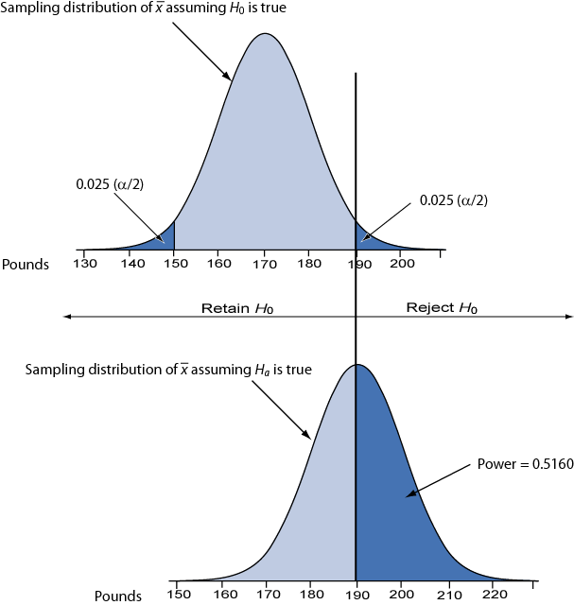

Slide 34
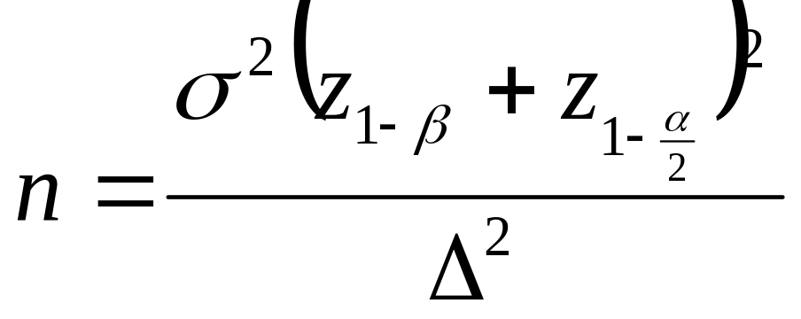
Sample Size Requirements
Sample size for one-sample z test:
where
1 – β ≡ desired power
α ≡ desired significance level (two-sided)
σ ≡ population standard deviation
Δ = μ₀ – μ_{a} ≡ the difference worth detecting

Slide 35
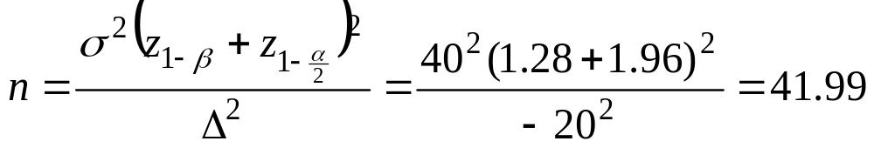
Example: Sample Size Requirement
How large a sample is needed for a one-sample z test with 90% power and α = 0.05 (two-tailed) when σ = 40? Let H₀: μ = 170 and H_{a}: μ = 190 (thus, Δ = μ₀ − μ_{a} = 170 – 190 = −20)
Round up to 42 to ensure adequate power.

Slide 36
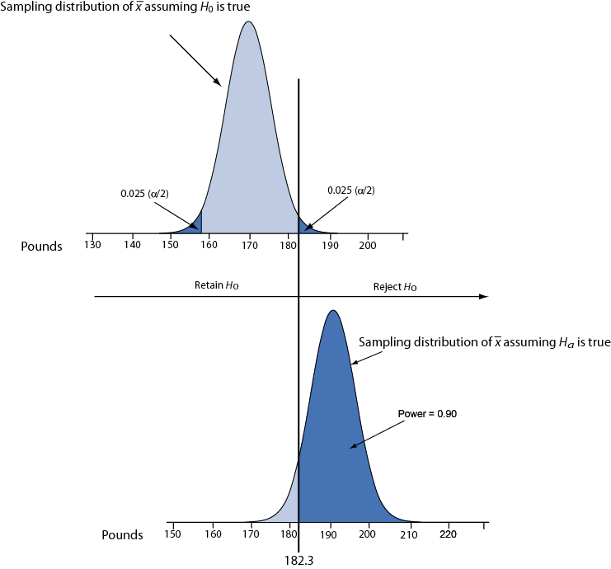
Illustration: conditions for 90% power.

