Slide 1

Linear Regression and Correlation
Chapter 13

Slide 2
GOALS
Understand and interpret the terms dependent and independent variable.
Calculate and interpret the coefficient of correlation, the coefficient of determination, and the standard error of estimate.
Conduct a test of hypothesis to determine whether the coefficient of correlation in the population is zero.
Calculate the least squares regression line.
Construct and interpret confidence and prediction intervals for the dependent variable.

Slide 3
Regression Analysis - Introduction
Recall in Chapter 4 the idea of showing the relationship between two variables with a scatter diagram was introduced.
In that case we showed that, as the age of the buyer increased, the amount spent for the vehicle also increased.
In this chapter we carry this idea further. Numerical measures to express the strength of relationship between two variables are developed.
In addition, an equation is used to express the relationship between variables, allowing us to estimate one variable on the basis of another.
EXAMPLES
Is there a relationship between the amount Healthtex spends per month on advertising and its sales in the month?
Can we base an estimate of the cost to heat a home in January on the number of square feet in the home?
Is there a relationship between the miles per gallon achieved by large pickup trucks and the size of the engine?
Is there a relationship between the number of hours that students studied for an exam and the score earned?
Correlation Analysis is the study of the relationship between variables. It is also defined as group of techniques to measure the association between two variables.
Scatter Diagram is a chart that portrays the relationship between the two variables. It is the usual first step in correlations analysis
The Dependent Variable is the variable being predicted or estimated.
The Independent Variable provides the basis for estimation. It is the predictor variable.

Slide 4
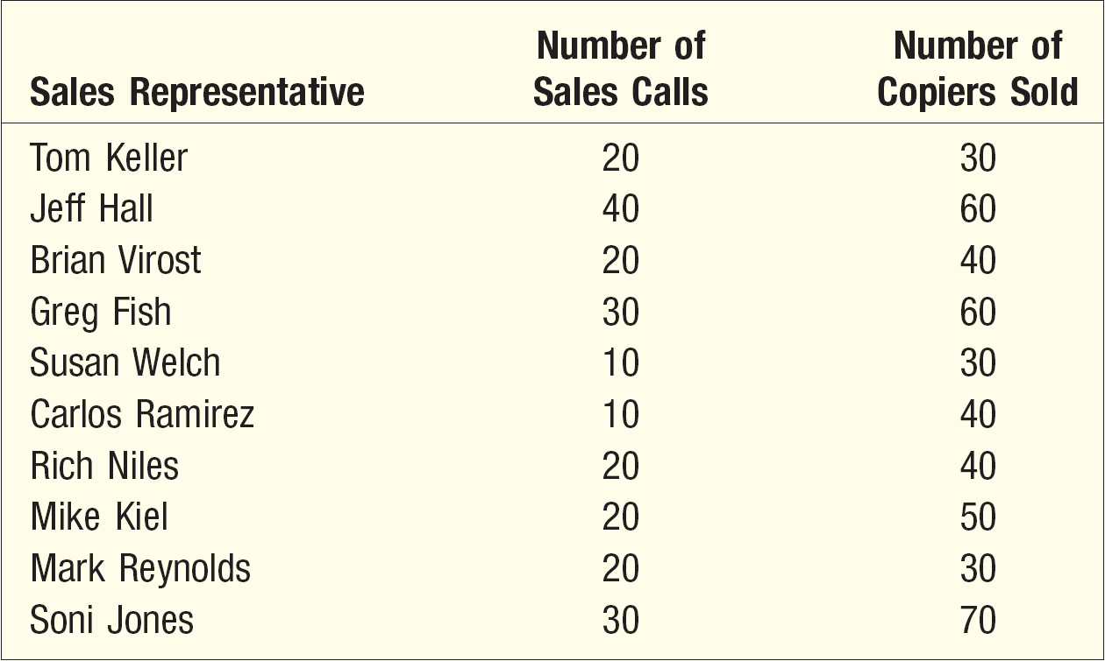
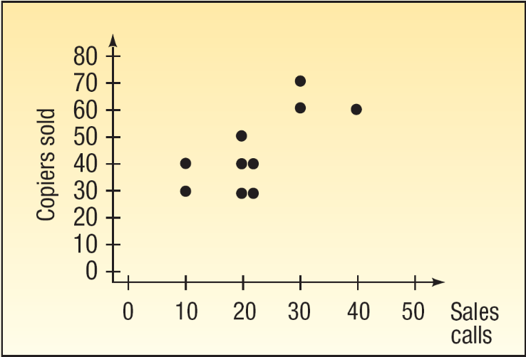
Scatter Diagram Example
The sales manager of Copier Sales of America, which has a large sales force throughout the United States and Canada, wants to determine whether there is a relationship between the number of sales calls made in a month and the number of copiers sold that month. The manager selects a random sample of 10 representatives and determines the number of sales calls each representative made last month and the number of copiers sold.

Slide 5
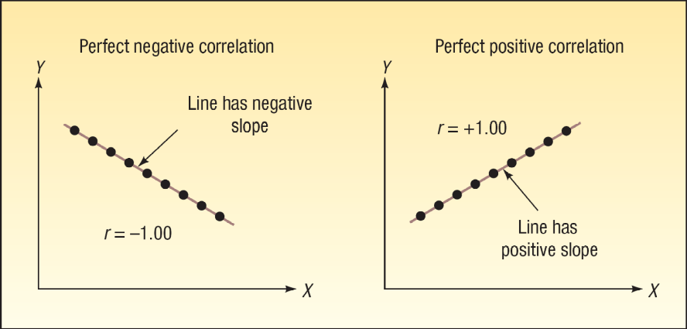
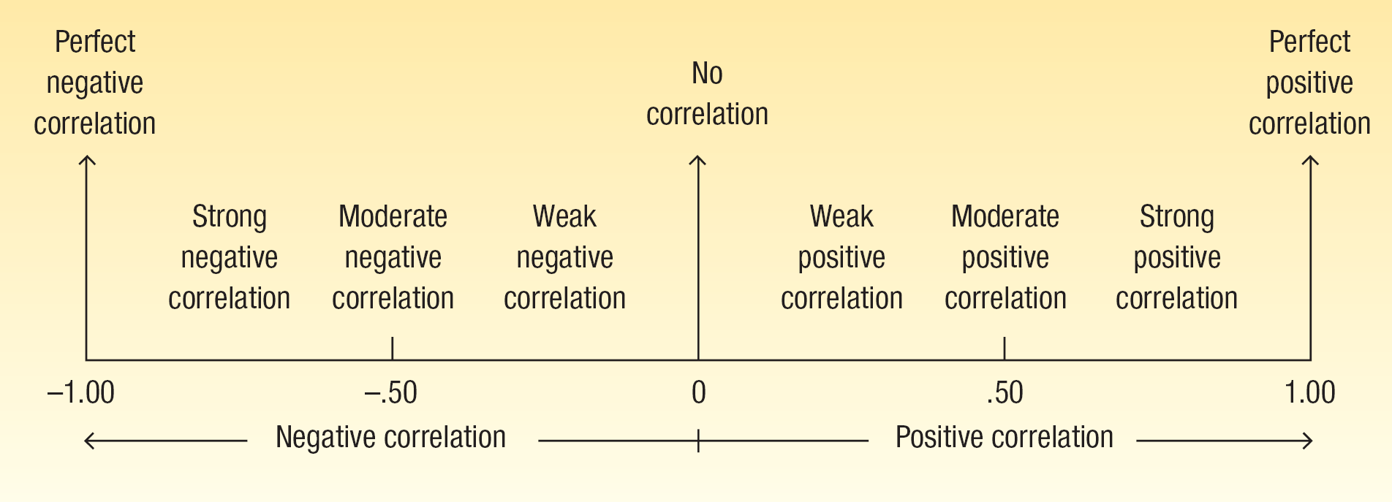
The Coefficient of Correlation, r
The Coefficient of Correlation (r) is a measure of the strength of the relationship between two variables.
It shows the direction and strength of the linear relationship between two interval or ratio-scale variables
It can range from -1.00 to +1.00.
Values of -1.00 or +1.00 indicate perfect and strong correlation.
Values close to 0.0 indicate weak correlation.
Negative values indicate an inverse relationship and positive values indicate a direct relationship.

Slide 6
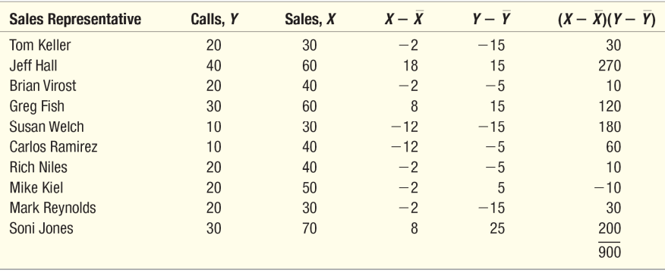
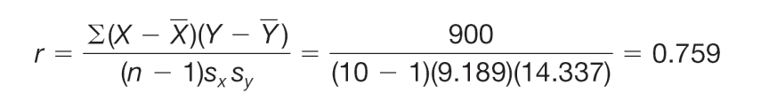
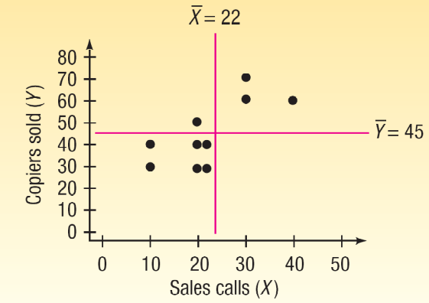
Correlation Coefficient - Example
EXAMPLE
Using the Copier Sales of America data which a scatterplot is shown below, compute the correlation coefficient and coefficient of determination.
Using the formula:
How do we interpret a correlation of 0.759?
First, it is positive, so we see there is a direct relationship between the number of sales calls and the number of copiers sold. The value of 0.759 is fairly close to 1.00, so we conclude that the association is strong. However, does this mean that more sales calls cause more sales? No, we have not demonstrated cause and effect here, only that the two variables—sales calls and copiers sold—are related.

Slide 7
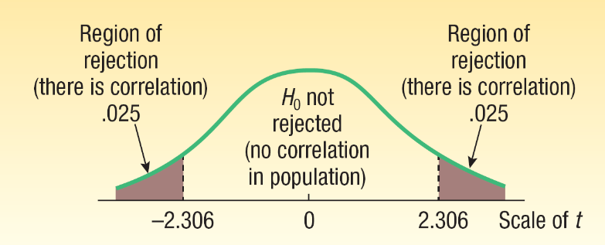
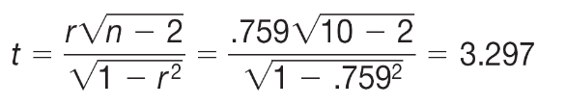
Testing the Significance of
the Correlation Coefficient – Copier Sales Example
H₀: ρ = 0 (the correlation in the population is 0)
H₁: ρ ≠ 0 (the correlation in the population is not 0)
Reject H₀ if:
t > t_{α/2,n-2} or t < -t_{α/2,n-2}
t > t_{0.025,8} or t < -t_{0.025,8}
t > 2.306 or t < -2.306
The computed t (3.297) is within the rejection region, therefore, we will reject H₀. This means the correlation in the population is not zero. From a practical standpoint, it indicates to the sales manager that there is correlation with respect to the number of sales calls made and the number of copiers sold in the population of salespeople.

Slide 8
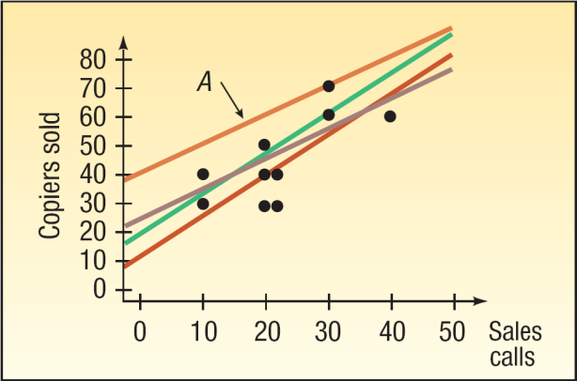
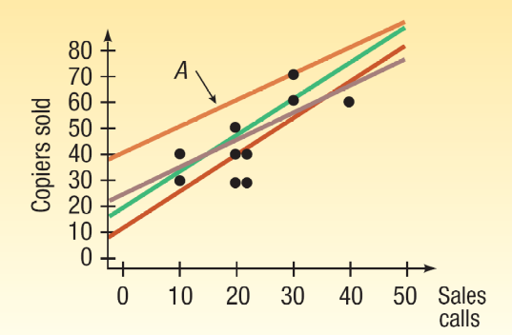
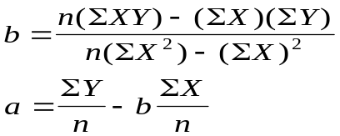
Regression Analysis
In regression analysis we use the independent variable (X) to estimate the dependent variable (Y).
The relationship between the variables is linear.
Both variables must be at least interval scale.
The least squares criterion is used to determine the equation.
REGRESSION EQUATION An equation that expresses the linear relationship between two variables.
LEAST SQUARES PRINCIPLE Determining a regression equation by minimizing the sum of the squares of the vertical distances between the actual Y values and the predicted values of Y.

Slide 9
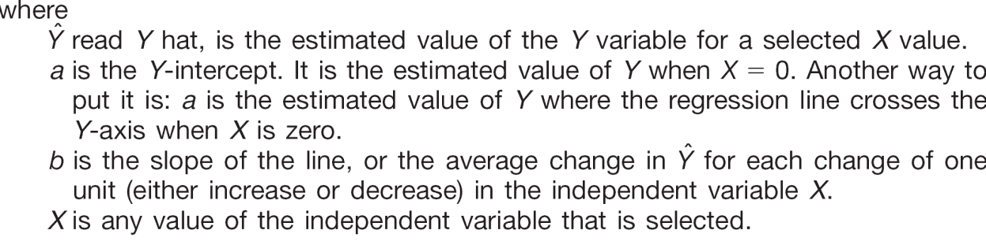
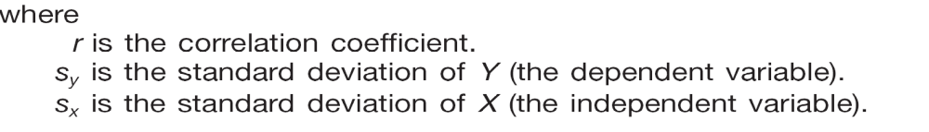
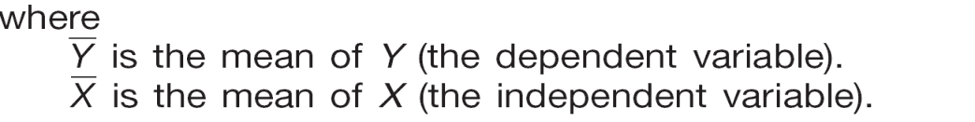
Linear Regression Model

Slide 10
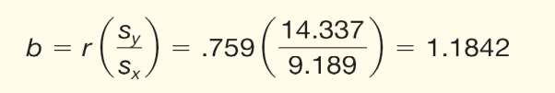

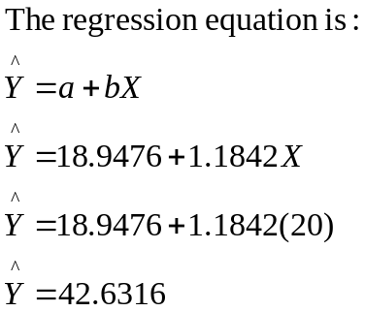
Regression Equation - Example
Recall the example involving Copier Sales of America. The sales manager gathered information on the number of sales calls made and the number of copiers sold for a random sample of 10 sales representatives. Use the least squares method to determine a linear equation to express the relationship between the two variables.
What is the expected number of copiers sold by a representative who made 20 calls?
Step 1 – Find the slope (b) of the line
Step 2 – Find the y-intercept (a)

Slide 11
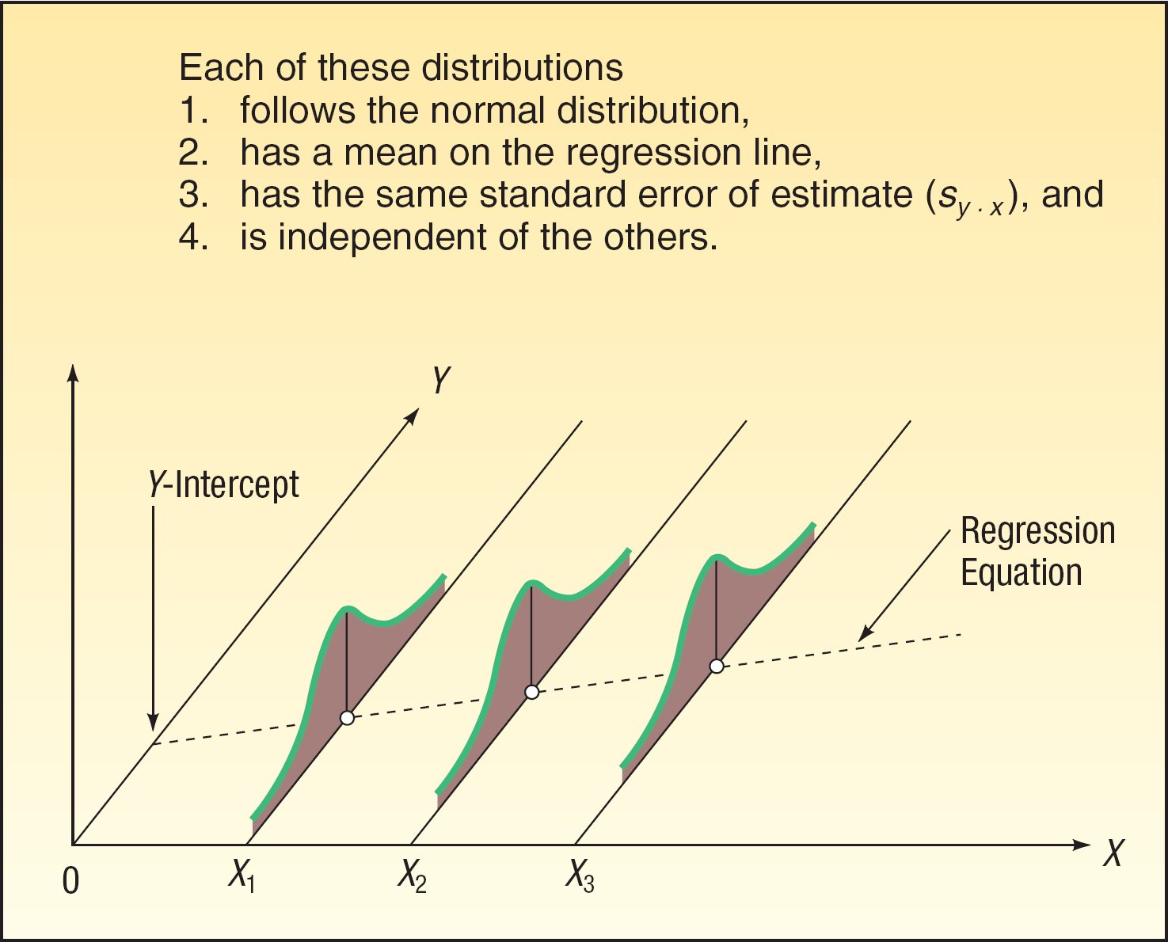
Assumptions Underlying Linear Regression
For each value of X, there is a group of Y values, and these
Y values are normally distributed. The means of these normal distributions of Y values all lie on the straight line of regression.
The standard deviations of these normal distributions are equal.
The Y values are statistically independent. This means that in the selection of a sample, the Y values chosen for a particular X value do not depend on the Y values for any other X values.

Slide 12
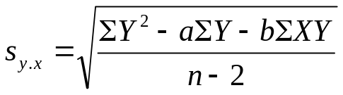

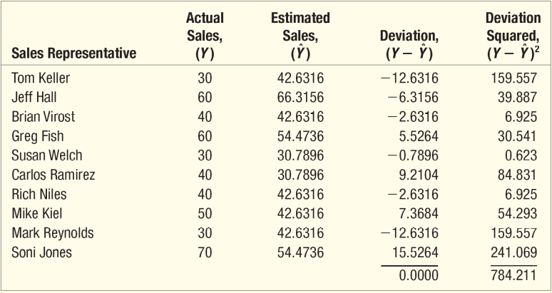
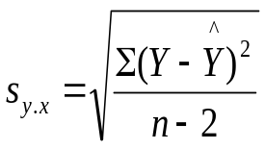
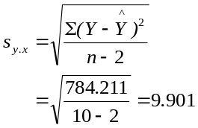
The Standard Error of Estimate
The standard error of estimate measures the scatter, or dispersion, of the observed values around the line of regression
Formulas used to compute the standard error:
EXAMPLE
Recall the example involving Copier Sales of America. The sales manager determined the least squares regression equation is given below. Determine the standard error of estimate as a measure of how well the values fit the regression line.
Step1: Compute the estimated y values using the regression equation:
Step 2: Apply the formula:

Slide 13
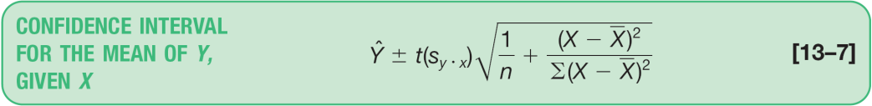
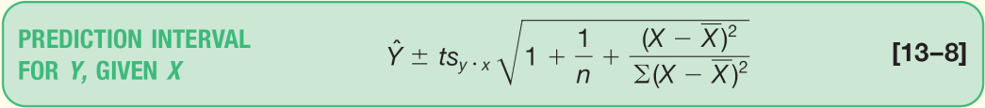
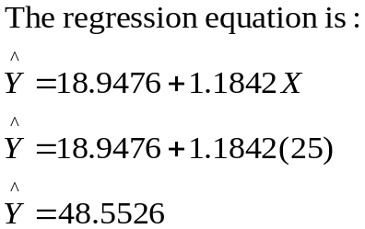
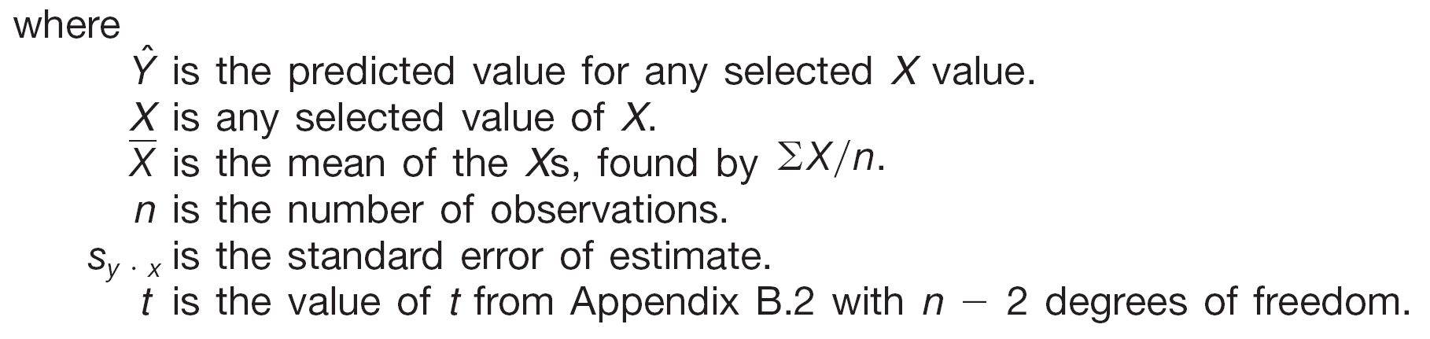
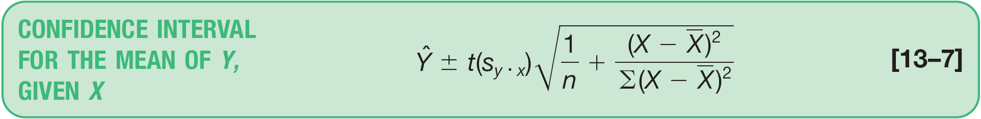
Confidence Interval and Prediction Interval Estimates of Y
A confidence interval reports the mean value of Y for a given X.
A prediction interval reports the range of values
of Y for a particular value of X.
We return to the Copier Sales of America illustration. Determine a 95 percent confidence interval for all sales representatives who make 25 calls.
Step 1 – Compute the point estimate of Y
In other words, determine the number of copiers we expect a sales representative to sell if he or she makes 25 calls.
Step 2 – Find the value of t
To find the t value, we need to first know the number of degrees of freedom. In this case the degrees of freedom is n - 2 = 10 – 2 = 8.
We set the confidence level at 95 percent.
The value of t is 2.306.

Slide 14


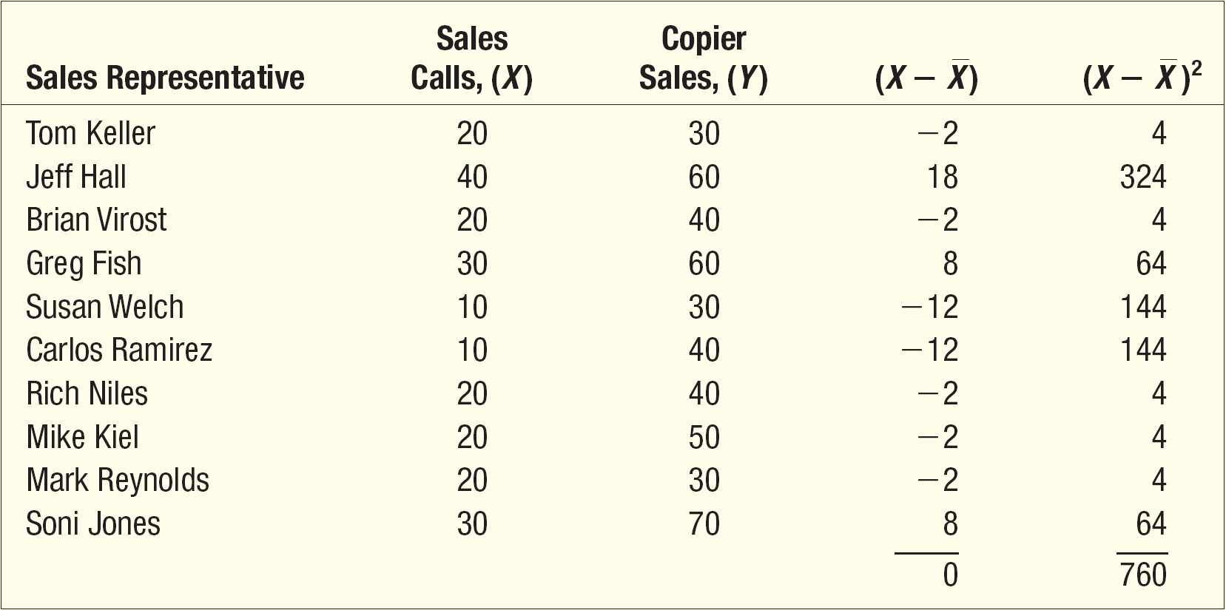
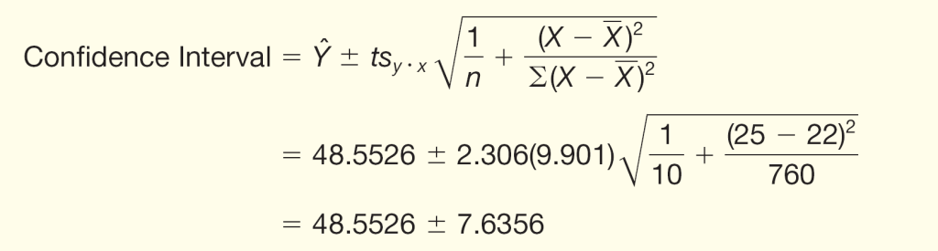
Confidence Interval Estimate - Example
Step 3 – Compute and
Step 4 – Use the formula above by substituting the numbers computed in previous slides
Thus, the 95 percent confidence interval for the average sales of all sales representatives who make 25 calls is from 40.9170 up to 56.1882 copiers.

Slide 15
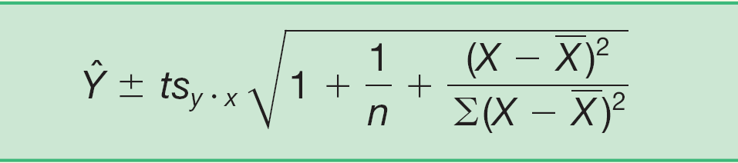
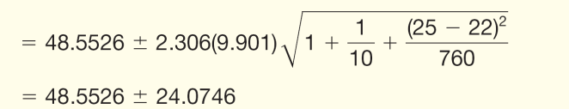
Prediction Interval Estimate - Example
We return to the Copier Sales of America illustration. Determine a 95 percent prediction interval for Sheila Baker, a West Coast sales representative who made 25 calls.
Step 1 – Compute the point estimate of Y
In other words, determine the number of copiers we expect a sales representative to sell if he or she makes 25 calls.
Step 2 – Using the information computed earlier in the confidence interval estimation example, use the formula:
If Sheila Baker makes 25 sales calls, the number of copiers she will sell will be between about 24 and 73 copiers.

