Slide 1
A Look into Prohibition and the War on Drugs
by Natalie Mueller
ECON-1740-503-F20
Salt Lake Community College

Slide 2
Table of Contents
Alcohol Prohibition
Origins
The Eighteenth Amendment and the Volstead Act
Effects of Prohibition
Effectiveness of Prohibition
Repealing Prohibition with the Twenty-first Amendment
Drug Prohibition
History
Anti-drug Legislation and the War on Drugs
Legalization Initiatives and Legalization by State
Economic Effects
Repealing Drug Prohibition?

Slide 3
Origins of Prohibition
The idea of alcohol prohibition was popularized by the Temperance movement and government war efforts
Notes:
The origins of Prohibition in the United States stemmed from both practical and moral backgrounds.
A leading proponent of Prohibition was the Temperance movement, which first spread through the United States during the 1820s. It got its name from the idea that it preached temperance, which is moderating consumption, rather than abstinence, which is full avoidance of alcoholic substances (Blocker, 1989).
Before passing the Eighteenth Amendment, which is what established Prohibition in the United States, the Wartime Prohibition Act was passed in November of 1918. This act banned the sale of alcoholic beverages with greater than 1.28% alcohol content (Miller, 2017, p. 151). While the purpose of this act was to stop the use of grain in alcohol production so it instead could be used for the war effort, this act was not passed and put into effect until World War I had already ended.

Slide 4
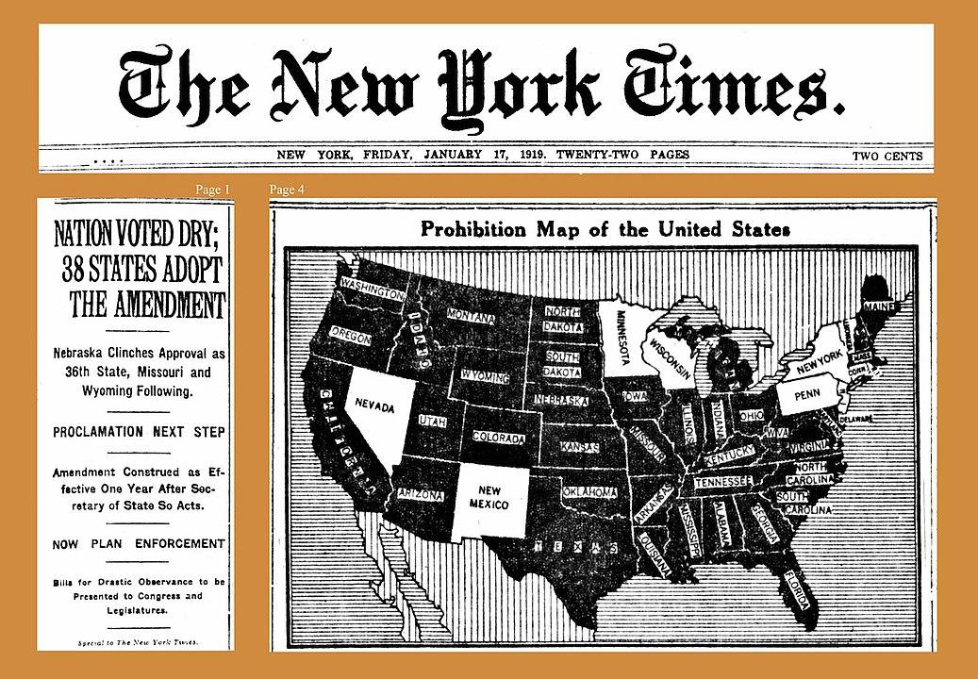
The Eighteenth Amendment and the Volstead Act
By The New York Times newspaper (published January 17, 1919) - Public Domain, https://newspaperarchive.com/new-york-times-jan-17-1919-p-1/https://newspaperarchive.com/new-yok-times-jan-17-1919-p-4/
Notes:
The Eighteenth Amendment was ratified in January of 1919. It effectively prohibited the making, transporting, and selling of alcoholic beverages. The Volstead Act enforced this amendment, putting in place legal procedures for preventing the production and sale of alcohol.
Roughly 14% of federal, state, and local tax revenues were derived from alcohol sales prior to the implementation of the Volstead Act in 1920 (Davis, 2012, p. 191).

Slide 5
The effects of Prohibition on alcohol consumption
Illegal imports of alcohol from Canada, Mexico, and other countries were made by bootleggers
People gathered at speakeasies to drink alcoholic beverages in secret
Organized crime syndicates controlled the production and sales of alcohol
Homebrewing and distilling led to poisonous product
The US government played a part in poisoning citizens
Notes:
After the beginning of Prohibition, people turned to the underground market for their alcohol consumption. Alcohol was imported by bootleggers. Secret saloons called speakeasies where consumers could go to drink popped up nationwide. Because there were no laws or regulations covering this creation and sale of alcohol, it quickly became overtaken with organized crime syndicates.
Because alcohol production was no longer regulated, careless brewing and distilling led to poisonous products. Additionally, the government itself was guilty of poisoning industrial alcohol to prevent consumption. More than 10,000 deaths were reported to have been caused by methanol poisoning due to these practices (Rothman, 2015).

Slide 6
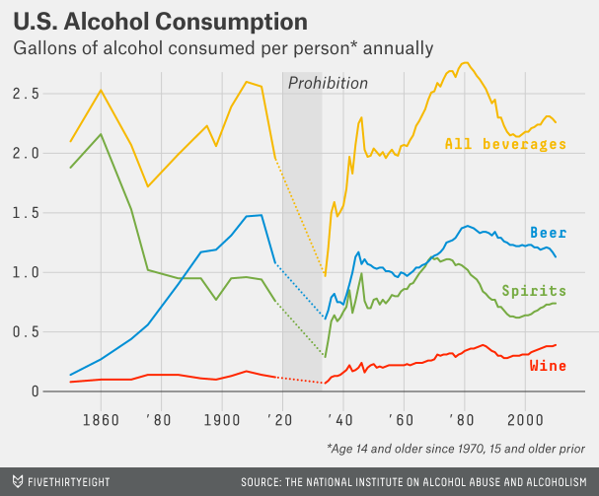
Prohibition slightly reduced the consumption of alcoholic beverages but was ineffective at total prevention. Many Americans believed that the government restricting personal choices was an assault on personal liberties.
Notes:
Opposition to prohibition made the argument that the choice to drink alcohol was a personal one, and the government effectively outlawing alcohol was an assault on personal liberties. They also stated that legal beer and alcohol would bring new tax revenues and would increase the safety of consumers, who would no longer be subject to the whims of criminals (Kyvig, 2000).

Slide 7
Repealing Prohibition
Prohibition was repealed in two parts:
The Cullen-Harrison Act which allowed the sale of beer and wine was passed in March 1933
The Twenty-first Amendment which nullified the Eighteenth Amendment was ratified in December 1933
Notes:
By the 1920s, the US public had turned against prohibition. Especially when the Great Depression hit, people saw alcohol production as both a much-needed source of employment and government revenue through taxation. Farmers who had originally fought for prohibition saw the negative impact to agriculture and supported the repeal (Gitlin, 2011).
President Roosevelt signed the Cullen-Harrison Act, which authorized sales of beer and wine, in March 1933, and by December 1933, the Twenty-first Amendment repealing the Eighteenth Amendment was ratified.

Slide 8
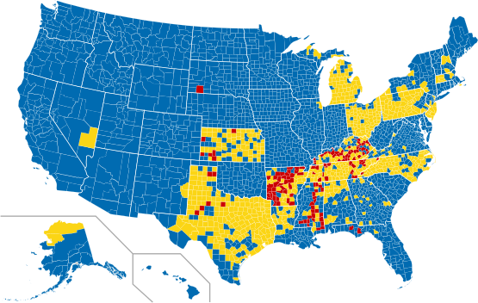
Map showing wet (blue), mixed (yellow), and dry (red) counties in the US as of March, 2012.
Public domain, https://commons.wikimedia.org/w/index.php?curid=18798115
Notes:
The Twenty-first Amendment does not prevent the restriction or ban of alcohol on a state level. To this day, several counties in the nation have chosen to remain dry, meaning the sale of alcohol is prohibited.

Slide 9
Drug Prohibition
Prior to addiction awareness, opium, cocaine, morphine, and heroin were commonplace.
Notes:
Alcohol is just one of many different types of psychoactive drugs consumed by Americans. Historically, many other drugs such as opium, cocaine, and heroin were commonly found in households. Cocaine was an ingredient in Coca-Cola, heroin was prescribed as a cough syrup, and opium dens were commonplace. By the end of the 19th century there was a heightened awareness that these types of substances were highly addictive (Stanford.edu, 2020).

Slide 10
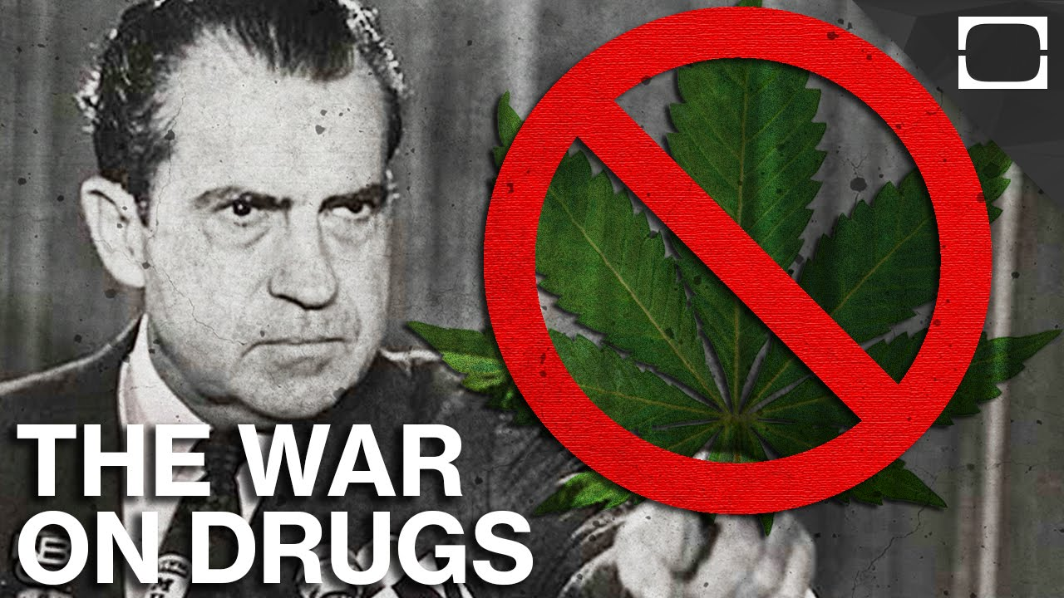
Anti-drug Legislation and the War on Drugs
An evocative graphic showing President Nixon with a marijuana leaf, https://www.pulj.org/the-roundtable/the-war-on-drugs-and-people-who-buy-use-or-sell-them-a-look-into-mass-incarceration
The Harrison Narcotics Act, 1914
Webb et al. v. United States, 1919
The Boggs Act, 1951
Narcotics Control Act, 1956
Controlled Substances Act, 1970
The War on Drugs, 1971
Notes:
The Harrison Narcotics Act was passed in 1914, and like the Eighteenth Amendment, restricted the manufacture and sale of substances, specifically marijuana, cocaine, heroin, and morphine.
The Supreme Court ruled that maintenance was not a legitimate form of treatment for addiction in 1919.
Penalties for marijuana use were greatly increased by the Boggs Act.
According to McWilliams, the Narcotics Control Act was "the most punitive and repressive anti-narcotics legislation ever adopted by Congress. All discretion to suspend sentences or permit probation was eliminated. Parole was allowed only for first offenders convicted of possession, and the death penalty could be invoked for anyone who sold heroin to a minor" (McWilliams, 1990, p.116).
After the social movement of the 1960s that popularized the use of illegal drugs, in 1971 President Nixon declared a nationwide war on drugs. This was after the Controlled Substances Act of 1970 split controlled substances into five different schedules, depending on potential for abuse, accepted medical use, and accepted safety under medical supervision.

Slide 11
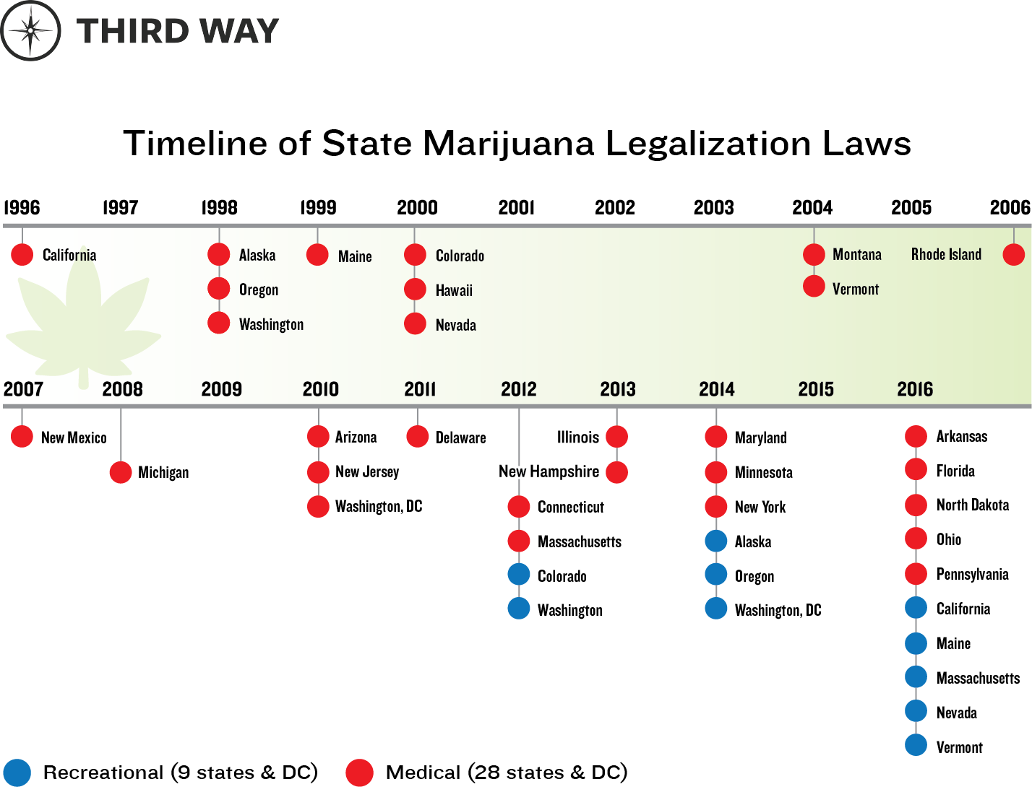
Due to the belief that cannabis is less dangerous than other controlled substances, there has been a push nationwide to decriminalize and legalize this drug.
This chart from Third Way shows the history of states passing laws regarding the legalization of cannabis from 1996 to 2016
Notes:
Cannabis is classified as a Schedule I drug under the Controlled Substances Act of 1970. This means that, according to the US government, it is purported to have "no accepted medical use" and is said to be highly addictive and have a great potential for abuse (DEA, 2013). However, many people argue that this is a misclassification as it is less addictive than other controlled substances, and in fact may be less destructive than alcohol. Because of this, many states have began passing laws regarding the legality of this substance, both recreationally and for medical use.
California was the first state to pass a law legalizing the use of medical marijuana in 1996. Many states followed its lead. It wasn’t until 2012 that states passed laws allowing the use of recreational marijuana without the need for medical approval or prescription (Trumble, 2016).

Slide 12
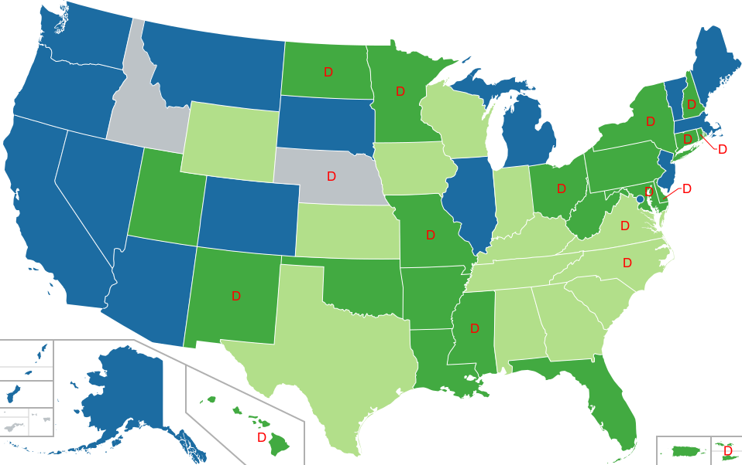
Legal
Medical use only
Medical use only (limited THC content)
Not legal
Decriminalized
D
Map showing legality of cannabis By Lokal_Profil, CC BY-SA 2.5, https://commons.wikimedia.org/w/index.php?curid=2370050
Notes:
Prior to the November 2020 election, medical use of cannabis has been legalized in 35 states. Recreational use is legal in 15 states, and 16 states have decriminalized the use of marijuana. Decriminalization means that possession of marijuana has been reduced from a felony to a misdemeanor, it does not mean that an individual is immune from punishment.

Slide 13
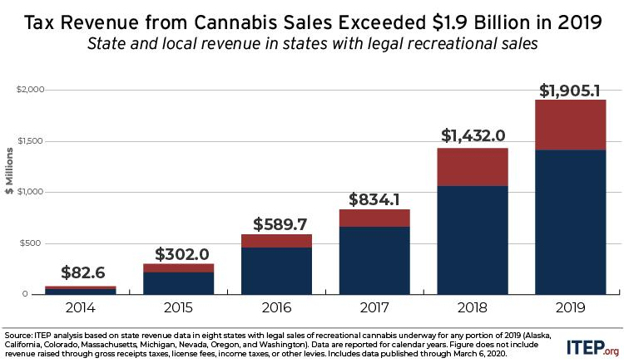
The above chart shows tax revenue from legal recreational marijuana sales in the US from ITEP https://itep.org/state-and-local-cannabis-tax-revenue-jumps-33-surpassing-1-9-billion-in-2019/
Notes:
Similar to opponents of the prohibition of alcohol, proponents of legal cannabis use have cited the creation of jobs and increased tax revenue. Indeed, ITEP has shown that starting in 2015, nationwide tax revenues on legal cannabis sales have grown over 100% on average year-over-year, with tax revenues in 2019 amounting to over $1.9 billion (Davis, 2020).

Slide 14
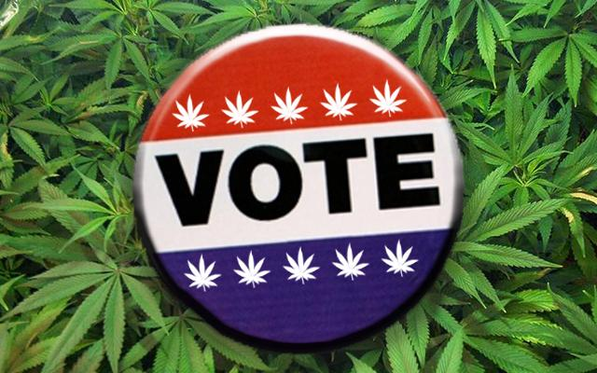
Repealing Drug Prohibition?
Voters in the following states voted for marijuana measures in 2020:
Arizona
Mississippi
Montana
New Jersey
South Dakota
A marijuana-themed vote button, https://www.keystonecannabiscoalition.org/political-landscape-cannabis-pa/votepot/
Notes:
On November 3, 2020, voters in five states voted in favor of measures that would legalize the sale and use of cannabis, both recreationally and medically. This continues a trend of recreational legalization at the state level that began eight years ago. This advancement will “likely put more pressure on lawmakers to reform drug policy at the federal level. Despite legalization efforts made...cannabis remains illegal under federal law. It shares the same drug classification as heroin, ecstasy, and LSD.” (Hutzler, 2020).
It has become apparent over the past few decades that Americans are beginning to view prohibition of drugs the same way that prohibition of alcohol was seen nearly 100 years ago. We value our personal liberties and freedom of choice over the government dictating what we are allowed to consume. We have already seen from the repeal of Prohibition that legalization leads to a safer product, decrease in illegal activities, creation of jobs, and valuable tax revenue (Stanford.edu, 2020). Even from the states that have already legalized recreational marijuana, we have seen notable tax revenues (Davis, 2020).

Slide 15
Sources
Blocker, J. S. (1989). American Temperance Movements: Cycles of Reform. Twayne Publishers.
Davis, C. (2020, March 10). State and Local Cannabis Tax Revenue Jumps 33%, Surpassing $1.9 Billion in 2019. ITEP. https://itep.org/state-and-local-cannabis-tax-revenue-jumps-33-surpassing-1-9-billion-in-2019/
Davis, M. (2012). Jews And Booze: Becoming American In The Age Of Prohibition, p. 191.
Gitlin, M. The Prohibition Era. Edina, MN: ABDO Publishing, 2011.
Hutzler, A. (2020, November 4). Marijuana had Big Night as Ballot Measures Push America Towards Legal Weed. Newsweek. https://www.newsweek.com/marijuana-had-big-night-ballot-measures-push-america-towards-legal-weed-1543348
Kyvig, D. E. (2000). Repealing National Prohibition.
Miller, W. D. (2017). Pretty Bubbles in the Air: America in 1919. University of Illinois Press. p. 151.
NIAAA. (n.d.). Publications | National Institute on Alcohol Abuse and Alcoholism | Surveillance Report #113. https://pubs.niaaa.nih.gov/publications/surveillance113/tab1_17.htm

Slide 16
Sources (cont’d)
Rothman, L. (January 14, 2015). "The History of Poisoned Alcohol Includes an Unlikely Culprit: The U.S. Government". Time. Retrieved November 6, 2020. https://time.com/3665643/deadly-drinking/
Trumble, S. (2016, May 2). Timeline of State Marijuana Legalization Laws - Third Way. Third Way. https://www.thirdway.org/infographic/timeline-of-state-marijuana-legalization-laws
The DEA Position on Marijuana. Dea.gov. Archived from the original on December 21, 2016. Retrieved November 6, 2020.
The United States War on Drugs. (June 27, 2020.) Stanford.edu. Retrieved November 6, 2020. https://web.archive.org/web/20200627183302/https://web.stanford.edu/class/e297c/poverty_prejudice/paradox/htele.html
The Volstead Act. History, Art & Archives, U.S. House of Representatives. Retrieved November 5, 2020. https://history.house.gov/HistoricalHighlight/Detail/36108

