Slide 1
3.3: LAB: Lab to Develop Content Cleaning, Standardisation and Enrichment Add-in
Nikolai_Mulconray
https://github.com/nmulconray/Family_Fixer
Peddle Thorp

Slide 2
The Family Fixer...What is it…?
The Family Fixer is an Add-in that reports and fixes some of the problems caused by erroneously built families, their poorly articulated positions and incorrect states in a project environment.
Notes:
In today’s lecture I’d like to discuss a Revit Add-in that I demonstrated to attendees at BILT2017 in Adelaide. The Add-in simply called the Family Fixer attempts to make a RVT model loaded with families ready for FFE documentation, Facilities management and assists general model maintenance. The Add-in achieves the integrity of parametric data and visibility control through various means as I will now demonstrate. However first I will provide some background on the topic.

Slide 3
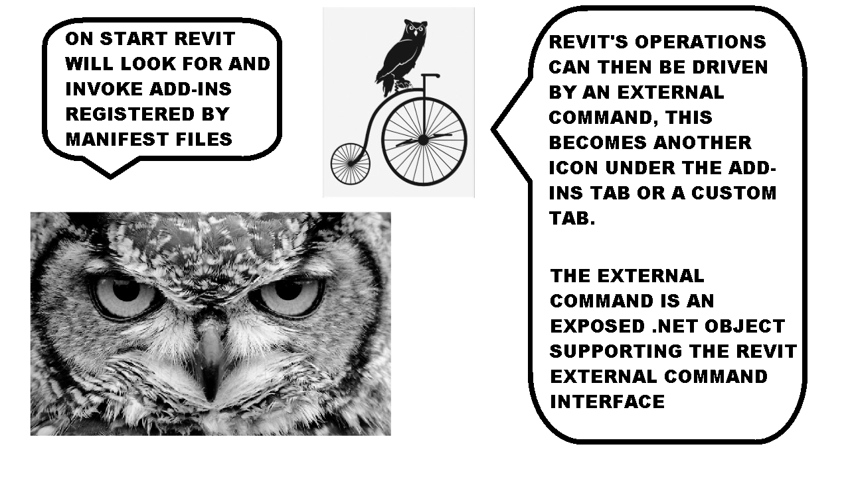
Add-ins...How do they work…?
Notes:
Revit Add-ins are written in .NET languages such as I have done in C#. They allow user interaction with something most people are familiar with a windows form. After a developer or user setups the .DLL file, the image file and the manifest file they are ready to run an external command from the Revit Ribbon. The Revit API has an interface that provides a window into Revit operations so you can make changes to the model inside transactions.

Slide 4
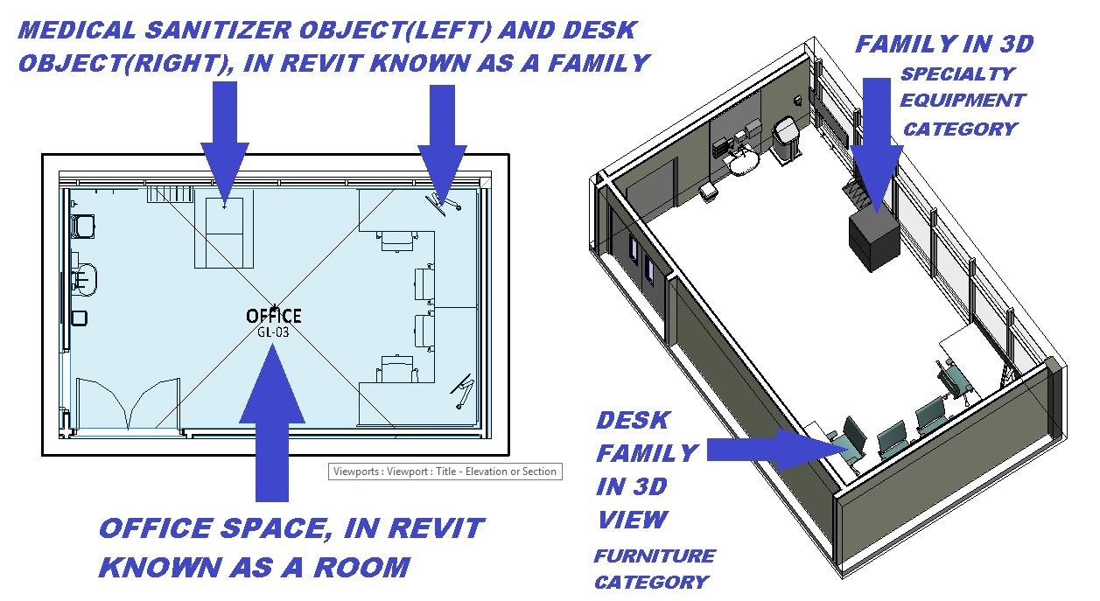
Terms for Newbies to Revit
Notes:
Revit is a 3D modelling tool that produces conceptual 3D and 2D documentation. It keeps most of the data stored in objects known as families and this data can be leveraged in schedules for FFE( furnitures, fixtures and equipment) in health room layouts, tagging etc. It is usually important in a Health project to keep the family names structured, subcategories correct, maintain parametric data integrity and filter unwanted families. Further families are usually in subsets of rooms within a project set. This relationship can become corrupt if not managed carefully.

Slide 5
Family Fixer…Some tasks it can do?
Filtering unwanted families such as shared nested
Reporting on family health in Revit(RVT) Projects such as in-place, if family is in a room set, it’s family document is not constructed to a company standard.
Amending the family document by automatically opening and editing the files category, adding a type image (work in progress)
Automatically setting units to metric, removing foreign shared parameters
Setting family names based on an automatically generated XML of family data
Notes:
The Family Fixer is capable in not only analysing Revit model health it also edit’s a family document directly and amends family instances through a seeker function that locates family instances based on a rule.
The Families and their types within the current document can be named, parameterized leveraging data stored in XML and CSV files. The Add-in also checks family subcategories and parameters against these values.

Slide 6
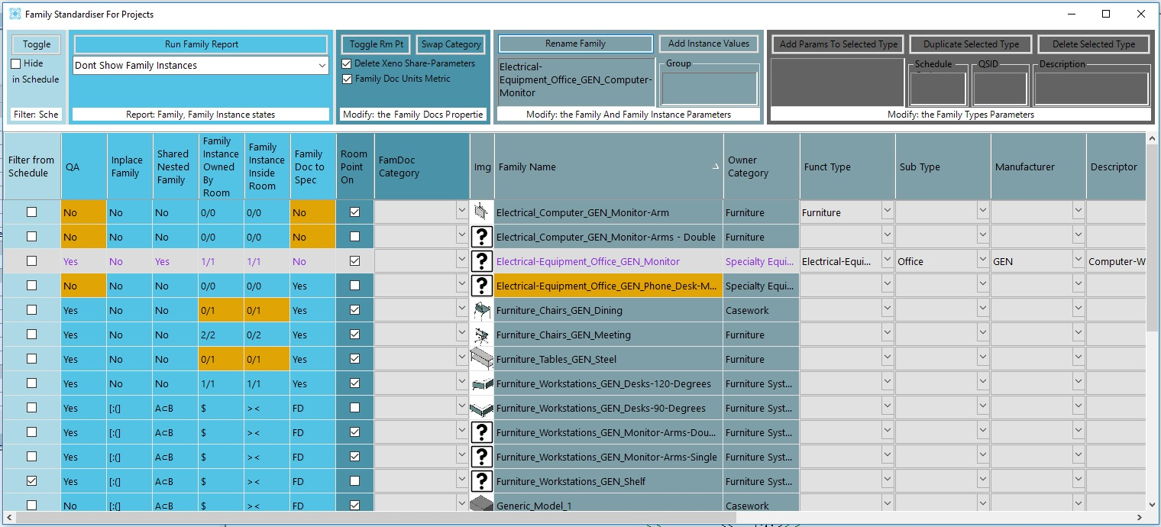
OVERVIEW - G U I...
Note the 5 Colours for the 5 Column groups...
Notes:
This is an example of the GUI, note how the main functions are grouped in five columns of the same colour. Each family occupies an entire row. This is achieved using a .NET control called a Data Grid View.

Slide 7
OVERVIEW - G U I
The Addin’s user interface...
Is split into 5 columns grouped by related function.
Families are listed as rows of data with embedded controls to set options.
User commands are actioned from the top panel buttons, these operate on user selected family row/s.
Notes:
After opening the Add-in in RVT a user can select Family row/s and amend some of the faults flagged by the Add-in with various commands found on the command panels along the top of the Graphic User Interface(GUI ɡuːiː/).

Slide 8
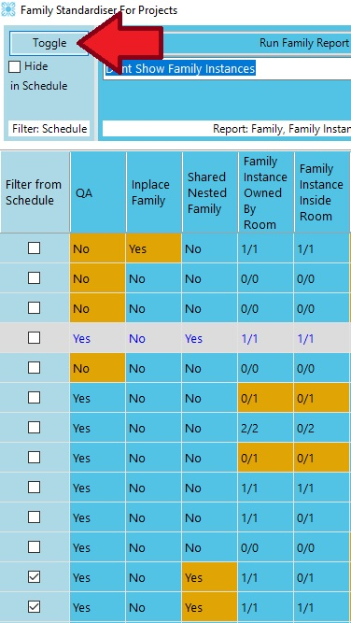
1. Filter in Views(Show in Model)
The first column group can be used as a global filter on family types, with the aid of a shared parameter, unwanted families(shared nested etc.) can be filtered from FFE schedules.
This seeks to create a clear language of how to filter, rather than use multiple complicated, contradicting filters.
Notes:
We can use the Toggle Schedule Filter to control families in Revit schedules.
?What in orange in the family report might you want to filter from appearing in schedules in Revit?
=>In-place families, nested families that are shared (shared so you can tag them)
?Will this function hide by Family instance, Family or family type?
=> All Family instances and types will be hidden.
?Will the filter automatically hide Revit families in schedules?
=> Yes and No shared parameter filters are required in the schedule first.

Slide 9
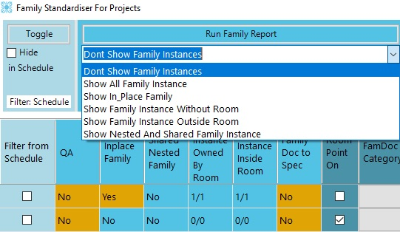
2. REPORTING_ON_FAMILIES...(Model)
As well as reporting, this section of the add-in aides in the amendment, this can be achieved by selecting a family row, then a viewing condition and running the family report again.
Notes:
The very first task I would perform if I was to Fix a model, is to do a report.
A row or rows are selected and the Report Button is pressed initiating the command.
To examine a report we would look for flagged cells in the Data grid view that are orange in colour.
One major issue that has recently prevented the automatic creation of schedules is that families are not being associated with Rooms for various reasons.
Another is that families are not using company default subcategories, the report will highlight these issues.

Slide 10
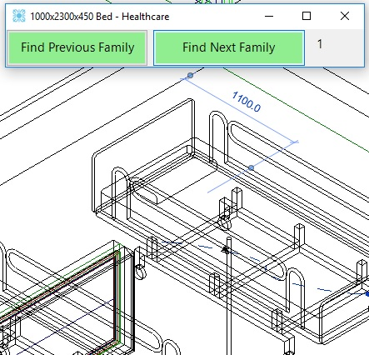
2. REPORTING_ON_FAMILIES...(model)
A viewing selector will open and facilitate the iteration through all instances that meet the show criteria. Here the iterator is paused 2 clicks on 0...1 as two beds are in the same place.
Notes:
If I run a report on the medical beds I can select a function to check for families that have been flagged outside of rooms.
As I iterate between family instances by clicking the “FIND NEXT FAMILY” button…
?Why does Revit sometimes prompt stating that there are no View showing the highlighted elements?
=> The family has been hidden in view and resulted in double counting in our FFE schedule.
?Why are some bed family instances not owned by a room, despite to appearances are inside of a room?
=> The room awareness point is actually inside of a wall.

Slide 11
2. REPORTING_ON_FAMILIES...(model)
A workflow...
As the Add-in is modeless, it is possible to modify each family instance by minimizing the GUI, for eg. by moving a bed within it’s room, see if you can fix the bed families so that they now are reporting in a room correctly!
Notes:
The Family Fixer add-in is Modeless which for Architects simply means you can make model and parametric changes within Revit with the Form still open and you can switch back to the form as long as the data from the database is kept up to date. This is why you might notice the Data Grid View row data resetting almost every time I make a change to the model.
Modeless control can all be achieved by implementing an external event and requires the invocation of a modeless form and the call-back to Revit outside a valid Revit API context through the external event.
Anyway how does this benefit us?
If we move the bed families in the room and run the report again on the family row, you can see that the bed families are now reporting their associated room.

Slide 12
2.FINE GRAINED REPORTS(model)
Report on...
Family doc
Subcategories
Parameter states
Notes:
A new feature I added after BILT2017 is the ability to perform more fine grained interrogation of Revit models and Family documents. This allows the cross checking against our subcategories stored in a CSV file exported by our family creator. The inspection of families for consistency in properties such as the number of origin points, the number of flip arrows and Family Parameters
?Why would I check if the flip arrows are present in our families?
=> Users implementing Revit family objects sometimes place them in a room(space) in plan backwards.
?Why would we check family parameters are populated, locked or present in a family in a RVT project?
=> The parameters are required in schedules and tagging.

Slide 13
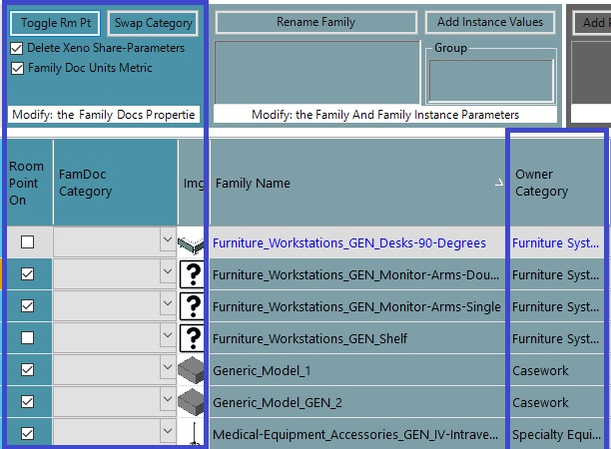
3.MODIFY_FAM_DOC
To Modify Families that have been flagged as problems, it is necessary to open a family and modify it.
Otherwise we are limited to just filtering, reporting, renaming and parameterising.
Notes:
It is not always enough to amend the accessible data in a RVT project, we may need to open and edit the Family Document or RFA file itself. The add-in can achieve this for some properties such as room awareness point and family category. It can also standardize the families properties such as units and shared parameters automatically.
Here I am selecting multiple rows containing families assigned erroneous categories.
?Which Category should the cupboards families be placed within?
=> I would say that Casework should replace the generic model category, it depends on your company standard.

Slide 14
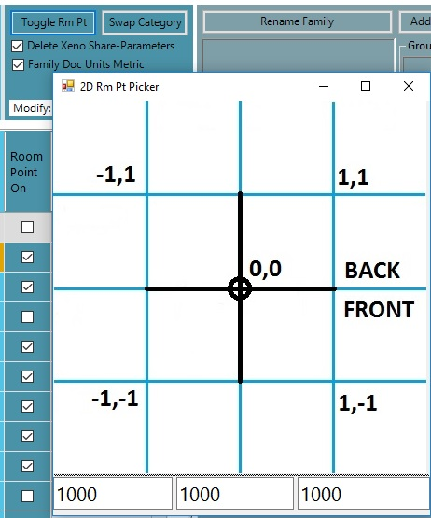
3.MODIFY_FAM_DOC...
To Modify the famDoc...
The room awareness point can
toggled on/off and positioned
Click the btn..click the form!
What happens? Is it just 2D?
Notes:
Now I am going to demonstrate toggling a room awareness point on / off when turning it on you can select the points locations in relation to the family origin intersection as well.
Which families would you expect this command to fail on and why?
=> IN-PLACE families, detail component families.

Slide 15
4.FAMILY_NAME_&_INSTANCE...
Family names are often neglected, however they cause model stochasticism...
Duplicate families for the same purpose arise
Sorting and tracking of families from the browser becomes confusing.
This is all exacerbated through poor family categorization(solved by modifying the famdoc).
Notes:
A lot of confusion occurs when sorting families, in the browser and schedules. Performing counts and tracking, updating from your family library. If we run a report on some rows we can see orange over family names indicating their name needs updating. So we will now do a name update on a family. Each column represents a part of a family name, By clicking the owner category I can constrain the results of the first part which is a subset of family category.
?Why are the family rename columns selected in sequence?
=> The name is created by cascading the list of possible name parts from the previous column reducing the options available and guiding the user as to the best name from our company standards.
Every family instance will also be updated if a group value is added.

Slide 16
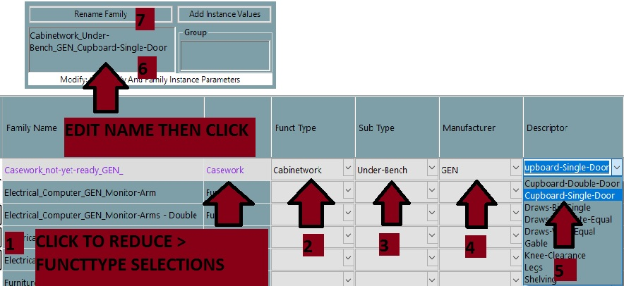
4.FAMILY_NAME_&_INSTANCE...
<FAMILY>
<FAMILY_NAME>Quasi-Form_People_GEN_Super-Family</FAMILY_NAME>
<CATEGORY>Entourage</CATEGORY>
<SUBCATEGORY>Piasecki Lines, Door Swing Lines </SUBCATEGORY>
<FUNCTIONALTYPE>Specialty-Equipment</FUNCTIONALTYPE>
</FAMILY>
Notes:
I will now click on the remaining columns to fill the textbox on the commands bar at the top of the form.
The family names and other parameter values like the QSID are sourced from the company family library.
We have another tool that exports these values directly from our family library and the data is used in other tools as a simple database.
Show the XML file.

Slide 17
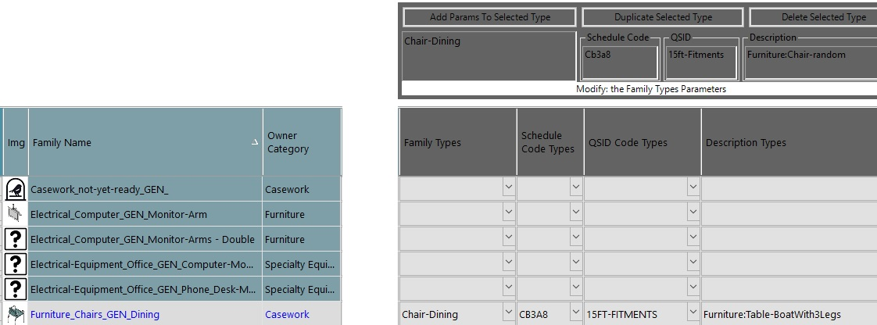
5.FAMILY_TYPES_&_TYPE_PARAMS
Using pre-populated lists to reduce anarchy in parametric data, try to add some type parameters.
Notes:
Family types can also be altered and type parameters added again deriving their values from an XML file.
We have also used our schedule codes as well as locked down parameter values.
Why are schedule codes an issue?
=> New FFE codes are constantly being created are not readily amenable to rules in functions.

Slide 18

Questions?
3.3: LAB: Lab to Develop Content Cleaning, Standardisation and Enrichment Add-in
Nikolai_Mulconray
Peddle_Thorp
n.mulconray@peddlethorp.com.au
https://github.com/nmulconray/Family_Fixer

