Slide 1
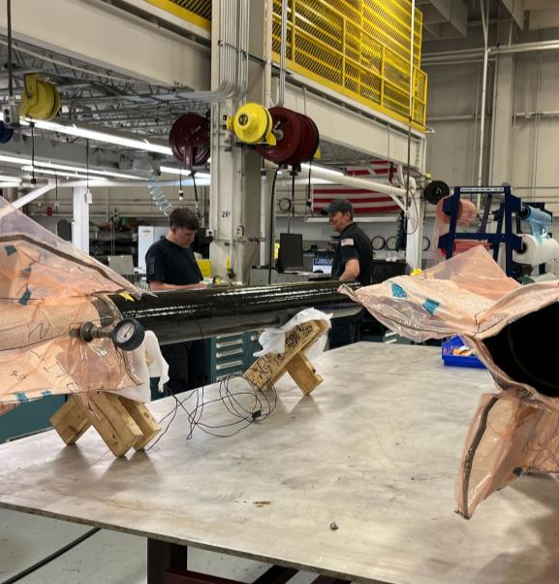
Nathaniel
Murcin
Aerospace Engineering
Georgia Institute of Technology
B.S. Aerospace Engineering
Expected May 2027
M.S. Aerospace Engineering
Expected May 2028
Notes:
Factual source: C:/Documents/Resumes/ATL/Nathaniel_Murcin_Resume.pdf. Education dates: user instructions. Authentic GTXR composite manufacturing photo from preserved portfolio.

Slide 2
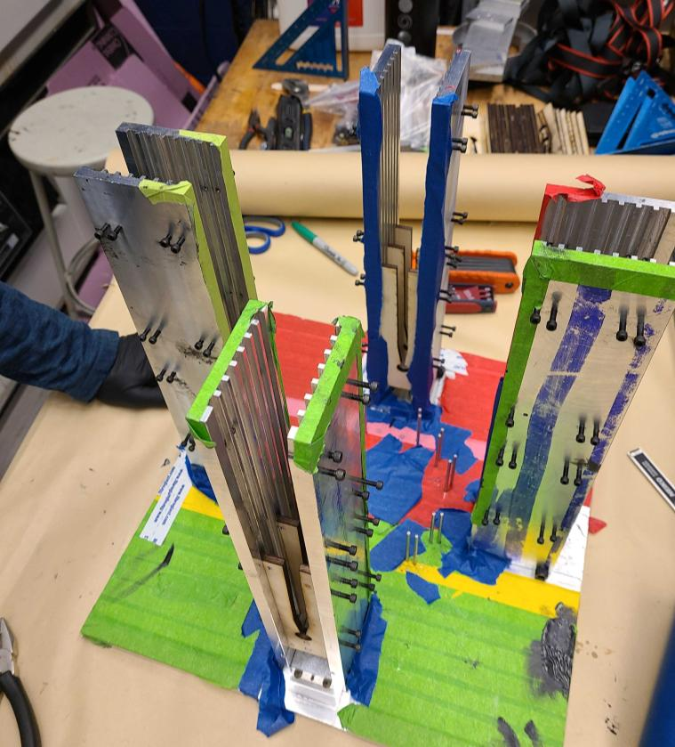
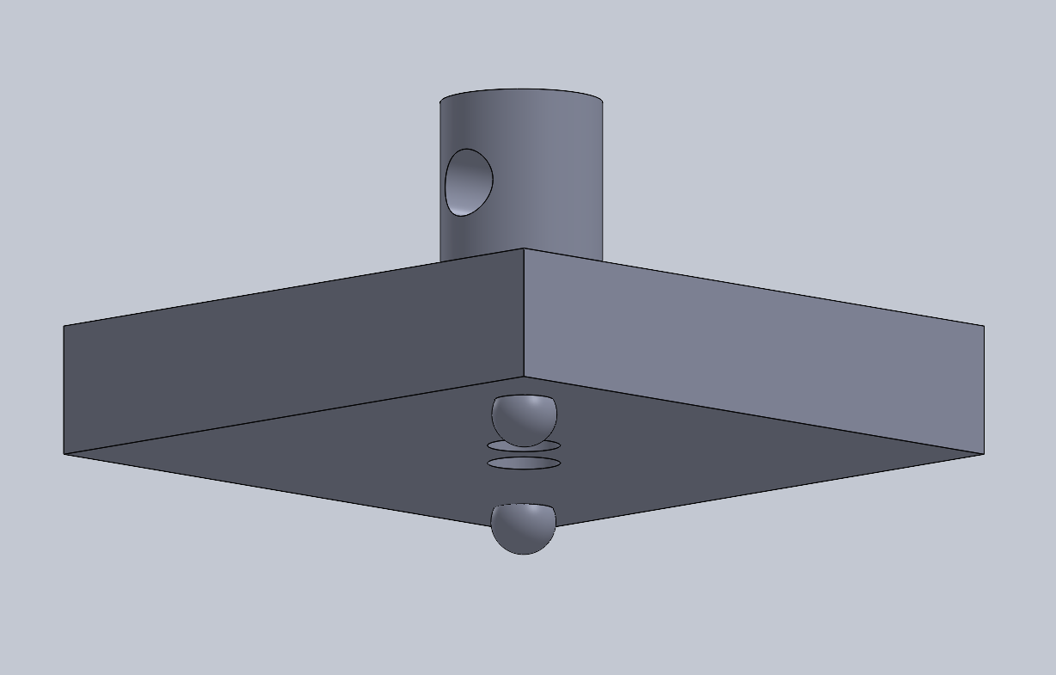
PORTFOLIO OVERVIEW
Selected engineering work
Blue Origin
GTXR flight hardware
Cryogenic systems and validated tooling
<0.1° error on all four fins
~60%
fewer tank-farm components
Pursuit Aerospace
Test engineering
Production tooling and qualified cleaning
Measured panel shear modulus to verify an ANSYS model
Nathaniel Murcin
02
Notes:
Factual source: C:/Documents/Resumes/ATL/Nathaniel_Murcin_Resume.pdf. Results from current resume. Overview intentionally uses approved typography for employer work. GTXR CAD and setup image: repository assets.

Slide 3
BLUE ORIGIN / FLUIDS & MANUFACTURING ENGINEERING INTERN / MAY-AUG. 2026
Cryogenic systems and manufacturing tooling
Ground-test fluid systems
Adaptable gripping fixture
Designed a cryogenic tank-farm P&ID, challenging requirements and simplifying heritage designs.
Designed six Creo versions to improve technician usability and prevent slip, part damage, and metal-chip FOD.
Sized piping, valves, and relief devices. Developed the BOM and coordinated procurement with suppliers.
Validated with hand calculations and static FEA. Design passed PDR.
~60%
8 to 1
reduction in component count
fasteners after fixture redesign
Nathaniel Murcin
03
Notes:
Factual source: C:/Documents/Resumes/ATL/Nathaniel_Murcin_Resume.pdf. Strict subset of current resume, Blue Origin experience. No proprietary imagery, inferred geometry, or technical expansion.

Slide 4
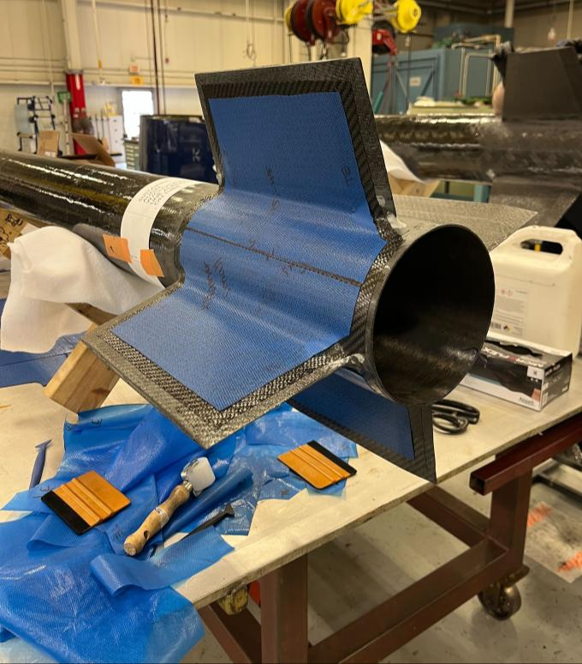
GTXR / FIN DESIGN & MANUFACTURING
Fin selection within structural and machining limits
G10 sustainer fins
Built a decision matrix comparing materials, geometry, and manufacturing constraints.
The team selected G10 for the high-Mach sustainer. Booster choices were wood on one vehicle and G10 on another.
GTXR fin fabrication. Context photograph, not evidence of the selected material.
Nathaniel Murcin
04
Notes:
Factual source: C:/Documents/Resumes/ATL/Nathaniel_Murcin_Resume.pdf. Resume: structured fin trade study. User notes: decision matrix and specific G10/wood selection. No supported roll-coupling account is available, so no causal history claimed. Image is contextual, not material-specific.

Slide 5
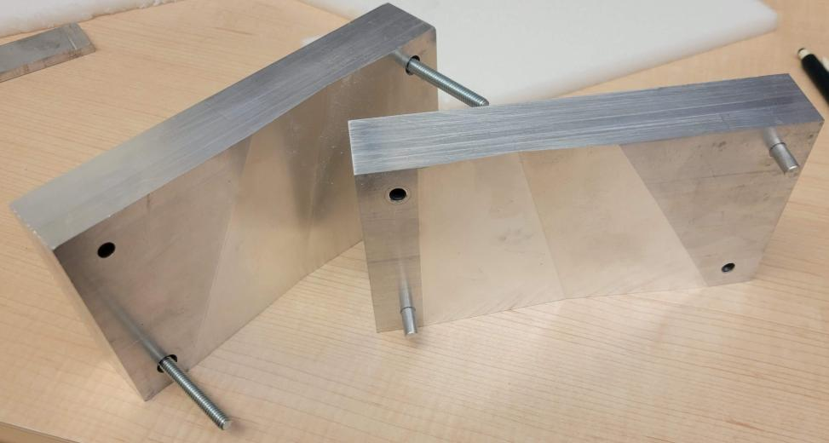
GTXR / MANUFACTURING RESEARCH
Thermoforming a candidate fin-core geometry
Co-developed and evaluated a thermoforming process for a future fin-core option.
0.28 mm
average global geometric error measured with 3D metrology
Manufacturing feasibility research. The PMI cores were not yet viable for flight.
CNC-machined aluminum tooling for double-wedge PMI foam cores.
Co-author and presenter, AIAA 2026-112793
Nathaniel Murcin
05
Notes:
Factual source: C:/Documents/Resumes/ATL/Nathaniel_Murcin_Resume.pdf. Current resume: tooling, co-development, and 0.28 mm average global geometric error. User notes: future PMI option, not flight-ready. Publication: Viability of Thermoformed Closed-Cell Foam Cores for Carbon Fiber Sandwich Rocket Fins, AIAA Regional Student Conference Proceedings, 2026.

Slide 6
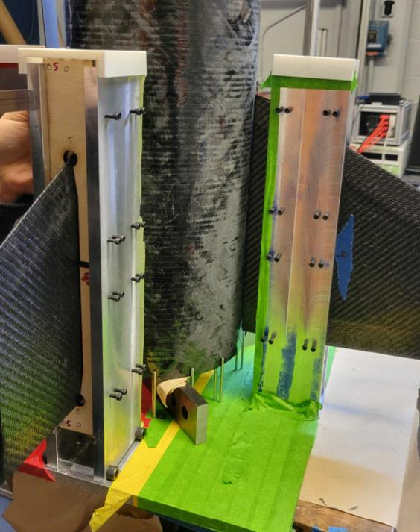
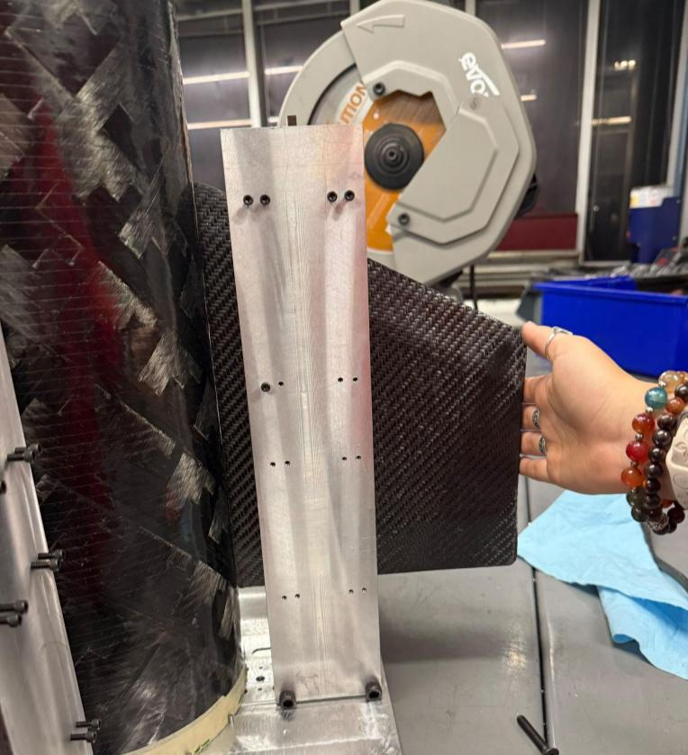
GTXR / PRECISION TOOLING
Modular tooling for repeatable fin cant
Designed, CAM programmed, and machined a four-tower fixture for changing rocket diameters and fin profiles.
<0.1°
error on all four fins, verified by independent metrology
Target cant: 1.6°
Laser-cut slots constrain each fin.
CAD, machined components, and fixture assembly
Fixture on the airframe
Nathaniel Murcin
06
Notes:
Factual source: C:/Documents/Resumes/ATL/Nathaniel_Murcin_Resume.pdf. Resume and firsthand user notes. Target 1.6 degrees, independently measured <0.1 degree error on all four fins. Actual modular four-tower hardware and laser-cut fin-profile slots.

Slide 7
PURSUIT AEROSPACE / ENGINEERING INTERN / AUG.-DEC. 2025
Production tooling and in-house cleaning
15 deployed fixtures
PHOTO NEEDED
Designed and built dot-peen marking fixtures using GD&T and DFM.
Quick-change marking fixtures
6 s to 1 s
Preferred: landscape
Show a fixture holding a representative approved part.
Average part load/unload time
40 s to 2 s
Inspection time with Go/No-Go gauges
Requested: deployed tooling with the locating and clamping features visible.
Qualified in-house supercleaning removed 3 days and $1,000/part in outsourced cleaning and shipping.
Nathaniel Murcin
07
Notes:
Factual source: C:/Documents/Resumes/ATL/Nathaniel_Murcin_Resume.pdf. Current resume. Cleaning process qualified by Rolls-Royce and Pursuit Quality. Broader one-piece-flow improvement of 55% intentionally omitted to avoid implied fixture-only attribution. Employer imagery must be authorized for public use.

Slide 8
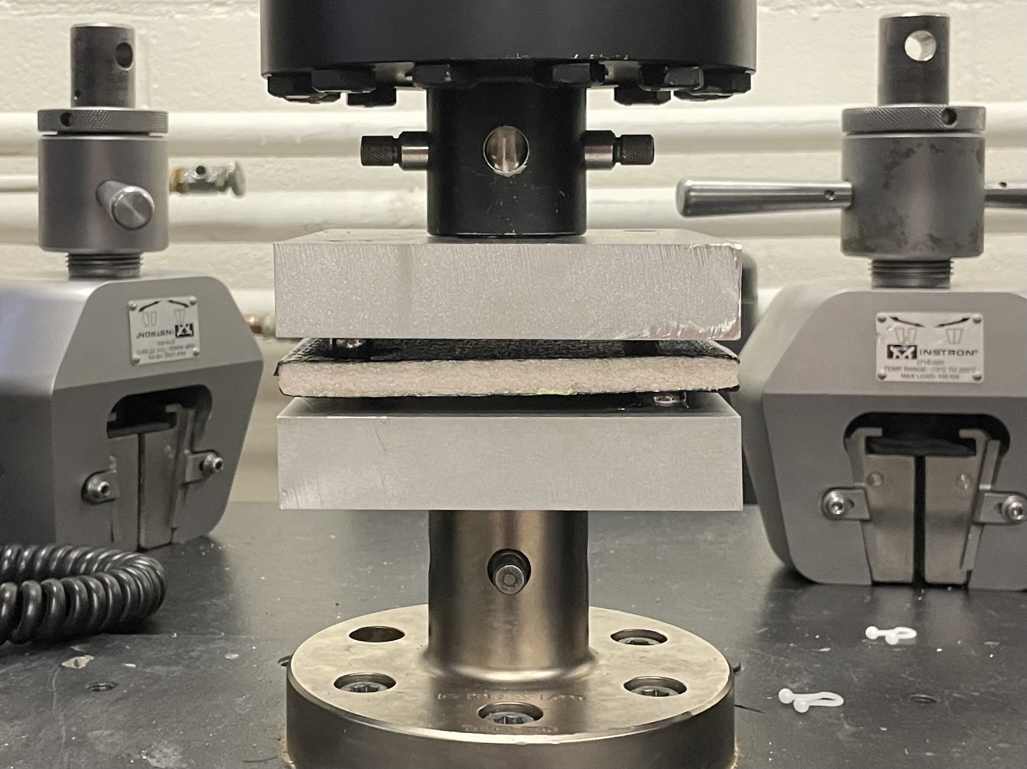
GTXR / EXPERIMENTAL VALIDATION
Plate-twist testing to verify the structural model
Designed and executed the plate-twist test to characterize composite sandwich panels.
ANSYS model
Verified within a 5% acceptance criterion for future fin development.
Co-author and presenter
AIAA 2024-85690
Physical test apparatus for in-plane shear modulus of sandwich panels.
Nathaniel Murcin
08
Notes:
Factual source: C:/Documents/Resumes/ATL/Nathaniel_Murcin_Resume.pdf. Resume and published GTXR paper, Shear Modulus Testing in Composite Sandwich Panels, AIAA Regional Student Conference Proceedings, 2024. Photo from paper Fig. 2. 5% is acceptance criterion, not measured model error.

Slide 9
GTXR / LAUNCH INTEGRATION
Overnight recovery of an electrical passthrough
A continuity failure threatened second-stage ignition. Designed and fabricated the replacement with the fin team.
PHOTO NEEDED
Flight electrical passthrough
14 hours
Preferred: landscape
Show the completed NPT body, wire exits, and sealing region.
Design and fabrication during launch integration
2× MEOP
Hydrostatic test performed by the propulsion lead
The vehicle flew and the second stage ignited.
Nathaniel Murcin
09
Notes:
Factual source: C:/Documents/Resumes/ATL/Nathaniel_Murcin_Resume.pdf. Resume and firsthand user notes. Exact continuity fault uncertain. Teammate sourced NPT plugs, experienced machinist drilled holes, fin team completed wiring/epoxy checks and cure calculations. Propulsion lead hydrotested at 2 times MEOP. No precise pressure invented.

Slide 10
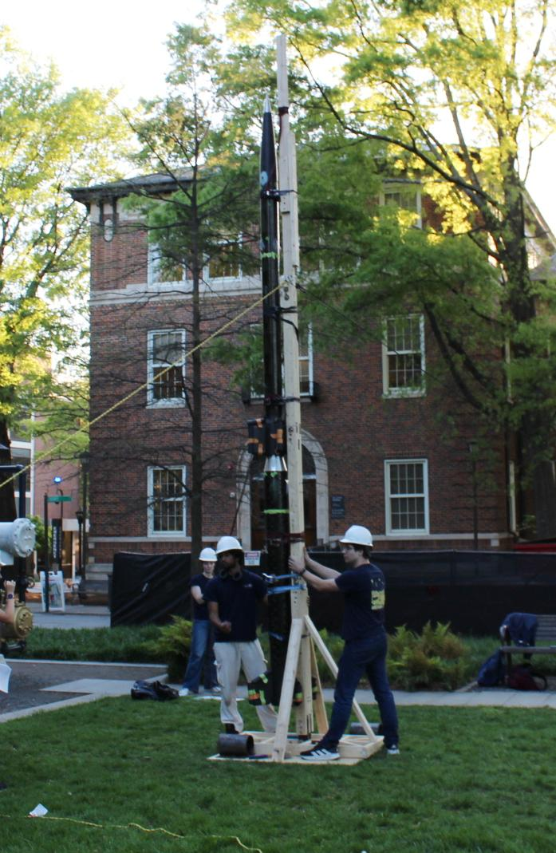
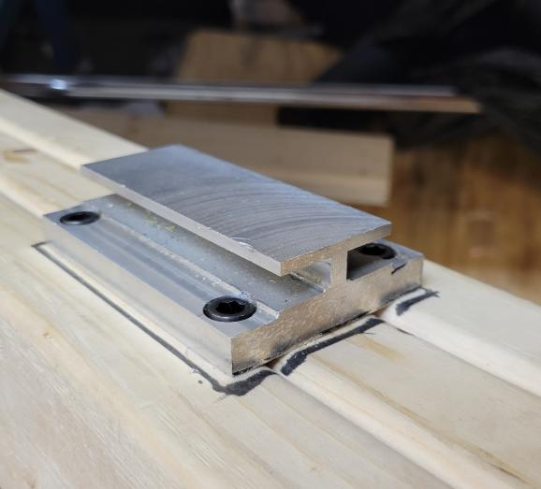
GTXR / ADDITIONAL HARDWARE
Mock launch rail from analysis to test
Guide hardware used in the rail assembly
Two-week build
Checked bending and buckling, completed CAD, and fabricated the rail in wood, steel, and aluminum.
Full-height rail and vehicle at the mock test
Nathaniel Murcin
10
Notes:
Factual source: C:/Documents/Resumes/ATL/Nathaniel_Murcin_Resume.pdf. Preserved V1 portfolio page 5: two-week mock launch rail project, bending/buckling checks, CAD and fabrication. No full flight qualification implied.

Slide 11
BEN T. ZINN COMBUSTION LABORATORY / UNDERGRADUATE RESEARCHER
Reacting-flow hardware and PIV processing
Experimental support
PHOTO NEEDED
Reacting jets-in-crossflow experiment
Assembled regulated multi-gas delivery hardware for reacting jets-in-crossflow experiments.
Preferred: landscape
Show approved multi-gas delivery hardware or the experimental setup.
Executed established MATLAB/PIV post-processing workflows.
Undergraduate researcher since January 2026
Nathaniel Murcin
11
Notes:
Factual source: C:/Documents/Resumes/ATL/Nathaniel_Murcin_Resume.pdf. Strict subset of current resume, Ben T. Zinn Combustion Laboratory. No measured result or original method development claimed. GTXR papers are separate work.

Slide 12

Nathaniel Murcin
Aerospace Engineering
Georgia Institute of Technology
nmurcin3@gatech.edu
linkedin.com/in/nathaniel-murcin
nmurcin.github.io
Notes:
Factual source: C:/Documents/Resumes/ATL/Nathaniel_Murcin_Resume.pdf. Identity, contact, and portrait from supplied materials.

