Slide 1
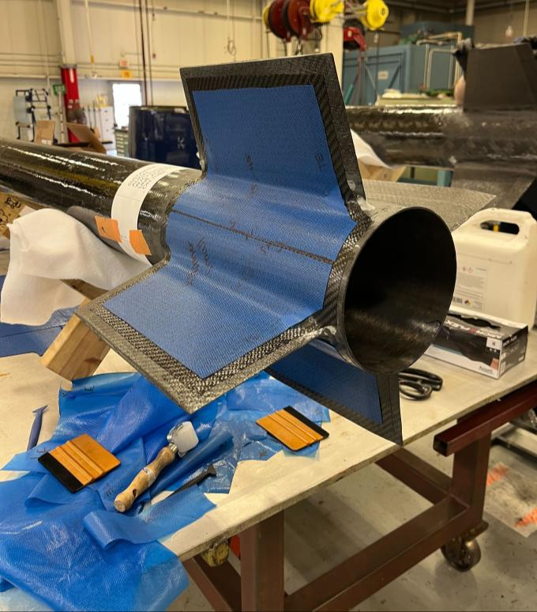
NATHANIEL MURCIN
Aerospace Engineering
Georgia Institute of Technology
Engineering portfolio
GTXR fin layup
Notes:
Factual source: C:/Documents/Resumes/ATL/Nathaniel_Murcin_Resume.pdf. Image: repository asset assets/v2_p3_0.jpeg.

Slide 2
Engineering profile
02
Education
Capability areas
Georgia Institute of Technology
Fluid systems and aerospace hardware
Structural analysis and experimental testing
Precision tooling and manufacturing
B.S. Aerospace Engineering
Expected May 2027
B.S./M.S. Aerospace Engineering Program
Minor in Astrophysics
GPA 4.00
Experience
Blue Origin
May 2026 - Aug. 2026
Pursuit Aerospace
Aug. 2025 - Dec. 2025
Georgia Tech Experimental Rocketry
Aug. 2023 - Present
Ben T. Zinn Combustion Laboratory
Jan. 2026 - Present
Aerospace hardware / Analysis / Manufacturing / Test
Notes:
Factual source: C:/Documents/Resumes/ATL/Nathaniel_Murcin_Resume.pdf. All education, capability, and date text comes from the resume.

Slide 3
Professional aerospace experience
03
BLUE ORIGIN
Fluids & Manufacturing Engineering Intern
Cape Canaveral, FL / May 2026 - Aug. 2026
FLUIDS ENGINEERING
LUNAR MANUFACTURING
Designed a cryogenic tank-farm P&ID for a large-scale ground-test facility. Reduced component count about 60% versus heritage designs by downsizing, eliminating branches, and challenging requirements.
Designed 6 Creo versions for an adaptable gripping fixture. Reduced fasteners from 8 to 1 while improving technician usability and preventing slippage, part damage, and metal-chip FOD. The design passed PDR.
Sized, selected, and validated cryogenic piping, valves, and relief devices. Developed the BOM and coordinated with suppliers through procurement.
Validated the fixture with hand calculations and Creo static structural FEA.
Preliminary hazard analysis and CONOPS supported formal HAZOP review.
Notes:
Factual source: C:/Documents/Resumes/ATL/Nathaniel_Murcin_Resume.pdf. Blue Origin experience: current resume, Fluids Engineering and Lunar Manufacturing.

Slide 4
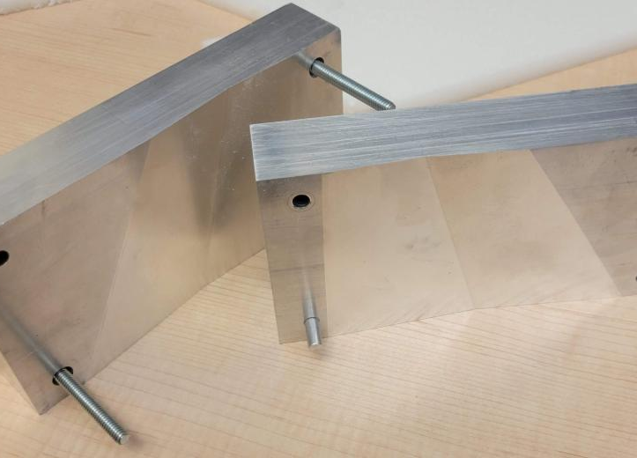
Fin design and thermoforming
04
Structured trade study
Evaluated materials, geometries, and manufacturing constraints. Down-selected feasible concepts using analytical feasibility, machinability, and engineering first principles.
Thermoforming process
Co-developed and evaluated a process for double-wedge PMI foam fin cores using CNC-machined aluminum tooling and 3D metrology.
0.28 mm
CNC-machined aluminum tooling
average global geometric error
Georgia Tech Experimental Rocketry / Fin Design & Manufacturing Lead
Notes:
Factual source: C:/Documents/Resumes/ATL/Nathaniel_Murcin_Resume.pdf. Image: repository asset assets/v2_p3_2.jpeg. Fin design and thermoforming claims: current resume, GTXR.

Slide 5
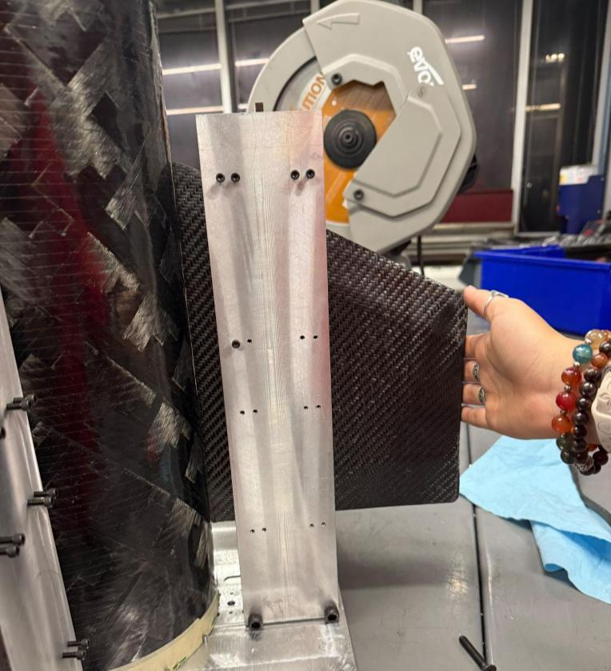
Fin alignment jig
05
CAD
Machining
Assembly
Roll-coupling problem
1.6° fin cant requirement
Modular four-tower fixture
CAD, CAM, and machining
<0.1°
Independent metrology verified all four fins within <0.1° of the 1.6° target.
Designed, CAM programmed, and machined by Nathaniel Murcin
Notes:
Factual source: C:/Documents/Resumes/ATL/Nathaniel_Murcin_Resume.pdf. Supporting public project evidence: C:/Documents/Resumes/Portfolio - Nathaniel Murcin.pdf. Images: repository assets v2_p4_0.webp, v2_p4_1.webp, and v2_p5_1.jpeg. Sequence and metrics come from the resume; roll-coupling context appears in the supplied V1 portfolio.

Slide 6
Emergency electrical passthrough
06
During launch integration, the sole flight unit failed.
Designed and fabricated a flight-critical NPT electrical passthrough.
14 hours
2× MEOP
design and fabrication turnaround
hydrostatic test passed
The hardware enabled successful flight.
Notes:
Factual source: C:/Documents/Resumes/ATL/Nathaniel_Murcin_Resume.pdf. Electrical passthrough claims: current resume, GTXR.

Slide 7
Composite shear modulus testing
07
TEST OBJECTIVE
MODEL VALIDATION
Determine the in-plane shear modulus of composite sandwich panels.
5%
acceptance criterion
EXPERIMENT
Designed and executed a plate-twist testing apparatus.
The experiment verified the ANSYS model within the acceptance criterion for future fin development.
Analysis / Experiment / Validation
Notes:
Factual source: C:/Documents/Resumes/ATL/Nathaniel_Murcin_Resume.pdf. Composite testing and model validation: current resume, GTXR.

Slide 8
Manufacturing engineering impact
08
PURSUIT AEROSPACE
Engineering Intern / Aug. 2025 - Dec. 2025
15
quick-change dot-peen fixtures
6 s to 1 s
average load/unload time
40 s to 2 s
inspection time using Go/No-Go gauges
55%
less time between completed parts
Broader one-piece-flow changes
3 days
less lead time
$1,000 / part
avoided outsourced cleaning and shipping
Developed an in-house supercleaning process qualified for production use by Rolls-Royce and Pursuit Quality.
Notes:
Factual source: C:/Documents/Resumes/ATL/Nathaniel_Murcin_Resume.pdf. All metrics and qualification language come from the resume.

Slide 9
Research and publications
09
BEN T. ZINN COMBUSTION LABORATORY
Undergraduate Researcher
Jan. 2026 - Present
Supported reacting jets-in-crossflow experiments by assembling regulated multi-gas delivery hardware and executing established MATLAB/PIV post-processing workflows.
AIAA REGIONAL STUDENT CONFERENCE PROCEEDINGS
2024
Shear Modulus Testing in Composite Sandwich Panels
AIAA 2024-85690 / Co-author & presenter
2026
Viability of Thermoformed Closed-Cell Foam Cores for Carbon Fiber Sandwich Rocket Fins
AIAA 2026-112793 / Co-author & presenter
Notes:
Factual source: C:/Documents/Resumes/ATL/Nathaniel_Murcin_Resume.pdf. Research role and publication metadata come from the resume. Both papers are AIAA Regional Student Conference Proceedings.

Slide 10
Engineering capabilities
10
ANALYSIS
HARDWARE & MANUFACTURING
Structural FEA
P&ID design
Cryogenic sizing and safety
Structural and bolted-joint analysis
Flutter analysis
GD&T and DFM
Composite layups and 3D printing
CNC mill, lathe, and waterjet
Instron testing
nmurcin3@gatech.edu
linkedin.com/in/nathaniel-murcin/
nmurcin.github.io
Nathaniel Murcin / Aerospace Engineering / Georgia Tech
Notes:
Factual source: C:/Documents/Resumes/ATL/Nathaniel_Murcin_Resume.pdf. Capabilities and contact details come from the resume.

Slide 11
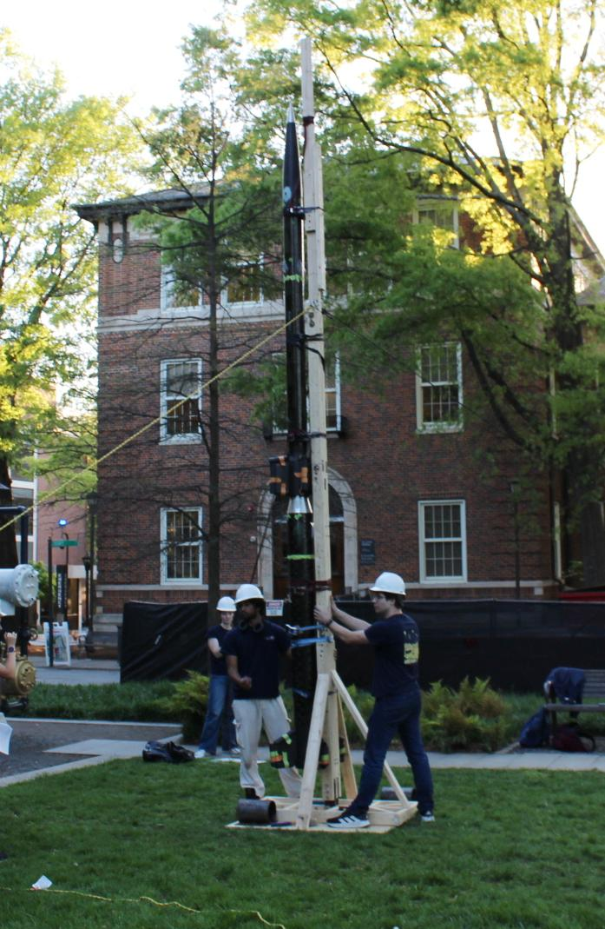
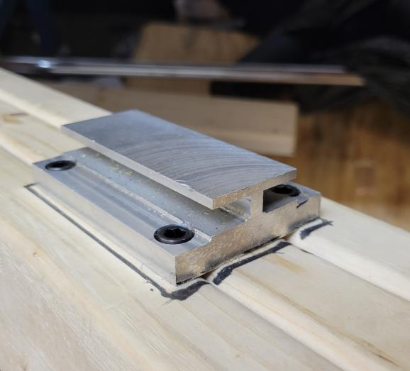
Appendix: mock launch rail
11
Two-week delivery
Completed bending and buckling calculations, modeled components in CAD, and manufactured the wood, steel, and aluminum parts.
Result
A functional assembled launch rail for the mock test.
Functional rail for the 2024-2025 GTXR mock test
Supporting project / Georgia Tech Experimental Rocketry
Notes:
Factual source: C:/Documents/Resumes/ATL/Nathaniel_Murcin_Resume.pdf. Supporting public project evidence: C:/Documents/Resumes/Portfolio - Nathaniel Murcin.pdf. Images: repository assets v2_p6_3.jpeg and v2_p6_0.jpeg. Project claims come from the supplied V1 portfolio.

