Slide 1
365-dashboard-ML-Final-Published
File created on: 01-12-2022 06:48:42

Slide 2
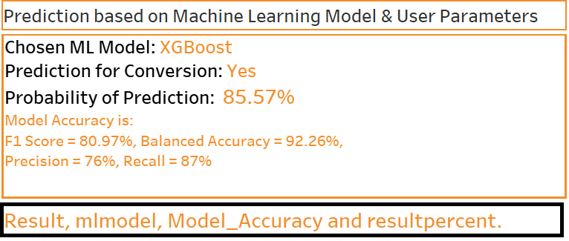

Slide 3
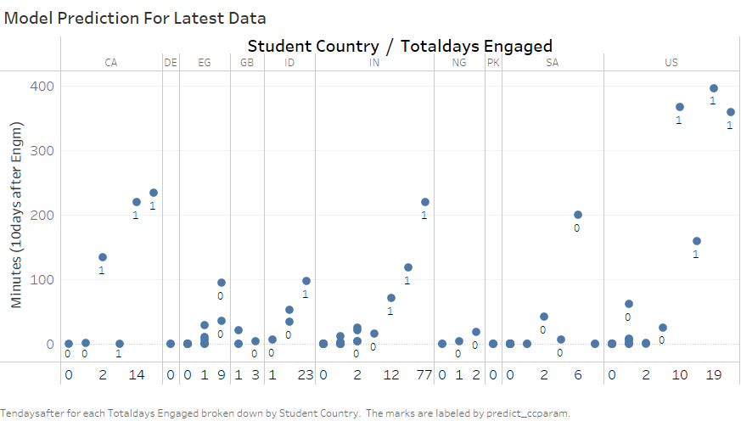

Slide 4


Slide 5


Slide 6
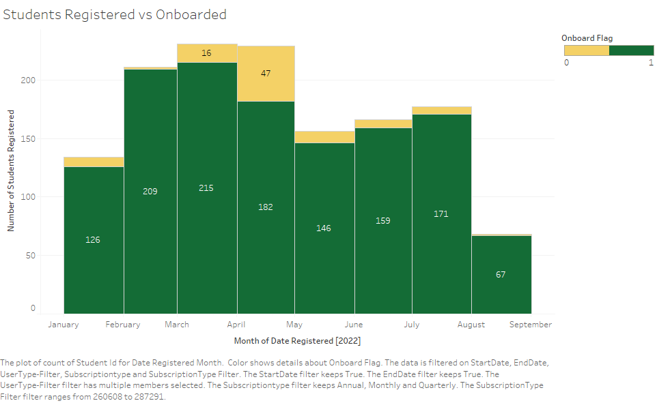

Slide 7
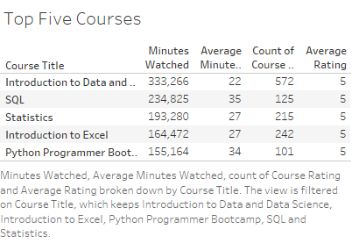

Slide 9


Slide 10


Slide 11


Slide 12
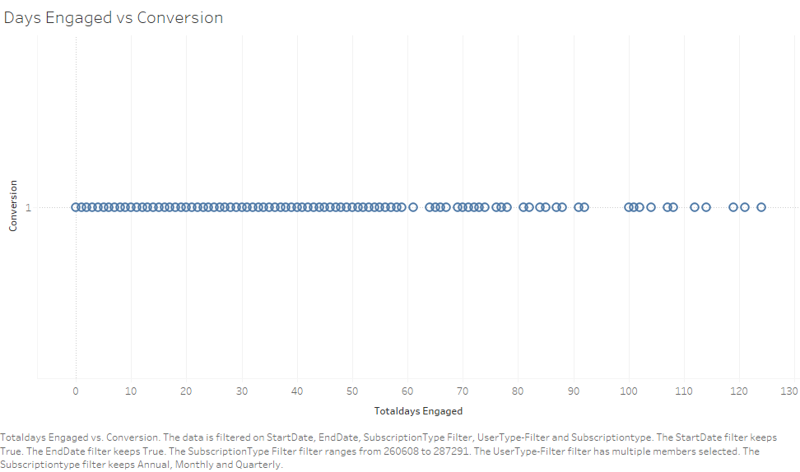

Slide 13
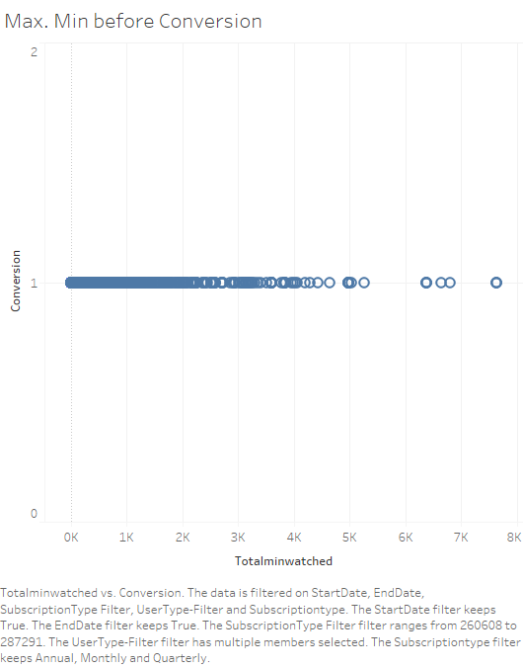

Slide 14
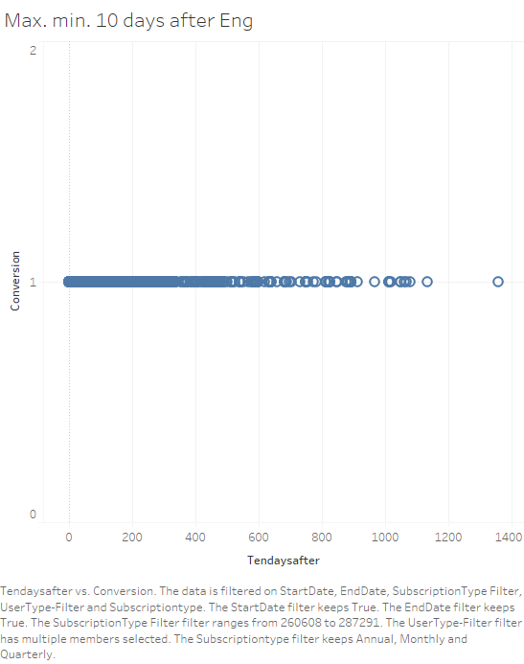

Slide 15
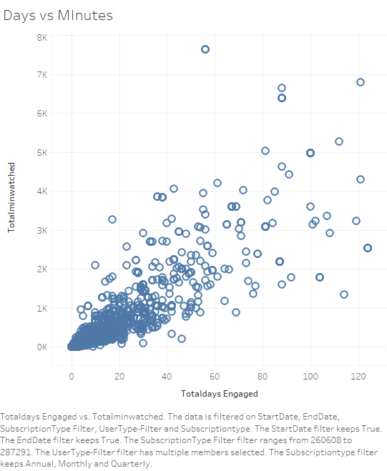

Slide 16
