Slide 1


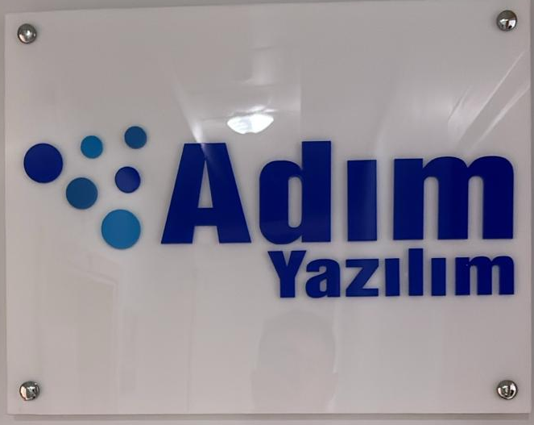

FE400 - Co-op / Engineering Internship
Adım Yazılım · Software Development Internship
2 February 2026 – 22 May 2026
TradeHub: An End-to-End E-Commerce Ecosystem
(Next.js, Flutter & MSSQL)
NURETTİN MUSTAFA ÖZKAYA-211501024
Department of Computer Engineering

Slide 2

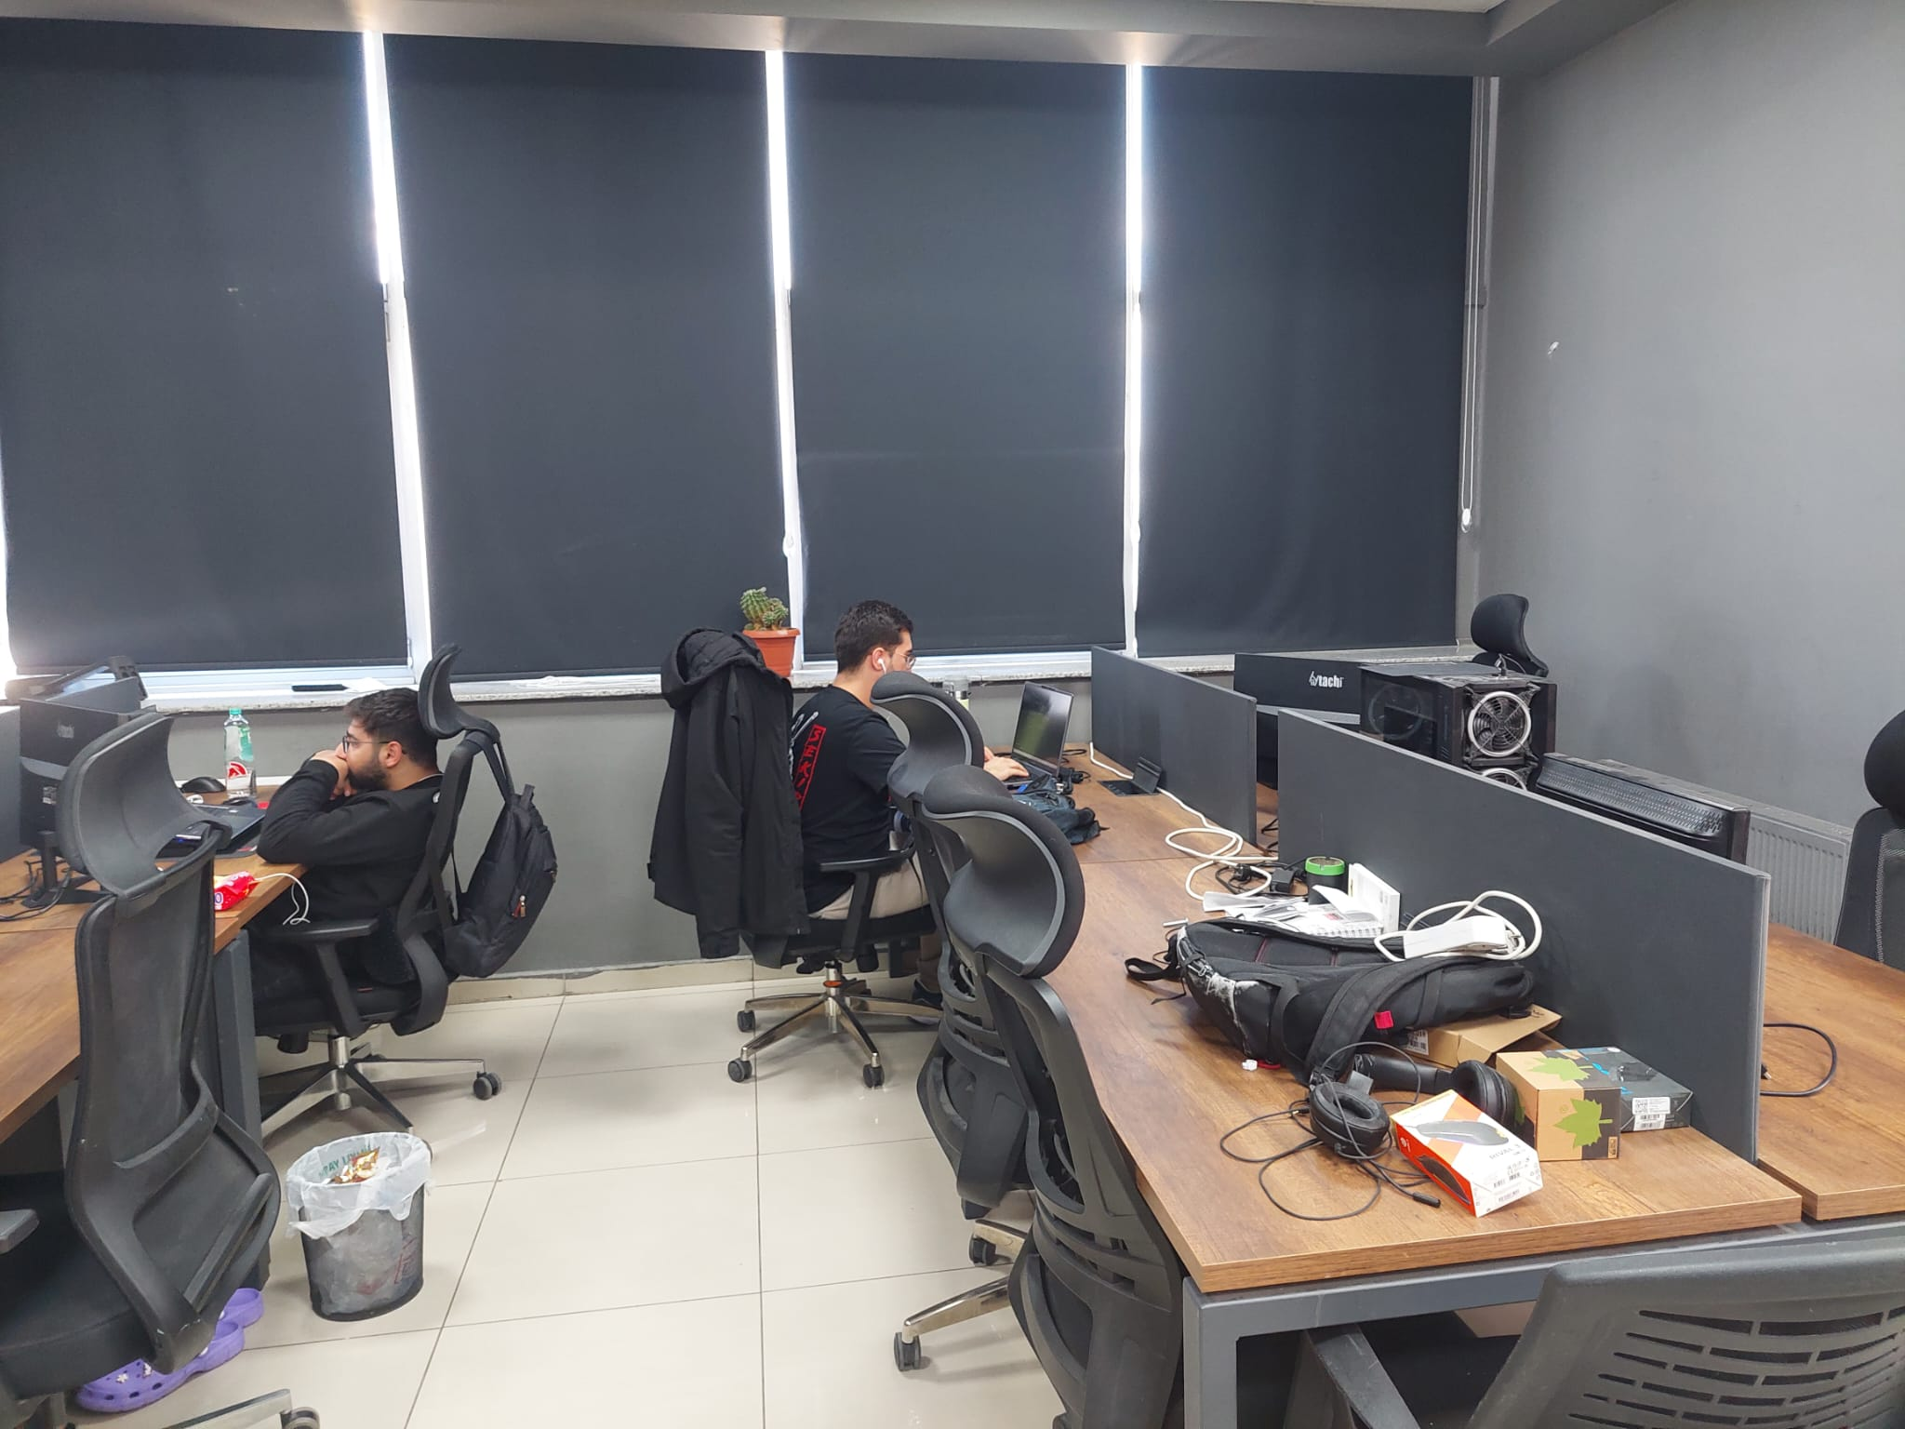

COMPANY OVERVIEW
Adım Yazılım
Who We Are
A software company based in Gaziantep Teknopark, delivering ERP systems, web applications, mobile solutions, database services, and digital transformation technologies.
Core Services
Custom software development
Web & mobile applications
Database architecture & consulting
API design & integration

Slide 3

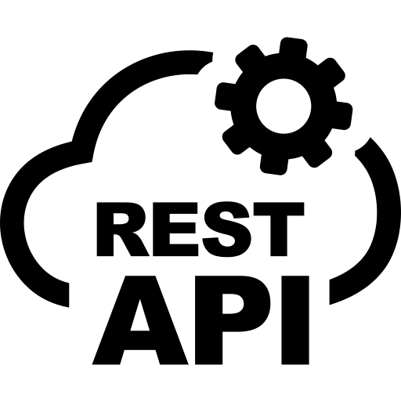
TECH STACK
Technologies Used
Microsoft SQL Server
Next.js
Relational database design, T-SQL queries, optimization
React-based SSR framework, routing, API integration
Flutter
REST APIs
Cross-platform mobile UI, state management, Dart
Designing, consuming, and testing API endpoints

Slide 4
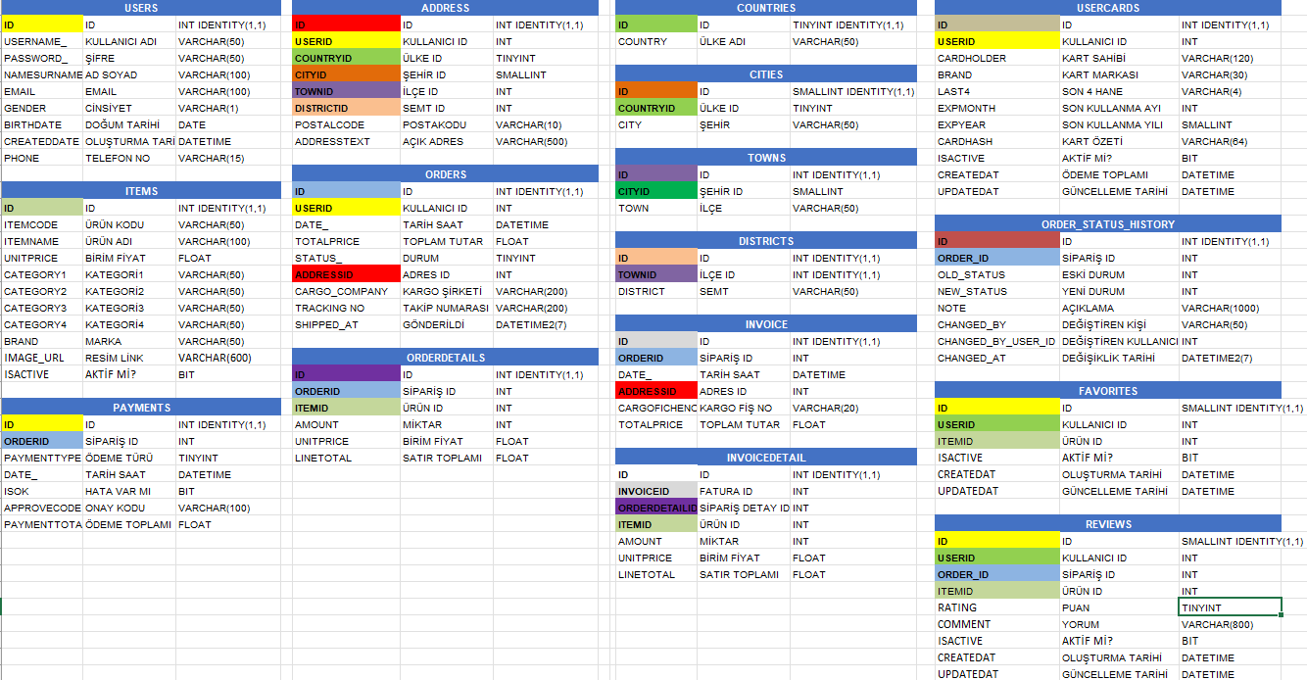
DATABASE DEVELOPMENT
Designing with MSSQL
Key Activities
Designed normalized relational schemas
Created database tables, foreign keys, and indexes
Developed complex T-SQL queries and stored procedures
Optimized query performance for large datasets

Slide 5
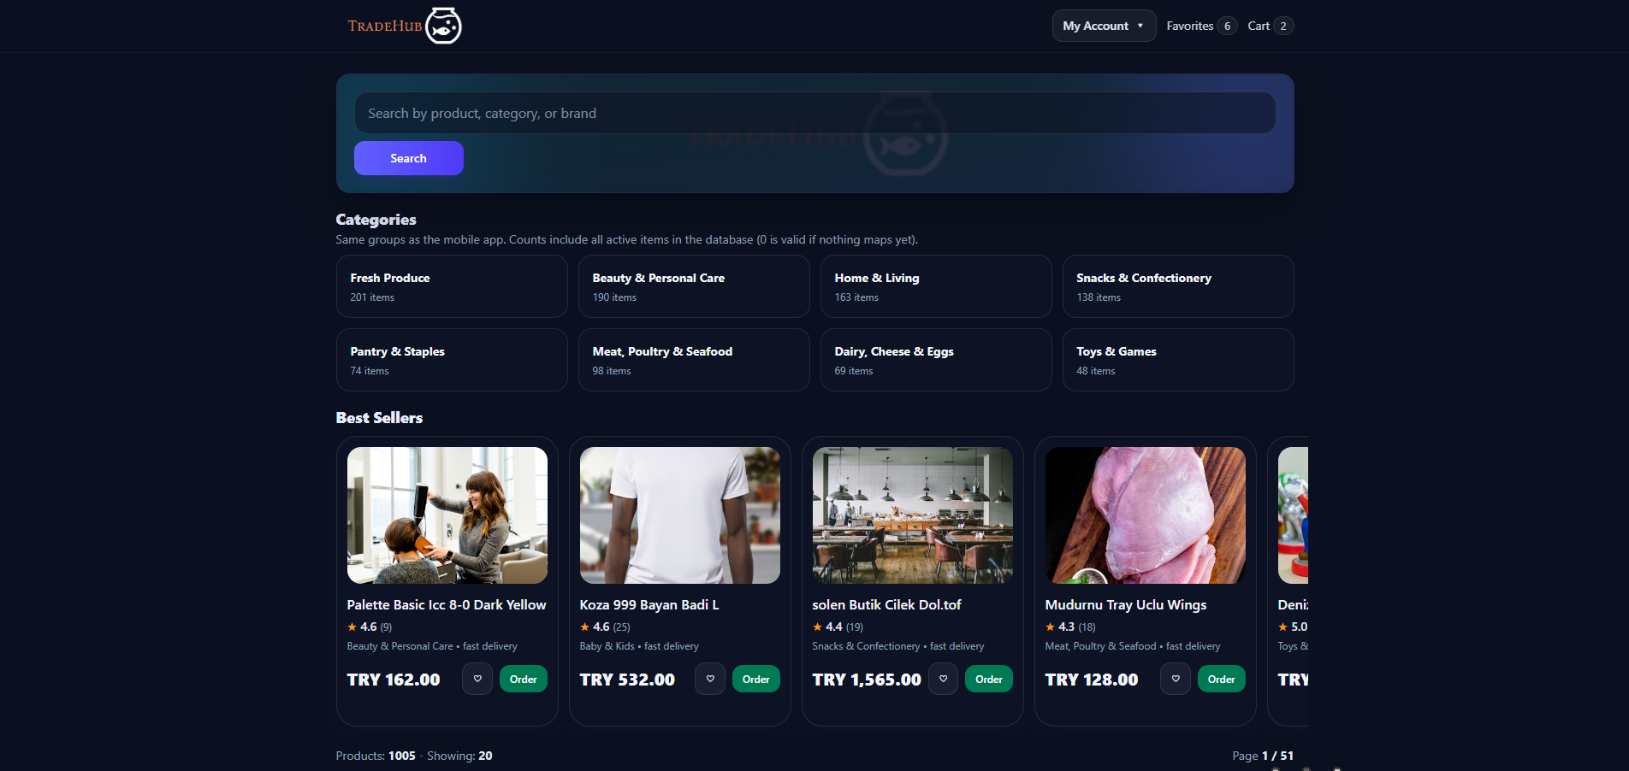
WEB DEVELOPMENT
Building with Next.js
What I Built
Responsive frontend components with React
Server-side rendering for performance
REST API integration & data fetching
Modern UI/UX following design guidelines

Slide 6

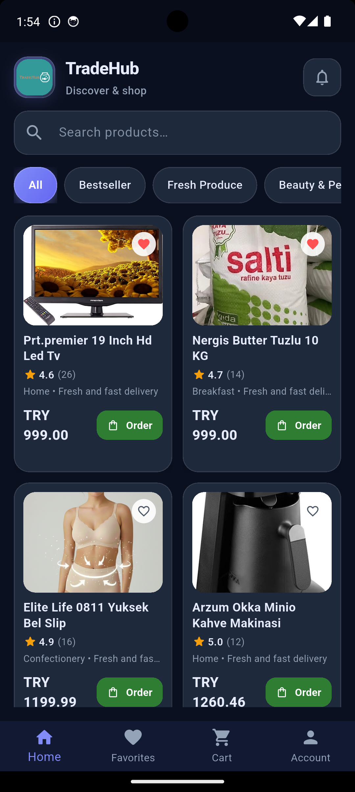
MOBILE DEVELOPMENT
Cross-Platform Apps with Flutter
State Management
Provider pattern, reactive data flow, clean architecture
UI & Layouts
Responsive widgets, adaptive layouts for iOS & Android
API Communication
HTTP requests, JSON parsing, async data handling

Slide 7
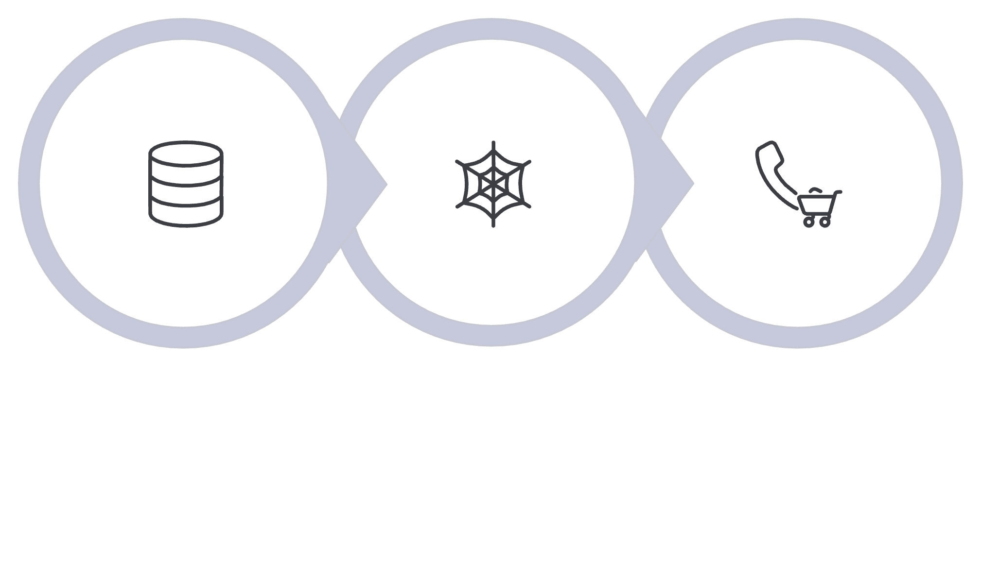

PROJECTS
Projects & Contributions
Database
Web
Mobile
Contributed across the full stack from database architecture to deployed mobile and web applications in real client-facing projects.

Slide 8
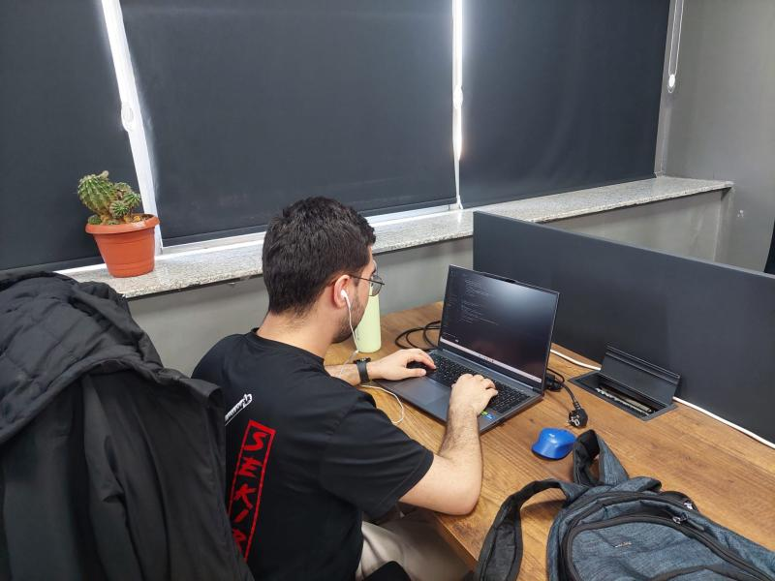
CONCLUSION
Summary & Future Goals
Internship Outcomes
Lessons Learned
Delivered real features across database, web, and mobile layers in a production environment
Real-world software engineering demands iteration, communication, and ownership
Next Steps
Pursue full-stack roles, deepen cloud expertise, and contribute to open-source projects

Slide 9

REFERENCES
Adım Yazılım, "SQL Server Training Content." Adım Yazılım. [Online]. Available: https://www.adimyazilim.com.tr/ [Accessed: May 2026].
Microsoft, "SQL Server Official Documentation." Microsoft. [Online]. Available: https://www.microsoft.com/en-us/sql-server/ [Accessed: May 2026].
Microsoft, "Transact-SQL Reference." Microsoft Docs. [Online]. Available: https://learn.microsoft.com/en-us/sql/t-sql/language-reference [Accessed: May 2026].
Vercel, "Next.js Official Documentation." Vercel. [Online]. Available: https://nextjs.org/ [Accessed: May 2026].
React Native, "React Native Official Documentation." Meta. [Online]. Available: https://reactnative.dev/ [Accessed: May 2026].
BTK Akademi, "Course Materials." BTK Akademi. [Online]. Available: https://www.btkakademi.gov.tr/ [Accessed: May 2026].
Flutter Documentation, "Flutter Documentation." Flutter. [Online]. Available: https://docs.flutter.dev/ [Accessed: May 2026].

