Slide 1
Classes and Objects
Rizky Januar Akbar

Slide 2
Terminology
Class
Instantiation
Instance
Objects
Encapsulation

Slide 3
Structure (struct)
struct RECTANGLE
{
int X1;
int Y1;
int X2;
int Y2;
};

Slide 4
Accessing Structure
RECTANGLE rect;
rect.X1 = 0;
rect.Y1 = 0;
rect.X2 = 10;
rect.Y2 = 10;

Slide 5
Defining Class
class <classname>
{
//member of class
} ;

Slide 6
Example of Class
class Person
{
public:
void speak()
{
cout << “Hello!” << endl;
}
};
int main()
{
Person p;
p.speak();
}

Slide 7
Inside of Class
class <classname>
{
//function member
//data member or fields
//static member
//constructor
//destructor
}

Slide 8
Data Member
class Person
{
private:
string name;
int age;
} ;

Slide 9
Function Member
class Person
{
public:
void sayName()
{
//prints name
}
} ;

Slide 10
Access Control in a Class
public: can be accessed anywhere within the scope of the class object.
private: can be accessed only by member of class.
protected: can be accessed from derived class.

Slide 11
Declaring Objects of a Class
Person person1;
Person budi;
Person person1(“Alex”);
Person person2(“John”);

Slide 12
Constructor
Constructor is a special function in a class that is responsible for creating new objects when required.
//declaring constructor
Person();
Person(string _name, int _age);

Slide 13
Example of Constructor
class Person
{
public:
string name;
int age;
Person(string _name, int _age)
{
name = _name;
age = _age;
}
};
Person person1(“Mary”, 26);

Slide 14
Destructor
Destructor is a function that destroys an object when it is no longer required or out of scope.
//declaring destructor
~Person();

Slide 15
Example of Destructor
class Person
{
public:
Person() {
//constructor
}
~Person(){
//destructor
}
};

Slide 16
Sample Class Definition
class Person
{
private:
string name;
int age;
public:
Person() {}
Person (string _name, int _age) {
name = _name;
age = _age;
}
void sayName() {
cout << “My name is ” << name << endl;
}
void sayAge() {
cout << “I am ” << age << “ years old” << endl;
}
};

Slide 17
Setter Function (Mutator)
class Person
{
private:
string name;
int age;
public:
void setName(string _name) {
name = _name;
}
void setAge(int _age){
age = _age;
}
};

Slide 18
Getter Function (Accessor)
class Person
{
private:
string name;
int age;
public:
string getName() {
return name;
}
int getAge() {
return age;
}
};

Slide 19
Static Member
class Person
{
public:
static int getCount();
private:
static int count;
}

Slide 20
This pointer
class Person
{
private:
string name;
int age;
public:
Person(string name, int age) {
this->name = name;
this->age = age;
}
}

Slide 21
This pointer
void Person::sayName() {
cout << this->getName() << endl;
}
string Person::getName() {
return this->name;
}

Slide 22
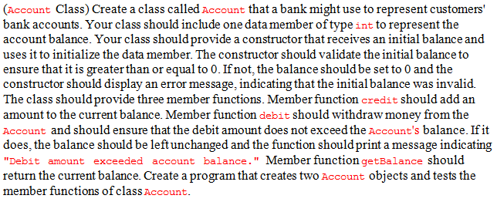
Exercise (Code and Class Diagram)

Slide 23
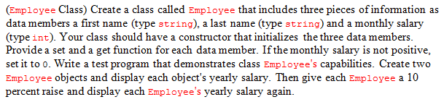
Exercise (Code and Class Diagram)

Slide 24
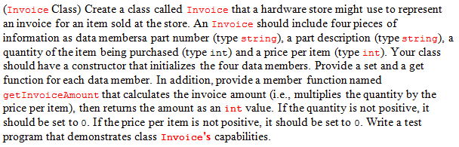
Exercise (Code and Class Diagram)

Slide 25
Homework
Check your facebook group ^>^

