Slide 1




www.linkedin.com/in/naresh-neelam
Databricks-Azure Blob Storage Mounting

Slide 2

There are couple of ways to do this, I am going to use OAuth 2.0 with an Azure service principal
Step 1
Add New App Registration in Azure Active Directory
Giving the Full permissions to the New App for Blob Storage
Step 2
Storing Credentials using Databricks Secrets
Mounting Blob Storage using Databricks Secrets

Slide 3
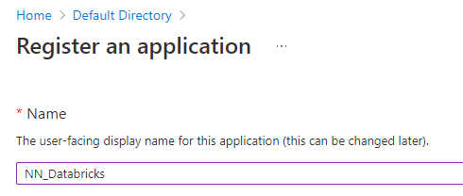

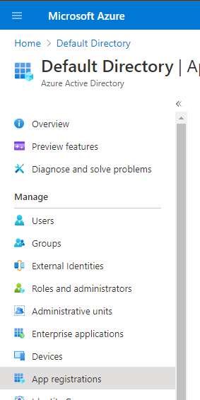
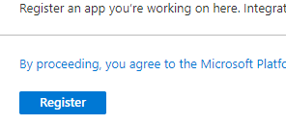
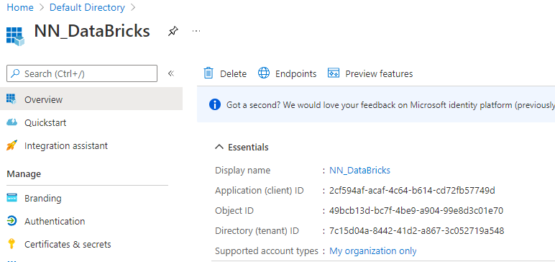
Step1 – need client id, tenant id

Slide 4
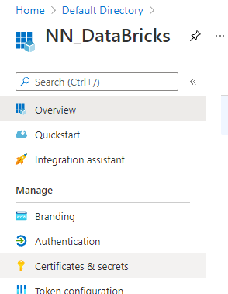
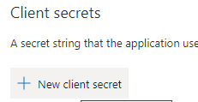
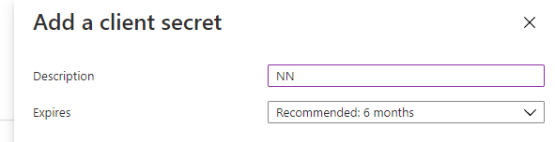
Step1 – need secret
Copy and store this secret immediately

Slide 5
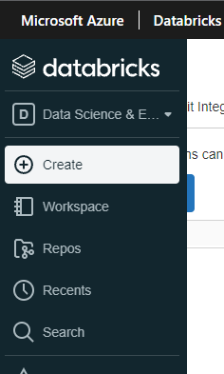
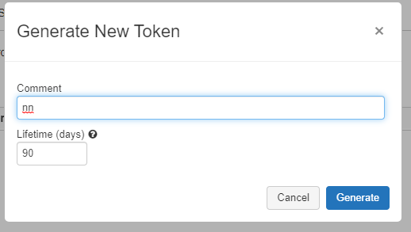
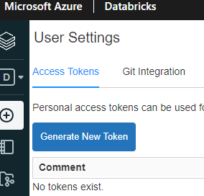
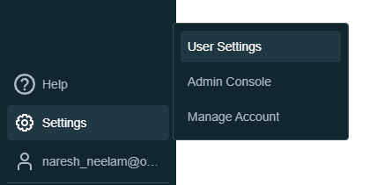
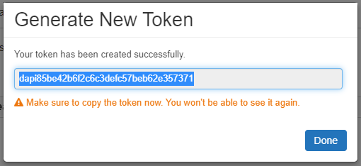
Step 2– Storing those Secret in Databricks using Databricks Secrets utils

Slide 6
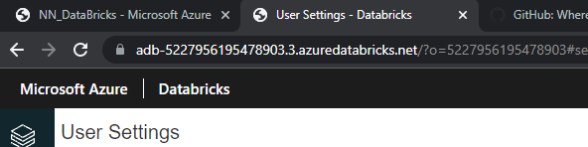




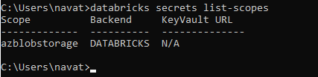
Step 2– Create scope and key

Slide 7
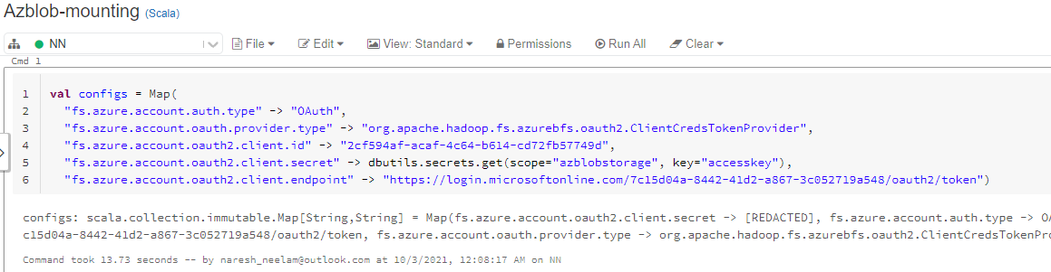
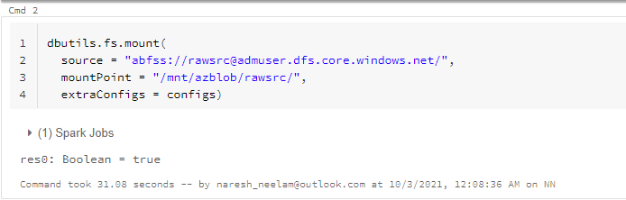
Step 2– mounting azure blob in Databricks

Slide 8
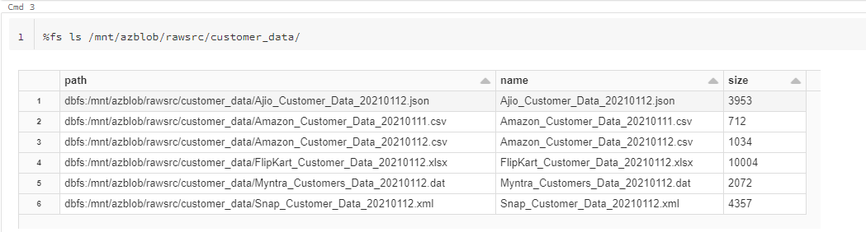
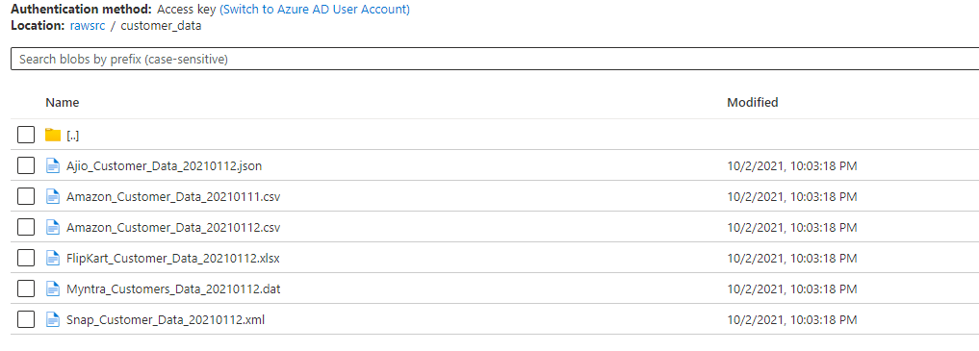
Step 2– mounting azure blob in Databricks

