Slide 1



www.linkedin.com/in/naresh-neelam
Databricks Cluster Configurations

Slide 2
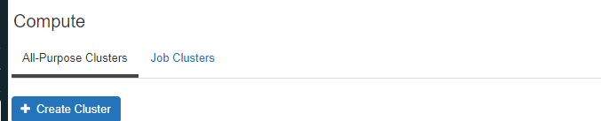
Cluster Types
All Purpose Cluster
Job Cluster
Need to created manually
Automatically Created By Job
It is Persistent
Automatically Terminated at End of Job
Suitable for Interactive workloads
Suitable for Automated workloads
Shared by Multiple User
Isolated just for Job
It is Expensive
It is Cheaper

Slide 3
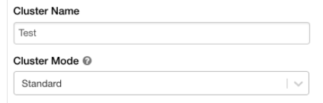
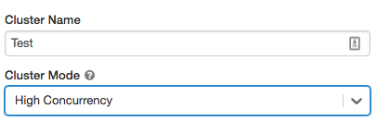
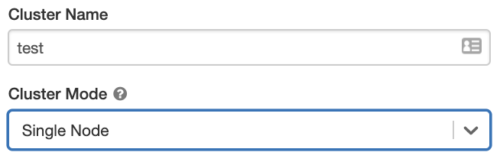
Cluster Modes
Standard
High Concurrency
Single Node
Single User Usage | Multiple Users | Single User
No Process Isolation | Provides Process Isolation | No Process Isolation
No Task Preemption | Provides Task Preemption | No Task Preemption
Support for All DSL | Doesn’t Support Scala | Support for All DSL
For Production Workload, Ad-hoc Development | For Interactive Analysis, Ad-hoc Development | Light Weight workload for ML, Data Analysis

Slide 4
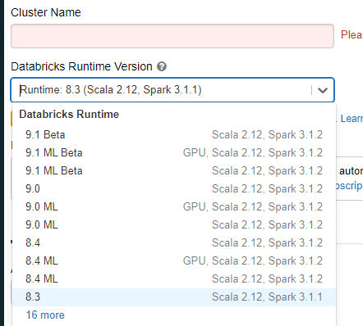
Runtime
Databricks Runtime:
Operating System: Ubuntu 20.04.2 LTS
Java: Zulu 8.54.0.21-CA-linux64
Scala: 2.12.10
Python: 3.8.10
R: 4.1.0 (2021-05-18)
Delta Lake 1.0.0:
Databricks Runtime Photon:
Faster Delta and Parquet tables
Databricks Runtime Machine Learning (ML):
Popular ML Libraries
(PyTorch, Keras, TensarFlow, XGBoost etc)
Databricks Runtime Light:
Runtime option for only jobs
not requiring advanced features

Slide 5
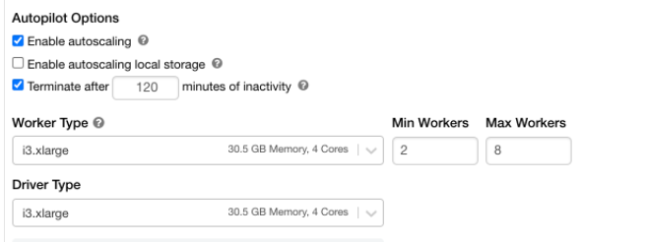
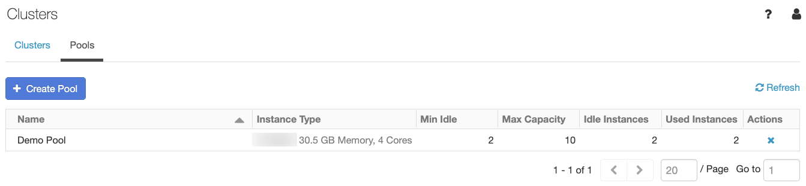
Auto Termination
Terminates the cluster after X minutes of inactivity
Default value for Single Node and Standard Clusters is 120 Minutes
High Concurrency cluster do not have a default auto termination set
Users can specify a value between 10 and 10000 mins as the duration
Auto Scaling
User specify the min and max work nodes
Auto Scales between min and max based on the workload
Not recommended for steaming workloads
VM Type/Size
Memory Optimized, Compute Optimized, Storage Optimized, General Purpose, GPU Accelerated
Pool
Ready to use instances, reduce cluster start and auto scaling times. You can specify difference pool for driver node and worker nodes, or use same pool for both.

