Slide 1
CS512 Final Project :
Image Classification using k Nearest Neighbours algorithm
GROUP 2:
ABHISHEK BHATT (ab2083)
HARSH BHATT (hb371)
SIVA HARSHINI DEV BONAM (sdb202)
TIANZHI CAO (tc796)

Slide 2
Project Goals
Implement KNN algorithm to find nearest neighbours (pre-labeled images in the MNIST training set) of an input image from the MNIST testing set.
Write an application on top of the KNN implementation that takes an image as input,and returns the digit it contains as an output.
Summarize the overall performance of the implementation in terms of time and accuracy.

Slide 3
Dataset
MNIST database of handwritten digits
Training set : 60,000 examples (IDX file format for implementation)
Test set : 10,000 examples (PNG file format for implementation)
Each image is 28x28 pixels in the raw dataset
Data is at rest and can fit in a typical desktop

Slide 4
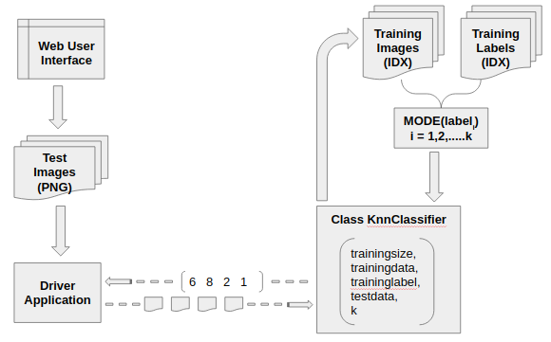
Project Modules
Algorithm implementation : Python class KnnClassifier
Image classifier web application : knn_image_classifier

Slide 5
Application Demo
To deploy the web application, we need to run applicationknnimageclassifier.py with Python. The UI is then accessible at port 8080 on the localhost URL.

Slide 6


Slide 7
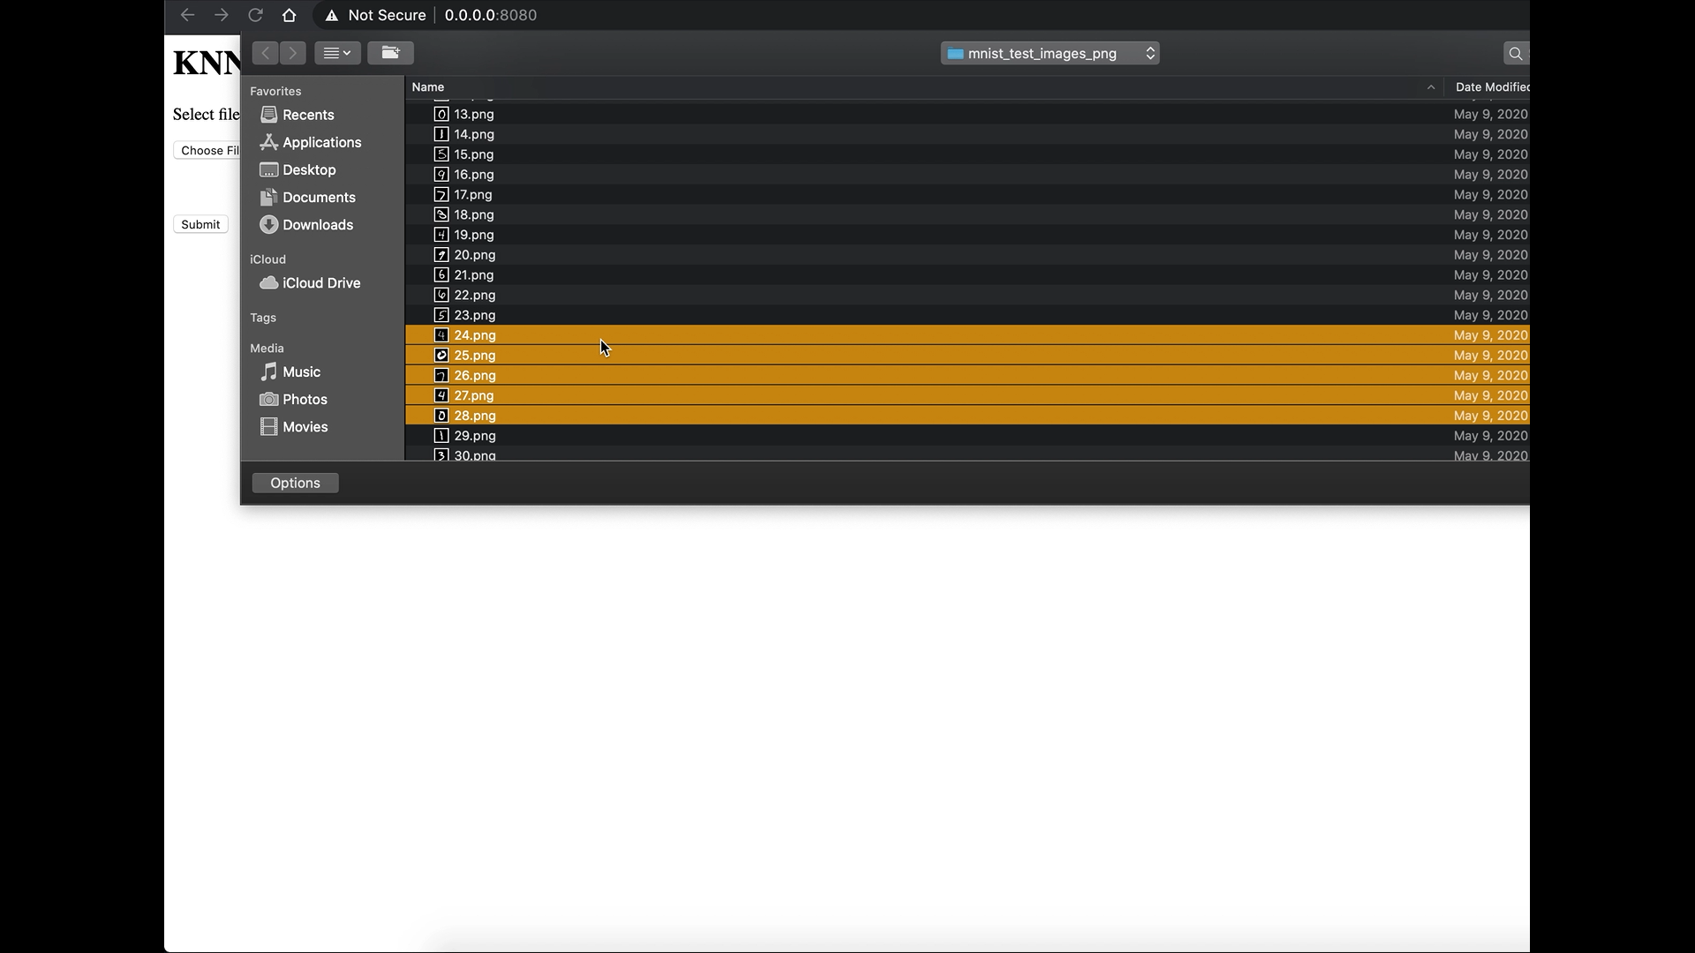

Slide 8


Slide 9
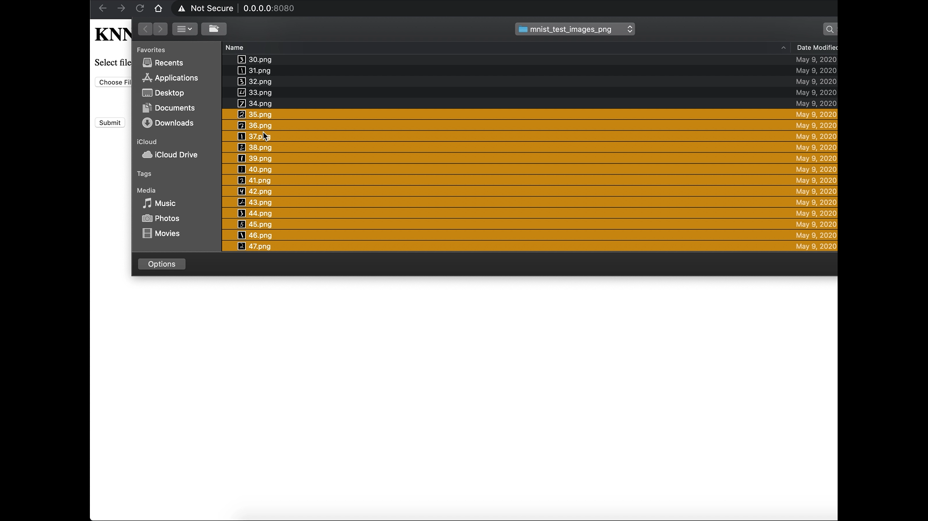

Slide 10


Slide 11
Analysis

Slide 12
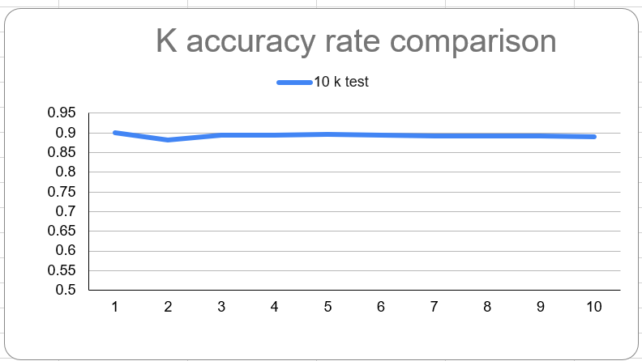

Slide 13
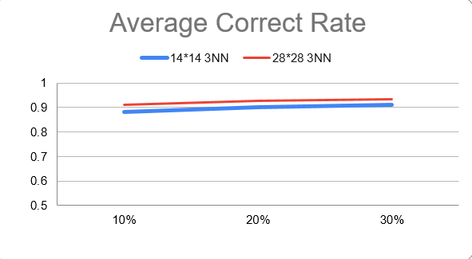

Slide 14
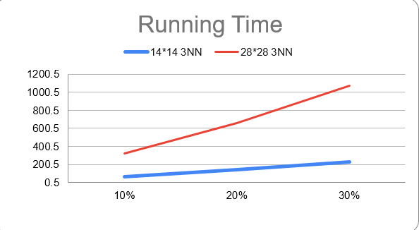

Slide 15
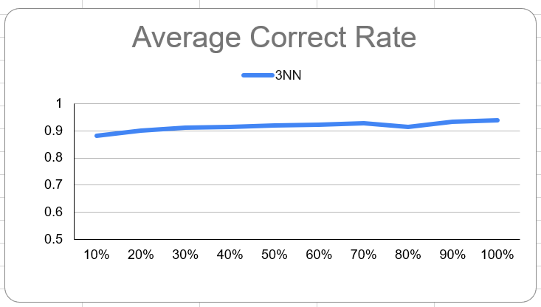

Slide 16
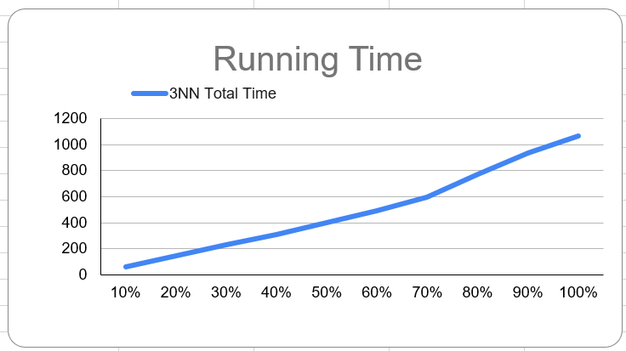

Slide 17
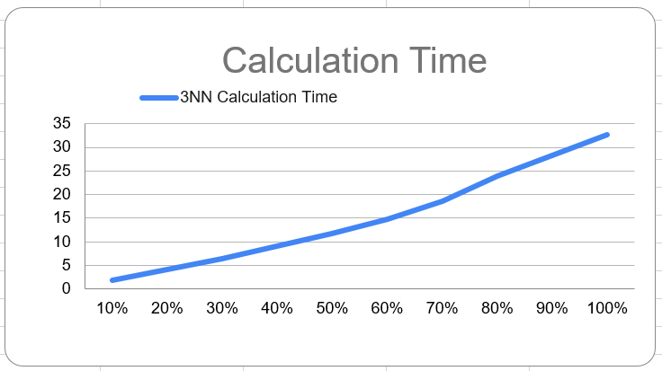

Slide 18
Observations
No significant change in accuracy was observed for k = 1 to 10.
Average correctness of predicted labels decreases after sub-sampling, but the drop is insignificant overall.
Running time drops sharply after sub-sampling, as we increase size of training set.
Average correctness of predicted labels is roughly same for all train sizes.
Running time increases approximately linearly until we take 70% of the training set (10% increments for each observation).
Beyond 70%, there is a sharp increase in running time per increment.

Slide 19
Conclusion
Through this project we have successfully demonstrated the application of the K-Nearest Neighbours algorithm for image classification and analyzed its performance in terms of the size of the training dataset.

Slide 20
Thank you

