Slide 1


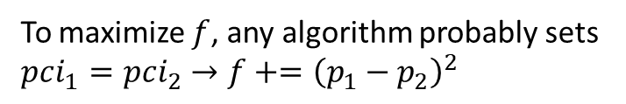




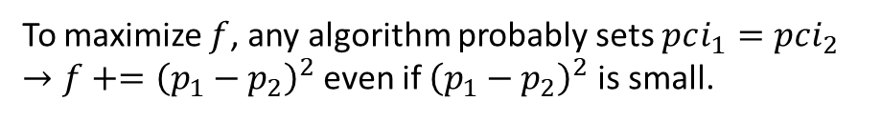


Finding a good objective function
Case 1
Case 2
$$f+= {1\left(pci_{1}=pci_{2}\right) \left(p_{1}−p_{2}\right)}^{2}$$
Ideal: $max⁡f$
$$p_{2}$$
2
$$p_{1}$$
$$p_{1}$$
$$p_{2}$$
1
1
2
Ideal: sites 1 and 2 can have the same PCI.
Ideal: sites 1 and 2 should have different PCIs.
To maximize $f$, any algorithm probably sets $pci_{1}=pci_{2}$ $→f+={\left(p_{1}−p_{2}\right)}^{2}$
To maximize $f$, any algorithm probably sets $pci_{1}=pci_{2}$ $→f+={\left(p_{1}−p_{2}\right)}^{2}$ even if ${\left(p_{1}−p_{2}\right)}^{2}$ is small.

Slide 2
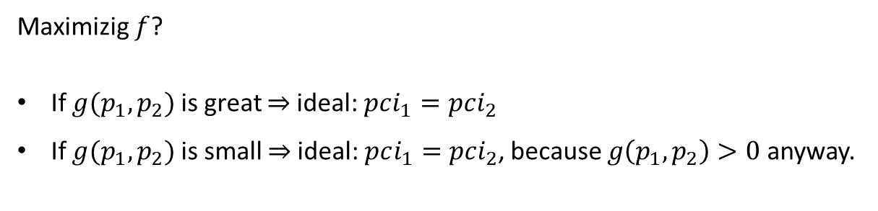

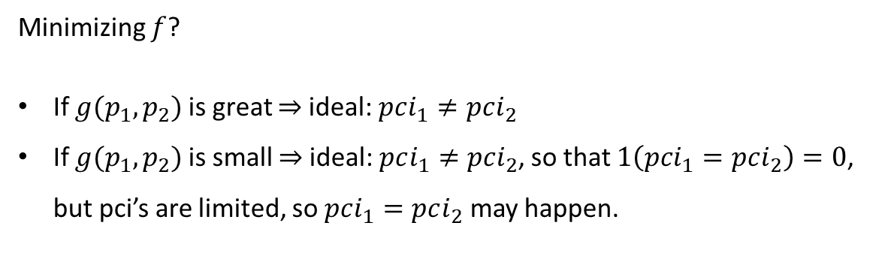


How to modify $f$ ?
$$f+=1\left(pci_{1}=pci_{2}\right) g(p_{1},p_{2})$$
Assumption: $g\left(p_{1},p_{2}\right)>0$ for all $p_{1},p_{2}$
Maximizig $f$?
If $g(p_{1},p_{2})$ is great $⇒$ideal: $pci_{1}=pci_{2}$
If $g(p_{1},p_{2})$ is small $⇒$ideal: $pci_{1}=pci_{2}$, because $g\left(p_{1},p_{2}\right)>0$ anyway.
Max is not good.
Minimizing $f$?
If $g(p_{1},p_{2})$ is great $⇒$ideal: $pci_{1}≠pci_{2}$
If $g(p_{1},p_{2})$ is small $⇒$ideal: $pci_{1}≠pci_{2}$, so that $1\left(pci_{1}=pci_{2}\right)=0$, but pci’s are limited, so $pci_{1}=pci_{2}$ may happen.
Min is good.

Slide 3
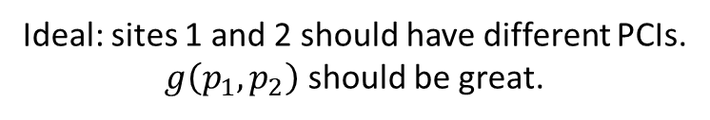
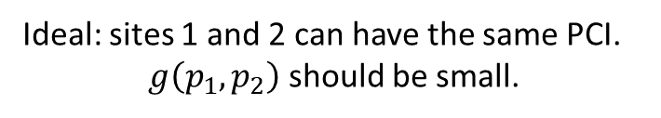

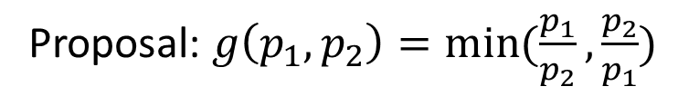

$$f+=1\left(pci_{1}=pci_{2}\right) g(p_{1},p_{2})$$
Case 1
Ideal: $\min{f}$
Case 2
$$p_{2}$$
2
$$p_{1}$$
$$p_{1}$$
$$p_{2}$$
1
1
2
Ideal: sites 1 and 2 can have the same PCI.
$g\left(p_{1},p_{2}\right)$ should be small.
Ideal: sites 1 and 2 should have different PCIs.
$g\left(p_{1},p_{2}\right)$ should be great.
Proposal: $g\left(p_{1},p_{2}\right)=\min{(\frac{p_{1}}{p_{2}},\frac{p_{2}}{p_{1}})}$

Slide 4
Greedy Algorithm
Initialize allocation matrix with 1/k
Calculate objective function from allocation matrix.
Form a list of changeable elements in allocation matrix (initially all elements of allocation matrix are included)
For all elements of changeable list:
Change element to 1 and find objective
Change element to 0 and find objective
Find the element with minimum objective.
Change the allocation matrix accordingly.
Update the changeable list.
Go to step 4 until changeable list is empty.
Unconstrained greedy algorithm always has a solution
PCI’s in a site maybe identical
PCI’s in a site my not be consecutive.

Slide 5
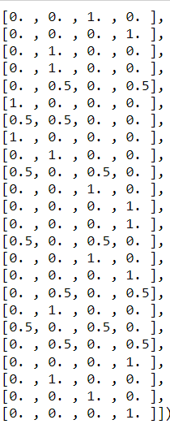

Constrained Greedy Algorithm
Initialize allocation matrix with 1/k
Calculate objective function from allocation matrix.
Form a list of changeable elements in allocation matrix (initially all elements of allocation matrix are included)
For all elements of changeable list:
Change element to 1, if consecutiveness condition is not violated, find objective.
Change element to 0, if consecutiveness condition is not violated, find objective
Find the element with minimum objective.
Change the allocation matrix accordingly.
Update the changeable list.
Go to step 4 if changeable list is not empty.
Constrained greedy algorithm may not have a solution.

Slide 6
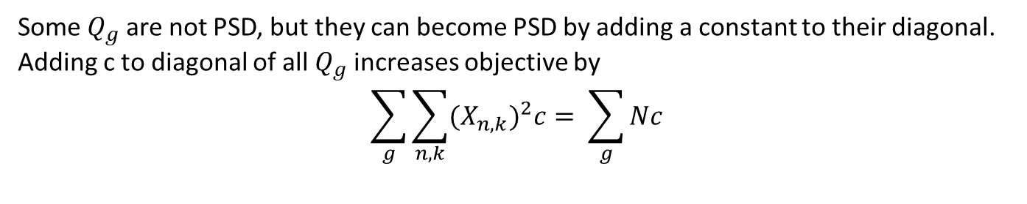
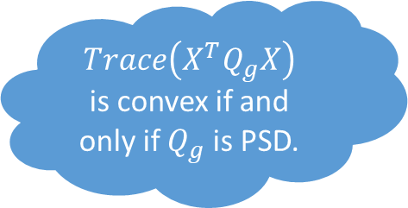
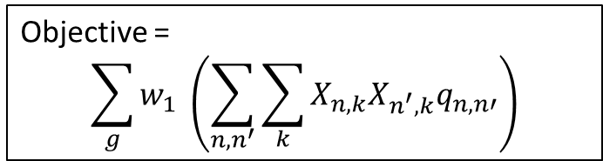
Solving the binary quadratic problem
If objective function of a minimization BQP is convex, it has a global solution.
$Trace\left(X^{T}Q_{g}X\right)$ is convex if and only if $Q_{g}$ is PSD.
Sum of convex functions is convex.
Some $Q_{g}$ are not PSD, but they can become PSD by adding a constant to their diagonal.
Adding c to diagonal of all $Q_{g}$ increases objective by
$$\sum_{g}{\sum_{n,k}{{{(X}_{n,k})}^{2}c= \sum_{g}{Nc}}}$$
Objective =
$$\sum_{g}{w_{1} \left(\sum_{n,n^{′}}{\sum_{k}{X_{n,k}X_{n^{′},k}q_{n,n′}}}\right)}$$

Slide 7
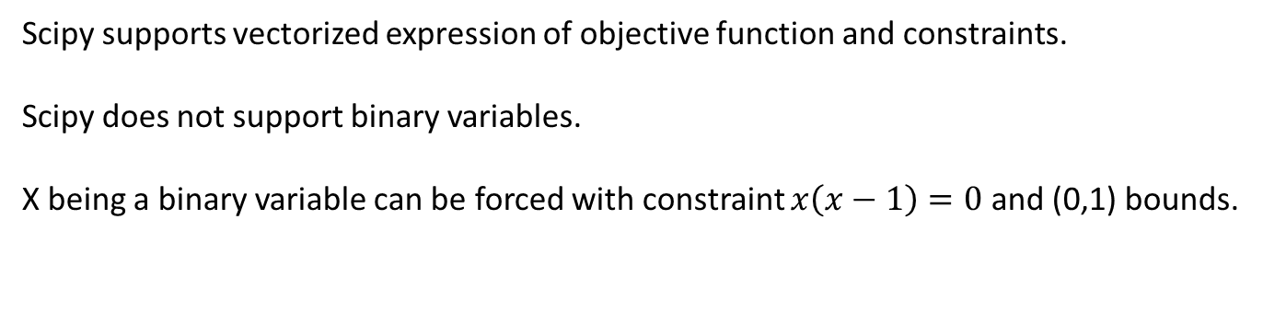
Method 1: scipy package
Scipy supports vectorized expression of objective function and constraints.
Scipy does not support binary variables.
X being a binary variable can be forced with constraint $x\left(x−1\right)=0$ and (0,1) bounds.
We tried SLSQP method with 5000 rounds, but algorithm did not converge after 2 hours.

Slide 8
Method 2: CVXPY package
CVXPY supports vectorized expression of objective function and constraints.
CVXPY does not support non-convex problems.
Even though our problem is convex, this package did not work.

Slide 9
Method 2: docplex package
For documentation of this method, please refer to jupyter botebooks.

