Slide 1
HTML

Slide 2
HTML - Hypertext Markup Language
Hypertext – tekst koji sadrži linkove na druge tekstove
Markup – nešto da se označi (na webu je to web content)
Language – jezik ima sintaksu i semantiku

Slide 3
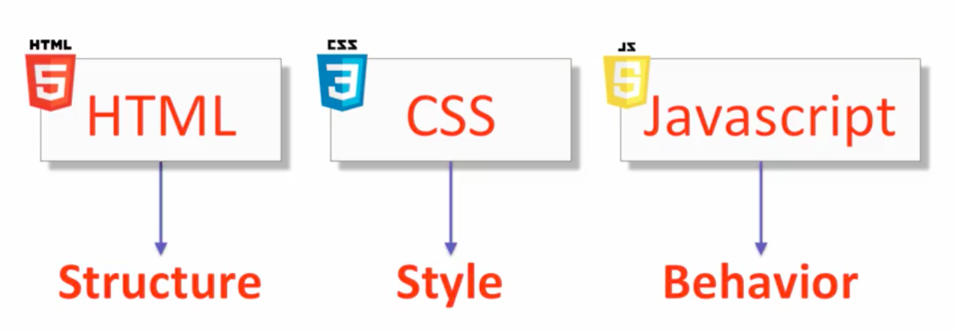
Web tehonologije

Slide 4
HTML tag
<p> … </p>
p je element
<p> je tag
</p> je closing tag, nekad nemamo closing tag <hr>
atribut (metadata o tagu) <p id = ‘par1’>

Slide 5
Struktura HTML dokumenta
<!DOCTYPE html>
<html>
<head>
… (metadata) …
<meta charset=”UTF-8”>
<meta name=”description” content=”This is an awsome website”>
<title>Title</title>
</head>
<body>
… (content) …
</body>
</html>
https://validator.w3.org

Slide 6
HTML tagovi
h1, h2, h2, … h6
h1 – glavni naslov
h2 prvi nivo podnaslova
...
p - paragraf
b - bold, i - italic
br – novi red
hr – horizontalna linija
big – malo veći font
small – malo manji font
sub - H2O
sup
<!-- ovo je komentar -->

Slide 7
DIV / SPAN
<div>*** Div 1: Neki sadrzaj ide tu ***</div>
<div>*** Div 2: Neki sadrzaj poske div 1</div>
<span>*** Span 1 odma posle Div 2</span>
<div>
*** Div 3: sadrzaj posle span 1
<span>*** Span 2: Unutar div 2 ***</span>
Nastavak div 3 sadrzaja
</div>

Slide 8
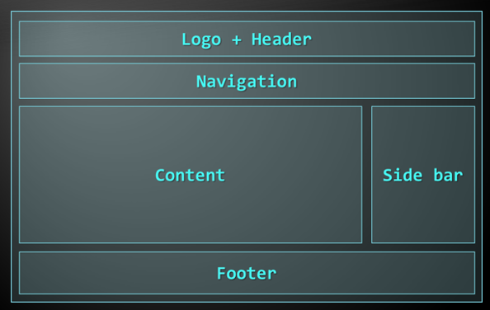
HTML tagovi
header
nav
section
article
aside
Footer
*SEO

Slide 9
Block element
Prikazuje se u novom redu i zauzima čitav red
Može da sadrži druge block ili inline elemente
Inline element
Prikazuje se u istom redu
Može sadržati samo inline elemente

Slide 10
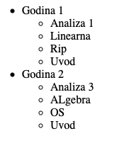
Liste
ul – unordered list
li – list item

Slide 11
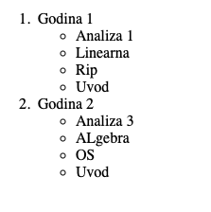
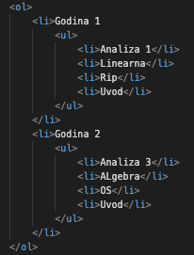
Lista
ol – ordered list
li – list item

Slide 12

Liste
Description list
<dl>
<dt>Coffe</dt> <dd>black hot drink</dd>
<dt>Milk</dt> <dd>width cold milk</dd>
</dl>

Slide 13
Tabele
<table></table>: begin / end the table
<tr></tr>: create a table row
<td></td>: create tabular data (cell)
<thead> denotes table header and contains <th> elements, instead of <td> elements
<tbody> denotes collection of table rows that contain the very data
<tfoot> denotes table footer but comes BEFORE the <tbody> tag

Slide 14
<table>
<colgroup>
<col style="width:200px" /><col />
</colgroup>
<thead>
<tr><th>Column 1</th><th>Column 2</th></tr>
</thead>
<tfoot>
<tr><td>Footer 1</td><td>Footer 2</td></tr>
</tfoot>
<tbody>
<tr><td>Cell 1.1</td><td>Cell 1.2</td></tr>
<tr><td>Cell 2.1</td><td>Cell 2.2</td></tr>
</tbody>
</table>

Slide 15
Link
<a href="">Tekst</a>
href - hypertext reference
title
target = ‘_blank’
link na lokalni fajl <a href=”index.html>
link na web stranu <a href=“https://www.facebook.com/”>
link na poziciju na našoj stranici
<section id=“section1”> … <a href = ”#section1”>

Slide 16
Slike
<a href="https://ucg.ac.me">
<img src="logo.jpeg" alt="">
</a>
<img src="" alt="">
width
height=""
width=""

Slide 17
Atributi
style = “color: blue;”
<body style=”background-color: lightblue;”>
Id =
Class =
…

Slide 18
iframe
<iframe width="560" height="315" src="https://www.youtube.com/embed/9BMwcO6_hyA" title="YouTube video player" frameborder="0" allow="accelerometer; autoplay; clipboard-write; encrypted-media; gyroscope; picture-in-picture" allowfullscreen></iframe>

Slide 19
Input elementi
<form action="">
<label for="name_input">Ime:</label> <input id="name_input" type="text">
<label for="name_input">Lozinka:</label> <input id="password_input" type="password">
<label>Broj indeksa:</label> <input type="number">
<label for="student_checkbox">Student: </label> <input id="student_checkbox" type="checkbox">
<label for="smejr_a">A</label> <input id="smejr_a" type="radio" name="smejr_in">
<label for="smejr_b">B</label> <input id="smejr_b" type="radio" name="smejr_in">
<label for="smejr_c">C</label> <input id="smejr_c" type="radio" name="smejr_in">
<label for="smejr_d">D</label> <input id="smejr_d" type="radio" name="smejr_in">
<input type="submit" value="Submit">
</form>
Button
label
text
checkbox
radio
color
date
password
range

Slide 20
Metadata
Charset
<meta charset=”UTF-8”>
Description
<meta name=”description” content=”tekst do 200 karaktera” >
Author
<meta name=”author” content=”Velibor”>
Keywords
<meta name=”keywords” content=”HTML, Tutorial”>
Viewport
<meta name=”viewport” content=”width=device-width” initial-scale=1.0”>

Slide 21
Style
<style></style>
<link rel="stylesheet" href="base.css">
http://www.csszengarden.com/214/page2/
http://www.csszengarden.com/215/page2/
http://www.csszengarden.com/216/page2/
http://www.csszengarden.com/217/page2/

Slide 22
Javascript
<script><script>
<script src="path/to/js/file"></script>

