Slide 1
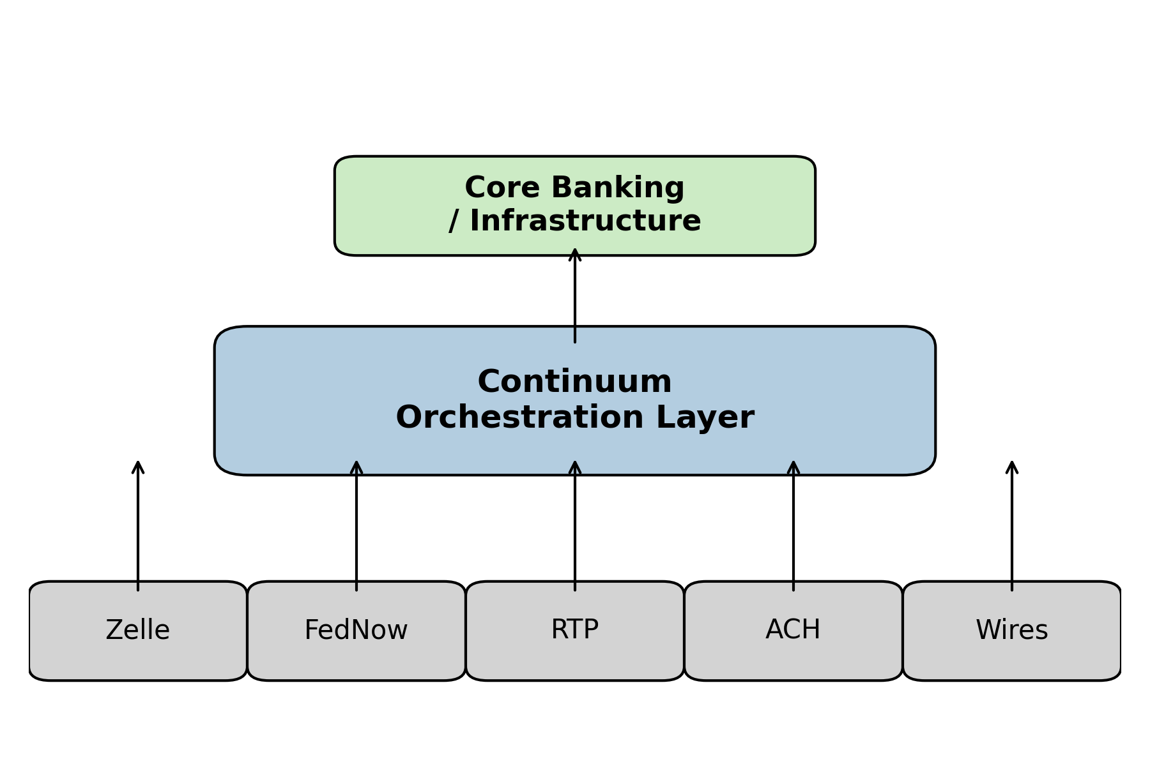
Continuum: Rail-Agnostic Payments Operations Platform
Solving operational chaos across Zelle, FedNow, RTP, ACH, and Wires with a unified orchestration layer.
  Unified control plane automates incident response, recovery, validation, and audits
  Does not touch transaction flow — non-invasive and compliance-safe
  Supports Zelle (operations only), FedNow, RTP, ACH, Wires, Core Banking
  Reduces risk, mean-time-to-repair, and regulatory exposure
  Designed for CIO / CRO / Payments Ops leadership

