Slide 1
CypherCrescent Software Academy
Backend Development Cohort
Assignment

Slide 2
Assignment 1
Separate the Programming Languages in Image 1 (page 4) into their separate usage; Application and program development, artificial development, database development, game development, computer drivers and hardware dev, internet and web page dev.

Slide 3
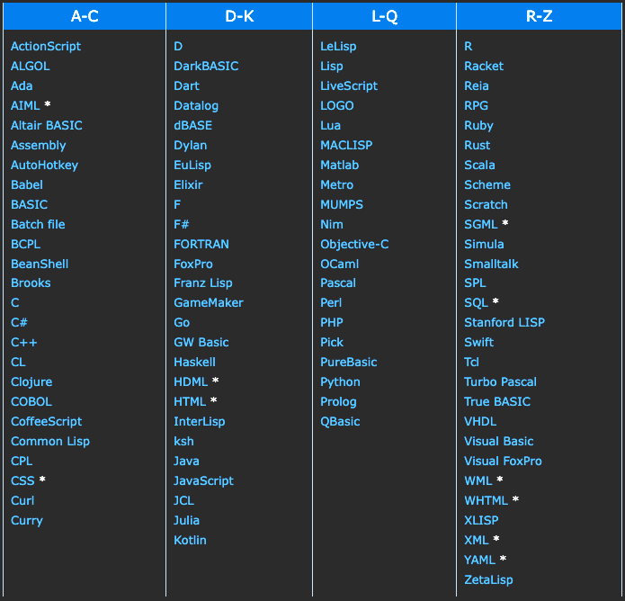

Slide 4
Application and Program Development
C
C#
C++
D
Java
Swift
Tcl
Visual Basic

Slide 5
Artificial Intelligence Development
AIML
C
C#
C++
Prolog
Python

Slide 6
Database Development
DBASE
FoxPro
MySQL
SQL
Visual Foxpro

Slide 7
Game Development
C
C#
C++
DarkBASIC
Java

Slide 8
Computer Drivers or Other Hardware Development
Assembly
C

Slide 9
Internet and Web Page Development
HDML
HTML
Java
JavaScript
Perl
PHP
Python
XML

Slide 10
Script Development
AutoHotkey
Awk
Bash
Batch file
Perl
Python
Tcl

Slide 11
Assignment 2
Separate Image 1 (page 4) into their corresponding programming language in page 5

Slide 12
Procedural
Ada
BCPL
C
Lisp
FoxPro
PureBasic
Racket

Slide 13
Functional
Algol
Elixir
F
Fortran
Haskell
Julia
Matlab
Pascal
R
Scheme

Slide 14
Scripting
AutoHotkey
Babel
Batch File
Bean Shell
CL
Clojure
Dart
JavaScript
JCL
LiveScript
Php
TCL

Slide 16
Logic
AIML
Brooks
DataLog
ProLog

Slide 17
Object
ActionScript
Basic
C#
C++
COBOL
D
DarkBasic
Dylan
GO
GW Basic
Java
Kotlin
Objective-C
Ocaml
Python
Reia
Ruby
Rust
Scala
Simula
SmallTalk
Swift
TurboPascal

