Slide 1
Testing a Pure Python
Game Engine
Software Testing & Debugging — Course Project
Nishanth Naik & Hsuan Wang
April 22, 2026

Slide 2
Agenda
01
Intro to the SUT
What is pure-python-game-engine? — 2–3 min
02
Testing Approach & Results
Blackbox, combinatorial, Integration, whitebox, mutation testing — 8–10 min
03
Faults Discovered
Real bugs found in the SUT — 2–3 min
04
Conclusion & Q&A
Key takeaways & lessons learned — 2–3 min

Slide 3
The System Under Test
pure-python-game-engine
github.com/jeremystevens/pure-python-game-engine
Type
Platform
Desktop application
2D game engine library
Cross-platform
(Windows, macOS, Linux)
Language
Users
Python 3
tkinter for rendering
Indie game developers
Python learners

Slide 4
Engine Modules Tested
math/
scene/
Vector2, Vector3, Quaternion, Transform
GameObject, Component, Scene
core/
input/
Logger, LoggerManager, LogLevel
InputManager, InputProfile, GamepadState
audio/
graphics/
Sound, SoundGenerator
Sprite, SpriteAnimation, SpriteAtlas
6 modules · 20+ classes · 1354 total tests

Slide 5
Testing Approach
Phase 1: Blackbox Testing
Equivalence Partitioning, Boundary Analysis, Error Guessing
Tested all public APIs without looking at source code
Phase 2: Combinatorial Testing
PWC, ECC, ACoC interaction testing
Systematic input combination coverage for complex parameter spaces
Phase 3: Integration Testing
Greybox integration testing of engine subsystems
Validated user interaction flows
Phase 4: Whitebox Testing
Branch coverage via coverage.py
Targeted uncovered branches to maximize code coverage
Phase 5: Mutation Testing
mutmut v2.5.1 on all 10 source files
Wrote targeted mutation-killing tests for surviving mutants

Slide 6
Blackbox Testing
Techniques: Equivalence Partitioning · Boundary Analysis · Error Guessing
Test File | Module | Key Scenarios
test_vector2.py / test_vector3.py | math/ | Arithmetic, normalize, distance, angle, lerp, zero division
test_quaternion.py | math/ | Hamilton product, rotation, slerp, gimbal lock
test_game_object.py | scene/ | Component lifecycle, tags, destroy, transform
test_scene.py | scene/ | Add/remove objects, find by name/tag, z-order
test_logger.py | core/ | Level filtering, stream routing, color toggle
test_input_manager.py | input/ | Key press/release, mouse, gamepad, profiles
test_sound_generator.py | audio/ | Waveforms, sweeps, explosion/engine sounds
test_sprite.py | graphics/ | Animation, atlas UV, collision, shader effects
~555 blackbox tests across 11 test files covering all public APIs

Slide 7

Combinatorial Testing Strategy
How We Implemented It
Tool: allpairspy + pytest parametrization
Coverage Strategies: PWC (Pairwise), ACoC (All Combinations), ECC (Each Choice)
Why Only Math, Graphics, Audio?
Targeted core modules where parameter interactions are most critical:
Math: Pure mathematical functions vs. integration/initialization logic
Graphics: Drawing operations depend on geometry vs. state machines
Audio: Waveform/synthesis combinations

Slide 8
Integration Testing
Greybox integration testing of engine subsytems
Approach
Scenarios Tested
Graybox Testing
Access game internals for assertions while testing through game API
Simulated Input
Keyboard input through input manager + scene updates
No Rendering
Tests game logic without Tkinter window output
Input Handling
Keyboard input → paddle movement, boundary constraints, multi-frame accumulation
Physics & Collisions
Wall bounces, paddle collision, brick destruction, speed scaling, sequence handling
Game State
Scoring system, lives management, state transitions (playing → game_over → level_complete)

Slide 9
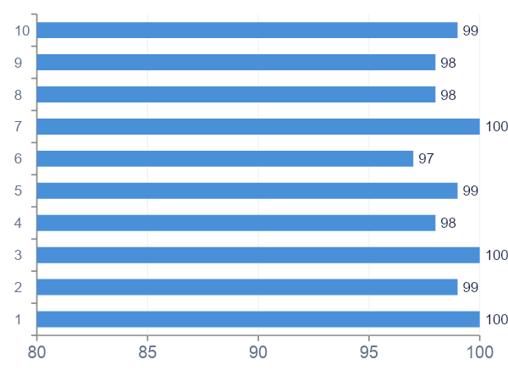
Branch Coverage Results
96%
branch coverage
on testable modules
Achieved via targeted whitebox tests for uncovered branches (coverage.py)

Slide 10
Mutation Testing Results
Tool: mutmut v2.5.1 · 1,685 total mutants generated across 10 modules
Module | Mutants | Killed | Score | Notes
vector2.py | 95 | 86 | 91% | 9 equivalent
vector3.py | 130 | 119 | 92% | 11 equivalent
quaternion.py | 390 | 300 | 77% | Equivalent @staticmethod
transform.py | 82 | 72 | 88% | 10 equivalent
game_object.py | 49 | 47 | 96% | 2 type annotation
scene.py | 25 | 25 | 100% | 100% killed
logger.py | 73 | 68 | 93% | Color code strings
input_manager.py | 351 | 289 | 82% | Key map strings
sound_generator.py | 289 | 177 | 61% | Numeric constants
sprite.py | 201 | 170 | 85% | Default values
1,353 / 1,685 mutants killed overall (80%) · Many survivors are equivalent mutants

Slide 11
Equivalent Mutants
Mutants that change code but not behavior — impossible to kill with any test
@staticmethod removal
In Python 3, calling a no-arg static method on a class works identically whether decorated or not
Type annotation strings
Python does not enforce type annotations at runtime — changing the string has zero observable effect
acos() clamp bound changes
dot/mag naturally stays in [-1, 1] for unit vectors, so the clamp never activates

Slide 12
Faults Discovered in the SUT
BUG 1: mouse_buttons_just_released always empty
In InputManager.update(), previous_mouse_buttons is overwritten with the current state BEFORE the diff is calculated. The "just released" set is computed as previous - current, but since previous was just set to current, the diff is always empty.
Impact: Any game logic relying on mouse button release detection will never trigger.
BUG 2: gamepad buttons_just_pressed always empty
Same root cause as Bug 1. In _update_gamepad_state(), previous_buttons is overwritten with current state before computing buttons_just_pressed = current - previous. Since they are now identical, the result is always an empty set.
Impact: Gamepad "just pressed" events never fire — breaks single-press actions like jump or shoot.
Notes:
Bugs 1 and 2 are detected through whitebox tests

Slide 13
Faults Discovered in the SUT
BUG 3: Frame Timing Bug
In SpriteAnimation's update() method, when delta_time exceeds frame_duration, the timer is reset to 0 instead of carrying over the excess time to the next frame.
Impact: Excess time is discarded, causing animation frames to be skipped when a frame takes longer than expected (e.g., during system slowdowns).
BUG 4: Triangle Point Containment Bug
In Sprite's contains_point() method, the code only handles two shape types: circle and then uses an else clause for everything else. This means triangle shapes are checked using rectangle collision logic instead of triangle logic.
Impact: Triangle-shaped sprites incorrectly report hit detection as if they were rectangles.

Slide 14
Live Demo
Running tests against the SUT
$ python -m pytest tests/ -v
$ coverage run --branch --omit="tests/*,..." -m pytest tests/ -q
$ coverage report
$ coverage html && open htmlcov/index.html
Notes:
coverage run --branch --omit="tests/*" -m pytest tests/ -v
coverage html
start htmlcov/index.html

Slide 15
Conclusion
1354
96%
4
10
Total Tests
Branch Coverage
Real Bugs Found
Modules Tested
Lessons Learned
Blackbox tests catch functional issues; whitebox finds hidden branches
Mutation testing reveals test quality gaps that coverage alone misses
Equivalent mutants are a real challenge — require manual analysis
Real bugs found in a published open-source project through systematic testing
Combinatorial testing uncovers parameter interaction bugs that coverage metrics miss.

Slide 16
Questions?
Thank you!

