Slide 1
MARKET OPPORTUNITY PLATFORM
MOP
From Clinic Discovery to a
Market Opportunity Platform
Regional insights across business sectors, online and offline
DISCOVERY JOURNEY | CURRENT DEMO | FUTURE PLATFORM
Notes:
We started with a focused clinic decision and used it to discover a broader regional opportunity workflow.
[Sources]
- /Users/nnair/Documents/Market Opportunity Platform/presentations/Market_Opportunity_Platform_Leadership_Script.md
- /Users/nnair/Documents/Market Opportunity Platform/docs/strategy/opportunity-inbox-implementation-plan.md
[/Sources]

Slide 2
WHERE WE STARTED
We started with two high-value problem spaces
CLINIC EXPANSION
USER CONTEXT
WHY THESE
Location evaluation
User Profile Studio
Governed decisions
Teams combine market, site, and feasibility signals to compare opportunities and prepare human decisions.
Useful customer and pet context exists, but it is not always translated into the next helpful action across experiences.
Both offered a clear role for AI: organize validated evidence and explain tradeoffs without taking ownership from people.
Clinic expansion became the first wedge because it offered a focused, high-value decision we could prototype.
Sources: Top 5 Ideas; Contacts & Conversations; Matt check-in
02
Notes:
We began with two high-value problem spaces. Clinic expansion became the first wedge because it gave us a focused regional decision with clear constraints and human ownership.
[Sources]
- /Users/nnair/Documents/Market Opportunity Platform/presentations/Market_Opportunity_Platform_Leadership_Script.md
- /Users/nnair/Documents/Market Opportunity Platform/docs/strategy/opportunity-inbox-implementation-plan.md
[/Sources]

Slide 3
DISCOVERY JOURNEY
Conversations moved us from broad ideas to a sharper clinic opportunity
WHO WE HEARD FROM
WHAT WE LEARNED
Cathy Harley • CVC / hybrid care
Customer and pet context is not always connected to action
Mike Cammarota • CVC operations
Clinic work crosses systems, owners, and handoffs
synthesis
Krista Bardelli • CVC CRM
Esri and Excel already cover major parts of analysis
Lana Lee • search + personalization
Market, property, and sequence are different decisions
Matt Merrill + Cale Harrington • expansion
The gap is a shared, reviewable decision trace
Sources: Contacts & Conversations; Cale notes; Matt check-in
03
Notes:
Our discovery conversations narrowed broad ideas into a sharper clinic opportunity and revealed that market, property, and execution decisions need different evidence and owners.
[Sources]
- /Users/nnair/Documents/Market Opportunity Platform/presentations/Market_Opportunity_Platform_Leadership_Script.md
- /Users/nnair/Documents/Market Opportunity Platform/docs/strategy/opportunity-inbox-implementation-plan.md
[/Sources]

Slide 4
WHAT WE LEARNED
Attractiveness, feasibility, and execution priority are different decisions
GEOGRAPHY
PROPERTY
PORTFOLIO
Attractiveness
Feasibility
Execution priority
Is this market or submarket appealing enough to justify deeper diligence?
Can this available property pass mandatory physical, legal, operational, and financial constraints?
Given availability, staffing, economics, timing, and dependencies, what should be reviewed first?
Sources: transition brief; MVP scope; open questions
04
Notes:
The most important learning was that attractiveness, property feasibility, and execution priority are separate decisions. A single hidden score should not combine them.
[Sources]
- /Users/nnair/Documents/Market Opportunity Platform/presentations/Market_Opportunity_Platform_Leadership_Script.md
- /Users/nnair/Documents/Market Opportunity Platform/docs/strategy/opportunity-inbox-implementation-plan.md
[/Sources]

Slide 5
OUR CURRENT PROJECT
The current demo is governed decision support, not a production locator
PUBLIC FOUNDATION
SYNTHETIC MARKETS
REPORTED SITE EVIDENCE
HUMAN-GATED TOOLS
Census + ACS
Map + compare
Briefs + compare
Agent + sandbox
Versioned CBSA universe, boundaries, and public context. Explicitly non-scored.
Synthetic attractiveness map and rank; compare 2 to 5 same-cohort markets with sensitivity.
Minimized Esri demo evidence, provenance, missingness, and raw comparison. Not scored.
The agent pauses on ambiguity; the sandbox tests constraints and weights. No recommendation.
Demonstrable now: traceable workflows and boundaries. Production inputs and ownership remain unresolved.
Sources: current implementation; MVP scope; user workflows
05
Notes:
The current project is governed clinic decision support. It makes evidence, calculations, missing information, and human review visible. It is not a production locator or autonomous recommendation engine.
[Sources]
- /Users/nnair/Documents/Market Opportunity Platform/presentations/Market_Opportunity_Platform_Leadership_Script.md
- /Users/nnair/Documents/Market Opportunity Platform/docs/strategy/opportunity-inbox-implementation-plan.md
[/Sources]

Slide 6
CURRENT DEMO CAPABILITIES
What the prototype can demonstrate today
MARKETS
MARKET REVIEW
LOCATIONS
CONTROL
Map and context
Synthetic market compare
Bounded Ask AI
Explore public CBSA boundaries, ACS context, workflow states, and selection.
Compare 2 to 5 same-cohort results with rank, gaps, warnings, and sensitivity.
Explain supplied structured results without changing scores or choosing a market.
Candidate briefs
Raw location compare
Sandbox + Seattle
Prepare source-linked drafts and show missing or conflicting demo evidence.
Compare 2 to 5 audited candidates field by field, with no composite or winner.
Test synthetic weights and constraints; run one human-confirmed synthetic deep dive.
Sources: current implementation and automated tests
06
Notes:
The prototype can demonstrate market context, comparisons, candidate briefs, bounded AI explanations, and controlled sandbox behavior with public, reported, or synthetic inputs.
[Sources]
- /Users/nnair/Documents/Market Opportunity Platform/presentations/Market_Opportunity_Platform_Leadership_Script.md
- /Users/nnair/Documents/Market Opportunity Platform/docs/strategy/opportunity-inbox-implementation-plan.md
[/Sources]

Slide 7
LIVE DEMO
A seven-minute demo shows what the prototype can do today
01
Markets workspace
Select a market; show public context, synthetic score, and workflow-state separation
02
Market comparison
Add two same-cohort markets; inspect subscores, missingness, sensitivity, and Ask AI
03
Seattle deep dive
Confirm synthetic segmentation before comparison; show tool activity and evidence receipts
04
Candidate briefs
Prepare a bounded brief, then compare audited locations without a winner or recommendation
05
Sandbox + boundary
Adjust synthetic weights and constraints; name what is non-scored, process-local, or unresolved
Sources: current local prototype; user workflows; automated tests
07
Notes:
In the demo, show the current clinic workflow from market context through comparison, evidence review, and bounded decision preparation.
[Sources]
- /Users/nnair/Documents/Market Opportunity Platform/presentations/Market_Opportunity_Platform_Leadership_Script.md
- /Users/nnair/Documents/Market Opportunity Platform/docs/strategy/opportunity-inbox-implementation-plan.md
[/Sources]

Slide 8
FUTURE DIRECTION
One platform turns regional signals into sector-specific action plans
Market Opportunity Platform
IT WOULD HELP TEAMS
qualifies regional changes through business-owned playbooks, then prepares the owner, action, deadline, outcome, guardrails, and stop conditions.
Detect meaningful changes
Qualify opportunities
Prepare owned actions
Measure and improve
Clinic location evaluation is where we learned the pattern. The future platform applies it across sectors.
Sources: user direction; market opportunity transition brief
08
Notes:
The future direction is bigger than connecting data. The platform should turn a qualified regional signal into a sector-specific action plan with an owner, deadline, outcome, guardrails, and stop conditions.
[Sources]
- /Users/nnair/Documents/Market Opportunity Platform/presentations/Market_Opportunity_Platform_Leadership_Script.md
- /Users/nnair/Documents/Market Opportunity Platform/docs/strategy/opportunity-inbox-implementation-plan.md
[/Sources]

Slide 9
FUTURE OPERATING MODEL
Qualified opportunities end in accountable action plans
01
02
03
04
Detect change
Qualify opportunity
Prepare action
Measure + learn
Observe a regional shift in demand, capacity, coverage, or the local ecosystem
Test the baseline, supporting evidence, contradictions, readiness, and expiration
Name the owner, deadline, ordered steps, guardrails, and stop conditions
Record the outcome, decision trail, and playbook changes for the next response
One operating model can support Growth, Pet Health, Market Ecosystem, and future sectors.
Sources: user direction; market opportunity transition brief
09
Notes:
The future operating model is detect, qualify, prepare the action, then measure and learn. Evidence remains traceable underneath, but the user experience leads with what should happen next.
[Sources]
- /Users/nnair/Documents/Market Opportunity Platform/presentations/Market_Opportunity_Platform_Leadership_Script.md
- /Users/nnair/Documents/Market Opportunity Platform/docs/strategy/opportunity-inbox-implementation-plan.md
[/Sources]

Slide 10
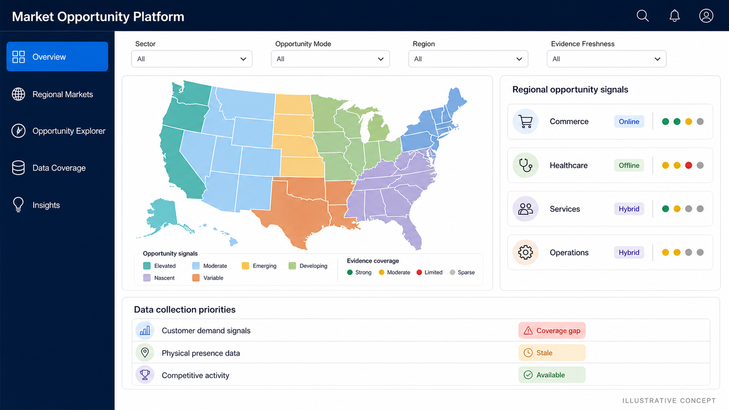
FUTURE HOME PAGE
The future home page makes regional opportunities ready for action
Illustrative future-state concept. Example sectors and signals only.
10
Notes:
This illustrative home page shows the future destination: one regional workspace where teams can identify opportunity signals and move them into the right sector playbook.
[Sources]
- /Users/nnair/Documents/Market Opportunity Platform/presentations/Market_Opportunity_Platform_Leadership_Script.md
- /Users/nnair/Documents/Market Opportunity Platform/docs/strategy/opportunity-inbox-implementation-plan.md
- /Users/nnair/Documents/Market Opportunity Platform/assets/market-opportunity-platform-home-concept-v2.png
[/Sources]

Slide 11
WHAT WE NEED TO VALIDATE
Five decisions define a measurable platform pilot
1
2
3
4
5
Pilot
question
Market
definition
Channel
model
Data
contracts
Business
outcome
One sector, one regional decision, and one accountable user
Approved regions, hierarchy, and comparison universe
Clear meanings for online, offline, and hybrid signals
Sources, permissions, freshness, gaps, and collection plan
Baseline, target, measurement window, guardrails, and stop conditions
Start with one action-ready opportunity, then improve and extend the playbook by sector.
Sources: user direction; market opportunity transition brief
11
Notes:
A credible pilot needs one owner, one regional question, an approved market definition, governed inputs, and a measurable business outcome with guardrails and stop rules.
[Sources]
- /Users/nnair/Documents/Market Opportunity Platform/presentations/Market_Opportunity_Platform_Leadership_Script.md
- /Users/nnair/Documents/Market Opportunity Platform/docs/strategy/opportunity-inbox-implementation-plan.md
[/Sources]

Slide 12
THE ASK
MOP
Choose one regional question. Prove the action workflow. Expand by sector.
Next step: select one accountable owner and one real regional decision. Test whether the platform shortens time to action, produces a measurable result, and avoids work when guardrails fail.
Notes:
The ask is to choose one real regional question and prove whether the platform improves the quality and speed of an accountable action before expanding by sector.
[Sources]
- /Users/nnair/Documents/Market Opportunity Platform/presentations/Market_Opportunity_Platform_Leadership_Script.md
- /Users/nnair/Documents/Market Opportunity Platform/docs/strategy/opportunity-inbox-implementation-plan.md
[/Sources]

