Slide 1
CHEWY VET CARE
CVC
CVC Clinic Market
and Location Discovery
From a governed clinic evaluator to a scalable market opportunity vision
MONDAY PRESENTATION | CURRENT DEMO + FUTURE DIRECTION
Notes:
Timing: 0:30
Open with the journey: we began with candidate-site diligence, learned the larger gap is between decision stages, and are proposing a broader future direction.
[Sources]
- PROJECT_CONTEXT.md
- docs/strategy/market-opportunity-platform-transition-brief.md
[/Sources]

Slide 2
WHERE WE STARTED
We started with a candidate property evaluator
EVIDENCE FIRST
DETERMINISTIC
HUMAN REVIEW
Assemble evidence
Compare candidates
Explain the result
Gather candidate inputs, provenance, missingness, and warnings in one reviewable place.
Apply explicit constraints, weights, contributions, and sensitivity to a small candidate set.
Draft source-linked briefs and questions while keeping the final decision with people.
Useful once candidates exist, but it does not tell us where to search next.
Sources: project context; MVP scope; discovery notes
02
Notes:
Timing: 1:15
Explain that the first concept was useful and deliberately bounded: assemble evidence, calculate transparently, and prepare a brief for human review after candidate properties were already known.
[Sources]
- PROJECT_CONTEXT.md
- docs/product/mvp-scope.md
- docs/technical/ai-boundaries.md
[/Sources]

Slide 3
DISCOVERY JOURNEY
Discovery expanded the problem from scoring sites to connecting decisions
WHERE WE STARTED
WHAT DISCOVERY SHOWED
Candidate addresses already chosen
Esri already handles spatial analysis
One property score
Excel already supports adjustable models
discovery
Local evidence assembly
Evidence fragments across handoffs
Single-reviewer workflow
Market, property, and sequence differ
Site-level recommendation risk
The gap is a shared decision trace
Sources: Cale discovery; MVP scope; user workflows
03
Notes:
Timing: 1:30
Describe the discovery shift. Existing tools already do important pieces. The recurring gap is the evidence and rationale lost between market selection, spatial analysis, broker search, Finance review, and opening sequence. Do not imply confirmed ownership beyond the documented discovery.
[Sources]
- docs/product/user-workflows.md
- docs/strategy/market-opportunity-platform-transition-brief.md
[/Sources]

Slide 4
WHAT WE LEARNED
Attractiveness, feasibility, and execution priority are different decisions
GEOGRAPHY
PROPERTY
PORTFOLIO
Attractiveness
Feasibility
Execution priority
Is this market or submarket appealing enough to justify deeper diligence?
Can this available property pass mandatory physical, legal, operational, and financial constraints?
Given availability, staffing, economics, timing, and dependencies, what should be reviewed first?
Sources: transition brief; MVP scope; open questions
04
Notes:
Timing: 1:00
This is the core product insight. A geography can be attractive while a specific property is infeasible. A feasible property may still be a poor near-term execution choice. One composite score would hide those tradeoffs.
[Sources]
- docs/strategy/market-opportunity-platform-transition-brief.md
- docs/product/open-questions.md
[/Sources]

Slide 5
OUR CURRENT PROJECT
The current demo is governed decision support, not a production locator
PUBLIC FOUNDATION
SYNTHETIC MARKETS
REPORTED SITE EVIDENCE
HUMAN-GATED TOOLS
Census + ACS
Map + compare
Briefs + compare
Agent + sandbox
Versioned CBSA universe, boundaries, and public context. Explicitly non-scored.
Synthetic attractiveness map and rank; compare 2 to 5 same-cohort markets with sensitivity.
Minimized Esri demo evidence, provenance, missingness, and raw comparison. Not scored.
The agent pauses on ambiguity; the sandbox tests constraints and weights. No recommendation.
Demonstrable now: traceable workflows and boundaries. Production inputs and ownership remain unresolved.
Sources: current implementation; MVP scope; user workflows
05
Notes:
Timing: 1:30
State exactly what is real in the current demo and what is not. Public Census context is non-scored. Market scoring is synthetic. Esri evidence is descriptive and ineligible for scoring. The agent and sandbox are human-gated prototype tools. This is not a legitimate national locator.
[Sources]
- docs/product/mvp-scope.md
- docs/product/user-workflows.md
- docs/technical/data-contracts.md
- docs/technical/ai-boundaries.md
[/Sources]

Slide 6
CURRENT DEMO CAPABILITIES
What the prototype can demonstrate today
MARKETS
MARKET REVIEW
LOCATIONS
CONTROL
Map and context
Synthetic market compare
Bounded Ask AI
Explore public CBSA boundaries, ACS context, workflow states, and selection.
Compare 2 to 5 same-cohort results with rank, gaps, warnings, and sensitivity.
Explain supplied structured results without changing scores or choosing a market.
Candidate briefs
Raw location compare
Sandbox + Seattle
Prepare source-linked drafts and show missing or conflicting demo evidence.
Compare 2 to 5 audited candidates field by field, with no composite or winner.
Test synthetic weights and constraints; run one human-confirmed synthetic deep dive.
Sources: current implementation and automated tests
06
Notes:
Timing: 1:30
These are the visible current capabilities. Clarify that the comparison supports two to five same-cohort markets or audited locations. Ask AI explains structured results only. The Seattle deep dive is synthetic and requires analyst confirmation before comparison.
[Sources]
- app/page.tsx
- components/market-attractiveness/MarketAttractivenessRanking.tsx
- components/location-workspace/CandidateBriefsWorkspace.tsx
- components/agent-workspace/CandidateReviewAgent.tsx
- components/market-deep-dive/SeattleMarketDeepDive.tsx
- components/scoring-sandbox/ScoringSandbox.tsx
[/Sources]

Slide 7
LIVE DEMO
A seven-minute demo shows what the prototype can do today
01
Markets workspace
Select a market; show public context, synthetic score, and workflow-state separation
02
Market comparison
Add two same-cohort markets; inspect subscores, missingness, sensitivity, and Ask AI
03
Seattle deep dive
Confirm synthetic segmentation before comparison; show tool activity and evidence receipts
04
Candidate briefs
Prepare a bounded brief, then compare audited locations without a winner or recommendation
05
Sandbox + boundary
Adjust synthetic weights and constraints; name what is non-scored, process-local, or unresolved
Sources: current local prototype; user workflows; automated tests
07
Notes:
Timing: 7:00 including live demo
Suggested clicks: start in Markets, select a scored metropolitan market, add two same-cohort markets, open comparison and Ask AI, open Seattle and confirm the illustrative segmentation, switch to Locations for Candidate briefs and raw comparison, then open the scoring sandbox. If time is tight, skip the full agent run and show its visible pause and evidence receipts.
Boundary line to say out loud: everything scored here is synthetic and unapproved; public context and Esri demo evidence are not scoring inputs; no lease, opening, or market-entry recommendation is produced.
[Sources]
- docs/product/user-workflows.md
- docs/product/mvp-scope.md
- tests/market-comparison-rendered.test.mjs
- tests/agent-workspace-rendered.test.mjs
- tests/seattle-market-deep-dive-rendered.test.mjs
[/Sources]

Slide 8
FUTURE DIRECTION
Thinking bigger: a Market Opportunity Platform
Market Opportunity Platform
IT WOULD HELP TEAMS
would automate nationwide screening, focus deeper analysis on promising submarkets, connect viable properties, and prepare a human-reviewed execution queue.
Scan nationally
Drill down selectively
Compare feasibility
Sequence transparently
The clinic prototype becomes the reference vertical, not the limit of the platform.
Sources: market opportunity transition brief
08
Notes:
Timing: 1:15
Transition clearly from current to future. This slide is a product direction, not a current capability claim. The clinic workflow supplies reusable patterns, but the broader platform would need a new validated opportunity definition and owner.
[Sources]
- docs/strategy/market-opportunity-platform-transition-brief.md
[/Sources]

Slide 9
FUTURE OPERATING MODEL
The future platform scales through a four-level funnel
01
02
03
04
Market
Submarket
Property
Sequence
Which metros deserve attention?
Tier + rank
Where is opportunity concentrated?
Ranked heat-map areas
Which available properties are feasible? Advance, review, or blocked
What should Chewy pursue first? Human-reviewed queue + rationale
Each stage narrows the search while preserving a separate decision and rationale.
Sources: market opportunity transition brief; open questions
09
Notes:
Timing: 1:15
Walk left to right. Scheduled screening narrows the approved market universe. Only promising markets earn submarket analysis. Available properties are screened separately. Viable opportunities enter a human-reviewed sequence based on confirmed constraints.
[Sources]
- docs/strategy/market-opportunity-platform-transition-brief.md
- docs/product/open-questions.md
[/Sources]

Slide 10
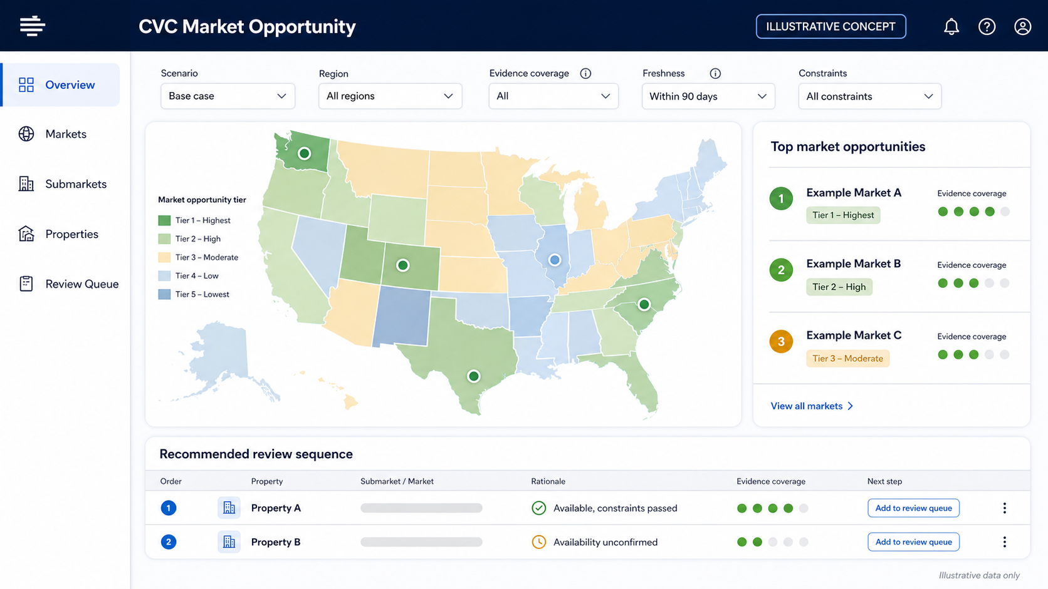
FUTURE HOME PAGE
One workspace could connect national scan, diligence, and review sequence
Illustrative future-state concept. No real rankings or properties shown.
10
Notes:
Timing: 0:45
This is an illustrative future-state concept generated for discussion. It uses generic markets and properties, contains no real rankings, and is not a screenshot of the current product. Point out the separation between the opportunity map and the review sequence.
[Sources]
- Generated concept asset: presentations/assets/cvc-market-opportunity-home-concept.png
- docs/strategy/market-opportunity-platform-transition-brief.md
[/Sources]

Slide 11
WHAT WE NEED TO VALIDATE
Four product decisions unlock a bounded pilot
1
2
3
4
5
Market model
Submarket definition
Property gate
Queue logic
Pilot scope
Approved attractiveness criteria, directions, and weights
Units, grouping rules, drive-time, and overlap method
Mandatory constraints and approved availability source
Rules separating attractiveness, feasibility, and priority
One accountable user, one decision, approved inputs, and measurable workflow baseline
Validate the workflow before claiming rankings, savings, or production readiness.
Sources: open questions; market opportunity transition brief
11
Notes:
Timing: 1:15
Ask for decisions rather than broad approval. We need approved market criteria, a submarket definition, mandatory property constraints and availability source, and explicit queue logic. The pilot also needs one accountable user and measurable baseline.
[Sources]
- docs/product/open-questions.md
- docs/strategy/market-opportunity-platform-transition-brief.md
[/Sources]

Slide 12
THE ASK
CVC
Choose one decision. Pilot the workflow. Validate the value.
Next step: name one accountable user, confirm the four decision rules, and run one bounded portfolio decision with approved inputs and a measurable baseline.
Notes:
Timing: 0:45
Close with a bounded ask: choose one real decision, one accountable user, approved inputs, and success measures. The next milestone is workflow validation, not national deployment.
[Sources]
- docs/product/open-questions.md
- docs/evaluation/success-metrics.md
[/Sources]

