Slide 1
CHEWY VET CARE
C
Clinic Location
Evaluator
Transparent evidence for better expert decisions
Synthetic, evidence-backed prototype
Notes:
Open with the core idea in one sentence: this tool helps experts compare possible clinic locations with visible evidence, calculations, and uncertainty. It does not choose the location for them.
[Sources]
PROJECT_CONTEXT.md
docs/product/mvp-scope.md

Slide 2
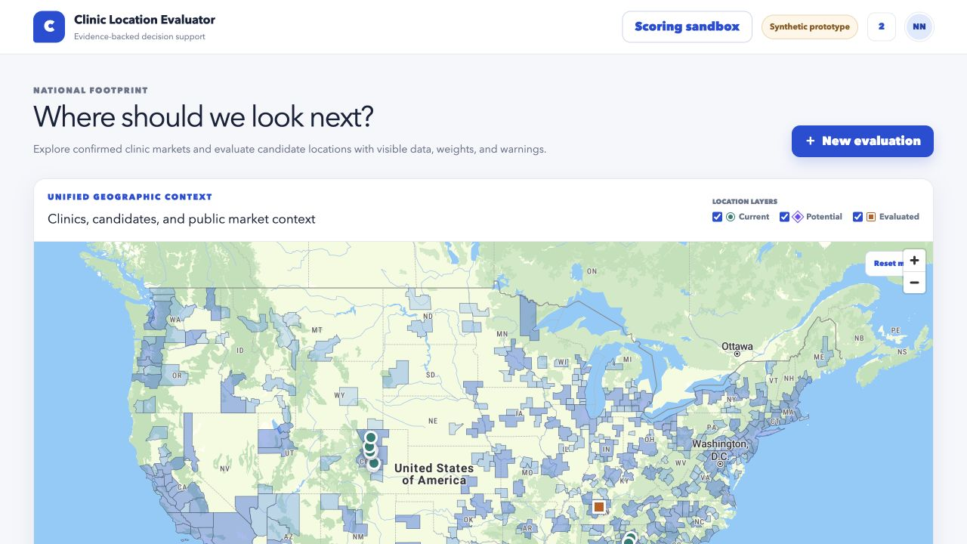
THE IDEA
One workflow replaces fragmented evidence
Bring the inputs together
Customer demand, competition, access, market context, staffing, and property evidence
Visible source, date, quality, and missingness for every input
Deterministic comparisons with expert review at the center
The product prepares the case. The business makes the decision.
Sources: CLM-015, CLM-017, CLM-020
02
Notes:
Explain that the wedge is intentionally narrow: assemble evidence, calculate consistently, compare candidates, and create a reviewable brief. It is not the entire clinic opening process and it is not autonomous site selection.
[Sources]
PROJECT_CONTEXT.md
docs/product/mvp-scope.md
docs/research/claim-ledger.md: CLM-015, CLM-017, CLM-020
Local prototype screenshot captured 2026-07-30

Slide 3
WHY THIS MATTERS
The decision is high context, but the evidence is easy to fragment
01
02
03
Many evidence types
Different confidence levels
Human judgment remains
Demand, competitors, drive time, foot traffic, demographics, staffing, real estate, and local research.
Some inputs are confirmed. Others are reported, derived, hypothetical, missing, or inaccessible.
Final decisions still need expert interpretation, diligence, and sometimes a physical visit.
Sources: SRC-001, SRC-002, SRC-003, SRC-007
03
Notes:
The problem is not a lack of judgment. It is that the evidence supporting judgment can live across tools, formats, owners, and confidence levels. The evaluator creates a consistent review surface without pretending that every input is equally reliable.
[Sources]
docs/research/selection-criteria.md
docs/research/claim-ledger.md: CLM-006 through CLM-018
docs/research/source-registry.md: SRC-001, SRC-002, SRC-003, SRC-007

Slide 4
END-TO-END WORKFLOW
The workflow moves from address to evidence to human decision
01
02
03
04
05
06
07
Confirm
Assemble
Validate
Screen
Compare
Explain
Decide
Address and geography
Approved evidence
Coverage and quality
Hard constraints
Weighted preferences
Risks and missing data
Human rationale
A failed constraint or missing input stays visible. A high score never becomes automatic approval.
Sources: CLM-017, CLM-020, CLM-024
04
Notes:
Walk left to right. The key control is the separation between screening, preference scoring, explanation, and the final human decision. Nothing is silently promoted from an address match into an evaluated site.
[Sources]
docs/product/user-workflows.md
docs/technical/data-contracts.md
docs/research/claim-ledger.md: CLM-017, CLM-020, CLM-024

Slide 5
PROTOTYPE TODAY
The prototype already makes geographic context and evidence boundaries visible
Sources: SRC-009, SRC-014, SRC-015, SRC-016
05
Notes:
Use the screenshot as proof of workflow, not proof of production readiness. Point out the separate current, potential, and evaluated layers, the synthetic label, and the evidence boundary on the map.
[Sources]
docs/technical/architecture.md
docs/product/user-workflows.md
docs/research/source-registry.md: SRC-009, SRC-014, SRC-015, SRC-016
Local prototype screenshot captured 2026-07-30

Slide 6
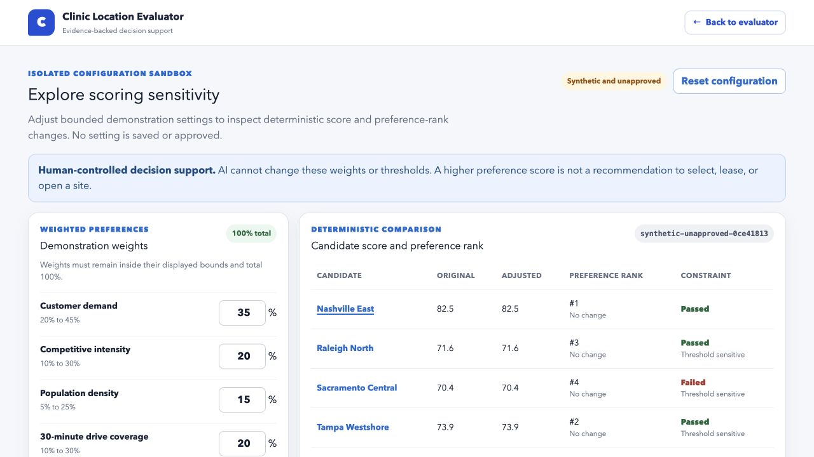
PROTOTYPE TODAY
Sensitivity stays visible without changing the baseline
What the sandbox demonstrates
Weights stay within bounded ranges and total 100%
Hard constraints remain separate from preference scores
Original and adjusted results stay visible
Every scenario carries a configuration fingerprint
Synthetic and unapproved
Sources: MVP scope, NFR-001, NFR-007
06
Notes:
Be explicit that the numbers are synthetic. The value of the prototype is the behavior: deterministic calculations, visible changes, bounded sensitivity, and a hard constraint that never contributes points.
[Sources]
docs/product/mvp-scope.md
docs/product/requirements.md: FR-004 through FR-007, NFR-001, NFR-007
docs/evaluation/evaluation-plan.md
Local prototype screenshot captured 2026-07-30

Slide 7
DATA FOUNDATION
A common contract lets approved sources plug in without hiding their limits
Canonical evidence record
PUBLIC CONTEXT
Census address matching, CBSA boundaries, and ACS context
Every observation carries a value or null, unit, source ID, date, geography, quality status, sensitivity, and allowed use.
APPROVED AGGREGATES
Manual clinic-level exports with definitions and owner approval
GOVERNED ADAPTERS
Possible Esri, Snowflake, Tableau, and Site Pipeline integrations
Missing is not zero.
EVIDENCE OUTPUT
Validated observations, rejected records, warnings, and lineage
Sources: SRC-002, SRC-010, SRC-011, SRC-013–016
07
Notes:
The contract is the integration strategy. Each adapter can change, but the output stays inspectable. Public Census layers are useful context today and explicitly have no scoring eligibility. Production sources require access, definitions, and approval.
[Sources]
docs/technical/data-contracts.md
docs/technical/integration-options.md
docs/research/source-registry.md: SRC-002, SRC-010, SRC-011, SRC-013 through SRC-016

Slide 8
DECISION LOGIC
Eligibility and preference are different questions
Hard constraints
Weighted preferences
Can this candidate proceed?
How do eligible candidates compare?
Pass, fail, or unresolved
Approved normalization and weights
Never contributes weighted points
Visible raw values and contributions
Cannot be overridden by a strong preference score
Versioned, reproducible, and sensitivity tested
Human decision and rationale are recorded separately from both.
Sources: FR-003–008, NFR-001, NFR-006
08
Notes:
This separation is one of the most important design decisions. It prevents an attractive score from hiding a failed requirement. It also makes policy decisions, such as thresholds and weights, reviewable instead of embedding them in a model.
[Sources]
docs/product/requirements.md: FR-003 through FR-008, FR-010
docs/technical/data-contracts.md
docs/evaluation/evaluation-plan.md

Slide 9
AI ROLE
AI explains the evidence. It does not control the decision.
AI may
AI may not
Humans retain
Summarize structured results
Explain score differences
Identify missing or conflicting evidence
Draft diligence questions
Create a source-linked brief
Invent or impute data
Perform hidden calculations
Choose or change weights
Score qualitative comments
Recommend a lease or clinic opening
Criteria approval
Data access approval
Interpretation and diligence
Physical inspection
Final decision and rationale
Sources: AI boundaries, NFR-004
09
Notes:
Position AI as a constrained explanation layer after the deterministic core. Every number must match the structured result, every factual claim needs a source ID, and the draft remains subject to human review.
[Sources]
docs/technical/ai-boundaries.md
docs/product/requirements.md: FR-009, FR-014, NFR-004
docs/evaluation/evaluation-plan.md: Stage 3

Slide 10
WORKFLOW IMPROVEMENT
The first value is a better review process, not a promised business outcome
Current risk
Improved workflow
Evidence gathered in different places
One source-linked candidate record
Definitions and freshness can be unclear
Validation before scoring or review
Missing inputs appear late in review
Visible contributions, warnings, and constraints
Score differences are hard to explain consistently
Reusable brief and audit trail for handoff
Measure the change before claiming the impact.
Sources: OQ-014, Success metrics
10
Notes:
Keep the impact claim disciplined. The prototype can plausibly standardize evidence collection, find missing data earlier, reduce explanation rework, and create a clearer handoff. Time savings, better site choices, fewer visits, or improved clinic performance must be measured in a pilot.
[Sources]
docs/evaluation/success-metrics.md
docs/product/open-questions.md: OQ-014
PROJECT_CONTEXT.md

Slide 11
IMPACT MEASUREMENT
A pilot should prove workflow value before outcome value
PREPARATION
EVIDENCE
REVIEW
Time
Coverage
Rework
Baseline and compare the time required to assemble a candidate comparison.
Track valid provenance, rejected inputs, and missing-data issues found before review.
Measure reviewer understanding, factual corrections, and follow-up needed.
Later: test decision quality or clinic outcomes only after an approved outcome, cohort, and maturity window exist.
Sources: Evaluation plan, Success metrics
11
Notes:
Propose a before-and-after or side-by-side workflow pilot. Start with preparation time, evidence quality, and review rework. Future predictive claims need an approved outcome, comparable cohort, time-correct features, and validation outside the training sample.
[Sources]
docs/evaluation/success-metrics.md
docs/evaluation/evaluation-plan.md
docs/product/open-questions.md: OQ-004, OQ-013, OQ-014

Slide 12
VALIDATION GATES
Six questions determine whether the idea should move forward
These are not cleanup items. Each can materially change or stop the MVP.
1
Ownership
Is the existing Vet Clinic Site Selection plan active, staffed, or implemented?
2
Fit
Should this become its review interface, extend it, or stop to avoid duplication?
3
User
Who is the first analyst or reviewer, and what exact decision do they make?
4
Outcome
Which clinic outcome, maturity window, and eligibility rule are approved?
5
Data
Which aggregate features and outcomes are available and governed for use?
6
Policy
Which criteria, thresholds, weights, exclusions, and hard constraints are approved?
Sources: OQ-001–007
12
Notes:
Frame these as healthy gates, not weaknesses. Resolving them prevents duplicate work, avoids false precision, and ensures the prototype supports a real decision with approved data and policy.
[Sources]
docs/product/open-questions.md: OQ-001 through OQ-007
PROJECT_CONTEXT.md
docs/research/claim-ledger.md: CLM-001 through CLM-003, CLM-021 through CLM-023

Slide 13
PATH FORWARD
The next step is a bounded workflow pilot with clear stop conditions
01
02
03
Align
Validate
Pilot
Confirm ownership, first user, decision point, and overlap with the existing plan.
Approve a small data template, criteria version, constraints, and measurement baseline.
Compare three to five candidates, observe review behavior, and measure time, coverage, and rework.
Stop if the workflow duplicates owned work, lacks approved data, or cannot support a named decision.
Sources: MVP exit criteria, Evaluation stages 1–4
13
Notes:
This is the recommended ask: permission to validate the workflow with the relevant owner and one real analyst, not permission to deploy production scoring. The pilot remains synthetic or uses approved aggregates until governance clears a source path.
[Sources]
docs/product/mvp-scope.md: Exit criteria and Invalidation
docs/evaluation/evaluation-plan.md: Stages 1 through 4
docs/technical/integration-options.md

Slide 14
DECISION
What I need from the room
1
Confirm the right owner and how this should relate to the existing site-selection plan.
2
Name one analyst, one decision point, and a small approved candidate set for workflow validation.
3
Agree on the baseline measures that would prove the workflow is useful or show that it should stop.
No production integration or scoring approval is requested today.
Sources: Open questions and approval gates
14
Notes:
Make the ask concrete and low risk. You are asking for alignment, access to a real workflow, and agreement on what to measure. You are not asking the group to approve production scoring, predictive modeling, or a lease decision.
[Sources]
docs/product/open-questions.md
docs/product/mvp-scope.md
AGENTS.md: repository review and approval rules

Slide 15
Q&A APPENDIX
Likely questions: value, ownership, and scope
01
How is this different from the existing Vet Clinic Site Selection plan?
04
What business impact can you defend today?
02
What problem does this solve that Esri or current dashboards do not?
05
Why use AI at all?
03
Who is the user, and at what point in the workflow would they use it?
06
What would make you stop or change direction?
Sources: SRC-001, OQ-001–004, OQ-014
15
Notes:
Suggested answers: This complements or interfaces with the existing plan by making its inputs and outputs reviewable, subject to owner confirmation. It is a workflow and evidence layer, not a replacement for Esri. The defensible current impact is standardization, earlier missing-data visibility, and clearer review. AI is optional and limited to structured explanation. Stop if ownership overlaps, approved data is unavailable, or the workflow does not help a named decision.
[Sources]
PROJECT_CONTEXT.md
docs/product/open-questions.md: OQ-001 through OQ-004, OQ-014
docs/research/source-registry.md: SRC-001

Slide 16
Q&A APPENDIX
Likely questions: data and risk
07
Do we actually have enough historical data to validate a model?
010
How do you prevent missing data from creating a misleading score?
08
Where will the customer, competitor, traffic, staffing, and property data come from?
011
Could AI hallucinate or bias the recommendation?
09
Who sets the weights and hard constraints?
012
How will you know the tool improves decisions rather than just creating another dashboard?
Sources: OQ-005–013, AI boundaries
16
Notes:
Suggested answers: Historical modeling is not yet justified until an approved outcome, maturity window, and roughly 30 to 50 clinic records are actually available. Production inputs require governed adapters or approved aggregates. Business owners approve criteria and thresholds. Null remains missing, rejected records remain visible, and evaluation fails closed when evidence is insufficient. AI never calculates the score or makes the decision. The pilot measures preparation time, evidence quality, review rework, and user usefulness against a baseline.
[Sources]
docs/product/open-questions.md: OQ-005 through OQ-013
docs/technical/data-contracts.md
docs/technical/ai-boundaries.md
docs/evaluation/success-metrics.md

Slide 17
THE TAKEAWAY
Decision support,
not decision replacement.
Align the owner. Validate the workflow. Measure the value.
Questions
Notes:
Close by returning to the core distinction. The evaluator is valuable if it helps experts assemble and inspect evidence more consistently. The next decision is whether to validate that workflow with the right owner and user.
[Sources]
PROJECT_CONTEXT.md
docs/product/mvp-scope.md

