Slide 1
CHEWY VET CARE
CVC
CVC Clinic Market
and Location Discovery
From a governed clinic evaluator to a scalable market opportunity vision
MONDAY PRESENTATION | CURRENT DEMO + FUTURE DIRECTION
Notes:
Timing: 0:30
Open with the journey: we began with candidate-site diligence, learned the larger gap is between decision stages, and are proposing a broader future direction.
[Sources]
- PROJECT_CONTEXT.md
- docs/strategy/market-opportunity-platform-transition-brief.md
[/Sources]

Slide 2
WHERE WE STARTED
We started with two high-value problem spaces
CLINIC EXPANSION
USER CONTEXT
WHY THESE
Location evaluation
User Profile Studio
Governed decisions
Teams combine fragmented market, site, and feasibility evidence to compare opportunities and prepare human decisions.
Useful customer and pet information is collected, but not always connected to the next helpful action across experiences.
Both offered a clear role for AI: organize validated evidence and explain tradeoffs without taking ownership from people.
Clinic expansion became the first wedge because it offered a focused, high-value decision we could prototype.
Sources: Top 5 Ideas; Contacts & Conversations; Matt check-in
02
Notes:
Timing: 1:15
Explain that discovery initially converged on two promising problems. User Profile Studio addressed customer and pet information that is collected but not consistently connected to action. Clinic expansion addressed fragmented market, property, and feasibility evidence. Clinic expansion became the first wedge because it offered a focused decision that could be prototyped with transparent boundaries.
[Sources]
- https://chewyinc.atlassian.net/wiki/spaces/AUS/pages/5325357932/TOP+5+IDEAS
- https://chewyinc.atlassian.net/wiki/spaces/AUS/pages/5330470157/01+Contacts+Conversations
- https://chewyinc.atlassian.net/wiki/spaces/AUS/pages/5352818031/Check-in+With+Matt
[/Sources]

Slide 3
DISCOVERY JOURNEY
Conversations moved us from broad ideas to a sharper clinic opportunity
WHO WE HEARD FROM
WHAT WE LEARNED
Cathy Harley • CVC / hybrid care
Customer and pet context is not always connected to action
Mike Cammarota • CVC operations
Clinic work crosses systems, owners, and handoffs
synthesis
Krista Bardelli • CVC CRM
Esri and Excel already cover major parts of analysis
Lana Lee • search + personalization
Market, property, and sequence are different decisions
Matt Merrill + Cale Harrington • expansion
The gap is a shared, reviewable decision trace
Sources: Contacts & Conversations; Cale notes; Matt check-in
03
Notes:
Timing: 1:30
Name only completed conversations that are documented. Cathy Harley, Mike Cammarota, Krista Bardelli, and Lana Lee informed the broader CVC and user-context problem space. Matt Merrill and Cale Harrington sharpened the clinic expansion opportunity. Their combined input showed that important tools already exist, while evidence and rationale fragment across decision stages.
[Sources]
- https://chewyinc.atlassian.net/wiki/spaces/AUS/pages/5330470157/01+Contacts+Conversations
- https://chewyinc.atlassian.net/wiki/spaces/AUS/pages/5352949587/Cale
- https://chewyinc.atlassian.net/wiki/spaces/AUS/pages/5352818031/Check-in+With+Matt
[/Sources]

Slide 4
WHAT WE LEARNED
Attractiveness, feasibility, and execution priority are different decisions
GEOGRAPHY
PROPERTY
PORTFOLIO
Attractiveness
Feasibility
Execution priority
Is this market or submarket appealing enough to justify deeper diligence?
Can this available property pass mandatory physical, legal, operational, and financial constraints?
Given availability, staffing, economics, timing, and dependencies, what should be reviewed first?
Sources: transition brief; MVP scope; open questions
04
Notes:
Timing: 1:00
This is the core product insight. A geography can be attractive while a specific property is infeasible. A feasible property may still be a poor near-term execution choice. One composite score would hide those tradeoffs.
[Sources]
- docs/strategy/market-opportunity-platform-transition-brief.md
- docs/product/open-questions.md
[/Sources]

Slide 5
OUR CURRENT PROJECT
The current demo is governed decision support, not a production locator
PUBLIC FOUNDATION
SYNTHETIC MARKETS
REPORTED SITE EVIDENCE
HUMAN-GATED TOOLS
Census + ACS
Map + compare
Briefs + compare
Agent + sandbox
Versioned CBSA universe, boundaries, and public context. Explicitly non-scored.
Synthetic attractiveness map and rank; compare 2 to 5 same-cohort markets with sensitivity.
Minimized Esri demo evidence, provenance, missingness, and raw comparison. Not scored.
The agent pauses on ambiguity; the sandbox tests constraints and weights. No recommendation.
Demonstrable now: traceable workflows and boundaries. Production inputs and ownership remain unresolved.
Sources: current implementation; MVP scope; user workflows
05
Notes:
Timing: 1:30
State exactly what is real in the current demo and what is not. Public Census context is non-scored. Market scoring is synthetic. Esri evidence is descriptive and ineligible for scoring. The agent and sandbox are human-gated prototype tools. This is not a legitimate national locator.
[Sources]
- docs/product/mvp-scope.md
- docs/product/user-workflows.md
- docs/technical/data-contracts.md
- docs/technical/ai-boundaries.md
[/Sources]

Slide 6
CURRENT DEMO CAPABILITIES
What the prototype can demonstrate today
MARKETS
MARKET REVIEW
LOCATIONS
CONTROL
Map and context
Synthetic market compare
Bounded Ask AI
Explore public CBSA boundaries, ACS context, workflow states, and selection.
Compare 2 to 5 same-cohort results with rank, gaps, warnings, and sensitivity.
Explain supplied structured results without changing scores or choosing a market.
Candidate briefs
Raw location compare
Sandbox + Seattle
Prepare source-linked drafts and show missing or conflicting demo evidence.
Compare 2 to 5 audited candidates field by field, with no composite or winner.
Test synthetic weights and constraints; run one human-confirmed synthetic deep dive.
Sources: current implementation and automated tests
06
Notes:
Timing: 1:30
These are the visible current capabilities. Clarify that the comparison supports two to five same-cohort markets or audited locations. Ask AI explains structured results only. The Seattle deep dive is synthetic and requires analyst confirmation before comparison.
[Sources]
- app/page.tsx
- components/market-attractiveness/MarketAttractivenessRanking.tsx
- components/location-workspace/CandidateBriefsWorkspace.tsx
- components/agent-workspace/CandidateReviewAgent.tsx
- components/market-deep-dive/SeattleMarketDeepDive.tsx
- components/scoring-sandbox/ScoringSandbox.tsx
[/Sources]

Slide 7
LIVE DEMO
A seven-minute demo shows what the prototype can do today
01
Markets workspace
Select a market; show public context, synthetic score, and workflow-state separation
02
Market comparison
Add two same-cohort markets; inspect subscores, missingness, sensitivity, and Ask AI
03
Seattle deep dive
Confirm synthetic segmentation before comparison; show tool activity and evidence receipts
04
Candidate briefs
Prepare a bounded brief, then compare audited locations without a winner or recommendation
05
Sandbox + boundary
Adjust synthetic weights and constraints; name what is non-scored, process-local, or unresolved
Sources: current local prototype; user workflows; automated tests
07
Notes:
Timing: 7:00 including live demo
Suggested clicks: start in Markets, select a scored metropolitan market, add two same-cohort markets, open comparison and Ask AI, open Seattle and confirm the illustrative segmentation, switch to Locations for Candidate briefs and raw comparison, then open the scoring sandbox. If time is tight, skip the full agent run and show its visible pause and evidence receipts.
Boundary line to say out loud: everything scored here is synthetic and unapproved; public context and Esri demo evidence are not scoring inputs; no lease, opening, or market-entry recommendation is produced.
[Sources]
- docs/product/user-workflows.md
- docs/product/mvp-scope.md
- tests/market-comparison-rendered.test.mjs
- tests/agent-workspace-rendered.test.mjs
- tests/seattle-market-deep-dive-rendered.test.mjs
[/Sources]

Slide 8
FUTURE DIRECTION
Thinking bigger: a Market Opportunity Platform
Market Opportunity Platform
IT WOULD HELP TEAMS
would automate nationwide screening, focus deeper analysis on promising submarkets, connect viable properties, and prepare a human-reviewed execution queue.
Scan nationally
Drill down selectively
Compare feasibility
Sequence transparently
The clinic prototype becomes the reference vertical, not the limit of the platform.
Sources: market opportunity transition brief
08
Notes:
Timing: 1:15
Transition clearly from current to future. This slide is a product direction, not a current capability claim.
Mission statement:
Our mission began with clinic location evaluation because it offered a focused, high-value way to improve how teams assemble evidence, compare opportunities, and prepare decisions. By bringing together a broad range of internal and external data, we learned that the greater opportunity is a transparent, governed platform that generates new insights across the sectors we hope to impact and helps teams move from fragmented evidence to confident human decisions.
[Sources]
- /Users/nnair/Documents/Market Opportunity Platform/market-opportunity-platform-transition-brief.md
[/Sources]

Slide 9
FUTURE OPERATING MODEL
The future platform scales through a four-level funnel
01
02
03
04
Market
Submarket
Property
Sequence
Which metros deserve attention?
Tier + rank
Where is opportunity concentrated?
Ranked heat-map areas
Which available properties are feasible? Advance, review, or blocked
What should Chewy pursue first? Human-reviewed queue + rationale
Each stage narrows the search while preserving a separate decision and rationale.
Sources: market opportunity transition brief; open questions
09
Notes:
Timing: 1:15
Walk left to right. Scheduled screening narrows the approved market universe. Only promising markets earn submarket analysis. Available properties are screened separately. Viable opportunities enter a human-reviewed sequence based on confirmed constraints.
[Sources]
- docs/strategy/market-opportunity-platform-transition-brief.md
- docs/product/open-questions.md
[/Sources]

Slide 10
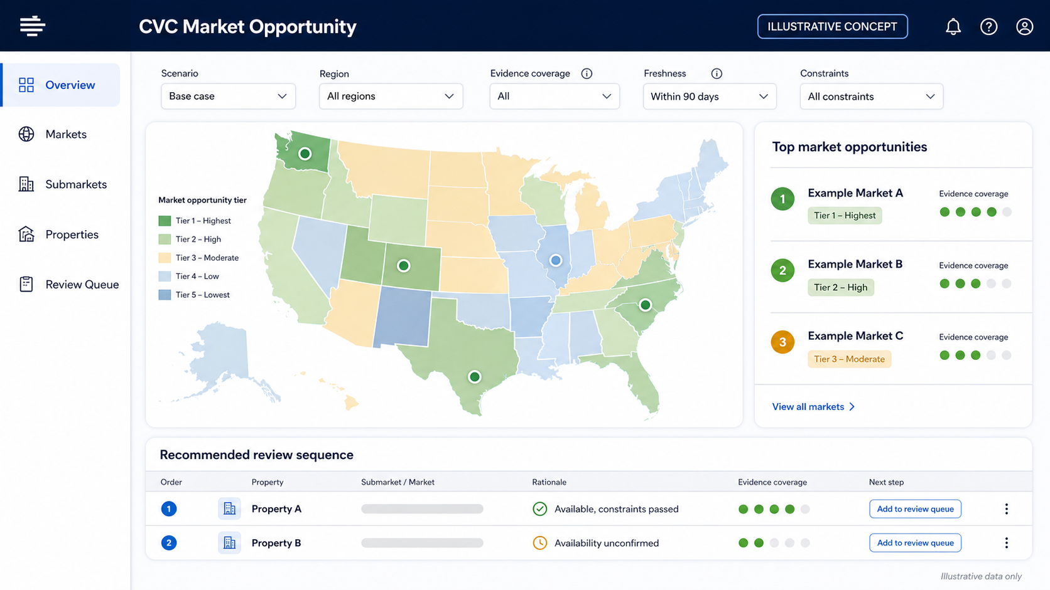
FUTURE HOME PAGE
One workspace could connect national scan, diligence, and review sequence
Illustrative future-state concept. No real rankings or properties shown.
10
Notes:
Timing: 0:45
This is an illustrative future-state concept generated for discussion. It uses generic markets and properties, contains no real rankings, and is not a screenshot of the current product. Point out the separation between the opportunity map and the review sequence.
[Sources]
- Generated concept asset: presentations/assets/cvc-market-opportunity-home-concept.png
- docs/strategy/market-opportunity-platform-transition-brief.md
[/Sources]

Slide 11
WHAT WE NEED TO VALIDATE
Four product decisions unlock a bounded pilot
1
2
3
4
5
Market model
Submarket definition
Property gate
Queue logic
Pilot scope
Approved attractiveness criteria, directions, and weights
Units, grouping rules, drive-time, and overlap method
Mandatory constraints and approved availability source
Rules separating attractiveness, feasibility, and priority
One accountable user, one decision, approved inputs, and measurable workflow baseline
Validate the workflow before claiming rankings, savings, or production readiness.
Sources: open questions; market opportunity transition brief
11
Notes:
Timing: 1:15
Ask for decisions rather than broad approval. We need approved market criteria, a submarket definition, mandatory property constraints and availability source, and explicit queue logic. The pilot also needs one accountable user and measurable baseline.
[Sources]
- docs/product/open-questions.md
- docs/strategy/market-opportunity-platform-transition-brief.md
[/Sources]

Slide 12
THE ASK
CVC
Choose one decision. Pilot the workflow. Validate the value.
Next step: name one accountable user, confirm the four decision rules, and run one bounded portfolio decision with approved inputs and a measurable baseline.
Notes:
Timing: 0:45
Close with a bounded ask: choose one real decision, one accountable user, approved inputs, and success measures. The next milestone is workflow validation, not national deployment.
[Sources]
- docs/product/open-questions.md
- docs/evaluation/success-metrics.md
[/Sources]

