Slide 1
MARKET OPPORTUNITY PLATFORM
MOP
From Clinic Discovery to a
Market Opportunity Platform
Regional insights across business sectors, online and offline
DISCOVERY JOURNEY | CURRENT DEMO | FUTURE PLATFORM
Notes:
Timing: 0:30
Open with the clinic evaluator as the origin story, not the platform definition. The broader opportunity is a reusable way to explore regional opportunities across sectors and channels while keeping evidence quality and human ownership visible.
[Sources]
- User direction, August 5, 2026
- /Users/nnair/Documents/Market Opportunity Platform/market-opportunity-platform-transition-brief.md
[/Sources]

Slide 2
WHERE WE STARTED
We started with two high-value problem spaces
CLINIC EXPANSION
USER CONTEXT
WHY THESE
Location evaluation
User Profile Studio
Governed decisions
Teams combine fragmented market, site, and feasibility evidence to compare opportunities and prepare human decisions.
Useful customer and pet information is collected, but not always connected to the next helpful action across experiences.
Both offered a clear role for AI: organize validated evidence and explain tradeoffs without taking ownership from people.
Clinic expansion became the first wedge because it offered a focused, high-value decision we could prototype.
Sources: Top 5 Ideas; Contacts & Conversations; Matt check-in
02
Notes:
Timing: 1:15
Explain that discovery initially converged on two promising problems. User Profile Studio addressed customer and pet information that is collected but not consistently connected to action. Clinic expansion addressed fragmented market, property, and feasibility evidence. Clinic expansion became the first wedge because it offered a focused decision that could be prototyped with transparent boundaries.
[Sources]
- https://chewyinc.atlassian.net/wiki/spaces/AUS/pages/5325357932/TOP+5+IDEAS
- https://chewyinc.atlassian.net/wiki/spaces/AUS/pages/5330470157/01+Contacts+Conversations
- https://chewyinc.atlassian.net/wiki/spaces/AUS/pages/5352818031/Check-in+With+Matt
[/Sources]

Slide 3
DISCOVERY JOURNEY
Conversations moved us from broad ideas to a sharper clinic opportunity
WHO WE HEARD FROM
WHAT WE LEARNED
Cathy Harley • CVC / hybrid care
Customer and pet context is not always connected to action
Mike Cammarota • CVC operations
Clinic work crosses systems, owners, and handoffs
synthesis
Krista Bardelli • CVC CRM
Esri and Excel already cover major parts of analysis
Lana Lee • search + personalization
Market, property, and sequence are different decisions
Matt Merrill + Cale Harrington • expansion
The gap is a shared, reviewable decision trace
Sources: Contacts & Conversations; Cale notes; Matt check-in
03
Notes:
Timing: 1:30
Name only completed conversations that are documented. Cathy Harley, Mike Cammarota, Krista Bardelli, and Lana Lee informed the broader CVC and user-context problem space. Matt Merrill and Cale Harrington sharpened the clinic expansion opportunity. Their combined input showed that important tools already exist, while evidence and rationale fragment across decision stages.
[Sources]
- https://chewyinc.atlassian.net/wiki/spaces/AUS/pages/5330470157/01+Contacts+Conversations
- https://chewyinc.atlassian.net/wiki/spaces/AUS/pages/5352949587/Cale
- https://chewyinc.atlassian.net/wiki/spaces/AUS/pages/5352818031/Check-in+With+Matt
[/Sources]

Slide 4
WHAT WE LEARNED
Attractiveness, feasibility, and execution priority are different decisions
GEOGRAPHY
PROPERTY
PORTFOLIO
Attractiveness
Feasibility
Execution priority
Is this market or submarket appealing enough to justify deeper diligence?
Can this available property pass mandatory physical, legal, operational, and financial constraints?
Given availability, staffing, economics, timing, and dependencies, what should be reviewed first?
Sources: transition brief; MVP scope; open questions
04
Notes:
Timing: 1:00
This is the core product insight. A geography can be attractive while a specific property is infeasible. A feasible property may still be a poor near-term execution choice. One composite score would hide those tradeoffs.
[Sources]
- docs/strategy/market-opportunity-platform-transition-brief.md
- docs/product/open-questions.md
[/Sources]

Slide 5
OUR CURRENT PROJECT
The current demo is governed decision support, not a production locator
PUBLIC FOUNDATION
SYNTHETIC MARKETS
REPORTED SITE EVIDENCE
HUMAN-GATED TOOLS
Census + ACS
Map + compare
Briefs + compare
Agent + sandbox
Versioned CBSA universe, boundaries, and public context. Explicitly non-scored.
Synthetic attractiveness map and rank; compare 2 to 5 same-cohort markets with sensitivity.
Minimized Esri demo evidence, provenance, missingness, and raw comparison. Not scored.
The agent pauses on ambiguity; the sandbox tests constraints and weights. No recommendation.
Demonstrable now: traceable workflows and boundaries. Production inputs and ownership remain unresolved.
Sources: current implementation; MVP scope; user workflows
05
Notes:
Timing: 1:30
State exactly what is real in the current demo and what is not. Public Census context is non-scored. Market scoring is synthetic. Esri evidence is descriptive and ineligible for scoring. The agent and sandbox are human-gated prototype tools. This is not a legitimate national locator.
[Sources]
- docs/product/mvp-scope.md
- docs/product/user-workflows.md
- docs/technical/data-contracts.md
- docs/technical/ai-boundaries.md
[/Sources]

Slide 6
CURRENT DEMO CAPABILITIES
What the prototype can demonstrate today
MARKETS
MARKET REVIEW
LOCATIONS
CONTROL
Map and context
Synthetic market compare
Bounded Ask AI
Explore public CBSA boundaries, ACS context, workflow states, and selection.
Compare 2 to 5 same-cohort results with rank, gaps, warnings, and sensitivity.
Explain supplied structured results without changing scores or choosing a market.
Candidate briefs
Raw location compare
Sandbox + Seattle
Prepare source-linked drafts and show missing or conflicting demo evidence.
Compare 2 to 5 audited candidates field by field, with no composite or winner.
Test synthetic weights and constraints; run one human-confirmed synthetic deep dive.
Sources: current implementation and automated tests
06
Notes:
Timing: 1:30
These are the visible current capabilities. Clarify that the comparison supports two to five same-cohort markets or audited locations. Ask AI explains structured results only. The Seattle deep dive is synthetic and requires analyst confirmation before comparison.
[Sources]
- app/page.tsx
- components/market-attractiveness/MarketAttractivenessRanking.tsx
- components/location-workspace/CandidateBriefsWorkspace.tsx
- components/agent-workspace/CandidateReviewAgent.tsx
- components/market-deep-dive/SeattleMarketDeepDive.tsx
- components/scoring-sandbox/ScoringSandbox.tsx
[/Sources]

Slide 7
LIVE DEMO
A seven-minute demo shows what the prototype can do today
01
Markets workspace
Select a market; show public context, synthetic score, and workflow-state separation
02
Market comparison
Add two same-cohort markets; inspect subscores, missingness, sensitivity, and Ask AI
03
Seattle deep dive
Confirm synthetic segmentation before comparison; show tool activity and evidence receipts
04
Candidate briefs
Prepare a bounded brief, then compare audited locations without a winner or recommendation
05
Sandbox + boundary
Adjust synthetic weights and constraints; name what is non-scored, process-local, or unresolved
Sources: current local prototype; user workflows; automated tests
07
Notes:
Timing: 7:00 including live demo
Suggested clicks: start in Markets, select a scored metropolitan market, add two same-cohort markets, open comparison and Ask AI, open Seattle and confirm the illustrative segmentation, switch to Locations for Candidate briefs and raw comparison, then open the scoring sandbox. If time is tight, skip the full agent run and show its visible pause and evidence receipts.
Boundary line to say out loud: everything scored here is synthetic and unapproved; public context and Esri demo evidence are not scoring inputs; no lease, opening, or market-entry recommendation is produced.
[Sources]
- docs/product/user-workflows.md
- docs/product/mvp-scope.md
- tests/market-comparison-rendered.test.mjs
- tests/agent-workspace-rendered.test.mjs
- tests/seattle-market-deep-dive-rendered.test.mjs
[/Sources]

Slide 8
FUTURE DIRECTION
One platform connects sectors, regions, and channels
Market Opportunity Platform
IT WOULD HELP TEAMS
connects internal and external data to surface regional opportunities across business sectors and online, offline, and hybrid channels.
Compare regions
Explore sectors
See coverage gaps
Plan data collection
Clinic location evaluation is the reference use case, not the boundary of the platform.
Sources: user direction; market opportunity transition brief
08
Notes:
Timing: 1:15
This is the corrected platform mission. Clinic location evaluation supplied the first focused workflow, but the platform is intended to support multiple business sectors and online, offline, and hybrid opportunities by regional market.
Mission statement:
Our mission began with clinic location evaluation because it offered a focused, high-value way to improve how teams assemble evidence, compare opportunities, and prepare decisions. By bringing together a broad range of internal and external data, we learned that the greater opportunity is a transparent, governed platform that generates new insights across the sectors we hope to impact. The platform helps teams compare regional opportunities across online, offline, and hybrid channels, identify gaps in available evidence, and focus data collection before people make the final decision.
[Sources]
- User direction, August 5, 2026
- /Users/nnair/Documents/Market Opportunity Platform/market-opportunity-platform-transition-brief.md
[/Sources]

Slide 9
FUTURE OPERATING MODEL
A common evidence workflow supports many opportunity types
01
02
03
04
Opportunity
Regional evidence
Insights + gaps
Action
Define the sector, customer, region,
and online, offline, or hybrid mode
Join governed internal and external
sources with provenance
Surface signals, evidence gaps,
and data collection priorities
Compare options and prepare
a human-reviewed next step
One workflow can support commerce, healthcare, services, operations, and future sectors.
Sources: user direction; market opportunity transition brief
09
Notes:
Timing: 1:15
Walk left to right. Every use case starts by defining the sector, customer, region, and channel mode. The platform assembles governed regional evidence, surfaces opportunity signals and evidence gaps, and helps teams decide what to investigate, collect, or test next. The workflow is common even when sector-specific evidence differs.
[Sources]
- User direction, August 5, 2026
- /Users/nnair/Documents/Market Opportunity Platform/market-opportunity-platform-transition-brief.md
[/Sources]

Slide 10
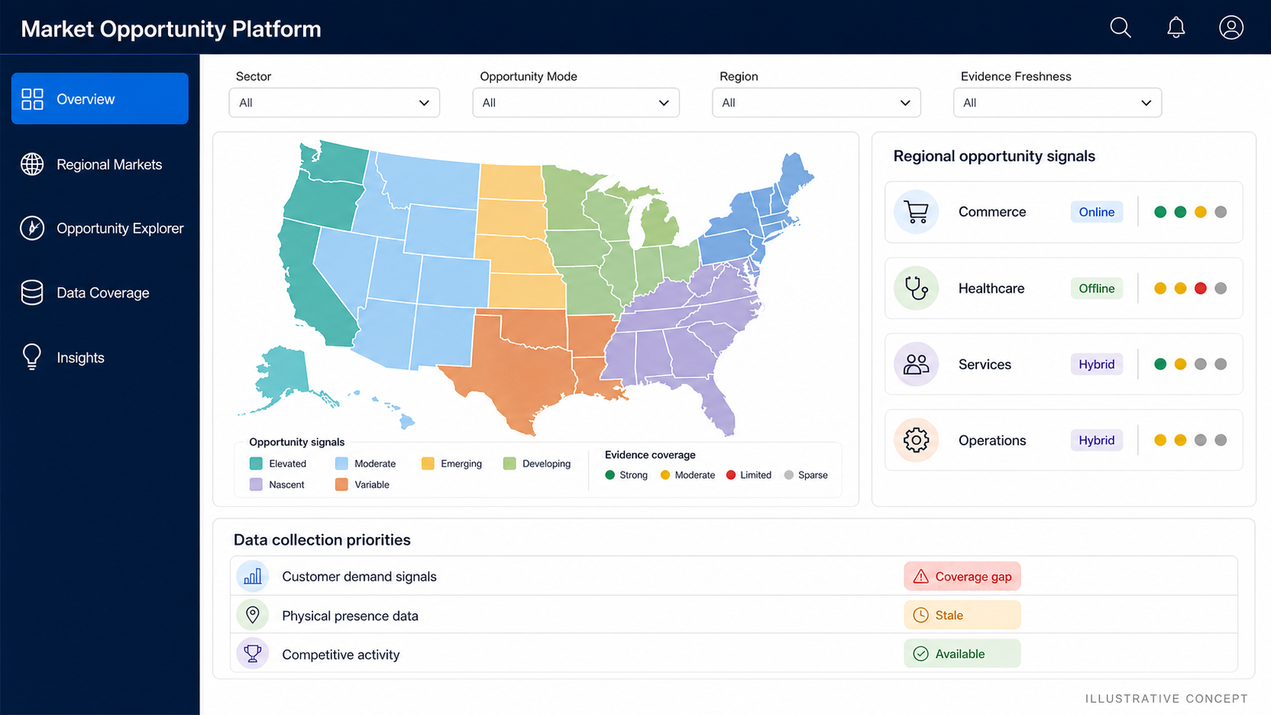
FUTURE HOME PAGE
One workspace connects regional opportunities, channels, and data gaps
Illustrative future-state concept. Example sectors and signals only.
10
Notes:
Timing: 0:45
This is an illustrative future-state concept, not a current product screenshot. It shows a sector-neutral regional opportunity map, online and offline opportunity modes, cross-sector signals, evidence coverage, and explicit data collection priorities. All labels and examples are synthetic.
[Sources]
- Generated concept asset: /Users/nnair/Documents/Market Opportunity Platform/assets/market-opportunity-platform-home-concept-v2.png
- User direction, August 5, 2026
[/Sources]

Slide 11
WHAT WE NEED TO VALIDATE
Five decisions define a bounded platform pilot
1
2
3
4
5
Pilot
question
Market
definition
Channel
model
Data
contracts
Pilot
measure
One sector, one regional decision, and one accountable user
Approved regions, hierarchy, and comparison universe
Clear meanings for online, offline, and hybrid signals
Sources, permissions, freshness, gaps, and collection plan
Baseline for insight quality, speed, and evidence readiness
Start with one question, but design the evidence model to travel across sectors.
Sources: user direction; market opportunity transition brief
11
Notes:
Timing: 1:15
The platform vision is intentionally broad, so the pilot must remain bounded. Choose one regional opportunity question, define the regional universe and channel meanings, approve the data contracts and collection plan, and measure whether the shared workflow improves insight and evidence readiness.
[Sources]
- User direction, August 5, 2026
- /Users/nnair/Documents/Market Opportunity Platform/market-opportunity-platform-transition-brief.md
[/Sources]

Slide 12
THE ASK
MOP
Choose one regional question. Prove the workflow. Expand by sector.
Next step: select one regional opportunity and accountable user. Define the market universe and test whether the platform improves insight, evidence coverage, and decision preparation.
Notes:
Timing: 0:45
Close with one pilot question, not one permanent sector. The pilot should validate a reusable evidence workflow that can later expand to other sectors, regions, and online, offline, or hybrid opportunity types.
[Sources]
- User direction, August 5, 2026
- /Users/nnair/Documents/Market Opportunity Platform/market-opportunity-platform-transition-brief.md
[/Sources]

