Slide 1
Microsoft SDL Threat Modeling
Michael Howard
mikehow@microsoft.com

Slide 2
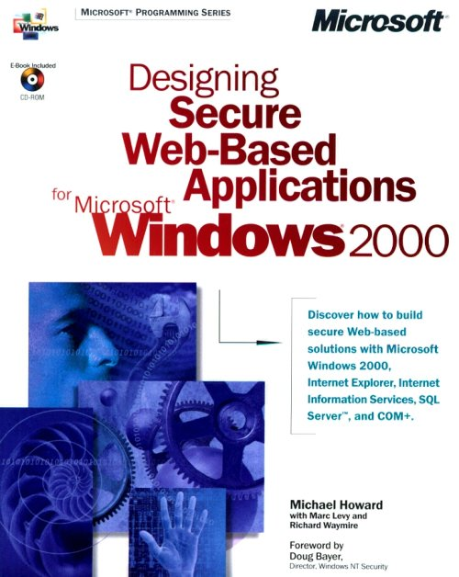
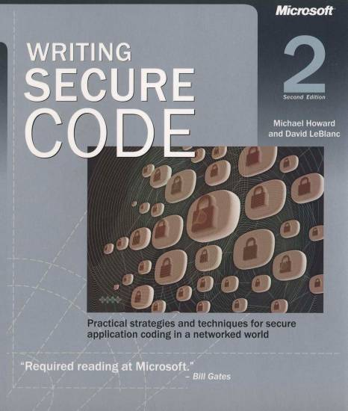
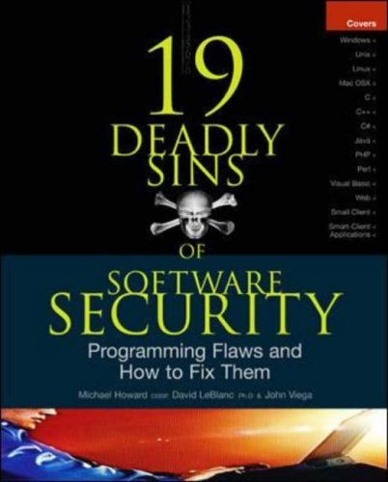
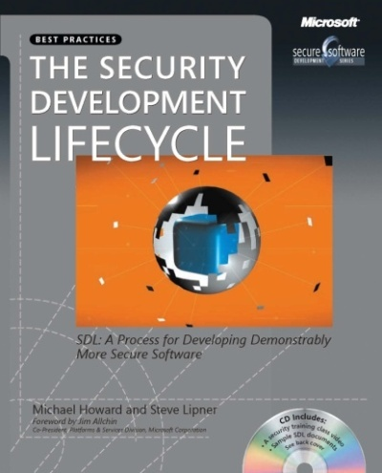
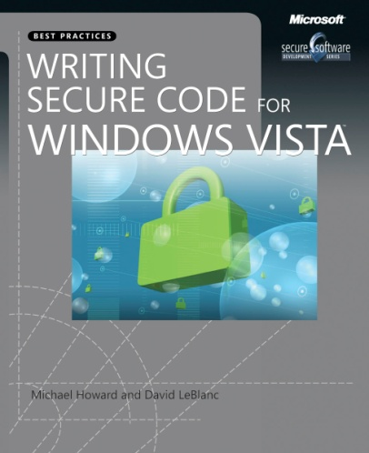
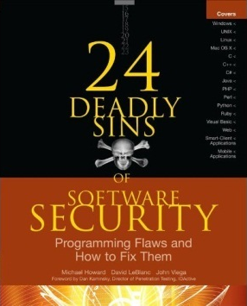


Who Is This Guy?
mikehow@microsoft.com
Microsoft employee for 17 years
Always in security
Worked on the SDL since inception

Slide 3
Overview
Introduction
Goals of Threat Modeling
The approach
Exercise
Learning resources

Slide 4
Threat Modeling Basics
Who?
What?
When?
Why?
How?
Notes:
Repeatable/deterministic?

Slide 5
Who
Building a threat model
Dev owns DFD (diagram)
Test owns ID threats (analyze)
PM owns overall process
Customers for threat models
Your team
Other feature, product teams
Customers, via user education
‘External’ QA resources like pen testers
Security Advisors
Notes:
FINDME: If sec team has gone through customizing, ack it here as 4th bullet under building, and new bullet above SWI

Slide 6
What
Reason about, document and discuss security in a structured way
Threat model & document
The product as a whole
The security-relevant features
The attack surfaces
Assurance that threat modeling has been done well
Notes:
It’s easy to break down threat models along feature team lines, and important to have the people who own the threat model talk to each other.

Slide 7
Why Threat Model
Produce software that’s secure by design
Improve designs the same way we’ve improved code
Because attackers think differently
Creator blindness/new perspective
Notes:
Mention assurance?

Slide 8
The Approach In a Nutshell
Vision
Diagram
Identify Threats
Mitigate
Validate

Slide 9
STRIDE/Element: Vision
Vision
Diagram
Identify Threats
Mitigate
Validate

Slide 10
Vision
Scenarios
Where do you expect the product to be used?
XBOX is different from Windows 7
xbox.com is different from XBOX
Use cases/Use Stories
Add security to scenarios, use cases
Assurances/Guarantees
Structured way to think about “what are you telling customers about the product’s security?”

Slide 11
STRIDE/Element: Diagramming
Diagram
Identify Threats
Mitigate
Validate
Vision

Slide 12
How to Create Diagrams
Go to the whiteboard
Start with an overview which has:
A few external interactors (some use ‘actors’)
One or two processes
One or two data stores (maybe)
Data flows to connect them
Check your work
Can you tell a story without edits?
Does it match reality?

Slide 13
Diagramming
Use DFDs (Data Flow Diagrams)
Include processes, data stores, data flows
Include trust boundaries
Diagrams per scenario may be helpful
Update diagrams as product changes
Enumerate assumptions, dependencies
Number everything (if manual)

Slide 14


Diagram Elements - Examples
External entity
Data
Flow
Process
Data Store
People
Other systems
Microsoft.com
etc…
DLLs
EXEs
Components
Services
Web Services
Assemblies
etc…
Function call
Network traffic
Etc…
Database
File
Registry
Shared Memory
Queue/Stack
etc…
Trust Boundary
Process boundary
File system

Slide 15
Diagrams: Trust Boundaries
Add trust boundaries that intersect data flows
Points/surfaces where an attacker can interject
Machine boundaries, privilege boundaries, integrity boundaries are examples of trust boundaries
Threads in a native process are often inside a trust boundary, because they share the same privs, rights, identifiers and access
Processes talking across a network always have a trust boundary

Slide 16
Diagram Iteration
Iterate over processes, data stores, and see where they need to be broken down
How to know it “needs to be broken down?”
More detail is needed to explain security impact of the design
Object crosses a trust boundary
Words like “sometimes” and “also” indicate you have a combination of things that can be broken out
“Sometimes this datastore is used for X”…probably add a second datastore to the diagram

Slide 17
Diagram layers
Context Diagram
Very high-level; entire component / product / system
Level 1 Diagram
High level; single feature / scenario
Level 2 Diagram
Low level; detailed sub-components of features
Level 3 Diagram
More detailed
Rare to need more layers, except in huge projects or when you’re drawing more trust boundaries

Slide 18
A Real Context Diagram (Castle)

Slide 19
A Real Level-0 DFD (Castle)

Slide 20
STRIDE/Element: Identifying Threats
Diagram
Identify Threats
Mitigate
Validate
Vision

Slide 21
Understanding the threats
Threat | Property | Definition | Example
Spoofing | Authentication | Impersonating something or someone else. | Pretending to be any of billg, xbox.com or a system update
Tampering | Integrity | Modifying data or code | Modifying a game config file on disk, or a packet as it traverses the network
Repudiation | Non-repudiation | Claiming to have not performed an action | “I didn’t cheat!”
Information Disclosure | Confidentiality | Exposing information to someone not authorized to see it | Reading key material from an app
Denial of Service | Availability | Deny or degrade service to users | Crashing the web site, sending a packet and absorbing seconds of CPU time, or routing packets into a black hole
Elevation of Privilege | Authorization | Gain capabilities without proper authorization | Allowing a remote internet user to run commands is the classic example, but running kernel code from lower trust levels is also EoP

Slide 22
Different threats affect each type of element
Element
S T R I D E


External Entity






Process

?


Data Store



Dataflow

Slide 23
Apply STRIDE Threats To Each Element
For each thing on the diagram:
Apply relevant parts of STRIDE
External Entity: SR
Process: STRIDE
Data Store, Data Flow: TID
Data stores which are logs: TID+R
Data flow inside a process:
Don’t worry about T,I or D
Number things so you don’t miss them

Slide 24
A Real Level-0 DFD (Castle)
TID
TID
STRIDE
TID
TID
STRIDE
Etc…

Slide 25
Use the trust boundaries
Trusted/high code reading from untrusted/low
Validate everything for specific uses
High code writing to low
Make sure your errors don’t give away too much

Slide 26
STRIDE/Element: Mitigating
Diagram
Identify Threats
Mitigate
Validate
Vision

Slide 27
Mitigation is the point of threat modeling
Mitigation:
To address or alleviate a problem
Protect customers
Design secure software
Why bother if you:
Create a great model
Identify lots of threats
Stop
So find problems and fix them
File bugs to track them

Slide 28
Mitigate
Address each threat
Four ways to address threats:
Redesign to eliminate
Apply standard mitigations
Invent new mitigations
Riskier
Accept vulnerability in design
Address each threat!
Notes:
FINDME: If you have support available, mention it here.

Slide 29
Standard Mitigations
Spoofing | Authentication | To authenticate principals: Basic & Digest authentication LiveID authentication Cookie authentication Windows authentication (NTLM) Kerberos authentication PKI systems such as SSL/TLS and certificates IPSec Digitally signed packets To authenticate code or data: Digital signatures Message authentication codes Hashes
Tampering | Integrity | Windows Mandatory Integrity Controls ACLs Digital signatures Message Authentication Codes
Repudiation | Non Repudiation | Strong Authentication Secure logging and auditing Digital Signatures Secure time stamps Trusted third parties
Information Disclosure | Confidentiality | Encryption ACLS
Denial of Service | Availability | ACLs Filtering Quotas Authorization High availability designs
Elevation of Privilege | Authorization | ACLs Group or role membership Privilege ownership Permissions Input validation

Slide 30
Inventing Mitigations is Hard
Mitigations are an area of expertise like networking, databases, or cryptography
Amateurs make mistakes, so do pros
Mitigation failures will appear to work
Until an expert looks at them
We hope that expert will work for us
When you need to invent mitigations, get expert help
We will try to talk you off the ledge ☺

Slide 31
STRIDE/Element: Validating
Model
Identify Threats
Mitigate
Validate
Vision

Slide 32
Validating Threat Models
Validate the whole TM
Does diagram match final code?
Are threats enumerated?
Minimum: STRIDE per element that touches a trust boundary
Has Test reviewed the model?
Created appropriate test plans
Tester approach often finds issues with TM, or details
Is each threat mitigated?
Are mitigations done right
Did you check these before FSR?
Shipping will be more predictable

Slide 33
Validate Quality of Threats & Mitigations
Threats
Describe the attack
Describe the context
Describe the impact
Mitigations:
Associate with a threat
Describe the mitigation(s)
File a bug
Fuzzing is a test tactic, not a mitigation

Slide 34
Validate Information Captured
Dependencies
What other code are you using?
What security functions are in that other code?
Are you sure?
Assumptions
Things you note as you build the threat model
“HTTP.sys will protect us against SQL Injection”
“LPC will protect us from malformed messages”
CryptGenRandom will give us crypto-strong randomness

Slide 35
Effective Threat Modeling Meetings
Start with a DFD walkthrough
Identify most interesting elements
Assets (if you identify any)
Entry points/trust boundaries
Walk through STRIDE against those
Threats that cross elements/recur
Consider library, redesigns

Slide 36
Pause for questions before exercise

Slide 37
Exercise
Handout
Work in teams to:
Identify all diagram elements
Identify threat types to each element
Identify at least 3 threats
Identify first order mitigations
Extra credit: improve the diagram

Slide 38
Identify all Elements: 16 Elements…
7
…and 2 trust boundaries, which don’t have threats against them
8
3
10
9
6
11
16
2
1
15
13
12
14
4
5

Slide 39
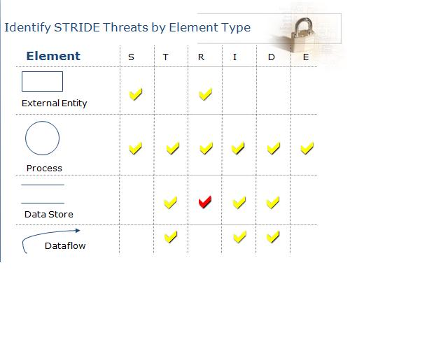
Identify threat types to each element
Threats Elements
Administrator
Admin console (2) , Host SW (3)
Config data (4), Integrity data (5),
Filesystem data (6), registry (7)
8. raw reg data
raw filesystem data
commands
resource integrity data
read settings
read
.... 16

Slide 40
Identify Threats!
Specific
Understand threat and impact
Identify 1st order mitigations

Slide 41
End exercise

Slide 42
Call to Action
Threat model your work!
Start early
Track changes
Work with your Security Advisors!
Talk to your “dependencies” about security assumptions
Learn more
http://blogs.msdn.com/sdl
Notes:
FINDME Put proper answer for “work with”

Slide 43
Learning Resources
MSDN Magazine
Uncover Security Design Flaws Using the STRIDE Approach http://msdn.microsoft.com/msdnmag/issues/06/11/ThreatModeling/default.aspx
http://msdn.microsoft.com/en-us/magazine/cc700352.aspx
Getting Started with the SDL TM Too
http://msdn.microsoft.com/en-us/magazine/2009.01.securitybriefs.aspx
Lots more SDL: Training and Resources
http://msdn.microsoft.com/en-us/security/cc448120.aspx
Books: lots of info which drove evolution of better processes

