Slide 1
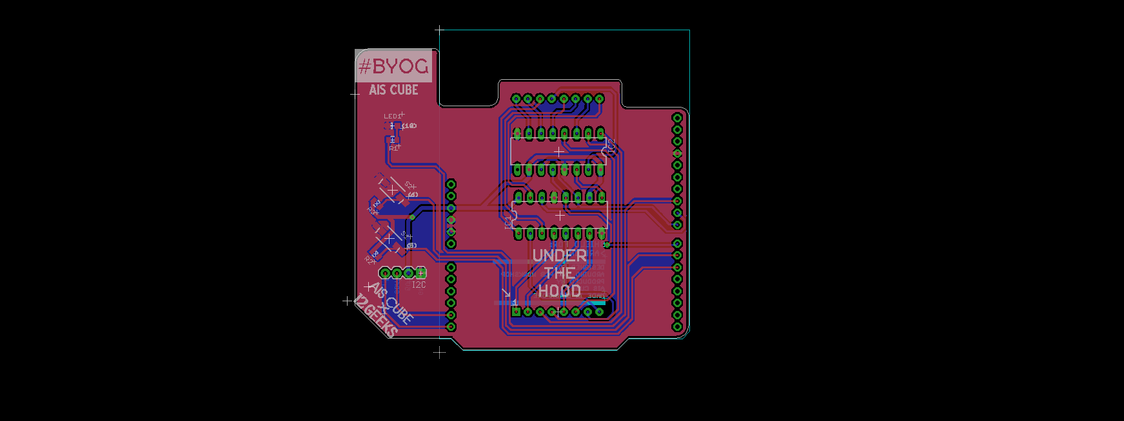


Build your own Arduino uno shield Session 02

Slide 2
Last week
Preparing the board
Part Placement
Preparing to Route
Power Lines
Signal Lines
Silkscreen Items
Schematic Drawing
GND Planes
You learnt to:
Breadboard & connect modules to the Arduino Uno
Basic program to control the LEDs on the dot matrix
Set up EAGLE directories
Add components in EAGLE

Slide 3
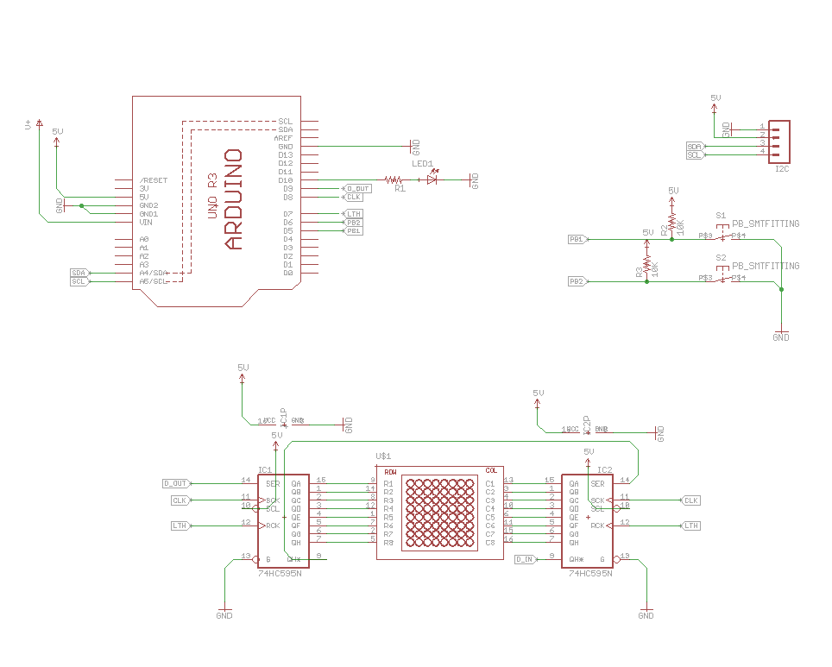
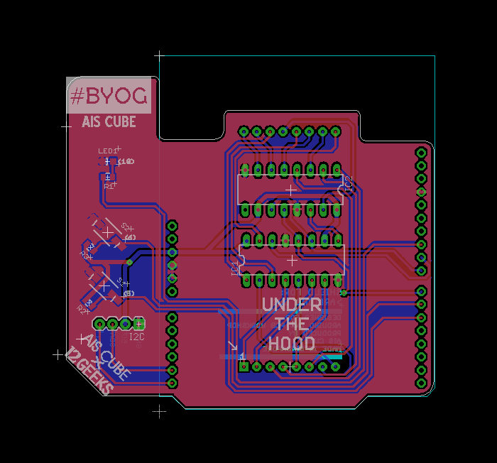
THIS week
Preparing the board
Part Placement
Preparing to Route
Power Lines
Signal Lines
Silkscreen Items
Schematic Drawing
GND Planes

Slide 4
Waypoints
Preparing the board
Board Dimensions
Part Placement
Good parts placement is half the battle won
Preparing to Route
Power Lines
Signal Lines
Silkscreen Items
Change grid units to mm
Change grid units to 10 mil
Setting up route parameters
Eg. (Bend Style, Width, Via shape, via drill size)
Trace width of 32 mil
Route lines in parallel on bottom layer
Trace width of 16 mil
Route lines on top layer
Logo
Labels
Schematic Drawing
GND Planes
Polygons, signals and ratsnest

Slide 5
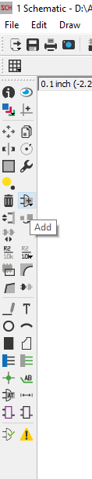
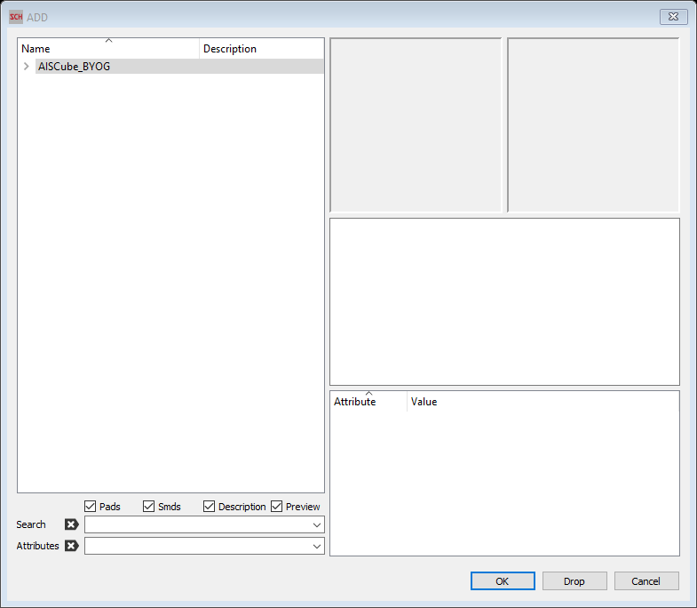
Adding components
Symbol Preview
Footprint Preview

Slide 6
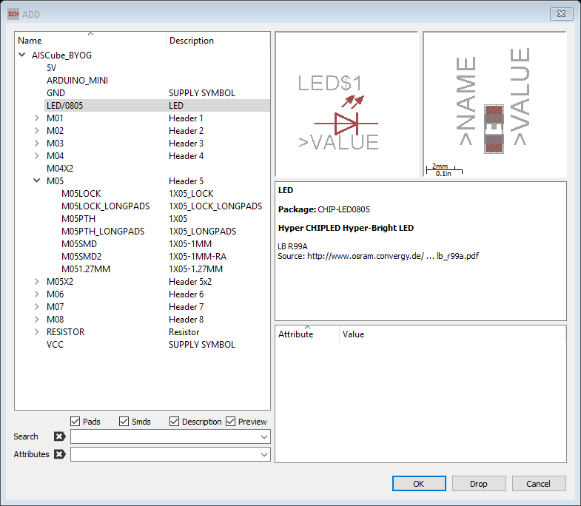
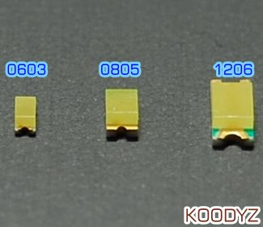
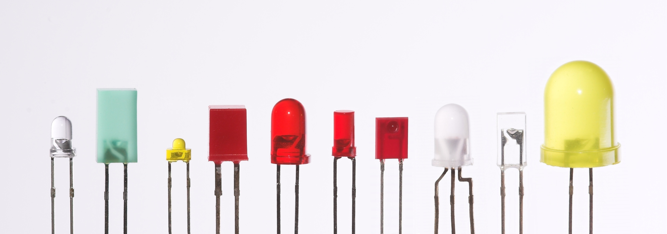
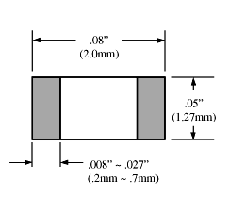
Symbol Preview
(DOES NOT CHANGE)
Footprint Preview
(CHANGES)
10mm
5mm
3mm

Slide 7
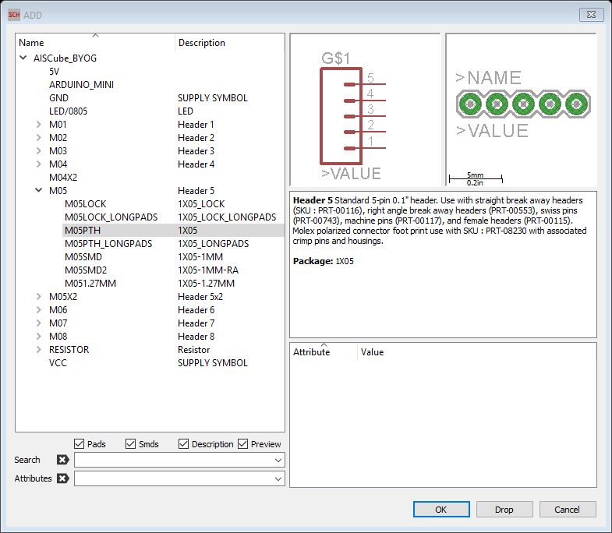
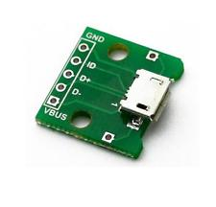
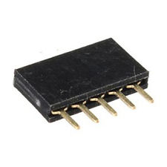
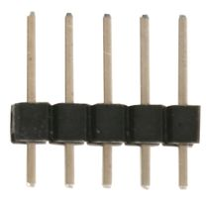
Symbol Preview
Footprint Preview

Slide 8

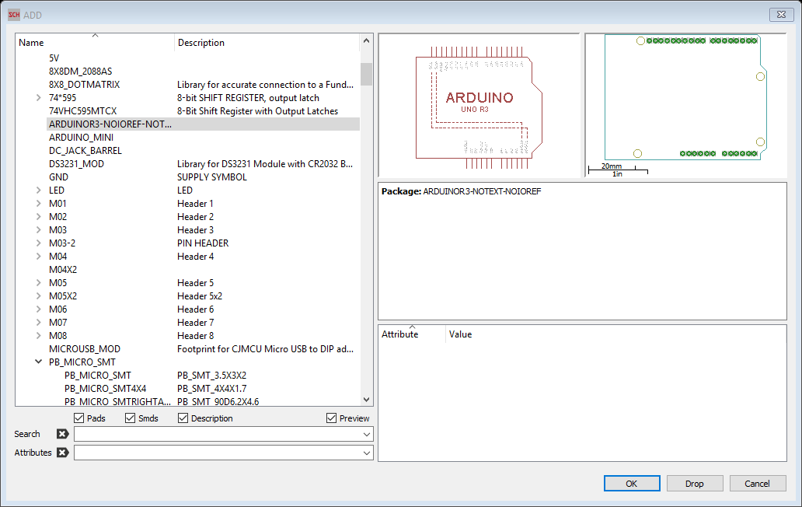
Preparing the board
Part Placement
Preparing to Route
Power Lines
Signal Lines
Silkscreen Items
Schematic Drawing
GND Planes
Add components
Let’s start with the Arduino Uno Reference
❖
Add components
◆
⬥

Slide 9
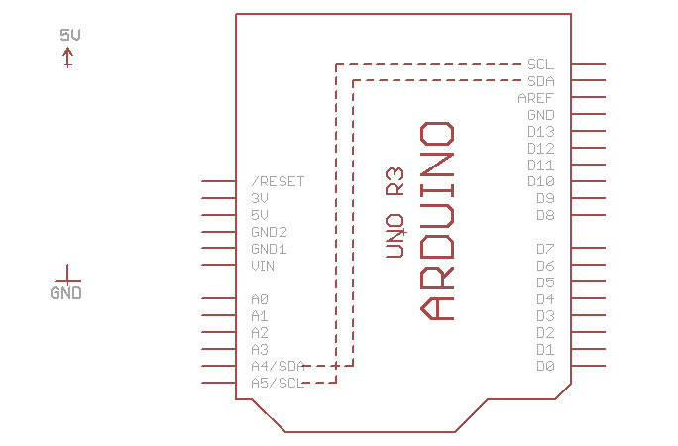
Preparing the board
Part Placement
Preparing to Route
Power Lines
Signal Lines
Silkscreen Items
Schematic Drawing
GND Planes
Add power symbols
Add components
Add 5V and GND

Slide 10
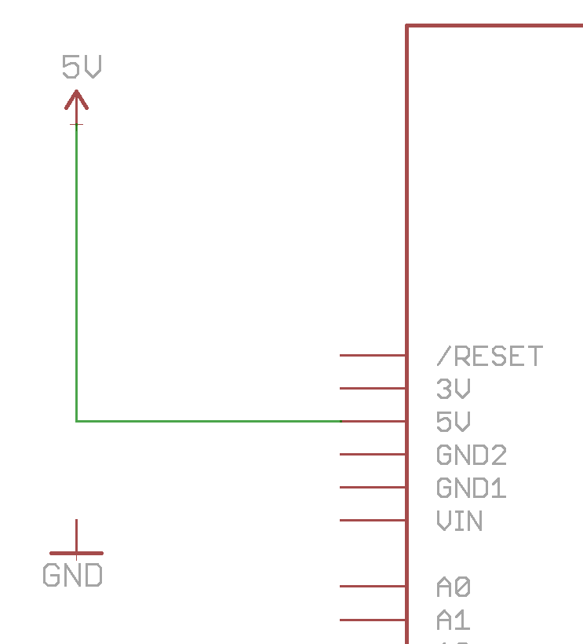
Preparing the board
Part Placement
Preparing to Route
Power Lines
Signal Lines
Silkscreen Items
Schematic Drawing
GND Planes
Connect the power lines to the Arduino
Use the net wire to connect the symbol
from point to point
Net

Slide 11
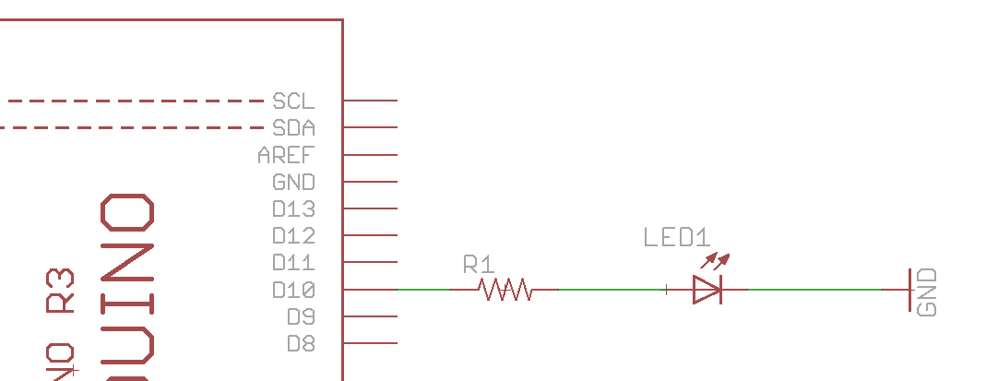
Preparing the board
Part Placement
Preparing to Route
Power Lines
Signal Lines
Silkscreen Items
Schematic Drawing
GND Planes
Your first EAGLE circuit
Try doing this by yourself
“Hello World” EAGLE style

Slide 12
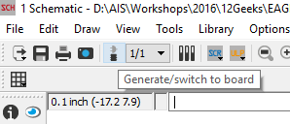
Preparing the board
Part Placement
Preparing to Route
Power Lines
Signal Lines
Silkscreen Items
Schematic Drawing
GND Planes
Understanding how .sch & .Brd are connected
EAGLE WALKTHROUGH
LIVE DEMO TIP :
Using move to auto-magically generate net wire connections.
Using copy to make copies of existing components (eg. GND) to add to the circuit.
Net wire in .sch → air wire in .brd
Notes:
Set up dual window layout
Do a live demo of the previous assignment.
Showcase the following tips
Using move to automagically generate net wire connections.
Using copy to make copies of gnd to add to the circuit.
Net wire in sch = air wire in brd

Slide 13
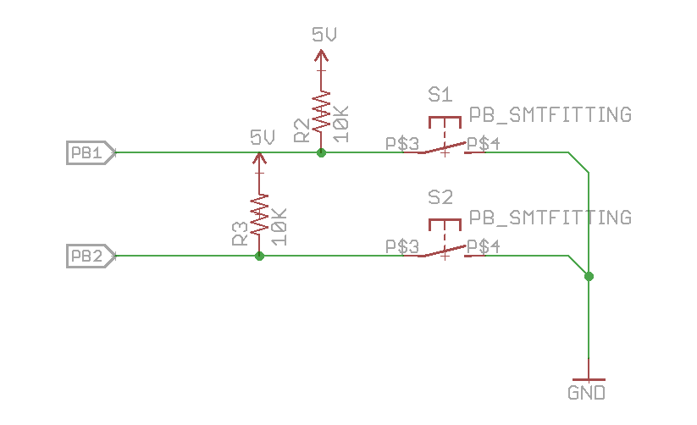
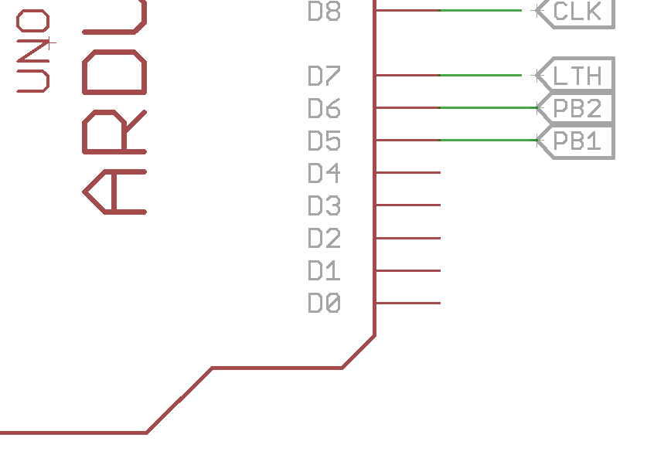
Preparing the board
Part Placement
Preparing to Route
Power Lines
Signal Lines
Silkscreen Items
Schematic Drawing
GND Planes
Let’s try that out with the push buttons
TIP :
You can make connections by naming the net wires as well.
Let’s try that out!

Slide 14
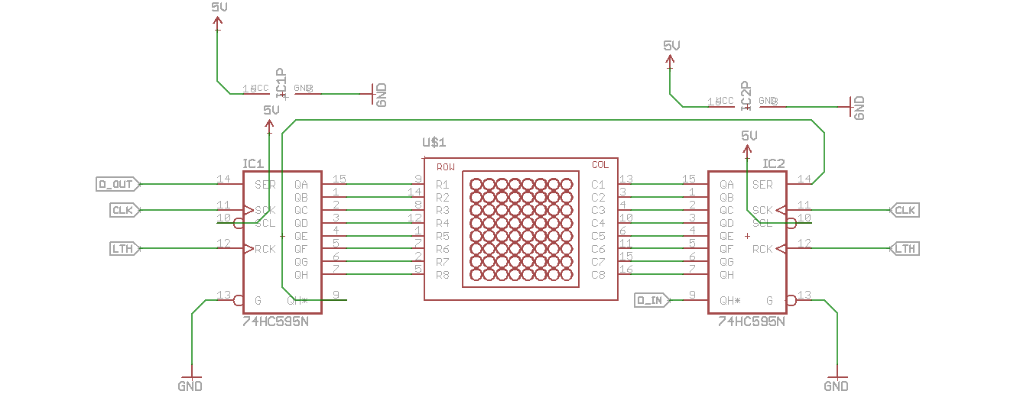
Preparing the board
Part Placement
Preparing to Route
Power Lines
Signal Lines
Silkscreen Items
Schematic Drawing
GND Planes
New tips, and here comes the matrix
EAGLE WALKTHROUGH
Notes:
New command:
Mirror
Move
Invoke power

Slide 15
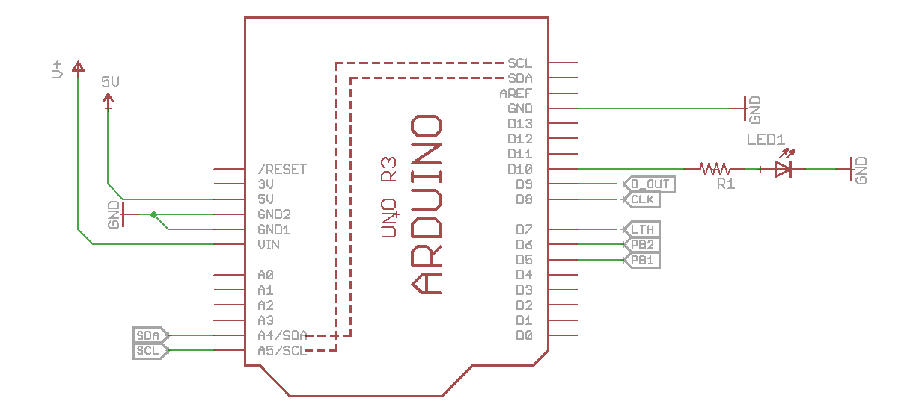
Preparing the board
Part Placement
Preparing to Route
Power Lines
Signal Lines
Silkscreen Items
Schematic Drawing
GND Planes
BY THIS TIME, Your Arduino should have the following pin outs

Slide 16
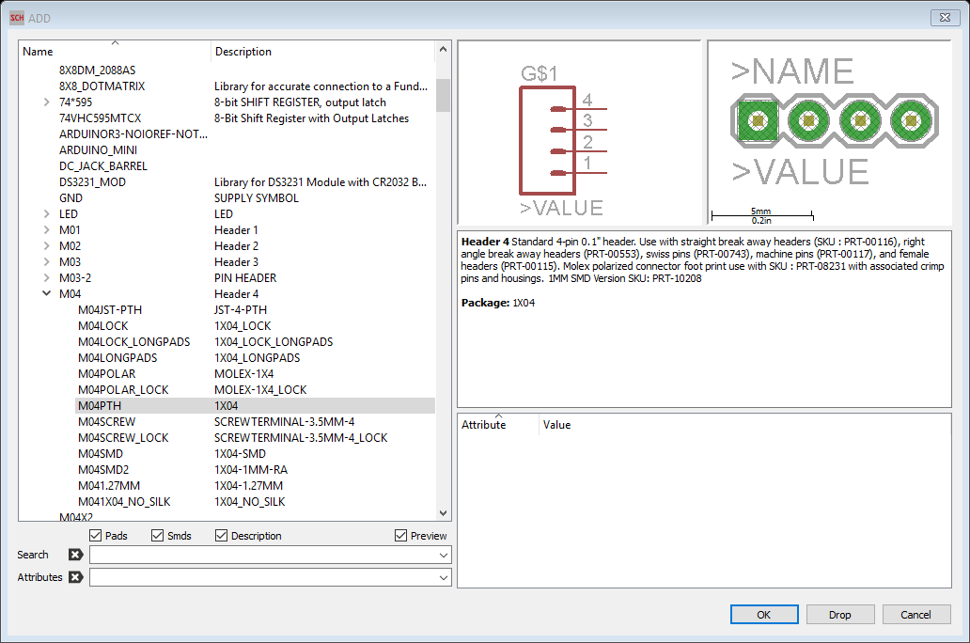
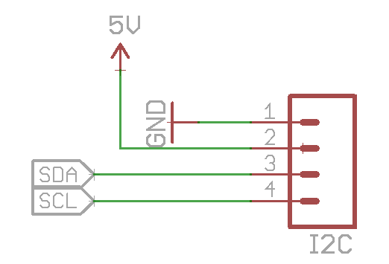
Preparing the board
Part Placement
Preparing to Route
Power Lines
Signal Lines
Silkscreen Items
Schematic Drawing
GND Planes
PAndemic Pindemic Breakout
(Optional )
For rtc
Notes:
This is where you might wanna breakout other pins as well if you’re planning to add in your own sensors/ general pin outs for future use

Slide 17
Preparing the board
Part Placement
Preparing to Route
Power Lines
Signal Lines
Silkscreen Items
Schematic Drawing
GND Planes
Error Checking (ERC)
Common Mistakes
Error Descriptions, what they mean, and how to solve it
ERC = Electrical Rule Check
This command is used to test schematics for electrical errors.
ERC

Slide 18
Preparing the board
Part Placement
Preparing to Route
Power Lines
Signal Lines
Silkscreen Items
Schematic Drawing
GND Planes
Great job getting here
Let’s take a break

Slide 19
Waypoints
Preparing the board
Board Dimensions
Part Placement
Good parts placement is half the battle won
Preparing to Route
Power Lines
Signal Lines
Silkscreen Items
Change grid units to mm
Change grid units to 10 mil
Setting up route parameters
Eg. (Bend Style, Width, Via shape, via drill size)
Trace width of 32 mil
Route lines in parallel on bottom layer
Trace width of 16 mil
Route lines on top layer
Logo
Labels
Schematic Drawing
GND Planes
Polygons, signals and ratsnest

Slide 20
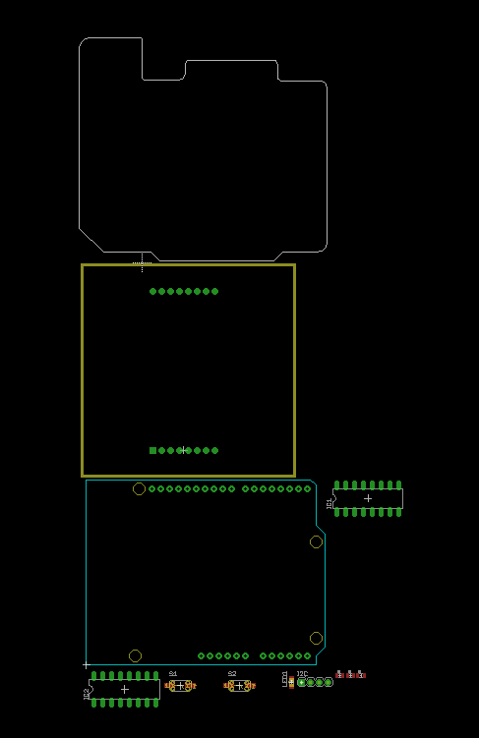
Preparing the board
Part Placement
Preparing to Route
Power Lines
Signal Lines
Silkscreen Items
Schematic Drawing
GND Planes
Board Dimension
Defined with Line of width 0
on Dimension Layer
Components situated
OUTSIDE of the board

Slide 21
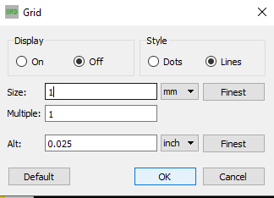
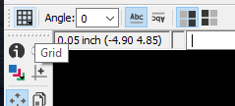
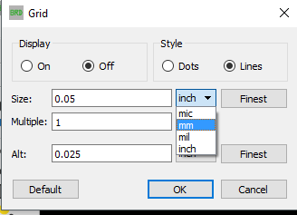
Preparing the board
Part Placement
Preparing to Route
Power Lines
Signal Lines
Silkscreen Items
Schematic Drawing
GND Planes
TIP : Working with grid units in mm is great for parts placement to have a sense of measurement
Change grid units to mm
◆
Select “On” to display grid lines
Select Grid

⬥
Change size to 1

Click OK
❖
Select mm

Slide 22
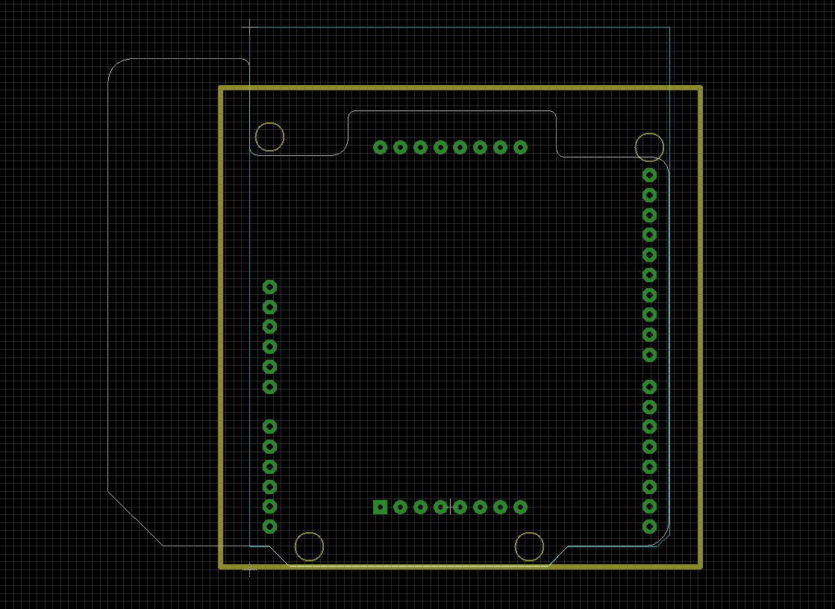

Preparing the board
Part Placement
Preparing to Route
Power Lines
Signal Lines
Silkscreen Items
Schematic Drawing
GND Planes
Parts placement :
Good parts placement is half the battle won
TIP : Use air-wires to help indicate the orientation and location of parts that provides the shortest path to route between each other.
Click on “Route” if the air-wires are not showing up. Alternatively, enable the unrouted (19) layer.
Since we’ve already helped you with the quick start for the Arduino layout & board dimensions, the next thing to place would be the dot matrix.
Select Move
◆
⬥
Align the dot matrix to the center using the blue
Arduino line as reference
❖
Select the origin of the footprint
EAGLE WALKTHROUGH
Notes:
EAGLE Live demo

Slide 23
Preparing the board
Part Placement
Preparing to Route
Power Lines
Signal Lines
Silkscreen Items
Schematic Drawing
GND Planes
TIP : While deciding on where to place the parts, keep in mind that it should not block the connection to other components/ other components are not blocking it.
Eg. OK to place shift registers underneath the dot matrix module.
NOT OK to place the push buttons or LEDs underneath the dot matrix module.

Slide 24
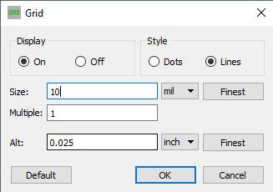

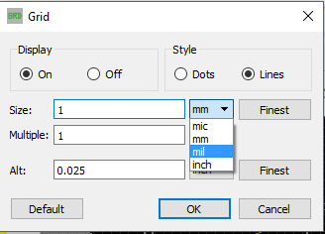
Preparing the board
Part Placement
Preparing to Route
Power Lines
Signal Lines
Silkscreen Items
Schematic Drawing
GND Planes
TIP: Working with grid units in mil is great for routing (dealing with a number like 10 mil is so much friendlier than 0. 25mm)
Change grid units to mil
(Unit of measurement for very thin objects - Equal to 1⁄1000 of an inch )
◆
Select Grid
⬥
Change size to 10
❖

Select mil
Click OK

Slide 25

Preparing the board
Part Placement
Preparing to Route
Power Lines
Signal Lines
Silkscreen Items
Schematic Drawing
GND Planes
Preparing to route
Some things you need to know
Select Route
◆

Slide 26
Preparing the board
Part Placement
Preparing to Route
Power Lines
Signal Lines
Silkscreen Items
Schematic Drawing
GND Planes
TIP : Route power lines on the bottom layer of the board, route all signal traces for components on the top layer.
Always run the power lines (+ and -) in parallel to each other.
Route power lines first
Select 32
⬥
Select Route
◆
❖

Select Bottom Layer

Slide 27
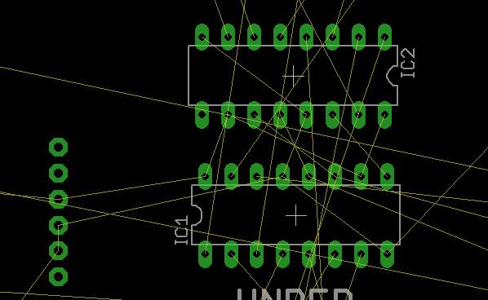
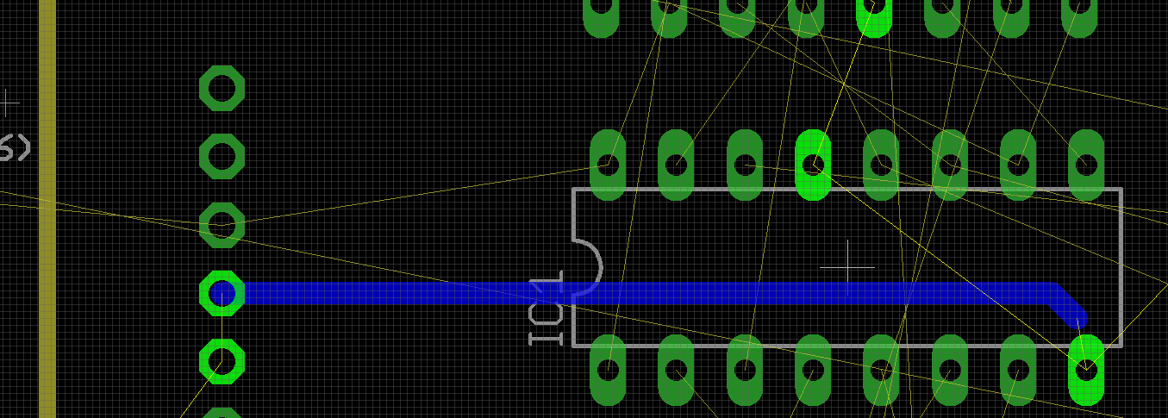
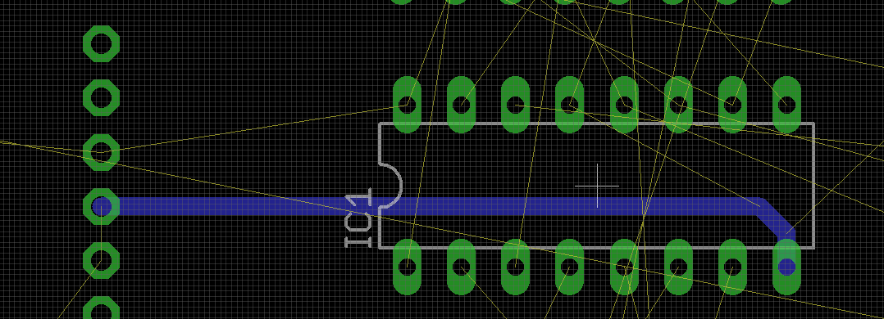
Preparing the board
Part Placement
Preparing to Route
Power Lines
Signal Lines
Silkscreen Items
Schematic Drawing
GND Planes
TIP : Route power lines on the bottom layer of the board, route all signal traces for components on the top layer.
Route power lines first
Click to place a bend point before continuing
❖
◆
⬥
Select air wire at GND of Arduino Board
Click on centre of GND pin to complete trace route
Line should automatically disappear

Slide 28
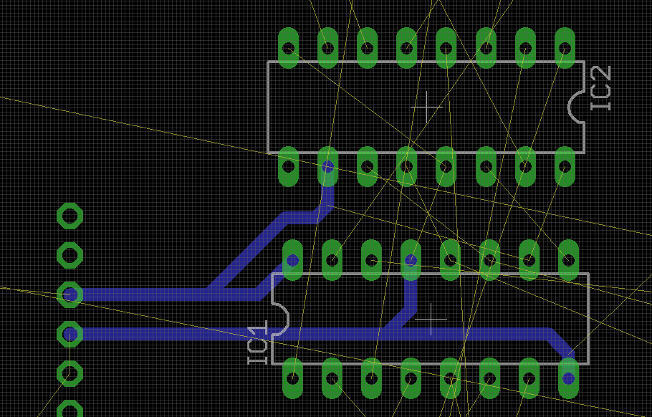
Preparing the board
Part Placement
Preparing to Route
Power Lines
Signal Lines
Silkscreen Items
Schematic Drawing
GND Planes
TIP : As much as possible, avoid daisy chaining the power lines from part-to-part.
Route power lines first
“Always run the power lines (+ and -) in parallel to each other.”
Repeat the steps the other 5V and GND lines.
5V
TIP :
Use the grid lines to gauge minimum clearance between the traces.
(That’s the reason why we use 10mil)
GND

Slide 29
Preparing the board
Part Placement
Preparing to Route
Power Lines
Signal Lines
Silkscreen Items
Schematic Drawing
GND Planes
ROUTE SIGNAL LINES
❖
Select 16 mil
◆
Select top Layer
TIP : Is another line blocking? Use Vias!
Eg. SMD on top layer of board needs to connect to a GND on the bottom layer of the board, route a top layer trace from the LED, and select Bottom Layer and continue routing to a GND pin. A via will automatically appear!

Slide 30
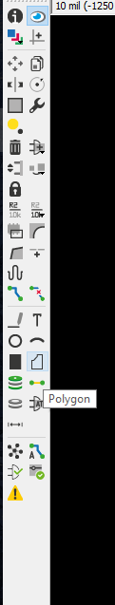
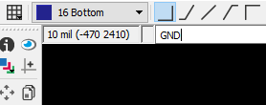
Preparing the board
Part Placement
Preparing to Route
Power Lines
Signal Lines
Silkscreen Items
Schematic Drawing
GND Planes
GROUND PLANES
❖
Large area of copper connected to a circuit’s ground point.
Serves as a return path for current from different components
Reduces electrical noise, interference, crosstalk
..and other functions depending on the circuit
Type GND
Hit Enter
⬥


Select Bottom Layer
Change to 16 mil
◆
Change to 10 mil
Select Polygon
Live Demo
Click and follow the edges of the board to form a polygon
The polygon will turn into a dotted line when closed
Use show on the polygon to check that the signal is GND.
(Your GND traces should be highlighted together with the polygon, if it doesn’t, use “NAME” on the polygon to name it as GND. )
Do the same for the Top Layer
Click on Ratsnest to generate solid ground planes

Slide 31
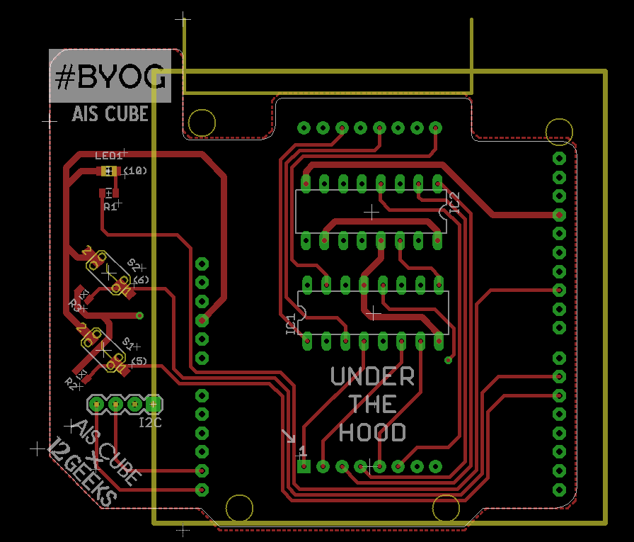
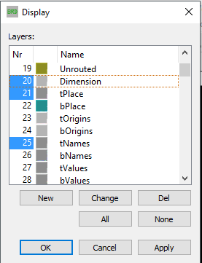
Preparing the board
Part Placement
Preparing to Route
Power Lines
Signal Lines
Silkscreen Items
Schematic Drawing
GND Planes
What goes on to the silkscreen layer?
Top Layer: tPlace(21), tNames(25)
Bottom Layer: bPlace(22), bNames(26)
Dimension
tNames
tPlace

Slide 32
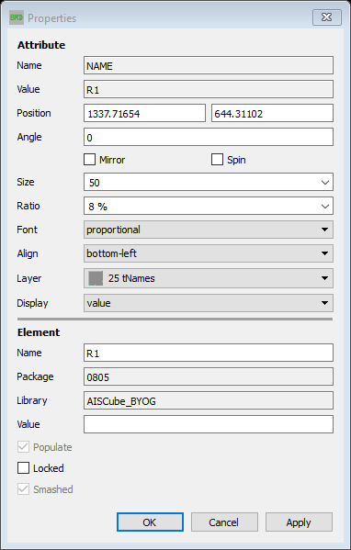

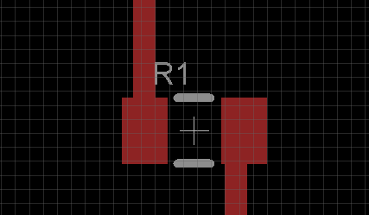
Preparing the board
Part Placement
Preparing to Route
Power Lines
Signal Lines
Silkscreen Items
Schematic Drawing
GND Planes
Making changes to the labels
Under Size, Select 50
Select R1
⬥
❖
Select Smash
◆
A cross hair for R1 will appear and make R1 editable.
Right Click R1 > Properties

You can now move the Labels as well.
Do the same for the others where required.

Slide 33
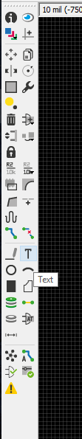
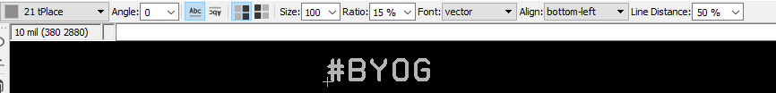
Preparing the board
Part Placement
Preparing to Route
Power Lines
Signal Lines
Silkscreen Items
Schematic Drawing
GND Planes
Writing text on to silkscreen layer
ALWAYS USE VECTOR FONT
⬥
Play around with size, ratio and font till happy
(Remember: Ratio only works with Font: Vector!)
❖
◆
Select tPlace for Top Layer
Select bPlace for Bottom Layer
Select Text > Write text > Enter
NOTE:
You may choose to have just text, or just an image, or both on the silkscreen layer.
If you’re just placing text, follow the instructions here, and when you’re done, go straight to the last slide.
If you wish to place an image, continue till the last slide.

Slide 34
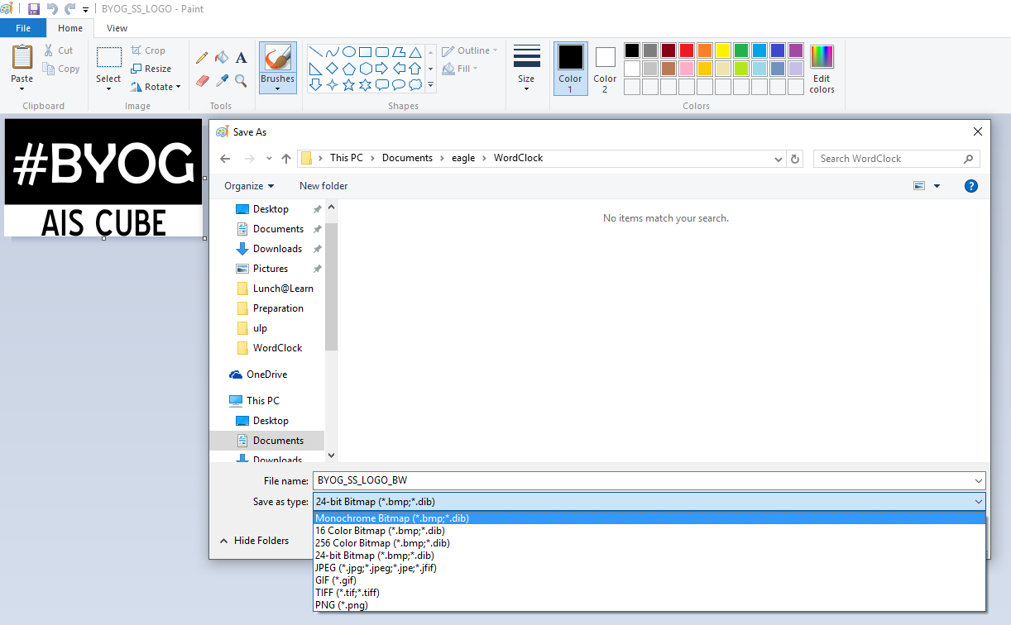
Preparing the board
Part Placement
Preparing to Route
Power Lines
Signal Lines
Silkscreen Items
Schematic Drawing
GND Planes
Preparing your image for silkscreen (Using paint)
WINDOWS USERS
Make sure your image is in .bmp Format, Monochrome (1bit)
(If your image is already in Black & White but not in the above format, use Paint to Save As .bmp Monochrome)
(If you have already done the conversion in PAINT, skip this slide)

Slide 35
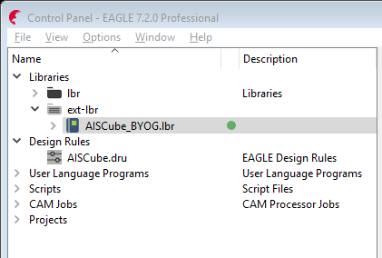
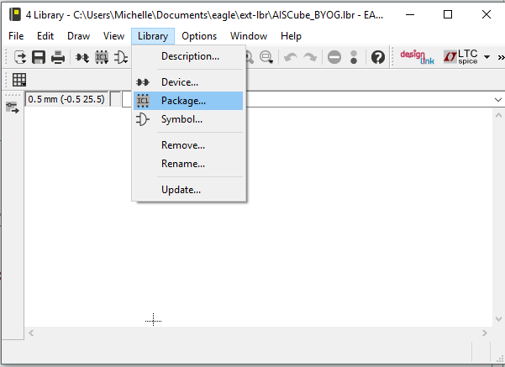
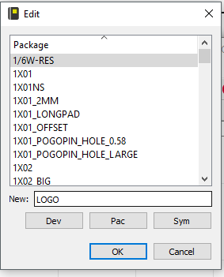
Preparing the board
Part Placement
Preparing to Route
Power Lines
Signal Lines
Silkscreen Items
Schematic Drawing
GND Planes
Adding your image into the library
Let’s put your image into the library for easy usage
Under EAGLE’s control panel, Double click on AISCube_BYOG.lbr
The library window will pop up
Select Library > Package
In the textbox next to “New”, Name your image as “Logo” (or whatever makes you happy)
Click OK
A package editor window (that looks like a board layout window) will pop up
Proceed to import bmp (next slide)
◆
❖
⬥


Slide 36
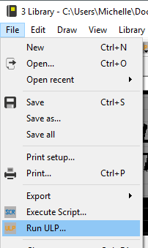
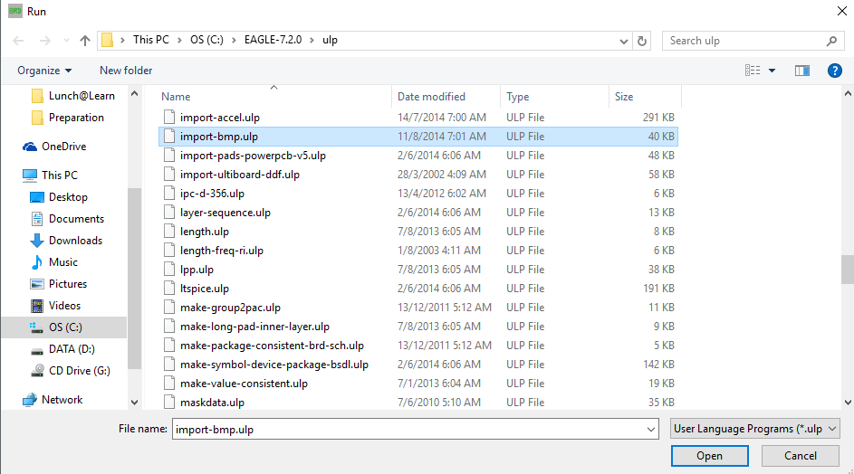
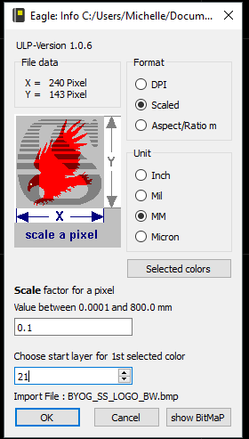

Preparing the board
Part Placement
Preparing to Route
Power Lines
Signal Lines
Silkscreen Items
Schematic Drawing
GND Planes
Import bmp
File > Run ULP
Select import-bmp.ulp
Select your image
Info Box > Click OK
Select Black > OK
Ensure your settings are as follows:
Format: Scaled
Unit: MM
Scale Factor: 0.1
Layer: 21 (tPlace)
OK > Run Script
Change the Grid to a value like 10mm to check sizing
If you would like to redo the image at a different size, Delete the entire group, and repeat from Step 1 while playing around with the scale factor till you’re happy with the sizing
Once you’re happy with the size, Save the library.
Go to EAGLE’s control panel
Update AISCube_BYOG.lbr (right click> update)
In your board design, Click on ADD > LOGO
Place logo onto board

Slide 37
Done!
Please email your entire project folder to
FAZLI@12GEEKS.COM
By Sunday (13/11/2016) Night 2359 hours

