Slide 1
Machine Learning
Group: NA
Natalia Namysłowska, Adam Jaworski

Slide 2
Regression: Developer Salary Prediction

Slide 3
Approach overview
1. Train / val / test split (70 / 15 / 15)
Key project decisions
2. R17 cleaning
R17 Cleaning
Removal of extreme values (mixed currency) from the training set only.
3. Feature engineering (~370 features)
4. Preprocessing pipeline (4 transformer groups)
Logarithmic Transformation
Modelling log1p(salary) and conditional Duan smearing.
5. Baseline 5-fold CV across 6 models
6. Grid search on SVR-RBF and ElasticNet
Ensemble Model
Linear combination of SVR-RBF and ElasticNet with learned weights.
7. Validation set decides smearing + ensemble weight
8. Final refit on full labelled data

Slide 4
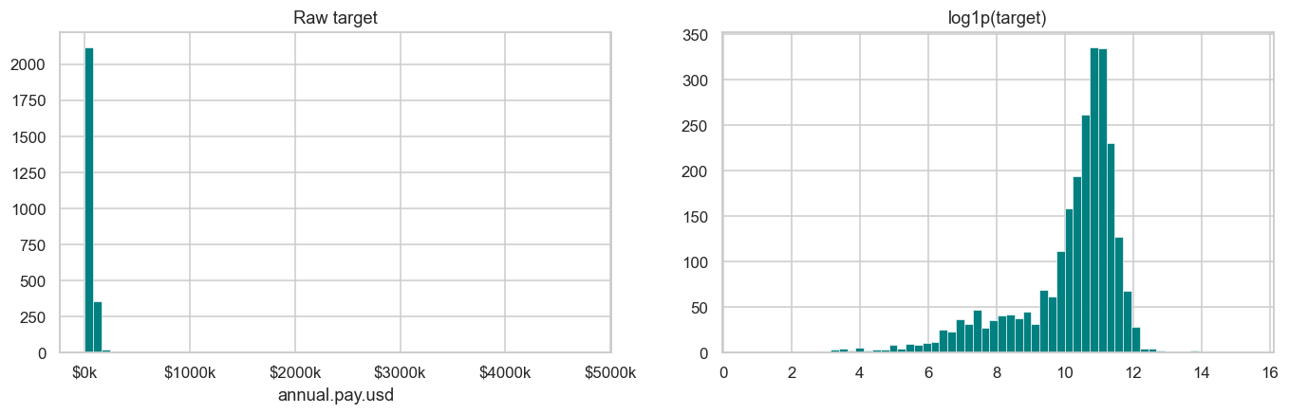
Target distribution
Skewness 33+
A handful of high-salary rows dominate the raw distribution.
Range $1 to $4.77M
Most reports look reasonable; the extremes do not.
Log-transform fixes skewness
log1p(salary) is roughly symmetric and stabilises linear models.
Implication for evaluation
RMSE is reported on raw scale; predictions are back-transformed.

Slide 5
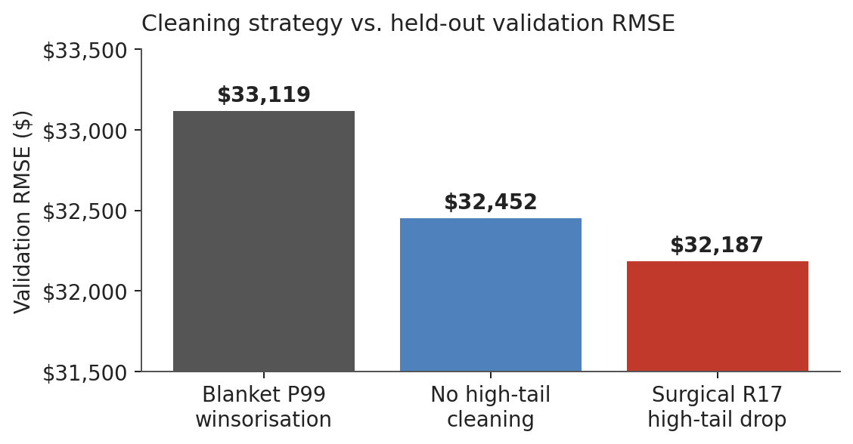
R17: the one decision that mattered most
Why the surgical filter wins
● R17 shows likely mixed-currency outliers: normal salaries up to ~$240K, then $1M+ cases.
● General P99 clipping would remove valid high earners.
● Targeted R17 filtering removes only 3 contaminated rows.
● This gave the lowest validation RMSE, without cleaning the validation set.
fix

Slide 6
Feature engineering
From 41 raw columns to ~370 model inputs
fix
● Experience curve. Drop redundant `coding.years.total` (r=0.86 with professional years); add quadratic and log1p terms on the two kept columns to capture diminishing returns.
● Seniority signal. Binary flags extracted from `dev.role` for Senior / Lead / Manager / Junior / Principal / Architect / Director / Executive / Staff / VP.
● Technology breadth. For each of the 15 multi-select columns: a per-column count and binary indicators for the top 25 items observed in training. Plus a global `tech_breadth_total` aggregate (useful to the non-linear SVR).
● Informative missingness. AI-related columns are only shown to AI users; missingness itself carries salary signal. Added a binary `miss_*` flag for every column with more than 10% missing values in training.
● Region x company size interaction. String-concatenated categorical, target-encoded so that company size is allowed to mean different things in different regions.

Slide 7
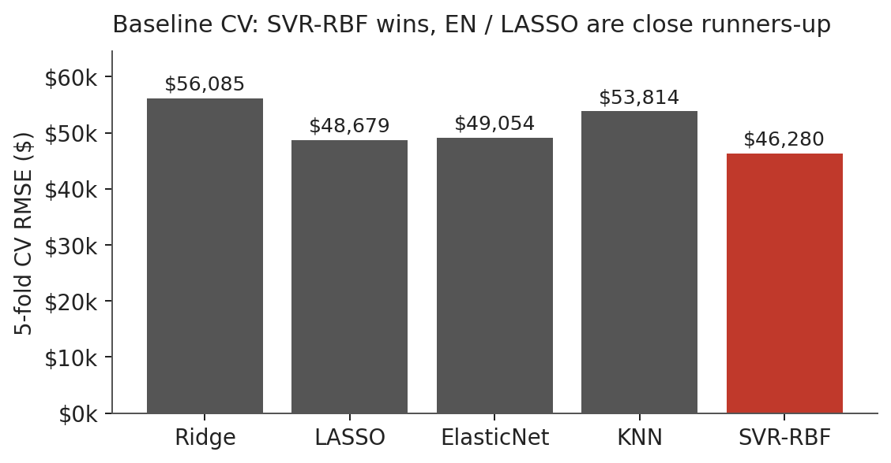
fix
Model selection & final results
SVR-RBF wins the baselines; final model is a linear ensemble with ElasticNet
Final ensemble
Model
0.56 × SVR-RBF + 0.44 × ElasticNet
SVR-RBF
C=1.0, ε=0.05, γ=0.001
ElasticNet
α=0.03, l1_ratio=0.7
Smearing (SVR / EN)
False / True
Feature matrix
369 columns
Validation RMSE
$32,187
Internal test RMSE
$73,028

Slide 8
Classification:

