Slide 1
ML1 (2026) — Task 2
Developer Salary Prediction
A regularised linear and SVR-RBF ensemble approach
[ Your name ]
[ Course / professor / date ]
Notes:
Quick opener. State your name, that this is your Task 2 regression submission, and that you'll spend the next four minutes covering the approach, the one decision that mattered most (R17 cleaning), the features, and the final results. Keep it under fifteen seconds so you have time for the substance.

Slide 2
Approach overview
Six syllabus regressors compared, the two best combined into a linear ensemble
1. Train / val / test split (70 / 15 / 15)
Three decisions that shaped the model
2. R17 cleaning (training only)
● R17 cleaning. Drop currency-mixed outliers (both tails) from training only.
● Log target. Model log1p(salary); apply Duan's smearing on back-transform only when validation says so.
● Ensemble. Linear combination of SVR-RBF and ElasticNet, weight learned on the validation split.
3. Feature engineering (~370 features)
4. Preprocessing pipeline (4 transformer groups)
5. Baseline 5-fold CV across 6 models
6. Grid search on SVR-RBF and ElasticNet
7. Validation set decides smearing + ensemble weight
8. Final refit on full labelled data
ML1 (2026) — Task 2: Developer Salary Prediction
2 / 7
Notes:
I built a single pipeline that takes the raw survey data, cleans the R17 region, engineers around three hundred and fifty features, runs five fold cross validation across the six syllabus regressors, tunes the two best with grid search, and then uses the held out validation set to decide whether to apply Duan's smearing on the back transform and what weight to give each model in the final ensemble. The three decisions on the right are the ones that actually moved the needle; the rest is plumbing. I'll spend most of the time on R17 and feature engineering.

Slide 3
Target distribution
Raw target is extreme; we model log1p(salary)
● Skewness 33+. A handful of high-salary rows dominate the raw distribution.
● Range $1 to $4.77M. Most reports look reasonable; the extremes do not.
● Log-transform fixes skewness. log1p(salary) is roughly symmetric and stabilises every linear model in the syllabus.
● Implication for evaluation. RMSE is reported on the raw dollar scale; predictions are back-transformed before measuring.
[ paste your raw / log distribution figure here ]
ML1 (2026) — Task 2: Developer Salary Prediction
3 / 7
Notes:
Standard observation that everyone working with this dataset makes: the raw target has skewness above thirty three, with reported salaries ranging from one dollar to four point seven seven million. That makes least squares regression behave very badly on the raw scale, because the loss is dominated by a tiny number of extreme rows. Modelling log one plus salary instead gives a roughly symmetric target, and we back transform to dollars before measuring RMSE so the metric is still on the scale the task asks for. I'll be quick here since the other presentations will cover the dataset in more depth.

Slide 4
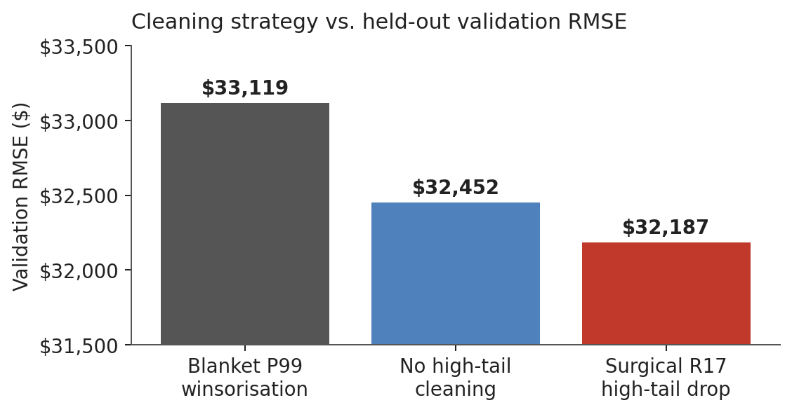
R17: the one decision that mattered most
Three cleaning strategies compared on held-out validation RMSE
Why the surgical filter wins
● R17 is bimodal: plausible salaries up to ~$240K, then a small cluster at $1M+ that almost certainly reflects local-currency reports.
● Blanket P99 also clips legitimate high earners in other regions, hurting predictions on rows we should get right.
● A targeted drop on R17 only (below $500 and above $500K) removes 3 contaminated rows without touching real high earners.
● Result: lowest validation RMSE, on a validation split that was itself never cleaned.
ML1 (2026) — Task 2: Developer Salary Prediction
4 / 7
Notes:
This is the slide that distinguishes my submission. R17 is a noisy region that contains both the lowest reported salaries in the entire dataset and the highest, all the way up to four point seven million. The most natural explanation is that some respondents reported in local currency rather than dollars. I tried three cleaning strategies. First, a blanket per region ninety ninth percentile winsorisation, the way many tutorials would suggest. That actually hurts, because it also clips legitimate high earners in other regions. Second, leaving everything intact above five hundred dollars. Better, but still has the R17 contamination in training. Third, a targeted two sided filter on R17 only: drop below five hundred and above five hundred thousand. Only three rows in the entire dataset get removed, but that surgical removal gives the lowest validation RMSE of the three approaches. The key insight is that more cleaning is not always better; the cleaning has to be targeted at the right contamination.

Slide 5
Feature engineering
From 41 raw columns to ~370 model inputs, no leakage
● Experience curve. Drop redundant `coding.years.total` (r=0.86 with professional years); add quadratic and log1p terms on the two kept columns to capture diminishing returns.
● Seniority signal. Binary flags extracted from `dev.role` for Senior / Lead / Manager / Junior / Principal / Architect / Director / Executive / Staff / VP.
● Technology breadth. For each of the 15 multi-select columns: a per-column count and binary indicators for the top 25 items observed in training. Plus a global `tech_breadth_total` aggregate (useful to the non-linear SVR).
● Informative missingness. AI-related columns are only shown to AI users; missingness itself carries salary signal. Added a binary `miss_*` flag for every column with more than 10% missing values in training.
● Region x company size interaction. String-concatenated categorical, target-encoded so that company size is allowed to mean different things in different regions.
All data-distribution-dependent rules (top-N tech items, missingness threshold) are fitted on the training split only.
ML1 (2026) — Task 2: Developer Salary Prediction
5 / 7
Notes:
Five groups of engineered features. The first three are about giving the linear models curvature where the data has curvature: quadratic and log terms on experience, seniority keywords parsed out of the dev role string, and technology breadth from the fifteen multi select columns, encoded both as counts and as binary indicators for the most common items. The fourth one is the most analytically interesting: for several AI related columns the row is only shown the question if they use AI tools at all, so the missingness itself is informative; I added a binary flag for every column with more than ten percent missing in training. The fifth is a region by company size interaction, target encoded, which lets the model learn that the same company size band can mean different salary levels in different regions. All the data dependent decisions, like the top N tech items, are fitted on the training split alone to prevent leakage.

Slide 6
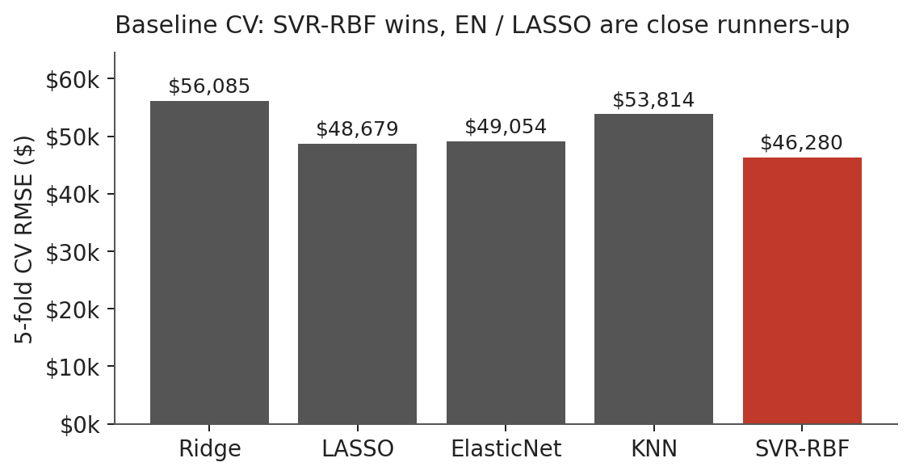
Model selection & final results
SVR-RBF wins the baselines; final model is a linear ensemble with ElasticNet
Final ensemble
Model
0.56 × SVR-RBF + 0.44 × ElasticNet
SVR-RBF
C=1.0, ε=0.05, γ=0.001
ElasticNet
α=0.03, l1_ratio=0.7
Smearing (SVR / EN)
False / True
Feature matrix
369 columns
Validation RMSE
$32,187
Internal test RMSE
$73,028
The internal test RMSE is dominated by a single $1.27M R17 row that the model deliberately predicts at the regional norm.
ML1 (2026) — Task 2: Developer Salary Prediction
6 / 7
Notes:
Baseline five fold cross validation on the cleaned training set with the same preprocessing pipeline for every model. SVR with the RBF kernel wins clearly at about forty six thousand dollars CV RMSE; LASSO and ElasticNet are tied as runners up around forty eight to forty nine thousand. I then tuned SVR and ElasticNet with grid search and combined them in a linear ensemble whose weight was scanned on the held out validation split. The final weights are zero point five six SVR and zero point four four ElasticNet. Smearing helps ElasticNet but not SVR, so I applied it only where the validation set said it improved RMSE. Final held out validation RMSE is about thirty two thousand two hundred. The internal test RMSE looks much larger at seventy three thousand, but more than half of that comes from one single R17 row reported at one point two seven million; my model predicts it at the regional norm because that's what the feature pattern says, and on the assumption that the row is currency contaminated this is the right behaviour.

Slide 7
Takeaways
Three lessons I'd carry to the next regression problem
1
Cleaning matters, but targeting matters more.
Blanket winsorisation looked good on the metric and made generalisation worse. The surgical R17 filter removes 3 rows and beats the blanket cap.
2
Validation set decisions beat training set heuristics.
Smearing correction, ensemble weight, and the choice of cleaning strategy were all decided on the held-out 377-row validation split, never on training residuals or CV averages alone.
3
Ensembles in the syllabus toolbox are enough.
SVR-RBF brings non-linear flexibility, ElasticNet brings a stable linear backbone. Their linear combination dominates either model on its own, with no need to step outside the course material.
ML1 (2026) — Task 2: Developer Salary Prediction
7 / 7
Notes:
Three takeaways in thirty seconds. First, cleaning matters but targeting matters more; the blanket cap looked great on the metric but generalised worse, while a three row surgical removal won on the validation set. Second, every selection decision in this notebook was made on the held out validation split, not on training residuals, which kept the methodology honest. Third, the six regressors from the syllabus, combined as a simple linear ensemble of the two best, are genuinely enough for this problem; no gradient boosting or deep learning was needed. Thanks for listening, happy to take questions.

