Slide 1
4th
The Fourth Sheet
SAMPLE DATA · invented figures for demonstration
Deliveries in and out
Sample Distribution Pty Ltd
Every delivery out to a customer and in from a supplier, for an invented distribution centre at Wacol, Brisbane.
How final is this data?
Today (6 Oct): incomplete, as at 2pm, Tue 6 Oct 2026.
1-5 October: provisional (October locks 3 Nov).
September and earlier: locked.
deliveries-sample.pptx
Data retrieved 2pm, Tue 6 Oct 2026 · Sample data
Slide 1 of 7

Slide 2
Sample Distribution Pty Ltd · Deliveries in and out
Deliveries out, to customers · last 30 days
Deliveries
On time
Late
Overdue now
In full
868
93.0%
60
1
98.0%
deliveries-sample.pptx
Data retrieved 2pm, Tue 6 Oct 2026 · Sample data
Slide 2 of 7

Slide 3
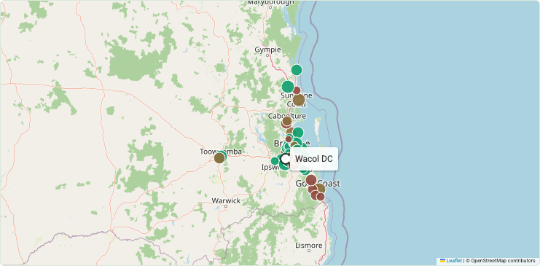
Sample Distribution Pty Ltd · Deliveries in and out
Deliveries out, to customers · map
Green 95%+ on time · rose 80-95% · brick under 80% or overdue · grey-blue on its way. Dot size = number of deliveries.
deliveries-sample.pptx
Data retrieved 2pm, Tue 6 Oct 2026 · Sample data
Slide 3 of 7

Slide 4
Sample Distribution Pty Ltd · Deliveries in and out
Deliveries out, to customers · where it's going wrong
 | Late | Of | % late
Carrier A · Gold Coast | 18 | 64 | 28.1%
Carrier B · Moreton Bay | 7 | 68 | 10.3%
Carrier A · Logan | 5 | 63 | 7.9%
deliveries-sample.pptx
Data retrieved 2pm, Tue 6 Oct 2026 · Sample data
Slide 4 of 7

Slide 5
Sample Distribution Pty Ltd · Deliveries in and out
Deliveries in, from suppliers · last 30 days
Deliveries
On time
Late
Overdue now
In full
128
91.9%
10
2
90.3%
deliveries-sample.pptx
Data retrieved 2pm, Tue 6 Oct 2026 · Sample data
Slide 5 of 7

Slide 6
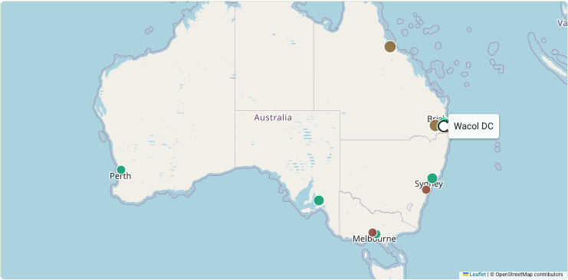
Sample Distribution Pty Ltd · Deliveries in and out
Deliveries in, from suppliers · map
Green 95%+ on time · rose 80-95% · brick under 80% or overdue · grey-blue on its way. Dot size = number of deliveries.
deliveries-sample.pptx
Data retrieved 2pm, Tue 6 Oct 2026 · Sample data
Slide 6 of 7

Slide 7
Sample Distribution Pty Ltd · Deliveries in and out
Deliveries in, from suppliers · where it's going wrong
 | Late | Of | % late
Supplier C · Line-haul (road) | 3 | 6 | 50.0%
Supplier D (imports) · Container cartage | 3 | 8 | 37.5%
Supplier K · Line-haul (road) | 2 | 12 | 16.7%
deliveries-sample.pptx
Data retrieved 2pm, Tue 6 Oct 2026 · Sample data
Slide 7 of 7

