Slide 1


Division of
IT Convergence Engineering (ITCE)
Distributed Processing & Network Management 2012
http://itce.postech.ac.kr
Notes:
Good afternoon, now I would like to summary what I studied last week.

Slide 2
Contents
Mobile is the Future
Mobile Detection
Kurogo Mobile Optimized Middleware
Adaptation frameworks
Nguyen Ngoc Chau Sang
Notes:
My presentation is include four key areas. My presentation will be in four parts.
Firstly I am going to having a very short talk about mobile and the future.
Second part is about how to detect a mobile when it access to our website.
Next I will summary about Modolabs.
Finally, It is a quick review some available adaptation frameworks.
Lê Thị Hoàng Ngân - KHMT-CNTT-KHTN

Slide 3
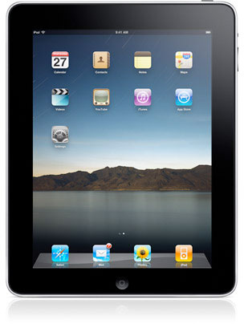
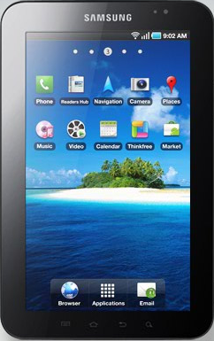
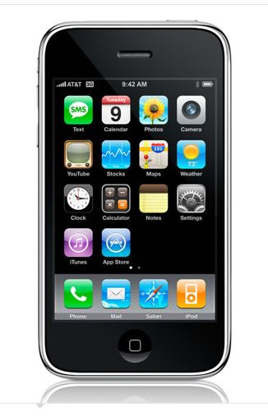
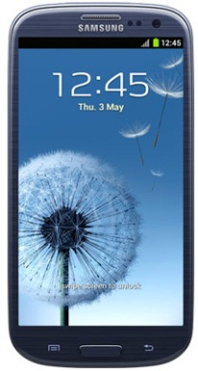
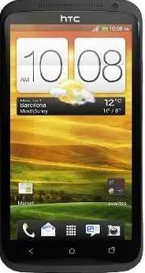
MOBILE IS THE FUTURE
  +1 billion mobile phones sold per year.
  +100 million mobile web users in the US.
  Mobile web access will surpass PCs by 2013 (Gartner).
  Today, all most mobiles can access internet, support for browsing, email,…
Nguyen Ngoc Chau Sang
Notes:
As you know, nowadays mobile are getting more popular.
Lê Thị Hoàng Ngân - KHMT-CNTT-KHTN

Slide 4

MOBILE IS THE FUTURE
  Mobile Internet is not the “mini-Internet”.
  Mobile devices can have significant limitations.
Nguyen Ngoc Chau Sang
Notes:
But …. Browsing on a desktop or laptop is a quite different experience than browsing on a mobile device.
Such as: small screen size, not support javascript, html…
Lê Thị Hoàng Ngân - KHMT-CNTT-KHTN

Slide 5
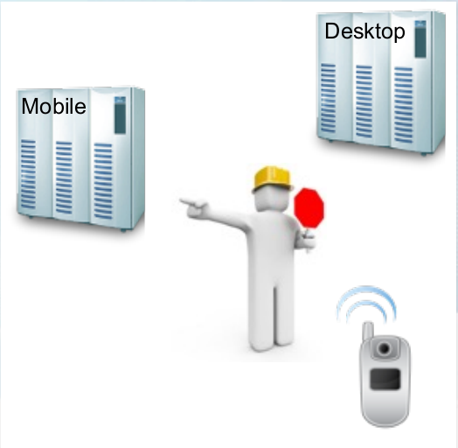
MOBILE DETECTION
Using JavaScript
Using the User-Agent
Using WURFL
Some other tools
Nguyen Ngoc Chau Sang
Notes:
When building a website, this is what most people want to do. They want to detect if their customer is on a mobile device and then redirect them to the suitable site (desktop version or mobile version). There are some method to acquire this requirement:
Lê Thị Hoàng Ngân - KHMT-CNTT-KHTN

Slide 6
Using JavaScript
We can use some type of browser detection script (jWURFL: http://ostatic.com/jwurfl)
Problems: Many devices currently don’t support JavaScript.
Nguyen Ngoc Chau Sang
Notes:
Lê Thị Hoàng Ngân - KHMT-CNTT-KHTN

Slide 7
Using User-Agent String
User-Agent Strings identify what a user is using to access a web-page.
Advantage: doesn’t depend on a scripting language. It uses a server-side language (PHP, ASP, JSP …) to look at the user agent.
Problems: We need more information about devices such as: screen size, image formats… to give the best user experience.
Nguyen Ngoc Chau Sang
Notes:
Such as its application type, operating system, software vendor
Lê Thị Hoàng Ngân - KHMT-CNTT-KHTN

Slide 8

WURFL (the Wireless Universal Resource File)
A big store of information that will help us not only recognize devices but also the ability to support certain feature.
Advantage: open source providing for the most common programming languages such as Java, Python, Ruby, PHP…
Nguyen Ngoc Chau Sang
Notes:
Such as its application type, operating system, software vendor
Lê Thị Hoàng Ngân - KHMT-CNTT-KHTN

Slide 9
Other tools
DeviceAtlas
51 Degrees
Nguyen Ngoc Chau Sang
Notes:
Such as its application type, operating system, software vendor
Lê Thị Hoàng Ngân - KHMT-CNTT-KHTN

Slide 10
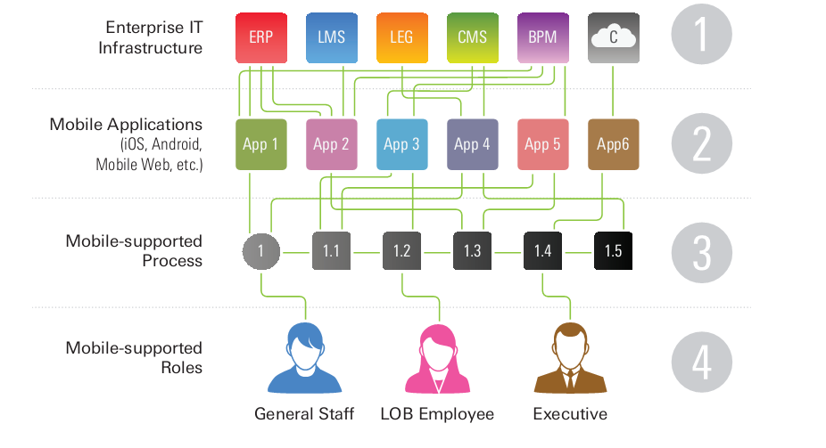
Mobile Value Chain Issues
Multi data formats
Multi P.Ls
Multi mobiles
☹
Nguyen Ngoc Chau Sang
Notes:
This figure show the basic problem in mobile value chain:
The company must spend more money and time creating and maintaining connections between mobile apps and data sources.
A lot of time for developing mobile applications because skills spread on multiple platforms and programming languages.
Testing is so complex because of the huge number of different mobile with different property.
So the user are not always provided the best experience.
We called all memtioned problems is the fragementation in mobile value chain
Lê Thị Hoàng Ngân - KHMT-CNTT-KHTN

Slide 11
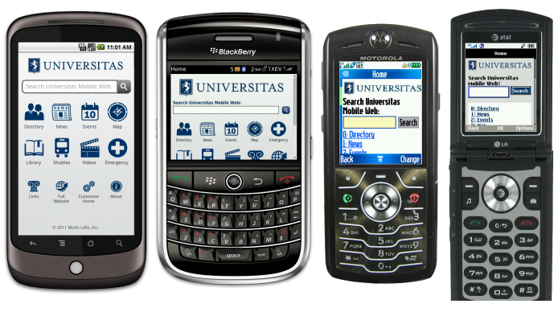
Kurogo Mobile Optimized Middleware
Kurogo Mobile Optimized Middleware (KMOM) is a new kind of middleware developed to address the fragmented mobile value chain.
Based on the MIT Mobile Framework, it was designed from the ground up specifically for mobile.
Nguyen Ngoc Chau Sang
Notes:
Lê Thị Hoàng Ngân - KHMT-CNTT-KHTN

Slide 12
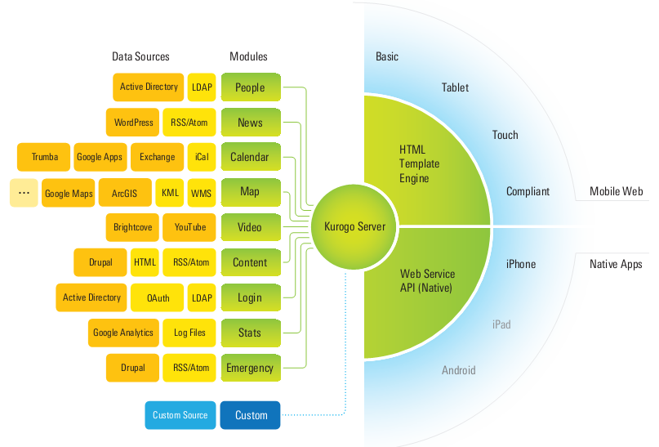
How does it work?
Mobile Web
Data Sources → Modules → Kurogo Server
Native apps
Providing an open, single API for all kind of data
Nguyen Ngoc Chau Sang
Notes:
Figure shows clearly the process: data sources integrate with modules, then they are pulled into the Kurogo Server. Kurogo Server create an open, single API for different data sources and data format. Native and mobile web-based solutions request data and content from Kurogo. Data and content are delivered to these solutions in an optimized way that takes in account the screen size, data input method (including keyboards or touch screens), platform, and device type of the user.
Lê Thị Hoàng Ngân - KHMT-CNTT-KHTN

Slide 13
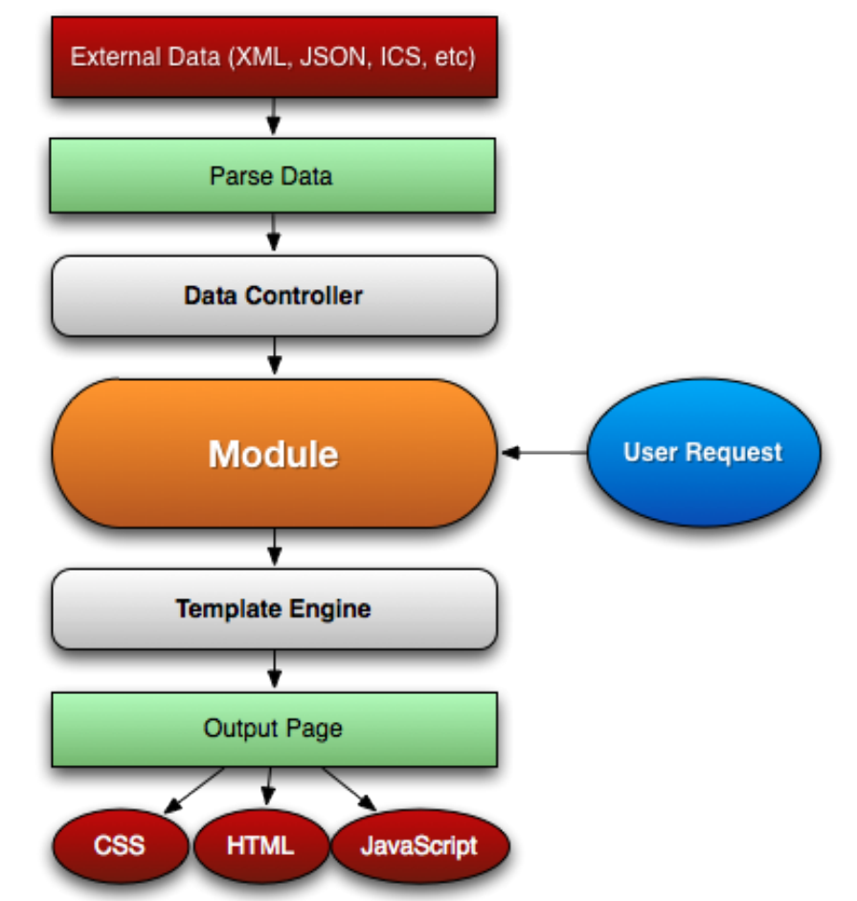
Kurogo MOM
MODEL
Feed data
CONTROLLER
Browser → suitable template
VIEW
Native App → JSON
Nguyen Ngoc Chau Sang
Notes:
The building block for Kurogo is modules. Each page request is handled by a module.
The function of a module is parsing the url and displays one of its pages with content.
Modules using Data Controller to feed data.
If user is on a browser, the module asks the Template Engine for templates suitable for the user’s device.
If user is using a native app, the module outputs is in JSON format.
Lê Thị Hoàng Ngân - KHMT-CNTT-KHTN

Slide 14
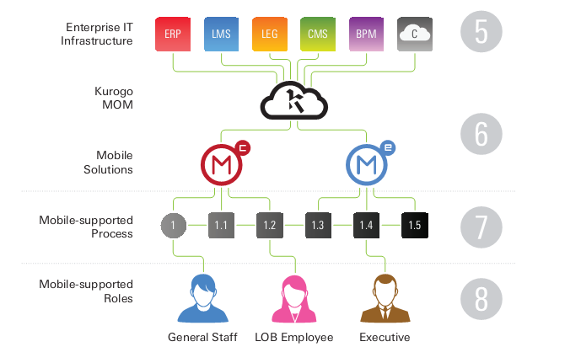
Kurogo MOM
Nguyen Ngoc Chau Sang
Notes:
So here is entire solution of Kurogo
Lê Thị Hoàng Ngân - KHMT-CNTT-KHTN

Slide 15
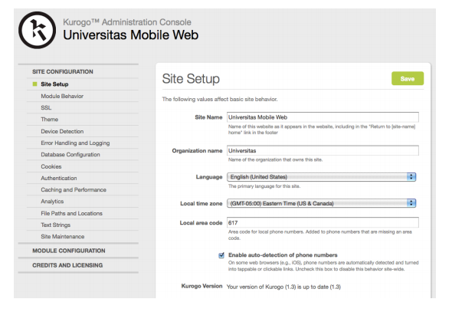
Kurogo MOM
Admin Console
Selecting module
Naming module
Ordering module
Hooking up data sources
Configuring business logic rules
Error handling
Reporting
…
Nguyen Ngoc Chau Sang
Notes:
It is a special module in Kurogo that provides a user-friendly interface to edit site and module.
Lê Thị Hoàng Ngân - KHMT-CNTT-KHTN

Slide 16
The Benefit of Kurogo Mobile Optimized Middleware
Integrated solution
Consistent interface
Can expose API to native applications
User-friendly interface.
Nguyen Ngoc Chau Sang
Notes:
Such as its application type, operating system, software vendor
Lê Thị Hoàng Ngân - KHMT-CNTT-KHTN

Slide 17
Adaptation frameworks
A semantics-Based Automatic Web Content Adaptation Framework for Mobile Devices [1].
A smart framework for web content and resources adaptation in mobile devices [2].
Nguyen Ngoc Chau Sang
Notes:
Lê Thị Hoàng Ngân - KHMT-CNTT-KHTN

Slide 18
A Semantics-Based Automatic Web Content Adaptation Framework for Mobile Devices
Overcome the presentation inconsistency among mobile devices and desktop computers.
Web pages and image file are automatically transcoded according to semantics extracted from CC/PP (Composite Capability/Preference) client device configuration and web contents.
This technology is suitable for resource-limited devices to balance information loss and information availability.
Nguyen Ngoc Chau Sang
Notes:
Lê Thị Hoàng Ngân - KHMT-CNTT-KHTN

Slide 19
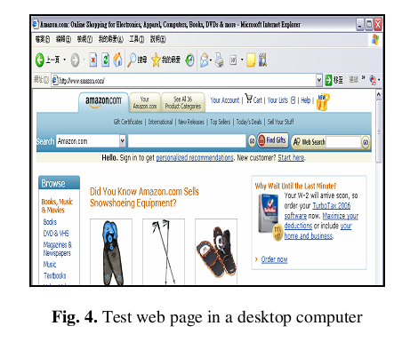
Nguyen Ngoc Chau Sang
Notes:
Lê Thị Hoàng Ngân - KHMT-CNTT-KHTN

Slide 20
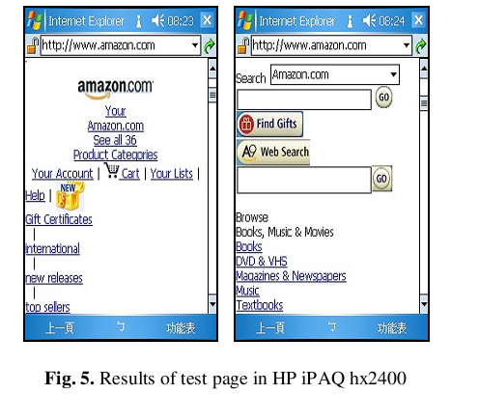
Nguyen Ngoc Chau Sang

Slide 21
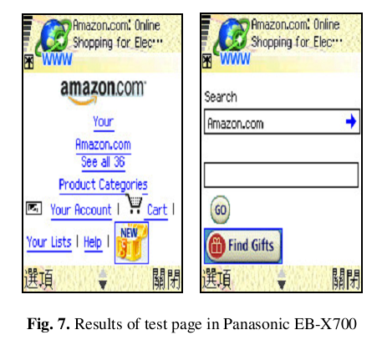
Nguyen Ngoc Chau Sang

Slide 22
A smart framework for web content and resources adaptation in mobile devices
Provide a tool for webmasters that could weaves both mobile web and traditional web production into just one single tool.
Provide media adaptation to provide special version of the best optimized and compressed.
Minimize the transferred data size for mobile access.
Nguyen Ngoc Chau Sang
Notes:
Lê Thị Hoàng Ngân - KHMT-CNTT-KHTN

Slide 23
References
[1] Chichang Jou, 2008 A Semantics-Based Automatic Web Content Adaptation Framework for Mobile Devices, Department of Information Management, Tamkang University, WEBIST 2007, LNBIP 8, pp. 230–242, © Springer-Verlag Berlin Heidelberg.
[2] Shawkat K. Guirguis and Mohamed A. Hassan. 2010. A smart framework for web content and resources adaptation in mobile devices. In Proceedings of the 12th international conference on Advanced communication technology (ICACT'10). IEEE Press, Piscataway, NJ, USA, 487-492.
Nguyen Ngoc Chau Sang
Notes:
Lê Thị Hoàng Ngân - KHMT-CNTT-KHTN

Slide 24
Thank you for your listening ☺
Q&A
Nguyen Ngoc Chau Sang
Notes:
Lê Thị Hoàng Ngân - KHMT-CNTT-KHTN

