Slide 1


Division of
IT Convergence Engineering (ITCE)
Distributed Processing & Network Management 2012
http://itce.postech.ac.kr
Notes:
Good afternoon, now I would like to summary what I studied last week.

Slide 2
Design Principles
Physical context: in a mobile space with small screen, may be not support JavaScript.
Technical context: on a mobile device with slow speed, bandwidth,…
Nguyen Ngoc Chau Sang
Notes:
Such as its application type, operating system, software vendor
Lê Thị Hoàng Ngân - KHMT-CNTT-KHTN

Slide 3
Design Principles
Weed out what is not suitable for mobile device
  Long or complex interactions and input
  Lots of screen real estate
  Heavy network use
Choose what is suitable for mobile device
  Mobilized
  Mobile-specific
Minimize Distance to Goals
Make it available for all kind of devices
Optimize for different platforms
Nguyen Ngoc Chau Sang
Notes:
Such as its application type, operating system, software vendor
Lê Thị Hoàng Ngân - KHMT-CNTT-KHTN

Slide 4
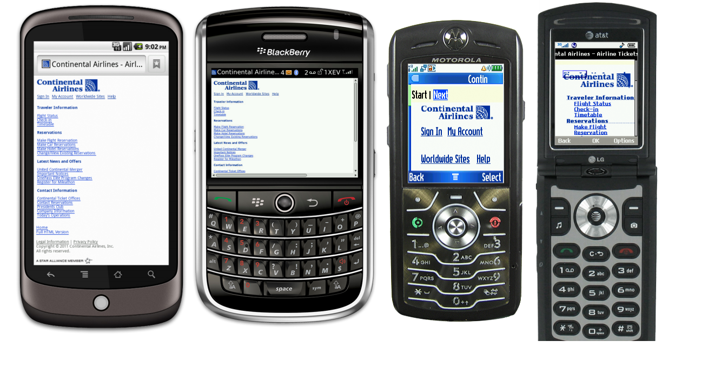
Nguyen Ngoc Chau Sang
Notes:
Such as its application type, operating system, software vendor
Lê Thị Hoàng Ngân - KHMT-CNTT-KHTN

Slide 5
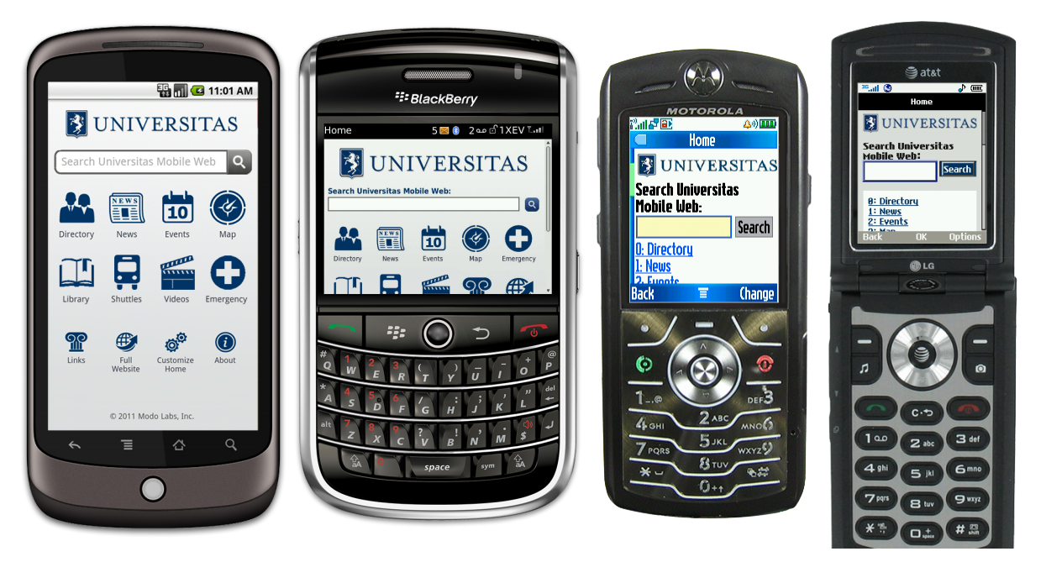
Nguyen Ngoc Chau Sang
Notes:
Such as its application type, operating system, software vendor
Lê Thị Hoàng Ngân - KHMT-CNTT-KHTN

Slide 6
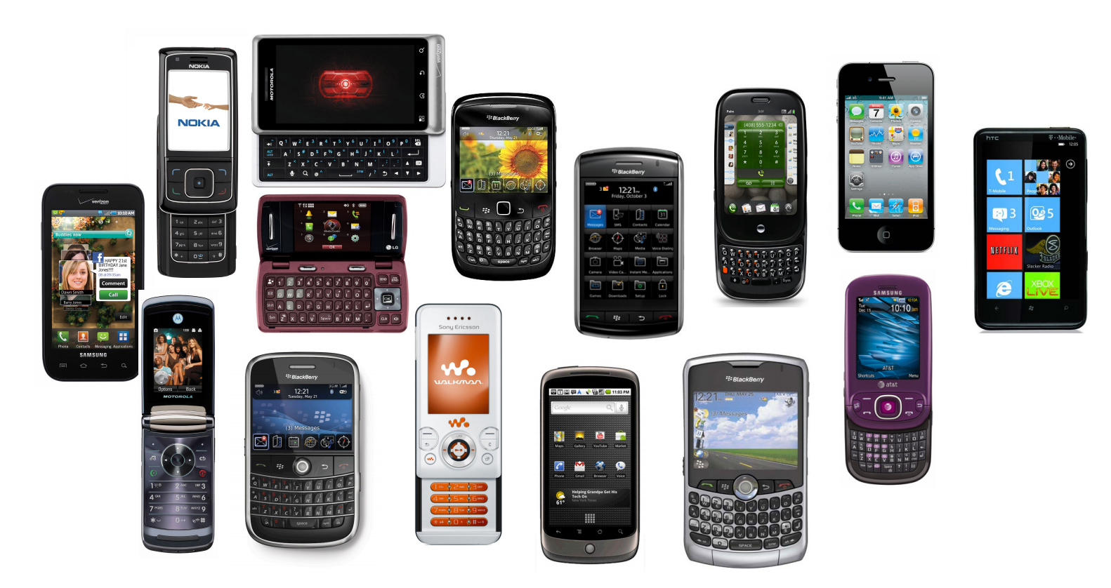
Nguyen Ngoc Chau Sang
Notes:
Such as its application type, operating system, software vendor
Lê Thị Hoàng Ngân - KHMT-CNTT-KHTN

Slide 7
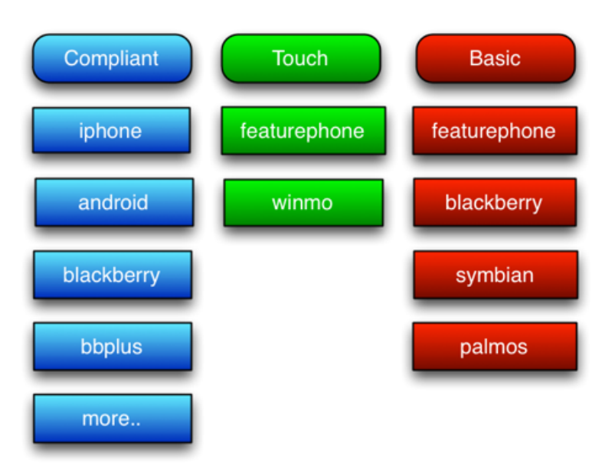

Nguyen Ngoc Chau Sang

Slide 8
Solutions of Kurogo
Segmentation and adaptation
Group into a manageable set of device classes for which we can optimize the web experience.
Nguyen Ngoc Chau Sang

Slide 9
Technical Principles
Separate presentation from logic
Model - Data Objects
View - HTML Templates using Smarty
Controller – Object Oriented modules
Nguyen Ngoc Chau Sang

Slide 10
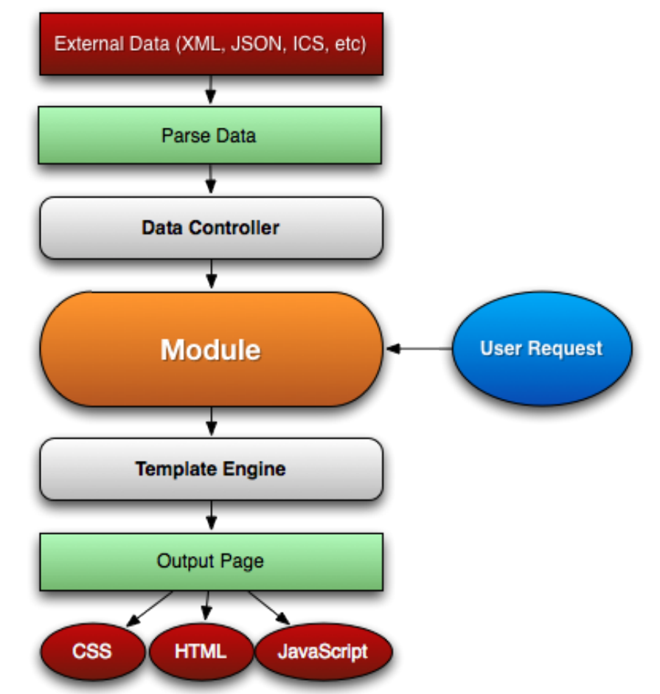
Kurogo MOM
MODEL
Feed data
CONTROLLER
Browser → suitable template
VIEW
Native App → JSON
Nguyen Ngoc Chau Sang
Notes:
The building block for Kurogo is modules. Each page request is handled by a module.
The function of a module is parsing the url and displays one of its pages with content.
Modules using Data Controller to feed data.
If user is on a browser, the module asks the Template Engine for templates suitable for the user’s device.
If user is using a native app, the module outputs is in JSON format.
Lê Thị Hoàng Ngân - KHMT-CNTT-KHTN

Slide 11
The Benefit of Kurogo Mobile Optimized Middleware
Integrated solution
Consistent interface
Single URL
Can expose API to native applications
Nguyen Ngoc Chau Sang
Notes:
Such as its application type, operating system, software vendor
Lê Thị Hoàng Ngân - KHMT-CNTT-KHTN

Slide 12
The Benefit of Kurogo Mobile Optimized Middleware
Open Source
Faster App and Website Creation
Code Specifically Written for Mobile
Standard Languages and Systems
Taming the Jungle
Focus on the User
Customization Options
Clean Break Between and Presentation Logic
Nguyen Ngoc Chau Sang
Notes:
Such as its application type, operating system, software vendor
Lê Thị Hoàng Ngân - KHMT-CNTT-KHTN

Slide 13
Open Source
100% direct access to their source code
The vibrant Kurogo community frequently make code contributions.
Nguyen Ngoc Chau Sang
Notes:
Such as its application type, operating system, software vendor
Lê Thị Hoàng Ngân - KHMT-CNTT-KHTN

Slide 14
Faster App and Website Creation
Open, flexible API.
Pre-built applications
Inheritable mobile web templates
Flexible data handling
Useful admin console
Nguyen Ngoc Chau Sang
Notes:
Such as its application type, operating system, software vendor
Lê Thị Hoàng Ngân - KHMT-CNTT-KHTN

Slide 15
Code Specifically Written for Mobile
Mobile websites and apps are optimized for the lower bandwidth, screen sizes and interaction method of all mobile devices.
Nguyen Ngoc Chau Sang
Notes:
Such as its application type, operating system, software vendor
Lê Thị Hoàng Ngân - KHMT-CNTT-KHTN

Slide 16
Standard Languages and Systems
Familiar languages and standards such as PHP, HTML5, CSS and JavaScript
Provide best user experience delivered across multiple device platforms
Can be installed on both Linux and Windows servers
Nguyen Ngoc Chau Sang
Notes:
Such as its application type, operating system, software vendor
Lê Thị Hoàng Ngân - KHMT-CNTT-KHTN

