Slide 1


Division of
IT Convergence Engineering (ITCE)
Distributed Processing
&
Network Management 2012
http://itce.postech.ac.kr

Slide 2
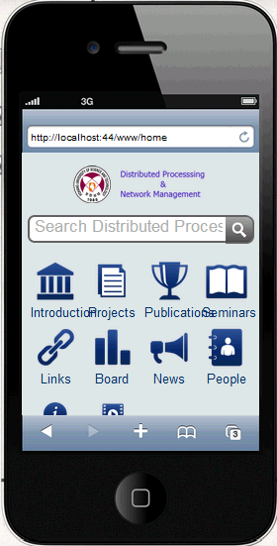

Requirement
Notes:
My requirement is build mobile version for our lab homepage
Lê Thị Hoàng Ngân - KHMT-CNTT-KHTN

Slide 3








Structure
Introduction
Projects
Publications
Seminars
Links
News
People
About
Notes:
Here is the structure of our website. I think we you need 9 module in Kurogo to complete version for mobile.
Lê Thị Hoàng Ngân - KHMT-CNTT-KHTN

Slide 4
Built-Pages
Introduction
Projects
Publications
Seminars
Links
News
People
About
Notes:
In previous week, I have finish built 6 module per nine at all. Here is my result.
Lê Thị Hoàng Ngân - KHMT-CNTT-KHTN

