Slide 1


Division of
IT Convergence Engineering (ITCE)
Distributed Processing
&
Network Management 2012
http://itce.postech.ac.kr

Slide 2
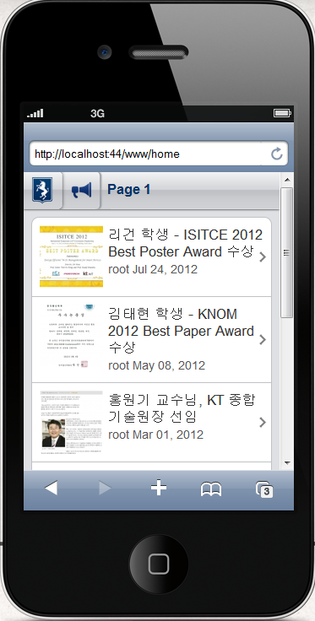
News Module
Notes:
My requirement is build mobile version for our lab homepage
Lê Thị Hoàng Ngân - KHMT-CNTT-KHTN

Slide 3
How to build a mobile website using Kurogo
Get content of our website, store it in XML format
Pull these XML files to Kurogo
Write template for specific device
Build module
Notes:
My requirement is build mobile version for our lab homepage
Lê Thị Hoàng Ngân - KHMT-CNTT-KHTN

Slide 4
Problem
Can not get the content of non-structural pages!!!
Notes:
Network
Lê Thị Hoàng Ngân - KHMT-CNTT-KHTN

