Slide 1


Division of
IT Convergence Engineering (ITCE)
Distributed Processing
&
Network Management 2012
http://itce.postech.ac.kr

Slide 2
Contents
Requirement
Get content of an HTML page
Conclusion
Notes:
My presentation will be in three parts.
Firstly, I will short talk about my requirement.
Secondly, it about how to get content of an HTML page
Finally, it is my conclusion, some problem that I meet when I do this assignment.
Lê Thị Hoàng Ngân - KHMT-CNTT-KHTN

Slide 3
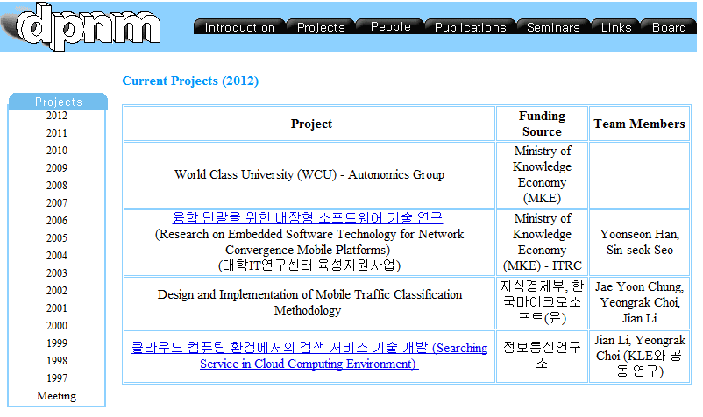
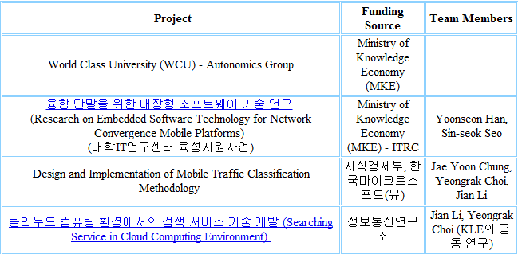


Requirement
Notes:
My requirement is Get content of an HTML page, convert it to XML format, so it can be the input of kurogo.
Lê Thị Hoàng Ngân - KHMT-CNTT-KHTN

Slide 4
Get content of an HTML page
Get HMTL source code
Find the rule of structure of page
Parse data
Write XML
Notes:
Lê Thị Hoàng Ngân - KHMT-CNTT-KHTN

Slide 5
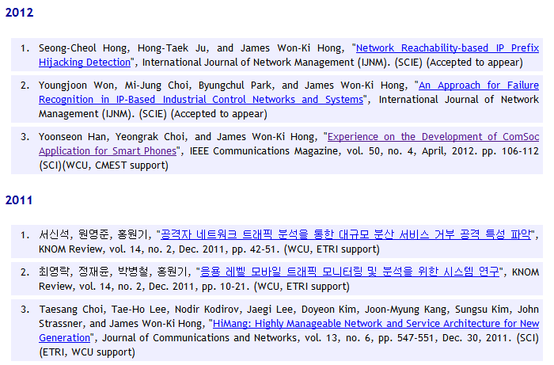
Get HTML source code
Notes:
Lê Thị Hoàng Ngân - KHMT-CNTT-KHTN

Slide 6
<h4>2012</h4>
<ol>
<div>Paper 1</div>
<div>Paper 2</div>
<div>Paper 3</div>
</ol>
<h4>2011</h4>
<ol>
<div>Paper 1</div>
<div>Paper 2</div>
<div>Paper 3</div>
</ol>
Lê Thị Hoàng Ngân - KHMT-CNTT-KHTN

Slide 7
Find the structure of page
<h4>2012</h4>
<ol>
<div>Paper 1</div>
<div>Paper 2</div>
<div>Paper 3</div>
</ol>
<h4>2011</h4>
<ol>
<div>Paper 1</div>
<div>Paper 2</div>
<div>Paper 3</div>
</ol>
Year
Paper
Paper
Paper
Year
Paper
Paper
Paper
Lê Thị Hoàng Ngân - KHMT-CNTT-KHTN
Notes:
Lê Thị Hoàng Ngân - KHMT-CNTT-KHTN

Slide 8
Parse and write XML
<journal>
<year>
<value>2012</value>
<paper>Paper 1</paper>
<paper>Paper 2</paper>
<paper>Paper 3</paper>
</year>
<year>
<value>2011</value>
<paper>Paper 1</paper>
<paper>Paper 2</paper>
<paper>Paper 3</paper>
</year>
</journal>
Notes:
Lê Thị Hoàng Ngân - KHMT-CNTT-KHTN

Slide 9
Conclusion
Advantages:
Do not need to access database.
Automatically change content according to desktop version site.
Disadvantages:
Can not convert HTML pages that does not follow any structure rule.
If the structure of data of HTML page changes, we must rewrite our module parser.
Each page has different module converter.
Notes:
Lê Thị Hoàng Ngân - KHMT-CNTT-KHTN

