Slide 1


Division of
IT Convergence Engineering (ITCE)
Distributed Processing & Network Management 2012
http://itce.postech.ac.kr

Slide 2







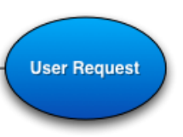





KUROGO and MODULE
Nguyen Ngoc Chau Sang
Notes:
Last week, I had a presentation give the generic view about entire structure of Kurogo framework.
Today, I will in depth about modules in Kurogo, very important element in Kurogo.
The Kurogo framework is based around modules.
Kurogo server in center using modules to handle user request and access external data.
Lê Thị Hoàng Ngân - KHMT-CNTT-KHTN

Slide 3
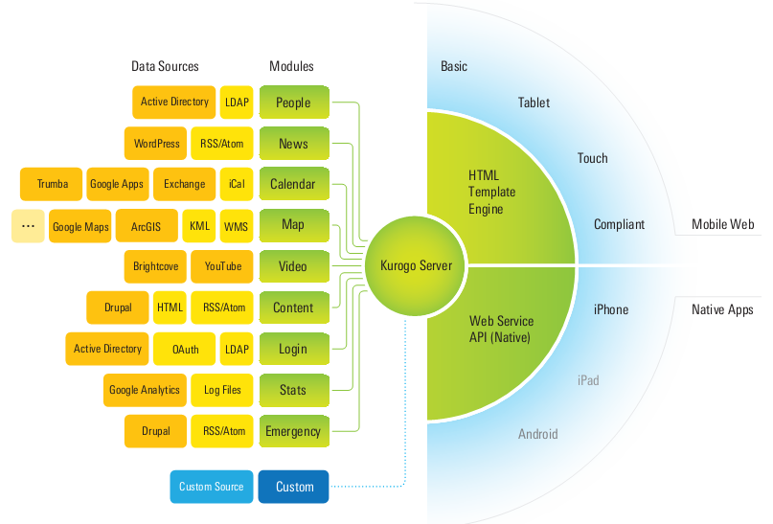
Mobile Web
Data Sources → Modules → Kurogo Server
Native apps
Notes:
The generic process is:
Firstly, external Data integrate with specific module, then they are pulled into the Kurogo server.
Native and mobile web-base solution request data and content from Kurogo server.
Then the request is sent to appropriate modules. This module handle this request and sent output to Kurogo server, Kurogo using Template Engine to present the output in an optimized way. Optimized way mean it takes in account the screen size, platform and device type of the user.
Lê Thị Hoàng Ngân - KHMT-CNTT-KHTN

Slide 4
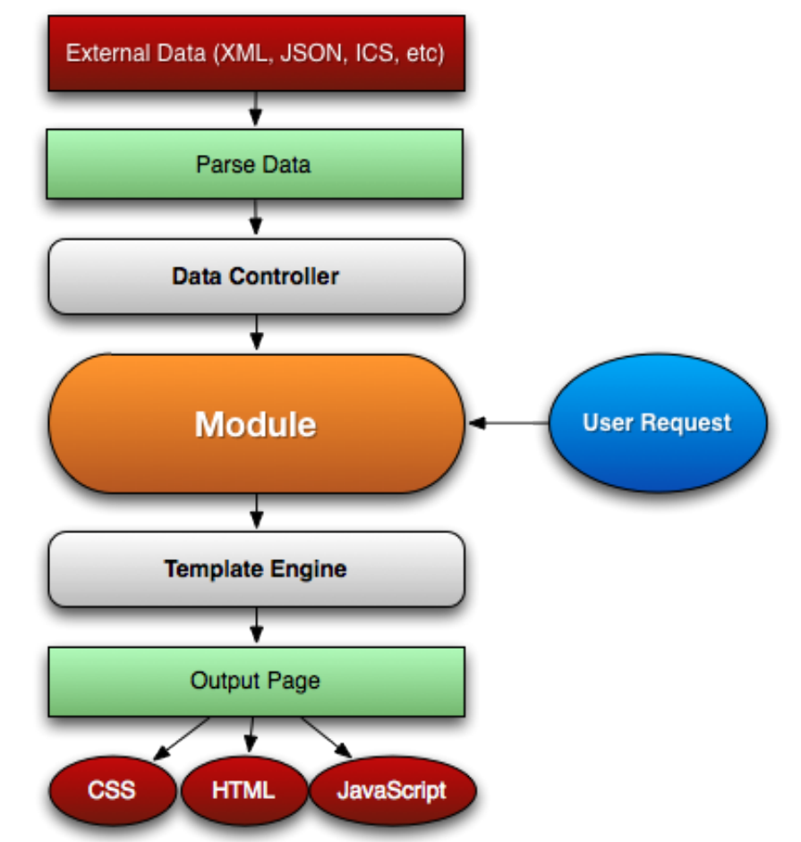
MODEL
Feed data
CONTROLLER
Browser → suitable template
VIEW
Native App → JSON
Notes:
Each module handles a specific user request. Each module which is a PHP object gives you the opportunity to choose the data source and processing methods for getting data in your application.
You can see in the picture:
Input of a Module is a user request. This request may come from a native app, a web mobile.
Once a request has been made, the loading system determines which module to load and creates an instance of it using the factory method.
The URL determines which module to load, which page to assign and any parameters that are included.
A typical user request would include querying a data source and parsing the resulting using Data controller.
Most modules will use a subclass of DataController. Each data controller has an object that is a subclass of DataParser that takes the resulting data and creates an appropriate PHP structure
Output of a Module is HTML, CSS, JavaScript or JSON data depending on user device.
If user is on a native app then Module ask template engine to produce JSON.
If user is on a mobile web the, the output is in the optimized way suitable for any mobile device.
Lê Thị Hoàng Ngân - KHMT-CNTT-KHTN

Slide 5
Functionality
  Connects to external services
  Feed and process data
  Send output data to Template Engine to display
Nguyen Ngoc Chau Sang
Notes:
PHP code connects to external services, process data
Template files, CSS and JavaScript’s function is display data on the device using standard HTML and CSS
Kurogo is designed to accept data from a variety of external sources, parse and process data and prepare it in a format suitable for presentation.
Lê Thị Hoàng Ngân - KHMT-CNTT-KHTN

Slide 6
STRUCTURE
  Each module is a subclass of the WebModule object. It contains:
  PHP code
  Template files
  Also CSS and JavaScript.
Nguyen Ngoc Chau Sang
Notes:
PHP code connects to external services, process data
Template files, CSS and JavaScript’s function is display data on the device using standard HTML and CSS
Kurogo is designed to accept data from a variety of external sources, parse and process data and prepare it in a format suitable for presentation.
Lê Thị Hoàng Ngân - KHMT-CNTT-KHTN

Slide 7





INCLUDED MODULE
CUSTOMIZE
URL
HOME
CONTENT
INFO
LINKS
VIDEO
MAP
ABOUT
EMERGENCY
CALENDAR
STATS
NEWS
LOGIN
Nguyen Ngoc Chau Sang
Notes:
There are a number of modules that are included inside the distribution of Kurogo.
Lê Thị Hoàng Ngân - KHMT-CNTT-KHTN

Slide 8
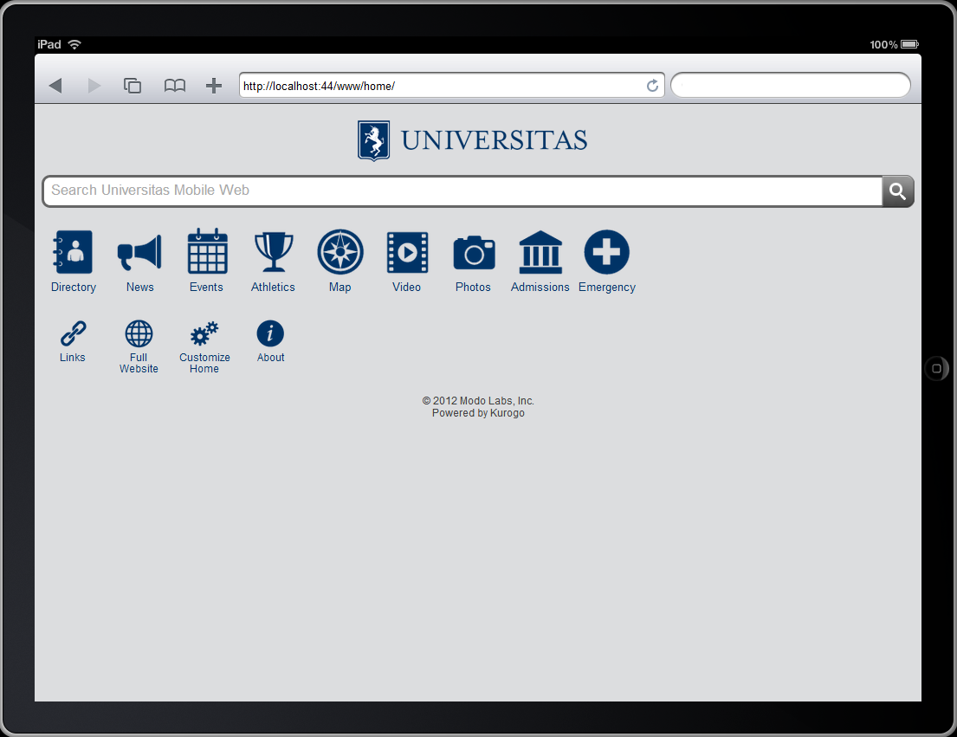
HOME MODULE
Primary modules
Secondary modules
Nguyen Ngoc Chau Sang
Notes:
Home module provide a unified list of modules available to user.
There are 2 sections [primary modules] and [secondary modules] that indicate which modules are shown on the home screen.
Primary modules can be rearranged and hidden by the user using the Customize modules.
Secondary modules appear smaller, but cannot rearranged or removed by the user.
Homepage can show the list in a variety of styles such as list, springboard.
Lê Thị Hoàng Ngân - KHMT-CNTT-KHTN

Slide 9
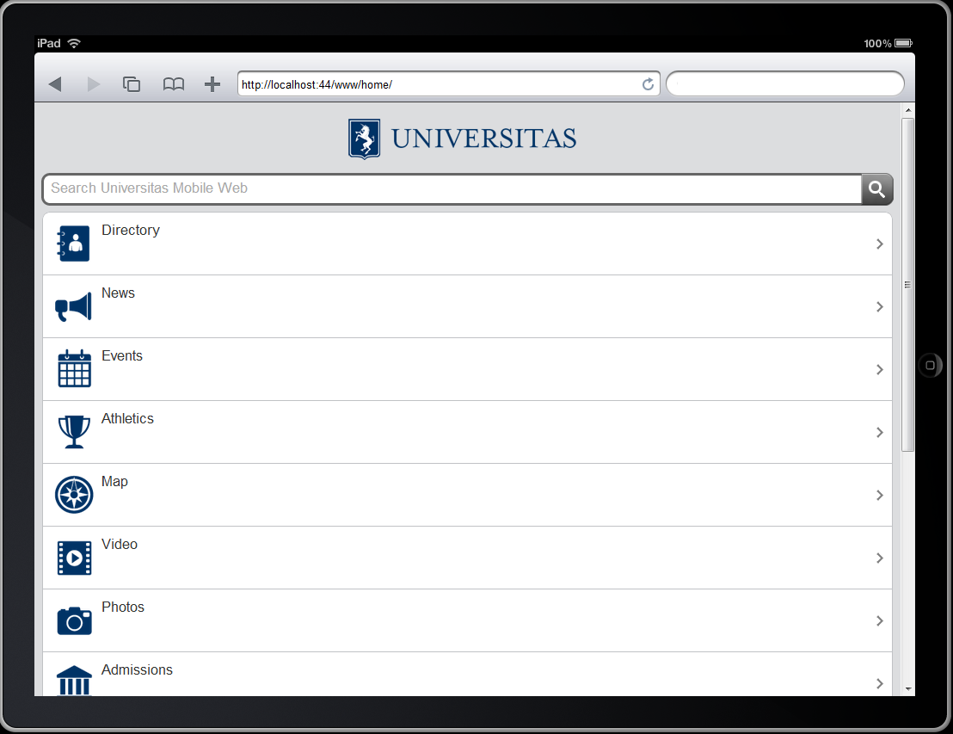

HOME MODULE
Nguyen Ngoc Chau Sang
Notes:
This is springboard style
Lê Thị Hoàng Ngân - KHMT-CNTT-KHTN

Slide 10
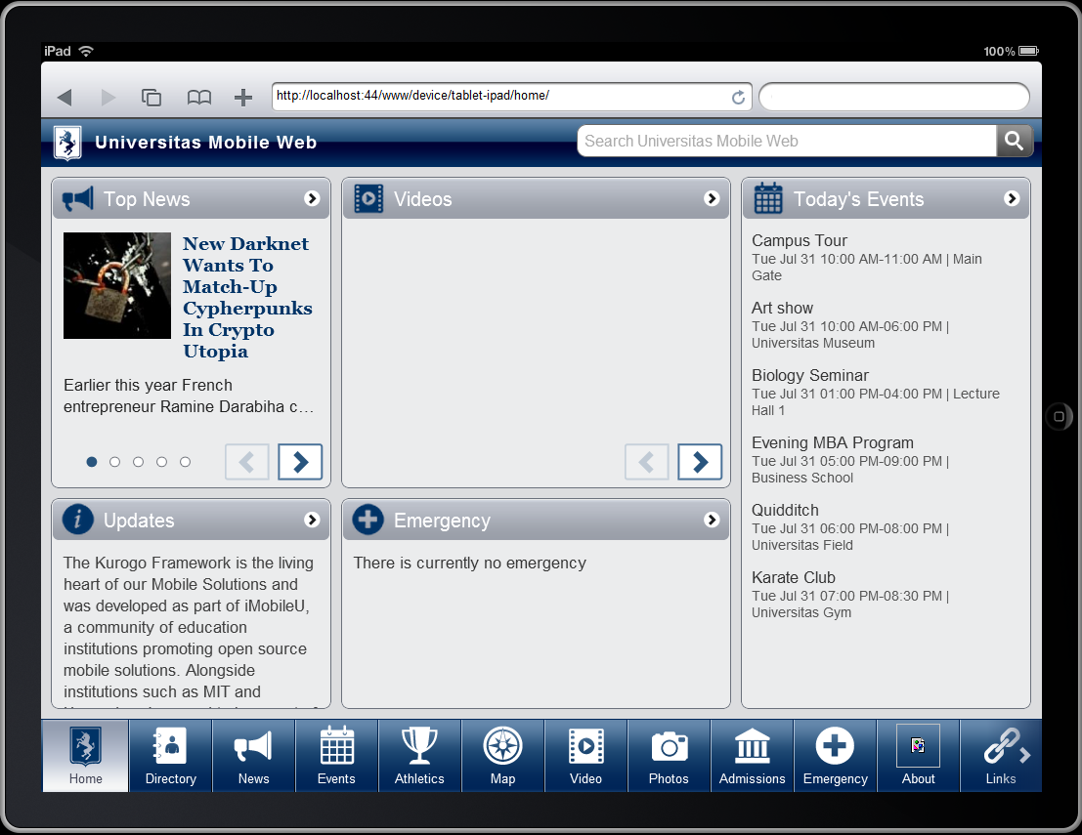
HOME MODULE
MEDIUM 1
LARGE
SMALL
MEDIUM 2
TALL
Navigation strip
Nguyen Ngoc Chau Sang
Notes:
Kurogo also include a special layout for table devices.
In this standard layout, there is a navigation strip that appears at the bottom of the screen on all pages. This allows easy navigation to any module. The home screen itself supports showing a reduced set of content on the home screen from a series of modules in panes. Currently the layout of the home screen is fixed with 5 different panes. You can choose which module will show up in which pane. You can easy set which modules will appear in which pane.
Lê Thị Hoàng Ngân - KHMT-CNTT-KHTN

Slide 11
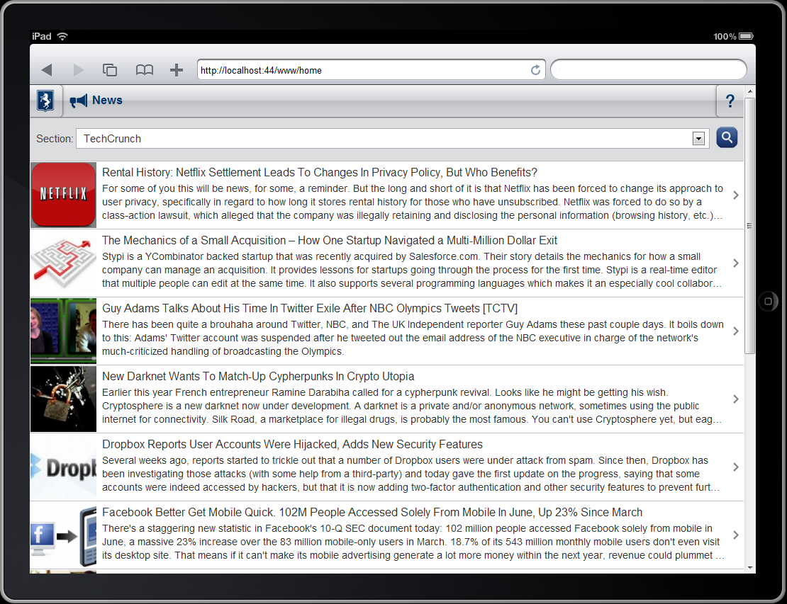
NEWS MODULE
Nguyen Ngoc Chau Sang
Notes:
The news module show a list of stories/articles from an RSS freed. If the feed provides full textual content, the article is shown to the user in mobile friendly format. If the feed does not contain full text then the module will redirect the browser to the URL of the article.
Lê Thị Hoàng Ngân - KHMT-CNTT-KHTN

Slide 12
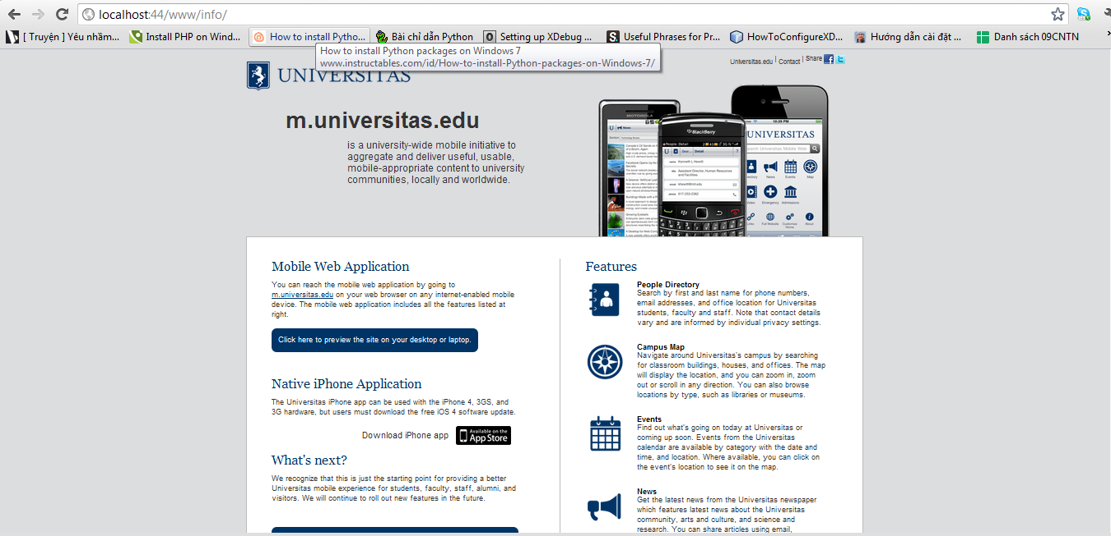
INFO MODULE
Nguyen Ngoc Chau Sang
Notes:
by default, shown to users who visit the site using a desktop browser. The intent it to provide users with information about your site. The default implementation contains no code, and the design included with the reference site is merely an example.
Lê Thị Hoàng Ngân - KHMT-CNTT-KHTN

Slide 13
Thank you for your listening ☺
Q&A
Nguyen Ngoc Chau Sang
Notes:
Lê Thị Hoàng Ngân - KHMT-CNTT-KHTN

