Slide 1


Division of
IT Convergence Engineering (ITCE)
Distributed Processing
&
Network Management 2012
http://itce.postech.ac.kr

Slide 2
Contents
Requirement
Making a mobile web
Using Kurogo to make our mobile web
Notes:
My presentation will be in four parts.
Firstly I am going to having a very short talk about my requirement: making mobile version for our homepage
Then i talk about the way to that, comparison between available method
Next, It is about how to use Kurogo for making our mobile website.
Finally, It is a short conclusion.
Lê Thị Hoàng Ngân - KHMT-CNTT-KHTN

Slide 3

Requirement
Notes:
The rise of the mobile is undeniable. Many and many people use mobile devices to access internet. The future is mobile. Sensing the importance of this, we want to create a mobile version of our homepage lab for any type of mobile devices.
Here is our homepage in desktop.
At the current state, our website do not display well on iPhone, because of the small screen size. But it is okay for iPad.
Lê Thị Hoàng Ngân - KHMT-CNTT-KHTN

Slide 4
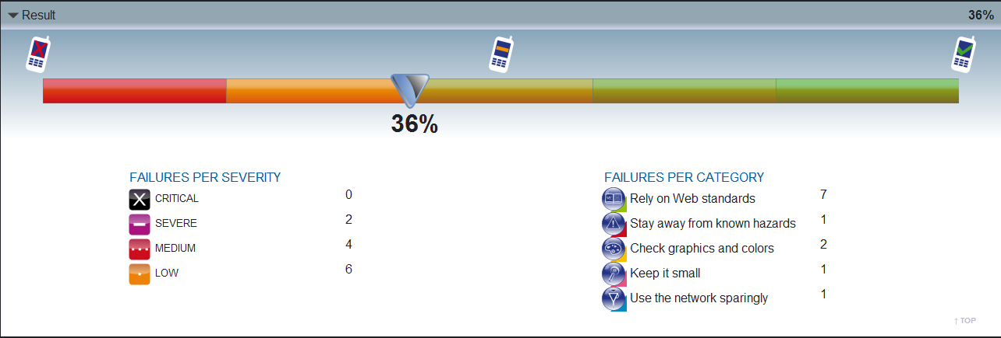
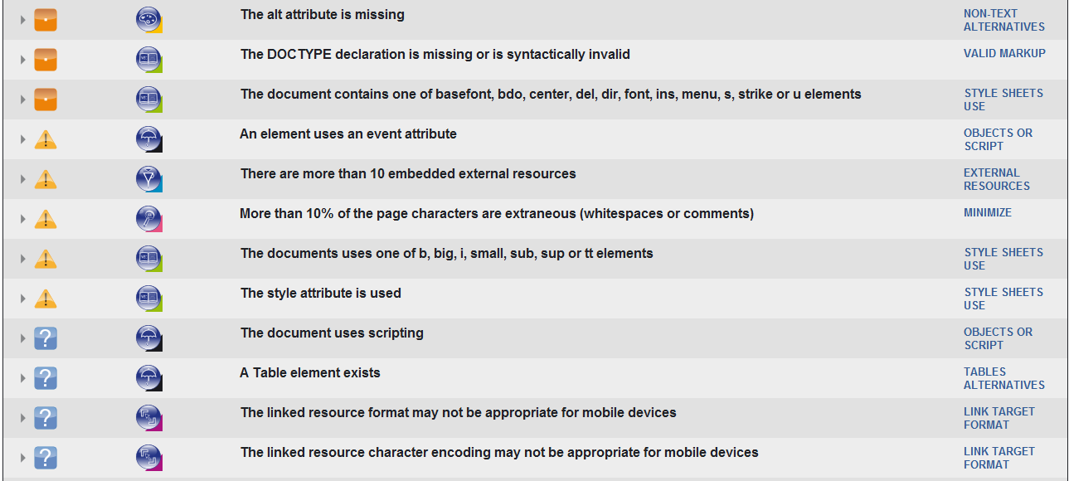
Notes:
The rise of the mobile is undeniable. Many and many people use mobile devices to access internet. The future is mobile. Sensing the importance of this, we want to create a mobile version of our homepage lab for any type of mobile devices.
At the current state, our website do not display well on iPhone, because of the small screen size. But it is okay for iPad.
But it’s just my opinion. For more scientific, I used W3C mobile Checker, a web to see how mobile-device-friendly our site is. It analyzed caching, graphics, colors, size, usage of network… Here is the result:
May be our current homepage is not good, many problem need solving for mobile – friendly such pop-up, the document is served without caching information, The document is not valid UTF-8,…
Lê Thị Hoàng Ngân - KHMT-CNTT-KHTN

Slide 5
Making a mobile web
Use mobile site builders
Use Modolabs
Notes:
Lê Thị Hoàng Ngân - KHMT-CNTT-KHTN

Slide 6
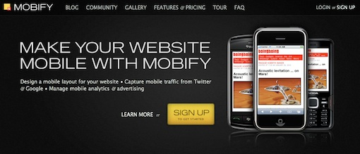
Use mobile site builders
MOBIFY

Slide 7
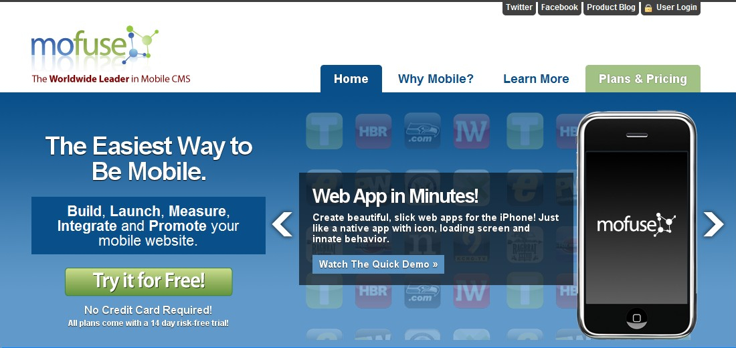
Use mobile site builders
MOFUSE

Slide 8
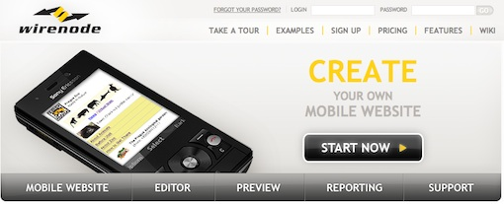
Use mobile site builders
WIRENODE

Slide 9
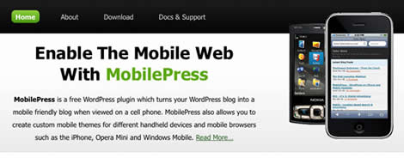
Use mobile site builders
MOBILEPRESS

Slide 10
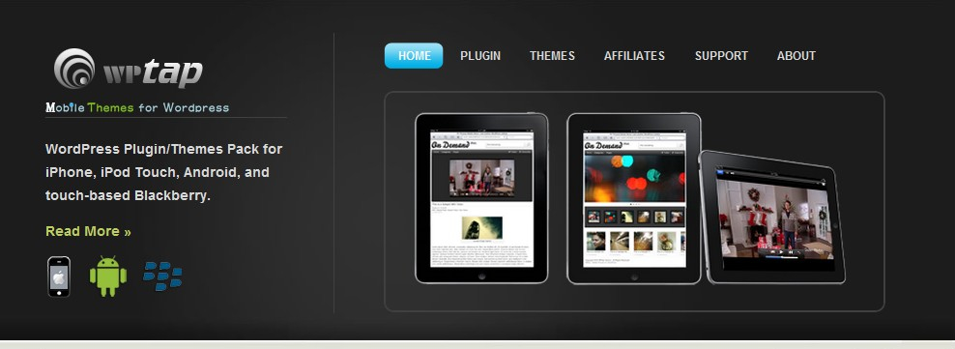
Use mobile site builders
WP-TAP

Slide 11
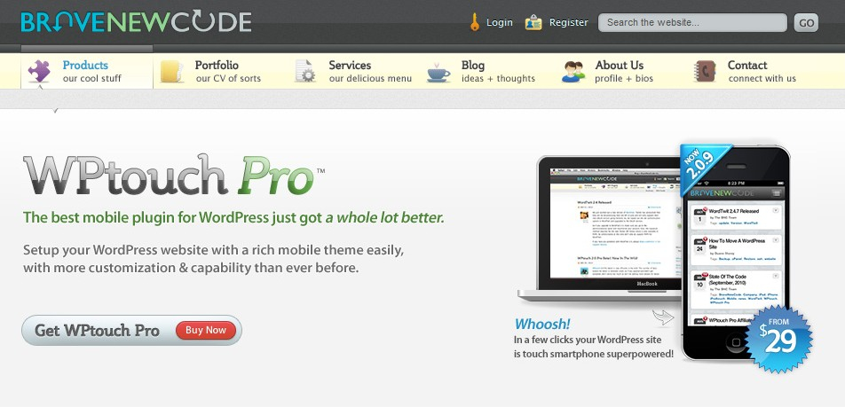
Use mobile site builders
WP-TOUCH PRO

Slide 12

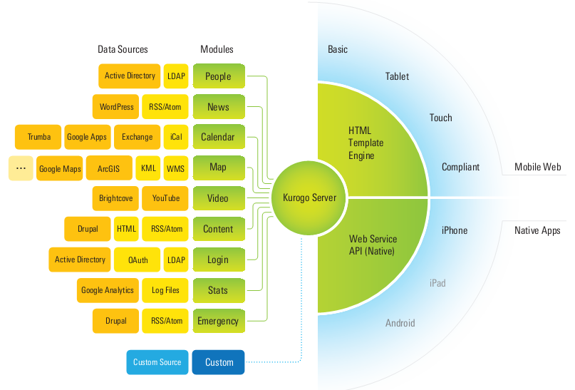
Use Modolabs
Notes:
An integrated solution for native apps and mobile web
Flexible
Open and free
Lê Thị Hoàng Ngân - KHMT-CNTT-KHTN

Slide 13
BUILDERS vs MODOLABS
 | Available tools | Kurogo
Difficulty | Easy | Not easy
Flexibility | Very little template for layout | Very flexible for developer
Fee | High | Free
Time developing | Very short | Need much time
Knowledge | A little knowledge about developing web, do not need care about hardware and software of user devices | Knowledge about PHP, HTML, CSS, hardware and software of user devices
Notes:
Available tools
Kurogo
Difficulty
Easy, made for non-programmer, need just few steps to convert.
Not easy, made for developer, very few documentations, guides and support, not perfect (exists many errors)
Flexibility
Very little template for layout
Very flexible for developer
Fee
High
Free
Time developing
Very short
Need much time
Knowledge
A little knowledge about developing web, do not need care about hardware and software of user devices
Knowledge about PHP, HTML, CSS, hardware and software of user devices
You can see this tools still use picture for links. It is not good for our mobile devices. Heavy images take the page complex, and maybe it take your phone forever to load.
Lê Thị Hoàng Ngân - KHMT-CNTT-KHTN

Slide 14
Developing mobile web using Kurogo
Knowledge about hardware and software of smartphones
Database of our website
Redesign layout
Building modules
Tester to test our web
Notes:
Lê Thị Hoàng Ngân - KHMT-CNTT-KHTN

Slide 15
Design principles
Keep only necessary things:
  Remove long or complex interactions, input, pages
  Remove heavy network usage
Minimize distance to goals:
  Easy to find and navigate what user want
  Provides back button
Make content glance able and actionable
Make it available for everyone
Notes:
Keeping only necessary thing
Weed out what is not mobile-appropriate:
Long or complex interactions and input: it can be time consuming to browse through or long complex page, so remember to put all of the most important information on the top of page and remove unnecessary things.
Heavy network use: heavy images make most mobile phones take forever to load, use plain-text instead of using images for buttons or links.
Choose what is mobile-appropriate
Minimize Distance to Goals
Easy to find and navigate what user want. If the user takes much time to find out what want, they maybe never come back to your site.
A good mobile website design provides back button and links because many phones are no equipped back buttons, try to provide them to escape dead ends.
Make content glanceable and actionable
Package, present content in a way that’s quick to understand and action.
Arrange your content in a single column layout, minimize the uses of table will make your site be better.
Make it available for everyone
Make sure that your mobile version is well-displayed on many, many user devices regardless of smartphone or stupid phone.
Lê Thị Hoàng Ngân - KHMT-CNTT-KHTN

Slide 16
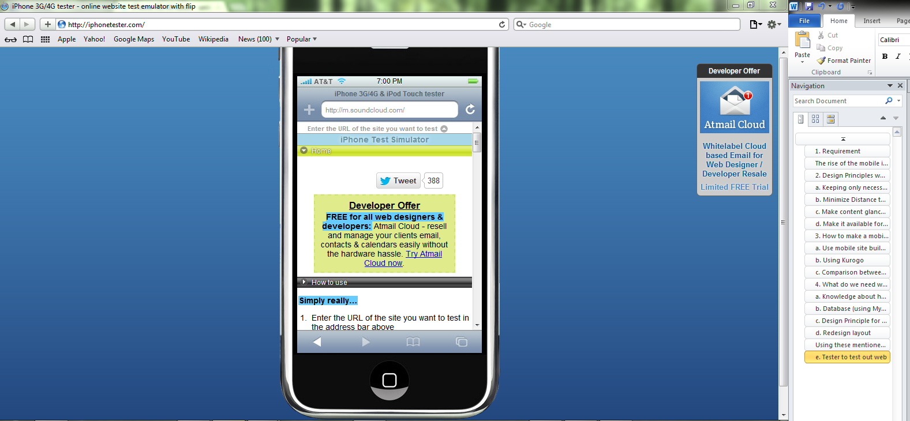
Tester and evaluator
http://iphonetester.com/

Slide 17
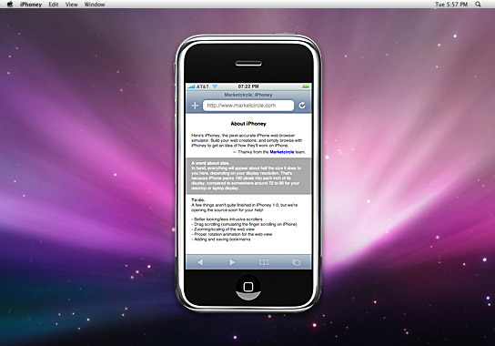
Tester and evaluator
IPhoney

Slide 18
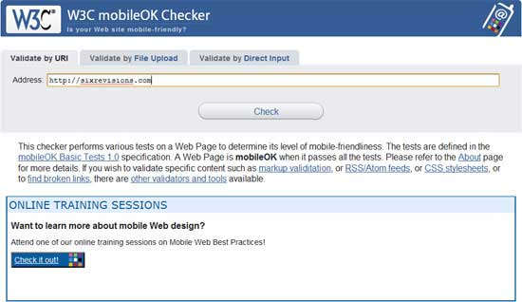
Tester and validator
http://validator.w3.org/mobile/

Slide 19
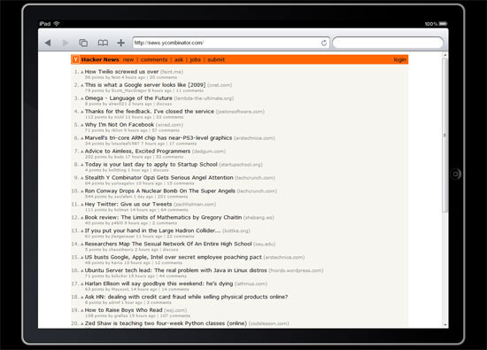
Tester and validator
http://ipadpeek.com/

Slide 20
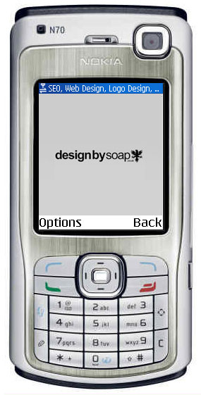
Tester and evaluator
DotMobi Emulator

Slide 21
Thank you for your listening ☺
Q&A
Nguyen Ngoc Chau Sang
Notes:
Lê Thị Hoàng Ngân - KHMT-CNTT-KHTN

