Slide 1
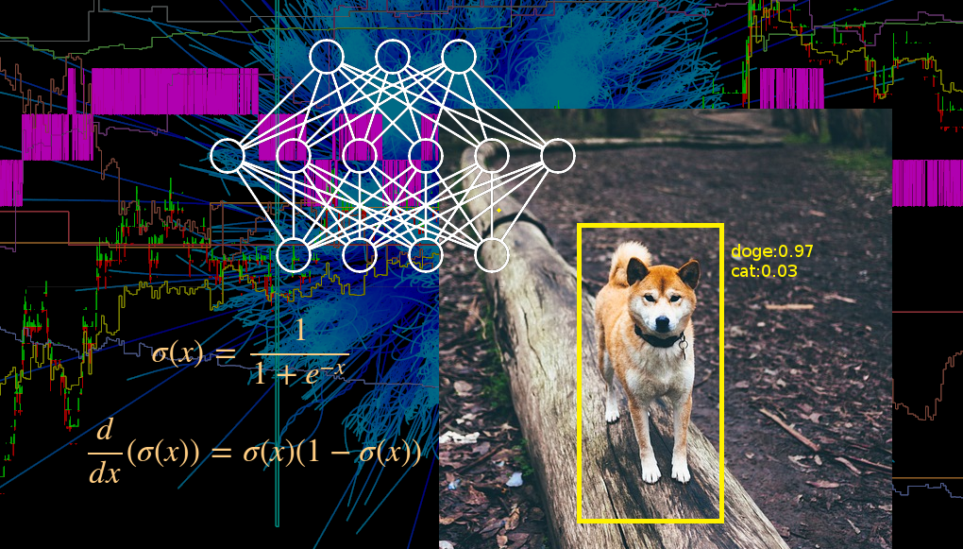
Neural Networks

Slide 2
Neural Networks
Solve problems by learning from data (vs. hard-coding solutions)
Applications:
  Self driving cars
  Alpha Go
  Cell Phones
    Face Detection
    Speech Parsing/Generation
  Much more!

Slide 3
A Neural Network is?
A type of mathematical function.
Take in an ordered group of numbers and deterministically produces another ordered group of numbers.*
Example math function:
  f(x,y,z) = ( x^2 + 5 + y*z , x/y + z )
  This function takes in 3 numbers and produces 2
  f(1,4,0) = (1^2 + 5 + 4*0 , ¼ + 0) = (6 , 0.25)
Demo time

Slide 4
Details of a single “forward step”
Node = Neuron
Parent Node = Node closer to the input side
Input Layer nodes’ input is determined by the global input to the network.
Each node looks at each Parent Node that it’s connected to - and computes a running sum of the parent’s output times the weight of the connection. That running sum is the input to that node.
  Note: each node’s running sum was reset at the beginning of the step.
Once all parents have been summed over, the node applies a predecided upon ACTIVATION FUNCTION to it’s input to generate it’s output.
“Forward Propagation”
Finally, the output Layer nodes’ output is the global output of the network.

Slide 5
Ok, I have the data!
Data format:
  A lot of pairs of (X,Y). In each pair X represents input and Y represents the output THAT WE WOULD LIKE the network to generate.
Choose a network structure and (random) initial weights.
When we apply the network to the input part of a data pair, we get something different from the desired Y
We want net(X) and Y to match!
Use an algorithm to find best weights, NOT BY HAND! This addition to neural networks makes it machine learning.

Slide 6
Matching our network to the data
We compare the network output for some X and the desired output Y. Adjust all the weights a tiny bit to make the net’s output is slightly closer to Y. Repeat with all (X,Y) pairs many times.
Little bit of math theory
Our strategy will be maximizing the probability of the network creating the data given some assumptions about noise, by adjusting the weights.

Slide 7
The loss
The difference between net(X) and Y is called “loss”.
A popular example of a “loss” is summing (net(X) – Y)^2 over the X,Y pairs.
This is intuitive. It is zero iff net(X) = Y, any increase in difference causes the sum to increase.
It is also mathematically motivated via probabilities
Tons of alternative ways to calculate the “loss”. How you compute it depends on your problem at hand (regression vs classification)

Slide 8
Back propagation
Minimize the loss via gradient descent on the network’s weights.
Thanks multidimensional chain rule!
demo on gradient

Slide 9
Basic Forw & Back code
See code / demo

Slide 10
“tricks”
Weight initialization (can matter a lot)
Batch gradient descent
Momentum
Dropout
Convolution Layers (weight sharing)
Batch normalization
Weight decay regularization
Max-Norm regularization
Model averaging (bagging)

Slide 11
Public examples
http://cs.stanford.edu/people/karpathy/convnetjs/
http://playground.tensorflow.org
Look at tensorflow examples
  Talk about architecture

Slide 12
Pros and Cons
Pros
  Flexible enough to solve many problems
  Popular, lots of tutorials and libraries
Cons
  Long computation time for training and inference
  May need a lot of data
  No straightforward way to encode prior knowledge
  Lots of tuning tricks based on practical results, that may be unintuitive

Slide 13
Generative Networks
Autoencoder
  network’s input is it’s output
VAE
  network tries to convert one distribution into the distribution of the data. Maximize likelihood of data.
GAN
  Generator network generates fake samples. Discriminator trained to identify fakes. Generator trained to fool discriminator.

Slide 14
Libraries
Python:
  Tensorflow (w/ Keras), SciKit, PyTorch
C++
  Cafe, Tensorflow
Javascript
  Convnet.js
LUA
  Torch

