Slide 1
Building
Workload Characterization Tools with Valgrind
IISWC-2006 Tutorial
Nicholas Nethercote - National ICT Australia
Robert Walsh - Qlogic Corporation
Jeremy Fitzhardinge - XenSource

Slide 2
This tutorial
Introduction to Valgrind
Example profiling tools
Building a new Valgrind tool
More advanced tools

Slide 3
(end of tutorial overview)

Slide 4
1. Introduction to Valgrind
Robert Walsh

Slide 5
This talk
What is Valgrind?
Who uses it?
How it works

Slide 6
What is Valgrind?

Slide 7
Valgrind is…
A framework
  For building program analysis tools
  E.g. profilers, visualizers, checkers
A software package, containing:
  Framework core
  Several tools: memory checker, cache profiler, call graph profiler, heap profiler
Memcheck, the most widely used tool, is often synonymous with “Valgrind”

Slide 8
What kind of analysis? (1/2)
Categorization 1: when does analysis occur?
  Before run-time: static analysis_x0001_
    Simple preliminaries: parsing
    Complex analysis: e.g. abstract interpretation
    Imprecise, but can be sound: sees all execution paths
  At run-time: dynamic analysis
    Complex preliminaries: instrumentation
    Simpler analysis: “Perfect light of run-time”
    Powerful, but unsound: sees one execution path
Valgrind performs dynamic analysis

Slide 9
What kind of analysis? (2/2)
Categorization 2: what code is analyzed?
  Source code: source-level analysis
    Language-specific
    Requires source code
    High-level information: e.g. variables, statements
  Machine code: binary analysis
    Language-independent (can be multi-language)
    No source code (but debug info helps)
    Lower-level information: e.g. registers, instructions
Valgrind performs binary analysis

Slide 10
Dynamic binary analysis
 | Static | Dynamic
Source | Static source-level analysis | Dynamic source-level analysis
Binary | Static binary analysis | Dynamic binary analysis
Valgrind: dynamic binary analysis (DBA)
  Analysis of machine code at run-time
  Instrument original code with analysis code
  Track some extra information: metadata
  Do some extra I/O, but don’t disturb execution otherwise

Slide 11
What kind of instrumentation?
Categorization: When does binary instrumentation occur?
  Before run-time: static binary instrumentation (SBI)
    A.k.a. binary rewriting
  At run-time: dynamic binary instrumentation (DBI)
Valgrind uses DBI. Compared to SBI:
  No preparation (e.g. recompilation) required
  All user-mode code instrumented
    Dynamically loaded libraries
    Dynamically generated code
    No code/data identification difficulties
  Instrumentation cost incurred at run-time
A good DBI framework mitigates the run-time cost and makes tool-writing much easier

Slide 12
An aside
Similar things to DBA and DBI:
  1. Dynamic binary optimisation
    Rewrite binary on-the-fly for speed-ups
    E.g. Dynamo
  2. Dynamic binary translation
    Run binary for platform X on platform Y
  3. Semantics-affecting tools
    E.g. sandboxing, fault injection
Not talking about these
  Valgrind tools can do (3), but usually don’t

Slide 13
Similar systems
DBI frameworks:
  Pin, DynamoRIO, DIOTA, DynInst, etc.
  Lots of overlap
  Each system supports different platforms
Purify
  Memcheck (a memory-checking tool) is similar
Valgrind:
  GPL
  Widely used, robust
  Slower for simple tools
  Designed for heavyweight tools, especially shadow value tools (more in talk 4)

Slide 14
Who uses Valgrind?

Slide 15
Valgrind users
Developers
  C (43%), C++ (49%), Fortran, Ada, Java
  Firefox, OpenOffice, KDE, GNOME, libstdc++, PHP, Perl, Python, MySQL, Samba, RenderMan, NASA, CERN, Unreal Tournament, parts of the Linux kernel
  Biggest program we know of: 25 MLOC
  Memcheck: 80% of usage, other tools still widespread
Researchers
  Cambridge, MIT, CMU, UT, UNM, ANU, etc.
  For building new kinds of analysis tools
  For experimental evaluation of programs (Cachegrind)
Website receives >1000 unique visitors per day

Slide 16
Availability
Free software (GPL)
Standard Linux package
Platforms:
  _x0005_Valgrind 3.2.1: x86/Linux, AMD64/Linux, PPC{32,64}/Linux
  In repository: PPC{32,64}/AIX
  Under development: PPC32/Darwin, x86/Darwin, x86/FreeBSD, others
www.valgrind.org

Slide 17
How does Valgrind work?

Slide 18
Basic architecture
Valgrind core + tool plug-in = Valgrind tool
Core:
  Executes the client program under its control
  Provides services to aid tool-writing
    E.g. error recording, debug info reading
Tool plug-ins:
  Main job: instrument code blocks passed by the core
Lines of code (mostly C, a little asm in the core):
  Core: 173,000
  Call graph profiler: 11,800
  Cache profiler: 2,400
  Heap profiler: 1,700

Slide 19
Running a Valgrind tool (1/2)
[nevermore:~] date
Sat Oct 14 10:28:03 EST 2006
[nevermore:~] valgrind --tool=cachegrind date
==17789== Cachegrind, an I1/D1/L2 cache profiler.
==17789== Copyright (C) 2002-2006, and GNU GPL'd, by Nicholas Nethercote et al.
==17789== Using LibVEX rev 1601, a library for dynamic binary translation.
==17789== Copyright (C) 2004-2006, and GNU GPL'd, by OpenWorks LLP.
==17789== Using valgrind-3.2.1, a dynamic binary instrumentation framework.
==17789== Copyright (C) 2000-2006, and GNU GPL'd, by Julian Seward et al.
==17789== For more details, rerun with: -v
==17789==
Sat Oct 14 10:28:12 EST 2006
==17789==
==17789== I refs: 395,633
==17789== I1 misses: 1,488
==17789== L2i misses: 1,404
==17789== I1 miss rate: 0.37%
==17789== L2i miss rate: 0.35%
==17789==
==17789== D refs: 191,453 (139,922 rd + 51,531 wr)
==17789== D1 misses: 3,012 ( 2,467 rd + 545 wr)
==17789== L2d misses: 1,980 ( 1,517 rd + 463 wr)
==17789== D1 miss rate: 1.5% ( 1.7% + 1.0% )
==17789== L2d miss rate: 1.0% ( 1.0% + 0.8% )
==17789==
==17789== L2 refs: 4,500 ( 3,955 rd + 545 wr)
==17789== L2 misses: 3,384 ( 2,921 rd + 463 wr)
==17789== L2 miss rate: 0.5% ( 0.5% + 0.8% )

Slide 20
Running a Valgrind tool (2/2)
Tool output goes to stderr, file, fd or socket
Program behaviour otherwise unchanged…
…except much slower than normal
  No instrumentation: 4-10x
  Memcheck: 10-60x
  Cachegrind: 20-100x
For most tools, slow-down mostly due to analysis code

Slide 21
Starting up
Valgrind loads the core, chosen tool and client program into a single process
Lots of resource conflicts to handle, via:
  Partitioning: address space, fds
  Time-multiplexing: registers
  Sharing: pid, current working directory, etc.
Starting up is difficult to do robustly
  Currently on our 3rd core/tool structuring and start-up mechanism!

Slide 22
Dynamic binary recompilation
JIT translation of small code blocks
  Often basic blocks, but can contain jumps
  Typically 5-30 instructions
Before a code block is executed for the first time:
  Core: machine code → (architecture neutral) IR
  Tool: IR → instrumented IR
  Core: instrumented IR → instrumented machine code
  Core: caches and links generated translations
No original code is run
Valgrind controls every instruction
  Client is none the wiser

Slide 23
Complications
System calls
  Valgrind does not trace into the kernel
  Some are checked to avoid core/tool conflicts
  Blocking system calls require extra care
Signals
  Valgrind intercepts handler registration and delivery
  Required to avoid losing control
Threads
  Valgrind serializes execution onto one thread
  Avoids subtle data races in tools
  Requires reconsideration due to architecture trends

Slide 24
Function wrapping/replacement
Function replacement
  Can replace arbitrary functions
  Replacement runs as if native (i.e. it is instrumented)
Function wrapping
  Replacement functions can call the function they replaced
  This allows function wrapping
  Wrappers can observe function arguments
System call wrapping
  Similar functionality to function wrapping
  But separate mechanism

Slide 25
Client requests
Trap-door mechanism
  An unusual no-op instruction sequence
  Under Valgrind, it transfers control to core/tool
  Client can pass queries and messages to the core/tool
  Allow arguments and a return value
  Augments tool’s standard instrumentation
Easy to put in source code via macros
  Tools only need to include a header file to use them
  They do nothing when running natively
  Tool-specific client requests ignored by other Valgrind tools
Example:
  Memcheck instruments malloc and free
  Custom allocators can be marked with client requests that say “a heap block was just allocated/freed”
  A little extra user effort helps Memcheck give better results

Slide 26
Self-modifying code
Without care, self-modifying code won’t run correctly
  Dynamically generated code is fine if it doesn’t change
  But if changed, the old translations will be executed
An automatic mechanism:
  Hash of original code checked before each translation is executed
  Expensive, by default on only for code on the stack
  E.g. handles GCC trampolines for nested functions (esp. for Ada)
A manual mechanism:
  A built-in client request: “discard existing translations for address range A..B”
  Useful for dynamic code generators, e.g. JIT compilers

Slide 27
Forests and trees
Valgrind is a framework for building DBA tools
Interesting in and of itself
  But it is a means to an end_x0001_
The tools themselves are the interesting part
  Actually, it is what the tools can tell you about programs that is really the interesting part
Next three talks cover:
  Existing profiling tools
  How to write new tools
  Some ideas for interesting new tools

Slide 28
(end of talk 1)

Slide 29
2. Example profiling tools
Jeremy Fitzhardinge

Slide 30
This talk
Three existing profiling tools
  Cache profiler
  Call graph profiler
  Heap profiler

Slide 31
Cachegrind: a cache profiler

Slide 32
Cachegrind
Cache behaviour is crucial
  L1 misses: ~10 cycles
  L2 misses: ~200 cycles
But difficult to predict
Cachegrind gives three outputs:
  Total hit/miss counts and ratios (I1, D1, L2)
  Per-function hit/miss counts (sorted from most to least)
  Per-line hit/miss counts (source code annotations)
Source code annotations are the most useful
  Most fine-grained data
  Data that programmers can act on to speed up their programs

Slide 33
Sample output
--------------------------------------------------------------------------------
Ir I1mr I2mr Dr D1mr D2mr Dw D1mw D2mw
--------------------------------------------------------------------------------
14,789,396 547 544 6,329,792 751 689 2,111,757 1,113,292 1,094,855 PROGRAM TOTALS
--------------------------------------------------------------------------------
Ir I1mr I2mr Dr D1mr D2mr Dw D1mw D2mw file:function
--------------------------------------------------------------------------------
14,688,273 1 1 6,294,531 0 0 2,098,178 1,113,088 1,094,656 example.c:main
--------------------------------------------------------------------------------
-- Auto-annotated source: example.c
--------------------------------------------------------------------------------
Ir I1mr I2mr Dr D1mr D2mr Dw D1mw D2mw
. . . . . . . . . int main(void)
10 0 0 0 0 0 1 0 0 {
. . . . . . . . . int i, j, a[1024][1024];
. . . . . . . . .
4,100 1 1 2,049 0 0 1 0 0 for (i = 0; i < 1024; i++) {
4,198,400 0 0 2,098,176 0 0 1,024 0 0 for (j = 0; j < 1024; j++) {
5,242,880 0 0 2,097,152 0 0 1,048,576 65,536 56,320 a[i][j] = 0; // fast
5,242,880 0 0 2,097,152 0 0 1,048,576 1,047,552 1,038,336 a[j][i] = 0; // slow
. . . . . . . . . }
. . . . . . . . . }
1 0 0 0 0 0 0 0 0 return 0;
2 0 0 2 0 0 0 0 0 }

Slide 34
How Cachegrind works
Each instruction is instrumented
  Call to a C cache simulation function
  Different functions for loads, stores, modifies
  Some combining of C calls for efficiency
Each source code line gets a cost centre
  Holds counters: accesses, hits and misses
  Uses debug info to map each instruction to a cost centre
Online simulation (i.e. no trace gathering)
Cost centres dumped to file at end
  Simple but compact text format
  Post-processing script produces previous slide’s output

Slide 35
Cache simulation
Approximates an AMD Athlon hierarchy
  I1, D1, inclusive L2
  Write-allocate
  LRU replacement
Each cache is command-line configurable:
  Cache size
  Line size
  Associativity
On x86/AMD64 can use CPUID to auto-detect these parameters
Simulation can be replaced easily

Slide 36
Inaccuracies
Imperfect address trace
  No kernel code
  Other processes ignored (arguably good)
  Conversion to Valgrind’s IR changes a very small number of loads/stores
Incorrect addresses
  Virtual addresses
  Memory layout and thread scheduling is different under Cachegrind compared to native
Prefetches and cache-bypassing are ignored
  Difficult to handle well without detailed microarchitectural simulation
Still useful for general insights

Slide 37
How is it used?
Characteriz_x0005_ation:
  Program A vs. program B
  Cache hierarcy A vs. cache hierarchy B
Optimisation:
  Identifies cache-unfriendly code
  Fixing such code requires non-trivial insight
    But easier (i.e. not impossible!) than fixing without this data
Evaluation of optimisations:
  Program A vs. optimised program A

Slide 38
Cachegrind summary
Cachegrind is a cache simulator
Gives total, per-function and per-line hit/miss counts
Simulation is imperfect, but still useful
Used for characterization, optimisation and evaluation

Slide 39
Callgrind: a call graph profiler

Slide 40
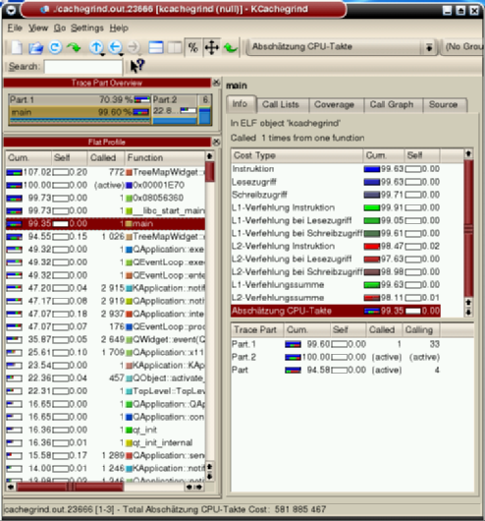
Callgrind
Extension of Cachegrind
By Josef Weidendorfer
Also provides:
  Call graph information
  Graphical results viewer (KCachegrind)
    Allows interactive browsing of results
    Accepts Cachegrind results also
  Greater selectivity of what code is profiled

Slide 41
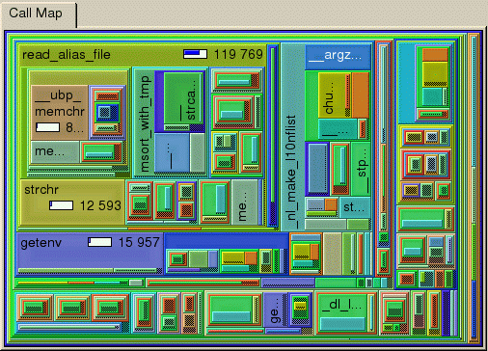
KCachegrind’s tree-map view
Box sizes represent relative counts
Nesting of boxes represents call chains
Interactive: can drill down through boxes

Slide 42
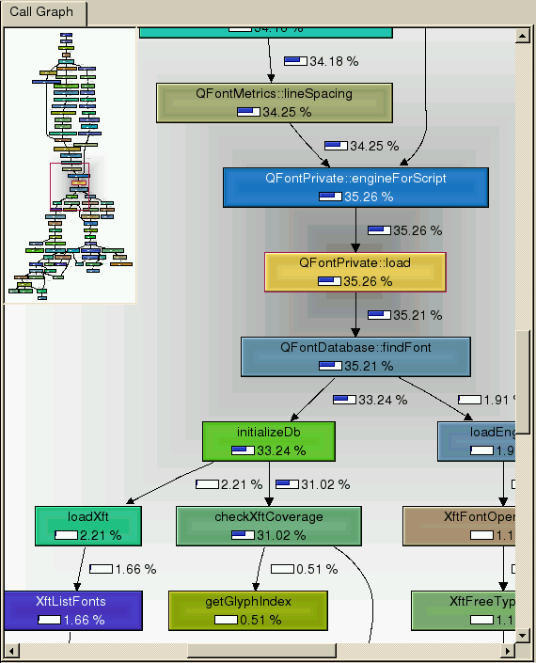
KCachegrind’s call graph view
Shows whole call graph
Boxes show count proportions
Interactive

Slide 43
Selective profiling
Can dump counts at particular times
  At termination (same as Cachegrind)
  Periodically (every N code blocks)
  At entry/exit of named functions
  At particular program points (using client requests)
  At any time (by invoking a separate script)
Counters are zeroed after each dump
Can choose which events to count
  Instructions
  Memory events (for cache simulation)
  Function entries/exits

Slide 44
An interesting difficulty
Callgrind maintains a call stack
  For tracking function entries/exits
Several difficulties:
  setjmp/longjmp
  Tail recursion
  Dynamic linking
    Calls through jump tables
    Jump table patched on first call after loading
  Stack switching
Missed entries/exits can throw everything out

Slide 45
Interesting lessons
Good tools go beyond the basics
  Results presentation
  Analysis selectivity
Some tool tasks are more difficult than you would expect

Slide 46
Massif: a heap profiler

Slide 47
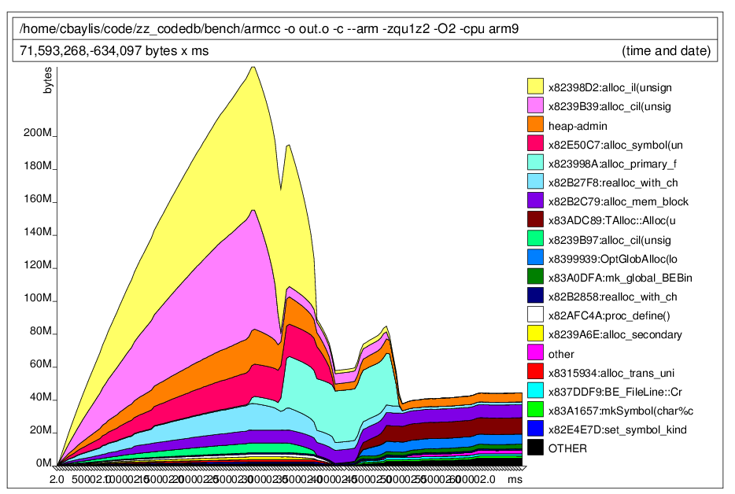
Massif heap graph

Slide 48
Massif
Measures heap and stack
  Each heap allocation site is a band
  Stack is a band
Also produces HTML output
  Represents the call graph underlying allocations
  Users can drill down through calling chains from allocation sites
Simple interaction with Valgrind’s core
  Only uses function wrapping
  No instrumentation of code blocks
  Complexity in the tool, not at the core/tool boundary

Slide 49
Summary
Cachegrind, Callgrind, Massif
Three different profilers
  Not necessarily what you need
  Demonstrate the kinds of things you can do
Next: details of how to write a tool

Slide 50
(end of talk 2)

Slide 51
3. Building a new Valgrind tool
Nicholas Nethercote

Slide 52
This talk
How to write a new tool from scratch
  Simple but useful example: memory tracer
  Start with simplest version
  Improve its accuracy and performance

Slide 53
A new tool from scratch

Slide 54
MemTrace
Example tool
Trace memory (data) accesses
  Loads, stores, modifies
Print entry for each memory access
  Data address
  Data size

Slide 55
Tool basics
Tools must provide functions for 3 tasks:
  Initialization
  Instrumentation
  Finalization
Analysis code can be added
  Inline
  Calls to C functions
Tools provide functions that help the core provide certain services
  E.g. error reporting, options processing

Slide 56
Build environment
In what follows, all filenames are relative to top-level Valgrind directory
Valgrind uses automake/autoconf
  Use an SVN version of Valgrind; this _x0005_simplifies Makefile handling
  www.valgrind.org explains how to get the SVN version

Slide 57
Preliminaries
Create empty directories:
  memtrace/
  memtrace/docs/
  memtrace/tests/
Create empty files:
  memtrace/docs/Makefile.am
  memtrace/tests/Makefile.am
Copy none/Makefile.am to memtrace/
Edit files:
  Add three entries to AC_OUTPUT in configure.in:
    memtrace/Makefile
    memtrace/docs/Makefile
    memtrace/tests/Makefile
  Add memtrace to TOOLS in Makefile.am
  Change names within memtrace/Makefile.am appropriately:
    s/none/memtrace/
    s/nl_/mt_/

Slide 58
First mt_main.c (1/3)
Create memtrace/mt_main.c
  Two-letter prefix is just a convention
#include "pub_tool_basics.h" // Needed by every tool
#include "pub_tool_tooliface.h" // Needed by every tool
#include "pub_tool_libcprint.h" // For printing functions
#include "pub_tool_machine.h" // For VG_(fnptr_to_fnentry)
Most tool-visible headers in include/pub_tool_*.h
Next: four functions must be defined
  Pre-option-processing initialization
  Post-option-processing initialization
  Instrumentation
  Finalization

Slide 59
First mt_main.c (2/3)
static void mt_pre_clo_init(void)
{
// Required details for start-up message
VG_(details_name) ("Memtrace");
VG_(details_version) ("0.1");
VG_(details_description) ("a memory tracer");
VG_(details_copyright_author)("Copyright (C) 2006, J. Random Hacker.");
// Required detail for crash message
VG_(details_bug_reports_to) ("/dev/null");
// Name the required functions #2, #3 and #4.
VG_(basic_tool_funcs) (mt_post_clo_init,
mt_instrument,
mt_fini);
}
// This prevents core/tool interface problems, and names the required
// function #1, giving the core an entry point into the tool.
VG_DETERMINE_INTERFACE_VERSION(mt_pre_clo_init)

Slide 60
First mt_main.c (3/3)
// Post-option-processing initialization function
static void mt_post_clo_init(void) { }
// Instrumentation function. "bbIn" is the code block.
// Others arguments are more obscure and often not needed -- see
// include/pub_tool_tooliface.h.
static IRBB* mt_instrument ( VgCallbackClosure* closure,
IRBB* bbIn,
VexGuestLayout* layout,
VexGuestExtents* vge,
IRType gWordTy, IRType hWordTy )
{
return bbIn;
}
// Finalization function
static void mt_fini(Int exitcode) { }
(These functions must precede mt_pre_clo_init)

Slide 61
Build and test
Build:
  ./autogen.sh
  ./configure --prefix=`pwd`/inst
  make install
Test:
  inst/bin/valgrind --tool=memtrace date
  Should run ok, but produce no output
So far, almost identical to none/nl_main.c
  Now ready for proper tool-writing

Slide 62
Vex IR
Intermediate representation (Vex IR)
  Vex is the name of the JIT compiler sub-system
  Short code blocks (IRBB)
    Represent roughly 3-50 instructions each
  Arbitrary number of temporaries (intermediate values)
    A block’s type environment holds size of each temporary
  Sequences of statements (with side-effects) (IRStmt)
    E.g. stores, register writes
  Statements contain expression trees (no side-effects) (IRExpr)
    E.g. loads, arithmetic operations
    E.g. a store’s address and value are both expressions
  Each block ends in a jump
All IR-related details are in VEX/pub/libvex_ir.h
  Included by pub_tool_tooliface.h, via libvex.h

Slide 63
mt_instrument (outer)
// include/pub_tool_basics.h provides types such as "Int".
Int i;
// Setup bbOut: allocate, initialize non-statement parts: type
// environment, block-ending jump's destination and kind.
IRBB* bbOut = emptyIRBB();
bbOut->tyenv = dopyIRTypeEnv(bbIn->tyenv);
bbOut->next = dopyIRExpr(bbIn->next);
bbOut->jumpkind = bbIn->jumpkind;
// Iterate through statements, copy to bbOut, instrumenting
// loads and stores along the way.
for (i = 0; i < bbIn->stmts_used; i++) {
IRStmt* st = bbIn->stmts[i];
if (!st) continue; // Ignore null statements
// <Instrument loads and stores here (next 2 slides)>
addStmtToIRBB(bbOut, st);
}
return bbOut;

Slide 64
mt_instrument (inner, 1/2)
switch (st->tag) {
case Ist_Store: {
// Pass to handle_store: bbOut, store address and store size.
handle_store(bbOut, st->Ist.Store.addr,
sizeofIRType(typeOfIRExpr(bbIn->tyenv, st->Ist.Store.data)));
break;
}
case Ist_Tmp: { // A "Tmp" is an assignment to a temporary.
// Expression trees are flattened here, so "Tmp" is the only
// kind of statement a load may appear within.
IRExpr* data = st->Ist.Tmp.data; // Expr on RHS of assignment
if (data->tag == Iex_Load) { // Is it a load expression?
// Pass handle_load bbOut plus the load address and size.
handle_load(bbOut, data->Iex.Load.addr,
sizeofIRType(data->Iex.Load.ty)); // Get load size from
} // type environment
break;
}
// <One more case (see next slide)>
}

Slide 65
mt_instrument (inner, 2/2)
“Dirty” statements represent unusual instructions, e.g. cpuid, fxsave
  Avoids encoding highly architecture-specific details in the IR
  Tools can still see the register and memory accesses done by the instruction, and so do basic instrumentation
case Ist_Dirty: {
IRDirty* d = st->Ist.Dirty.details;
if (d->mFx == Ifx_Read || d->mFx == Ifx_Modify)
handle_load(bbOut, d->mAddr, d->mSize);
if (d->mFx == Ifx_Write || d->mFx == Ifx_Modify)
handle_store(bbOut, d->mAddr, d->mSize);
break;
}

Slide 66
Adding calls to tracing functions
static void add_call(IRBB* bb, IRExpr* dAddr, Int dSize,
Char* helperName, void* helperAddr)
{
// Create argument vector with two IRExpr* arguments.
IRExpr** argv = mkIRExprVec_2(dAddr, mkIRExpr_HWord(dSize));
// Create call statement to function at "helperAddr".
IRDirty* di = unsafeIRDirty_0_N( /*regparms*/2, helperName,
VG_(fnptr_to_fnentry)(helperAddr), argv);
addStmtToIRBB(bb, IRStmt_Dirty(di));
}
static void handle_load(IRBB* bb, IRExpr* dAddr, Int dSize) {
add_call(bb, dAddr, dSize, "trace_load", trace_load);
}
static void handle_store(IRBB* bb, IRExpr* dAddr, Int dSize) {
add_call(bb, dAddr, dSize, "trace_store", trace_store);
}
(These functions must precede mt_instrument)

Slide 67
Run-time tracing functions
// VG_REGPARM(N): pass N (up to 3) arguments in registers on x86 --
// more efficient than via stack. Ignored on other architectures.
static VG_REGPARM(2) void trace_load(Addr addr, SizeT size)
{
VG_(printf)("load : %08p, %d\n", addr, size);
}
static VG_REGPARM(2) void trace_store(Addr addr, SizeT size)
{
VG_(printf)("store : %08p, %d\n", addr, size);
}
(These functions must precede handle_load and handle_store)
These functions called for every load and store at run-time
VG_(printf) is Valgrind’s printf function
  Valgrind does not use libc
  VG_() is a macro that prefixes a longer string to the name

Slide 68
Improving accuracy and speed

Slide 69
Improving Memtrace’s accuracy
Previous code treats “modify” instructions as a load + store
  addl %eax, (%ebx) modifies (%ebx)
Some instructions load/store multiple separate locations
  cmpsb loads (%esi), loads (%edi)
  pushl (%edx) loads (%edx), stores -4(%esp)
  movsw loads (%esi), stores (%edi)
Collect load and store accesses for each instruction to identify memory access type, then instrument
  IMark statements mark instru_x0001_ction boundaries in statement list
  Modifies have a load and store to same address
  Allows instruction reads to be traced as well
  See lackey/lk_main.c for exactly this
Could track loads/stores at system call boundaries

Slide 70
Improving Memtrace’s speed
C calls are expensive
  Save/restore caller-save registers around call
  Setup arguments
  Jump to function and back
Can group C calls together
  E.g. common pairs like load/load, load/store, store/store
  ~1/2 as many C calls to trace functions
  ~1/2 as many calls to VG_(printf)

Slide 71
Improving speed in general
C calls are expensive
  Combine when possible
  Use inline code where possible
    Especially for simple things like incrementing a counter
Do work at instrumentation-time, not run-time
  Cachegrind stores unchanging info about each instruction (instr. size, instr. addr, data size if a load/store) in a struct, passes struct pointer to simulation functions
    Fewer arguments passed, shorter, faster code
Do work in batches
  Eg. Instruction counter: increment by N at start of block, rather than by 1 at every instruction
Compress repetitive analysis data

Slide 72
More about tool-writing
Vex IR is powerful but complex
  We have only scratched the surface
  All IR details are in VEX/pub/libvex_ir.h
Tool-visible headers, one per module:
  include/pub_tool_*.h
  VEX/pub/libvex{,_basictypes,_ir}.h
About 30 tool-visible modules:
  Header files provide best documentation
  coregrind/pub_core_<M>.h also helps explain things about module <M>
Existing tools (especially Lackey) are best guides

Slide 73
Summary
Have seen how to build a very simple tool
Next: ideas for more ambitious tools

Slide 74
(end of talk 3)

Slide 75
4. More advanced tools
Nicholas Nethercote

Slide 76
This talk
Some interesting kinds of advanced tools
  Shadow location tools
  Shadow value tools
    Example: Redux, a dynamic dataflow graph tracer
    Idea: Bandsaw, a memory bandwidth profiler
What can you do with a Valgrind tool

Slide 77
Shadow location & value tools

Slide 78
Shadow location tools
Tools that shadow every register and/or memory location with a metavalue that says something about it
Examples:
  Memcheck: addressability of memory bytes
  Eraser: lock-sets held when memory bytes accessed
  Or, simpler: count how many times the location has been accessed
Each shadow location holds an approximation of the history of its corresponding location

Slide 79
Shadow value tools
Tools that shadow every register and/or memory value with a metavalue that says something about it
Examples:
  Memcheck: definedness of values
  TaintCheck: taintedness of values
  Annelid: bounds of pointer values
  Hobbes: run-time types of values
Each shadow value is an approximation of the history of its corresponding value

Slide 80
A powerful facility?
Shadowing every location or value is expensive and difficult, but doable
  Valgrind provides unique built-in support for it
  Memcheck’s slowdown factor is 10--60x
What can you achieve by recording something about every location or value in a program?
  Let us consider an illuminating example
  Redux, a dynamic dataflow graph tracer

Slide 81
Two programs
int faci(int n)
{
int i, ans = 1;
for (i = n; i > 1; i--)
ans = ans * i;
return ans;
}
int main(void)
{
return faci(5);
}
int facr(int n)
{
if (n <= 1)
return 1;
else
return n * facr(n-1);
}
int main(void)
{
return facr(5);
}

Slide 82
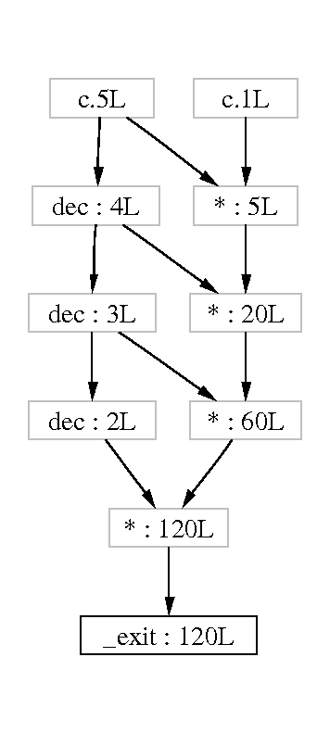
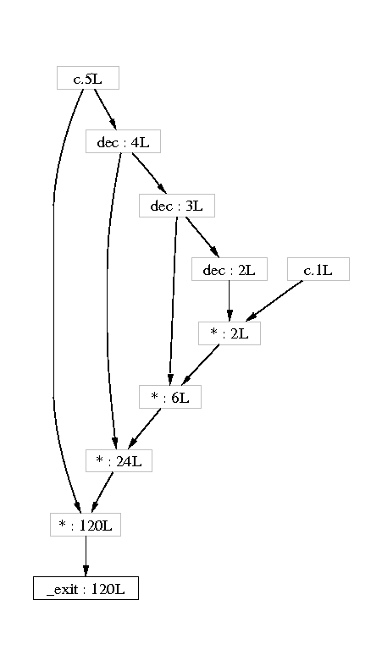
Two DDFGs

Slide 83
DDFG Features
Each node represents a constant, or value-producing operation:
  Arithmetic/logic instructions (add, sub, and, or, ...)
  Address computation instructions (lea)
  System calls
Doesn’t show other operations:
  Copies (register/register, register/memory)
  Function calls, returns
  Branches
Only shows:
  System call nodes (external behaviour)
  Parts of graph reachable from system call nodes (data flow)
  Interesting computations only! No book-keeping

Slide 84
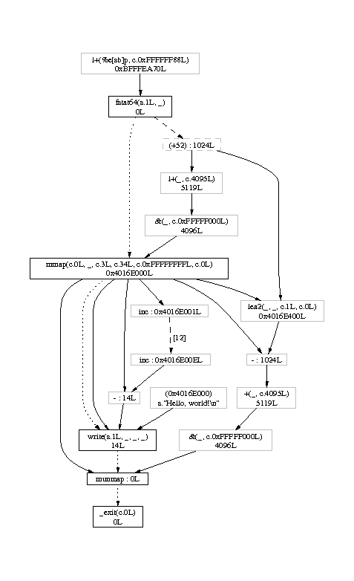
Hello world
fstat64 checks stdout
mmap allocates an output buffer
String length is counted
write prints the string
munmap frees the output buffer
_exit terminates program
29,000 nodes built, 17 shown!
  Most in dynamic linker

Slide 85
Essences
int faca(int n, int acc)
{
if (n <= 1)
return acc;
else
return faca(n-1, acc*n);
}
int main(void)
{
return faca(5, 1);
}
Accumulator recursion
Algorithmically equivalent to iterative version
Identical DDFGs

Slide 86
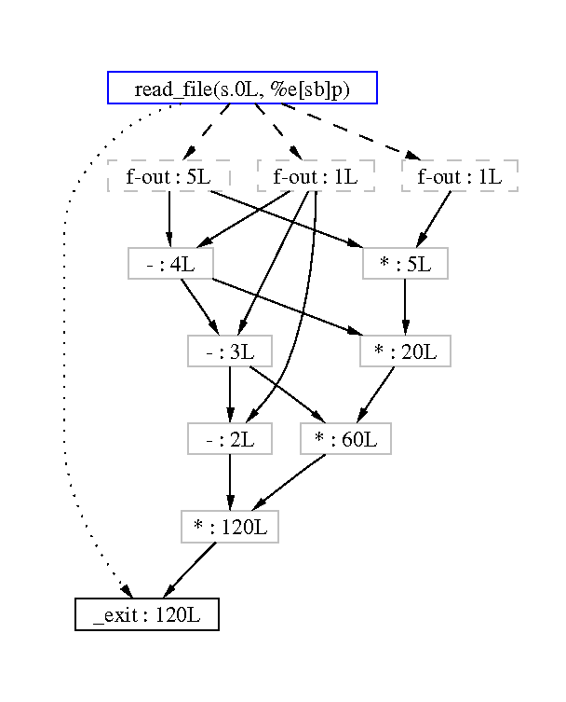
Stack machine version
Folded top node reads program, converts ASCII characters to integers (1, 1, and 5)
Very different computation model
Same as C version, except -(X,1) vs. dec(X)

Slide 87
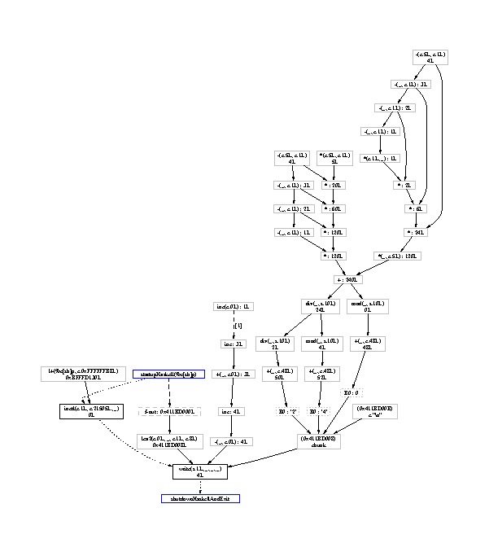
Haskell version
main =
putStrLn
(show
(facr 5 +
faca 5 1)
)
fac computations top right

Slide 88
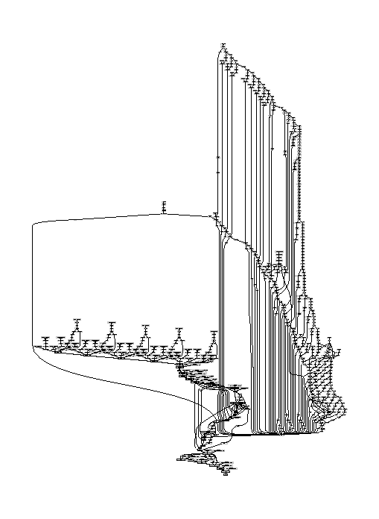
Scaling difficulties
bzip2’ing a two-byte file
  dot: 8 seconds
  ghostview: 5 seconds
Scales terribly
  CPU/memory use
  Too big to view

Slide 89
Possible uses?
Hmm, maybe:
  Program visualisation
  Debugging by sub-graph inspection
  Dynamic slicing
  Program comparison
Really, grasping at straws
  Too impractical as-is

Slide 90
So why talk about Redux?
It is a good pedagogical tool
  Explains dynamic binary analysis
  Explains shadow value tools
  Gets people thinking, generates ideas
    “You can do anything” is too abstract
    Makes the possibilities more concrete
Shadow values are approximations of a value’s history
  Redux shows most of that history

Slide 91
Shadow value/location profilers
All existing shadow value/location tools are error checkers
  Except Redux
Profiling shadow location tools?
  Count how many times registers or memory locations accessed?
Profiling shadow value tools?
  Count how many times value has been copied?
Something more interesting?

Slide 92
An idea: Bandsaw
Show how data flows from place to place through memory
Measure the amount of memory bandwidth used by each producer/consumer instruction pair
line A: for (i = 0; i < 10*1000*1000; i++)
a[i] = <...whatever...>
line B: for (i = 0; i < 10*1000*1000; i++)
sum += a[i];
40 MB transferred from line A to line B
Shadow locations
  Each memory location shadowed with instr. addr of its producer
  Upon a read, increment the producer/consumer pair count
Useful? Don’t know… but shows what you can do

Slide 93
What can you do with a Valgrind tool?

Slide 94
Valgrind tools can…
Delete, replace or augment every user-mode instruction
Add analysis code inline, or as calls to C functions
Wrap any system call
Wrap any function
Replace any function with a different one
Observe or change any register or memory value

Slide 95
Instrumentation limitations
Tools see Valgrind’s IR, not original _x0005_instruction stream
  Allows platform-independent instrumentation
  Some information is lost
  But instruction boundaries are preserved
Virtual addresses
Microarchitecture not directly visible (e.g. pipelines, µ-ops)
  Can simulate to a point (e.g. caches, branch predictors)

Slide 96
Some underlying concepts
Profilers:
  Concepts: X happened N times, X happened near Y
    Cachegrind, Callgrind, Massif
Checkers:
  Concept: X happened so Y should/should not happen
    Memcheck, Helgrind, TaintCheck, Annelid, Daikon
  Concept: X and Y were true at the same time, so…
    Data race detectors (Eraser, DRD)
Visualizers:
  Concept: X fed into Y
    Redux
These _x0005_concepts are common, but not the only ones

Slide 97
Brainstorming for new tools
Power consumption profiling (Valgrind too high-level?)
Floating point analysis/tracking
  Loss of precision, underflows, NaN propagation
Global domain-specific constraints
  Pre/post-conditions, e.g. pthreads
  Resource allocation/deallocation tracking
Fault/event injection
Data flow profiling to guide hardware compilation
De-compilation/de-obfuscation tools
Test suite generation
Analyse crypto code as it runs to extract keys?

Slide 98
Tool design is difficult
Need output that programmers can directly act on
Efficiency of analysis code is crucial
In checkers: getting the false positive rate down is hard
Compilers generate really strange code
  So do humans
Inferring high-level info from low-level code is hard
  E.g. is that a stack switch or large local array?
Simple tools are boring!
  The good tools are 1000s of lines of code, not 10s or 100s
  Instrumentation (basic data extraction) is often only a small part
  Good tools do clever things with the extracted data
  Ability to write an instruction counter in only 5 lines is overrated

Slide 99
Take-home message

Slide 100
What do you want to know?
What do you want to know about program execution that existing tools cannot tell you?
Valgrind lets you build powerful program analysis tools
  Can you learn what you want about programs using shadow locations or shadow values?
  Or any other Valgrind-supported feature?
The best tools do not arise in a vacuum
  Good: “I wish I knew X about my program…”
  Bad: “I want to write a tool. What would be a good one?”
You are the people with the “I wish I knew X” ideas
  Let your imaginations loose
  Talk to the tool-makers
  Maybe your idea is possible

Slide 101
Acknowledgments
Valgrind developers: Julian Seward, Nicholas Nethercote, Tom Hughes, Jeremy Fitzhardinge, Robert Walsh, Josef Weidendorfer, Dirk Mueller, Paul Mackerras, Cerion Armour-Brown, and many others
Other contributors: Donna Robinson, Alan Mycroft
Tim Sherwood and IISWC organizers for the invitation

Slide 102
(end of talk 4)

