Slide 1

<number>
Parts we need are in RED:
Septum
Kicker
Dipole
Quads (5-7 final)
Staging Beamline Layout
~2° from kicker and ~13° from septum
Septum
~2.0 m
Spect
Kicker
EEX Dipole
~0.5 m
Spect
Dipole
~2.0 m
Key:
Spectrometer
=
Dipole
Spect

Slide 2
Parts List
New Hardware
Standard Hardware
Scott:
kicker
chamber before septum
IMP/Wei
Septum
Quads (5-7)
Jing?
Waveguide
Nicole
4 feedthroughs
8? YAGS
6 Crosses
6 Actuators
2 inch pipe
John?
Dipole
Jing?
Structures

Slide 3
Overview Proposed Timeline 2017-2018
Month 2017 | Part | Work | Lead | Comments
May | Kicker | Septum | Fabrication | Scott, Wei
June
July
August | Kicker |  | Initial Testing | Nicole, Jing?
September |  |  | Installation | Eric?, Nicole
October | Septum |  | Initial Testing | Nicole
November |  |  | Installation | Eric?, Nicole
December | Kicker + Septum | Beam Test | Nicole
Month 2018 | Part | Work | Lead | Comments
January | PETS, Accel?, Quad, Dipole | Installation | Eric?, Jing?, Nicole
February | Full Beam Line Tests | Measurements | Nicole, Eric?
March
April
May

Slide 4
Details Proposed Timeline May-June 2017
Month 2017 | Part | Work | Lead | Comments
May
Week 1 | FID Connector Arrives | Test Vacuum | Eric?, Nicole | Also waiting for septum
Week 2
Week 3-4 | FID connector | Order 6 more | Scott?
Kicker, chamber | Finalize drawings and send out for fabrication | Scott?
June
Week 1-2 | Kicker, chamber | Send out parts for fabrication | Scott? | Also waiting for septum
Week 3-4 | Wait for parts

Slide 5
Details Proposed Timeline July-Aug 2017
Month 2017 | Part | Work | Lead | Comments
July
Week 1-3 | Get HV supply from APS | Contact APS | Jing? | Waiting on parts
Week 4 | Beam Studies | Validate Linac Simulations | Nicole
August
Week 1-2 | Kicker Arrives | Initial bench Tests | Nicole, Jing or Shao? | Also waiting for septum
Week 3-4 | Begin Installation | Eric?, Nicole

Slide 6
Details Proposed Timeline Sept-Oct 2017
Month 2017 | Part | Work | Lead | Comments
Sept
Week 1-2 | Kicker | Finish Installation | Eric?, Nicole
Week 3-4 | Beam Studies | Test Kicker, verify angle | Nicole
Oct
Week 1-2 | Septum Arrives? | Initial bench Tests | Nicole, Charles? | If Septum hasn’t arrived, installation of quads and wakefield structures after kicker can begin
Week 3-4 | Begin Installation | Eric?, Nicole

Slide 7
Details Proposed Timeline Nov-Dec 2017
Month 2017 | Part | Work | Lead | Comments
Nov
Week 1-2 | Septum | Finish Installation | Eric?, Nicole
Week 3-4 | Beam Studies | Test septum, verify angle | Nicole
Dec
Week 1-2 | Beam Studies | Cont. kicker and septum tests. | Nicole
Week 3-4 | Christmas Holiday

Slide 8
Details Proposed Timeline Jan-Feb 2017
Month 2017 | Part | Work | Lead | Comments
Jan
Week 1-2 | Quads, Dipole, Accelerating Structures | Installation |  | Eric?, Nicole
Week 3-4
Feb
Week 1-2 | Beam Studies Power Measurements | Straight through w/ structures | Nicole
Week 3-4 | Beam Studies Power Measurements | Bent Beam line w/ structure | Nicole
March
Week 1-4 | Beam Studies | Full Beam Line | Nicole

Slide 9
Back-UP

Slide 10
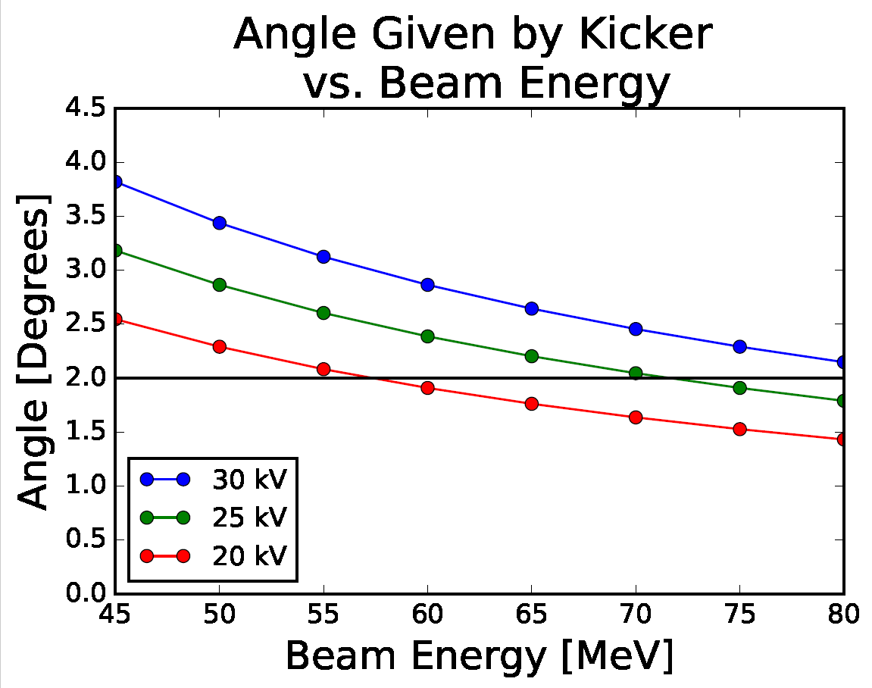
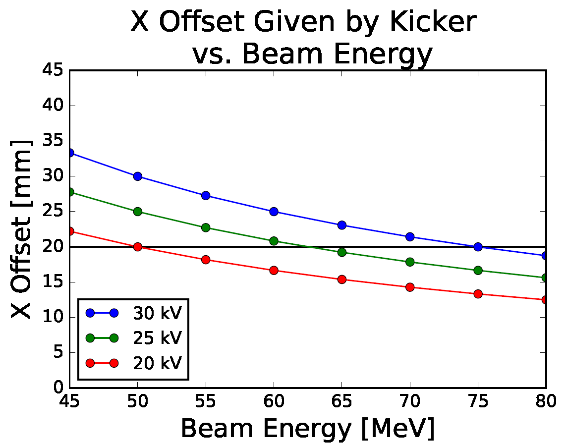
Drift needed after kicker to get ∆x = 65 mm. i.e. 40 mm gap between beam edges | 2.29° 19.9 mm | 2.08° 18.1 mm
 | 1.6 m | 1.8 m
Kicker Values
MeV | +/-20 kV | +/-25 kV | +/-30 kV
 | θ° | ∆x [mm] | θ° | ∆x [mm] | θ° | ∆x [mm]
75 | 1.53 | 13.3 | 1.91 | 16.6 | 2.29 | 19.9
70 | 1.64 | 14.2 | 2.04 | 17.8 | 2.45 | 21.4
65 | 1.76 | 15.3 | 2.20 | 19.2 | 2.64 | 23.0
60 | 1.91 | 16.6 | 2.39 | 20.8 | 2.86 | 24.9
55 | 2.08 | 18.1 | 2.60 | 22.7 | 3.13 | 27.2
50 | 2.29 | 19.9 | 2.86 | 24.9 | 3.44 | 29.9

