Slide 1


The Technology Value Stream
CSD 380 – DevOps
Natasha Foreman

Slide 2
Technology Value Stream
The Technology Value Stream represents the complete flow of work needed to transform an idea into a delivered product or service.
It includes planning, development, testing, deployment, and ongoing operations.
DevOps focuses on optimizing this flow by reducing friction, tightening feedback loops, and improving team collaboration.

Slide 3

Lead Time vs. Processing Time
Lead Time is the total duration from when a request is initiated until it is delivered to the customer.
Processing Time is the actual hands-on time spent performing work, which is often only a small portion of total lead time.
Most delays occur between steps, and DevOps practices aim to reduce these waiting periods.

Slide 4
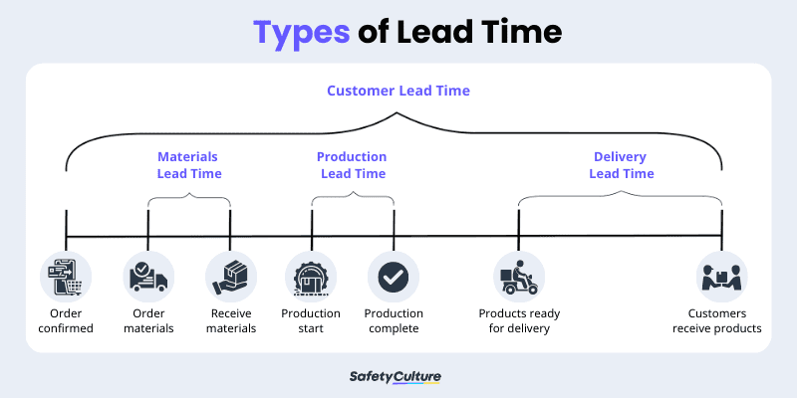
SafetyCulture. Understanding Lead Time in the Supply Chain. SafetyCulture, 2025. https://safetyculture.com/topics/supplier-quality-management/lead-time

Slide 5
Deployment Lead Times of Months
Many organizations experience deployment cycles that take weeks or months due to traditional workflows and siloed teams.
Manual approval steps, long testing queues, and large batch releases significantly delay delivery.
These delays reduce responsiveness and increase release risk.

Slide 6
Problems to Long Deployment Times
Bottlenecks often occur in testing and operations where teams must wait for resources or approvals.
Code frequently sits in queues awaiting scheduled release windows.
Lack of automation increases workload, delays, and error rates.

Slide 7
Deployment Lead Times of Minutes
High-performing DevOps organizations deploy multiple times per day.
Automated testing, CI pipelines, and automated deployment reduce the time from commit to production.
Smaller, more frequent releases reduce risk and improve stability.

Slide 8
Making Rapid Deployment Possible
Infrastructure as Code standardizes and automates environment creation.
CI/CD pipelines automate testing and deployment, removing manual barriers.
Cross-functional collaboration helps identify and resolve issues faster.

Slide 9
Key Takeaways
Traditional delivery methods are slowed by manual steps and organizational bottlenecks.
DevOps dramatically shortens lead time through automation and continuous feedback.
Shortening the value stream enables faster innovation and higher quality outcomes.

Slide 10
References
Kim, Gene, et al. The DevOps Handbook. 2nd ed., 2021.
SafetyCulture. Understanding Lead Time in the Supply Chain. SafetyCulture, 2025. https://safetyculture.com/topics/supplier-quality-management/lead-time

