Slide 1
3. Konzeptueller Entwurf
Data Management Foundations

Slide 2
Recap

Slide 3
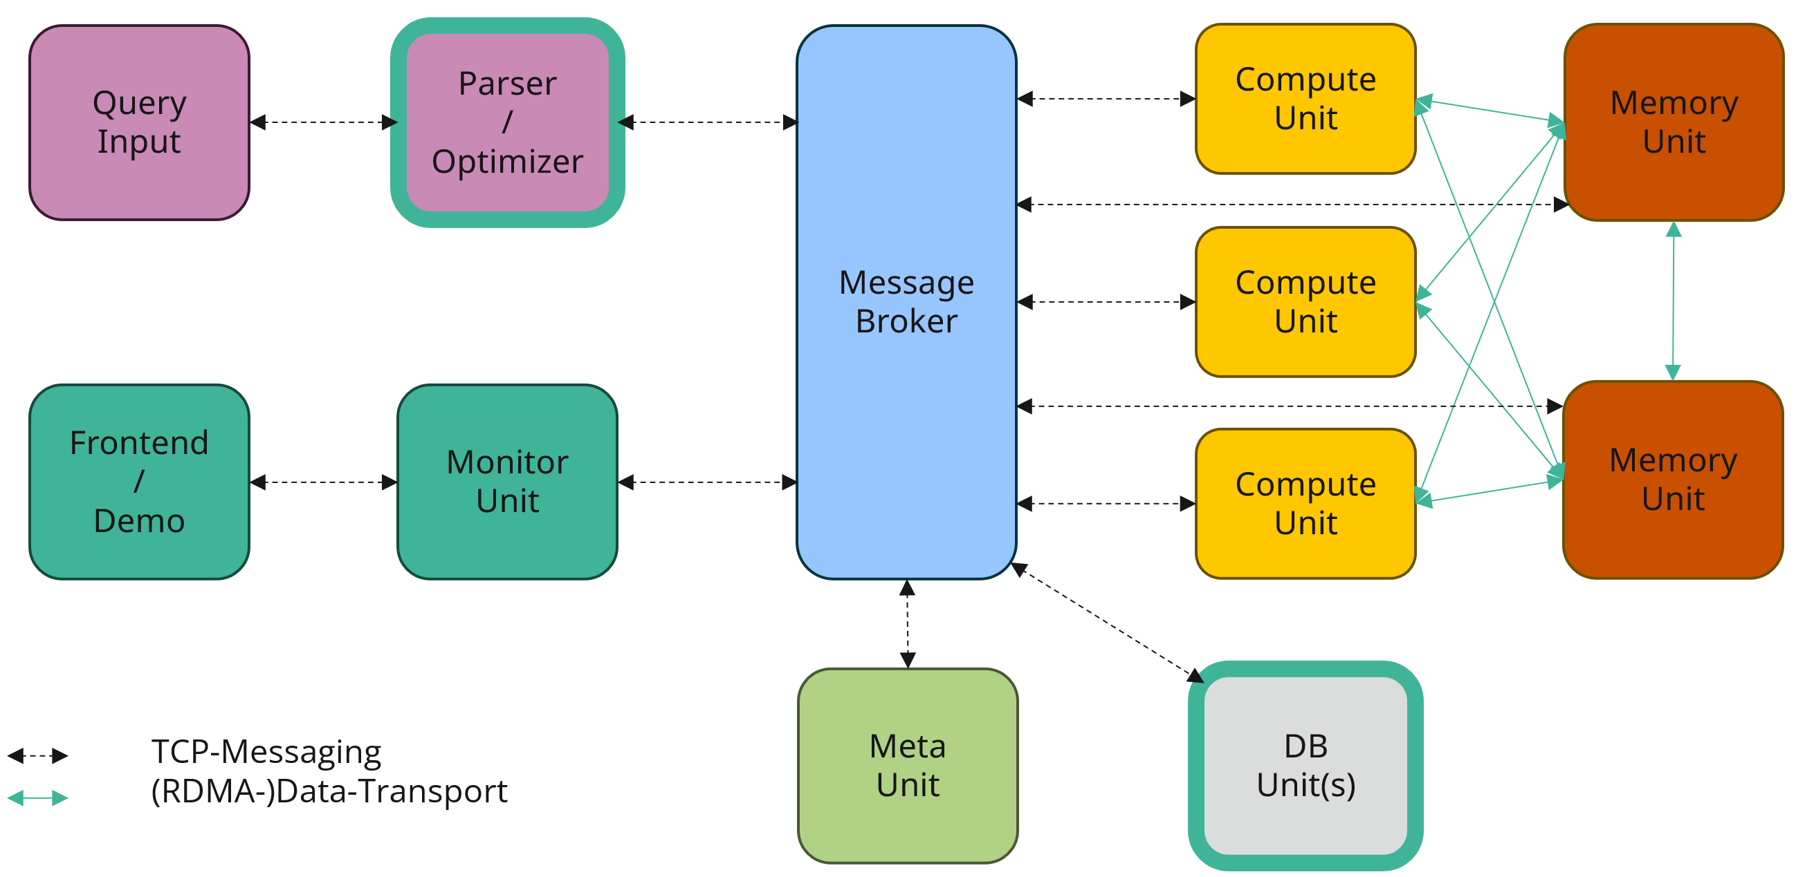
Details
Parser / Optimizer
Parser
Optimizer
Translation
SQL
PB-
Packages

Slide 4
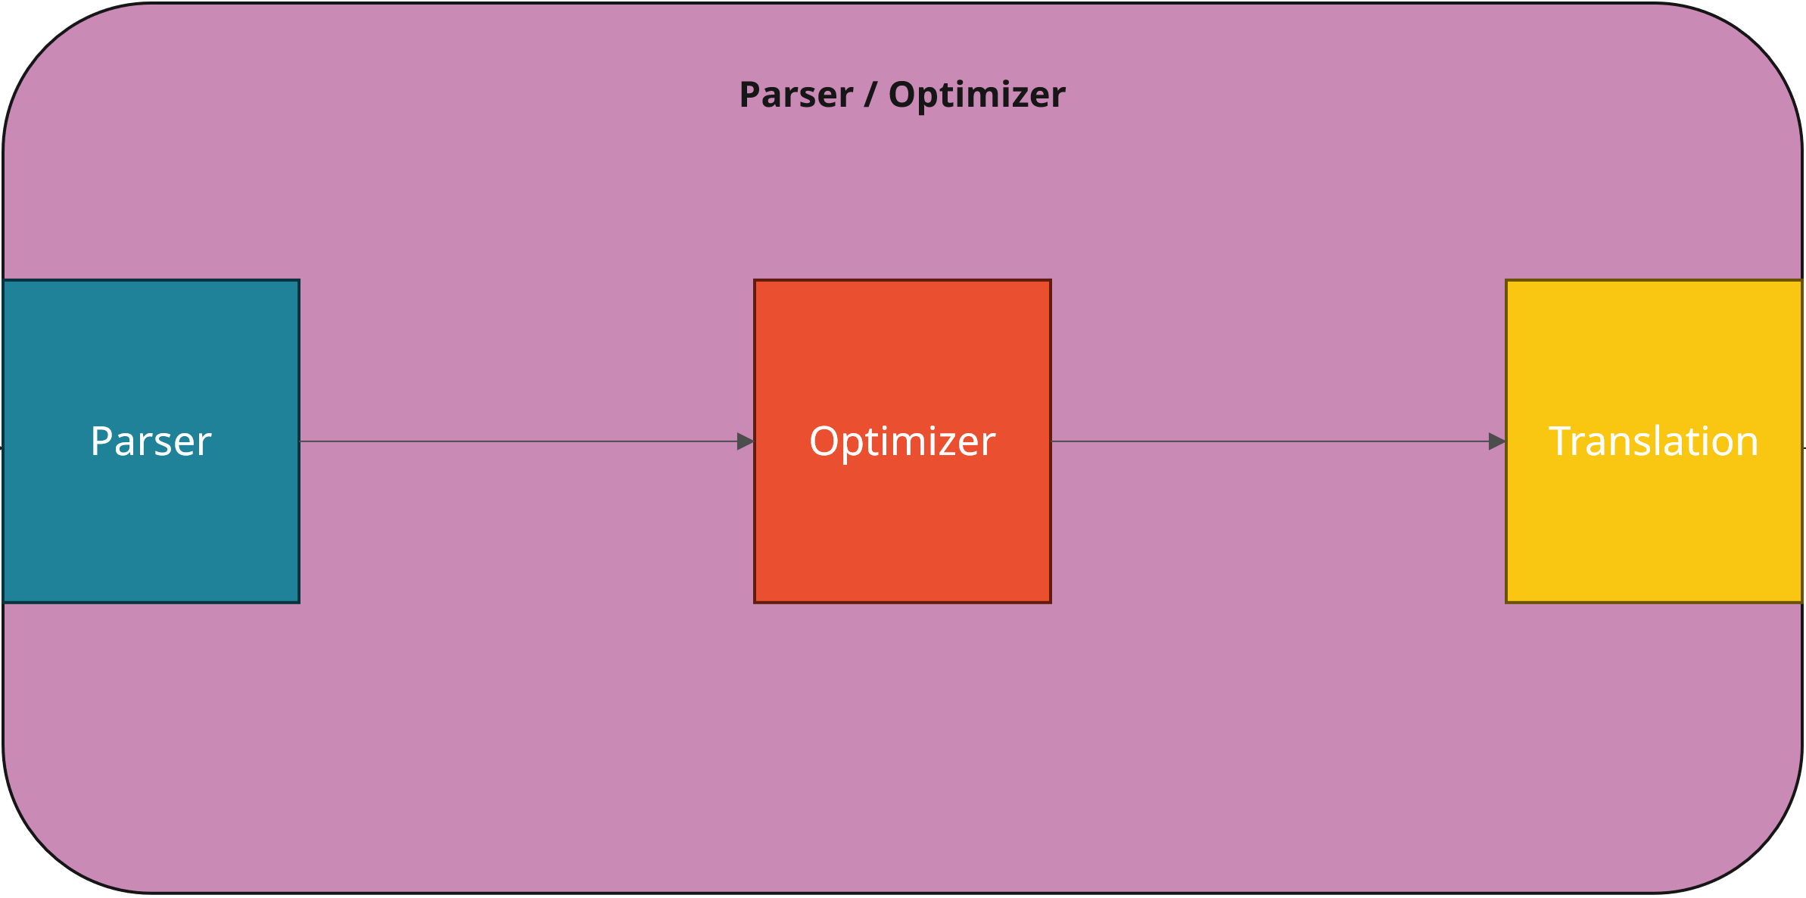
Expectations
Basic:
  Parsing and translation of an SQL-Query into system-specific PB-Packages
  Translation from Postgres-Plan to PB-Packages
  Multiple Queries at once (multi-threading)
Intermediate:
  Implementation of simple optimizations (e.g., simple Selection-Push-Down)
  Different physical operators are possible
Advanced:
  Creating statistics on queries/created packages
  UES (Explanation when necessary)
  Taking system capabilities into account
  Your own creative ideas…

Slide 5
Zooming in

Slide 6
Standard Optimizer
Query Optimization
Query
Parsing to
Logical
Query Plan
Access and
Integrity
Control
Logical
Plan
Rewrite
Plan
Trans-
formation
Logical DB Processor/
Compile Time System (CTS)
Query Processor
Query
Execution
Plan (QEP)
Query Compile Time
Query Runtime
Physical DB Processor/
Runtime System (RTS)
Result
Result
Provisioning
Execution
Control
Code
Generation
Plan Para-
meterization

Slide 7
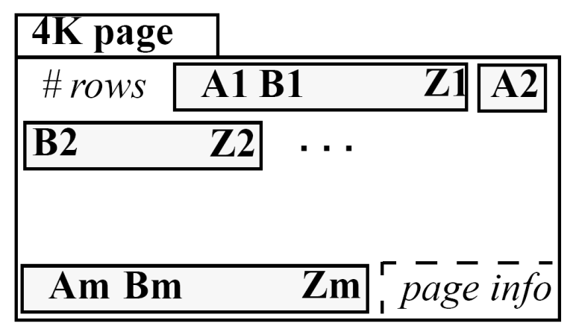
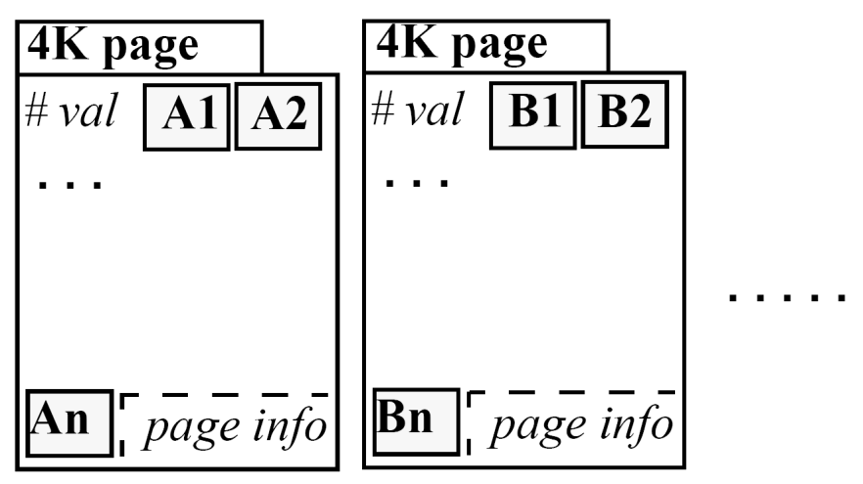
Why we don’t use a standard optimizer
Row store
  Easy to add/modify a record
  Even if only a few attributes value are needed, all attributes values have to be read
  → unnecessary IO-cost
  Compression is hard since consecutive values are from different domains (e.g. name, age, street addr, zip code, etc.)
Column store
  Only need to read in relevant data, more efficient scan operators
  Compression easily possible (for example run length encoding)
  tuple writes require multiple accesses
  Reading all columns of a single row requires expensive row-reconstruction (1:1 join)

Slide 8
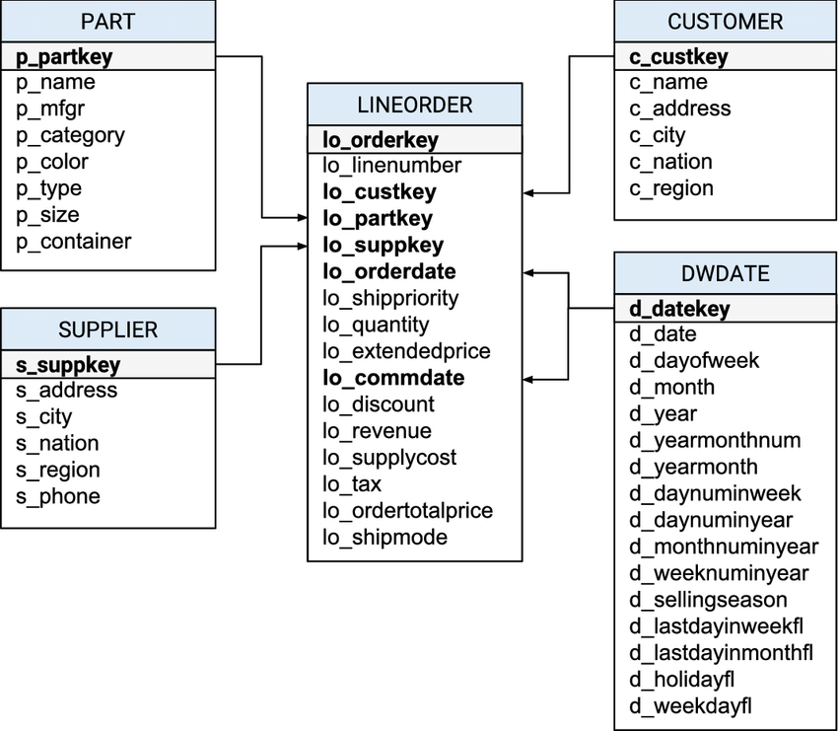
SSB

Slide 9
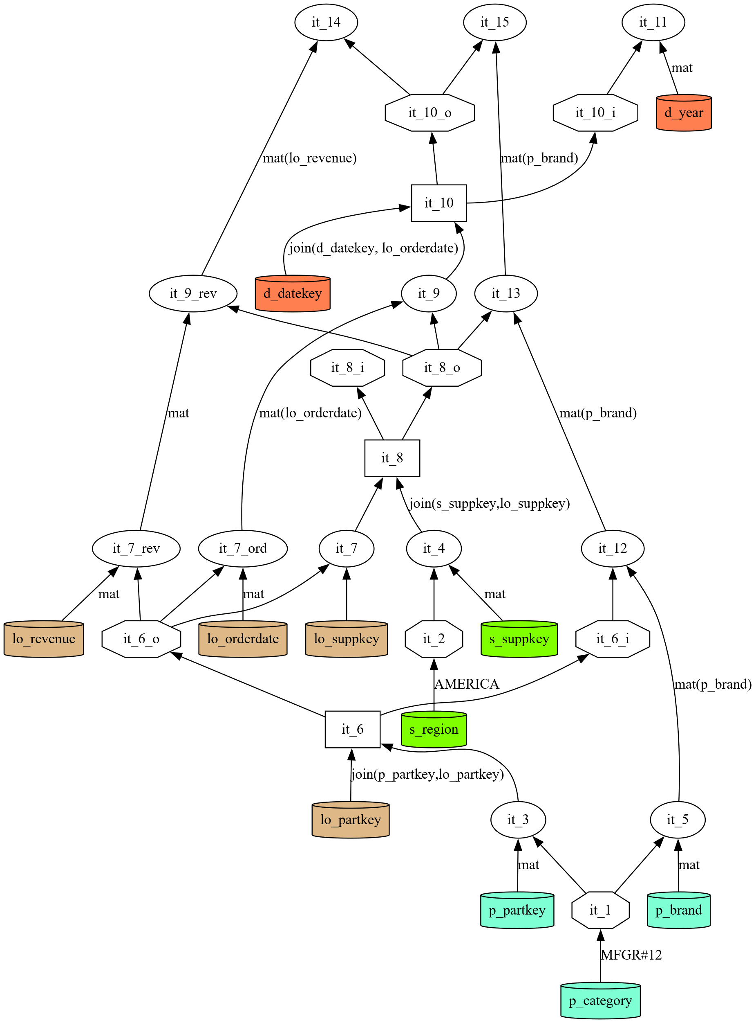
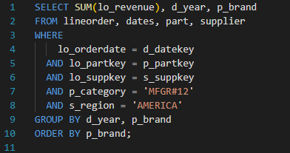
Why we don’t use a standard optimizer…

Slide 10
Operators

Slide 11
Position List
s_region
AMERICA
EUROPE
ASIA
ASIA
AUSTRALIA
EUROPE
AMERICA
AMERICA
EUROPE
ASIA
pos_list
0
6
7
FILTER
&
=
= „AMERICA“

Slide 12
Bitmap
s_region
AMERICA
EUROPE
ASIA
ASIA
AUSTRALIA
EUROPE
AMERICA
AMERICA
EUROPE
ASIA
Bitmap
1
0
0
0
0
0
1
1
0
0
FILTER
&
=
= „AMERICA“

Slide 13

Operator Overview
Operator | Input | Output
Filter | (Base)Column + Type + Val | Pos_List / Bitmap
Materialize | (Base)Column + Pos_List / Bitmap | Column
Set (Union/Intersect) | Pos_List / Bitmap x2 | Pos_List / Bitmap
Join (Hash) | (Base)Column I + (Base)Column O | Pos_List I + Pos_List O
Group By | Column(s) + Aggregation + Order | Pos_List(s)
Sort (Order By) | Column(s) + Order | Pos_List(s)
Aggregate | Column + Func | Column
Map | (Column + Column / Val) + Func | Column

Slide 14
Set
Bitmap
1
0
0
0
0
0
1
1
0
0
Bitmap
0
0
1
0
0
0
1
0
0
1
Bitmap
0
0
0
0
0
0
1
0
0
0
pos_list
0
2
6
7
9
pos_list
0
6
7
pos_list
2
6
9
∪
=
∩
=

Slide 15
Join
lo_partkey
22
22
88
88
11
33
11
99
11
22
p_partkey
00
11
22
33
44
55
66
77
pos_list O
4
6
8
0
1
9
5
pos_list I
1
1
1
2
2
2
3
⋈
=
,

Slide 16
Our System

Slide 17
Going back to…

Slide 18
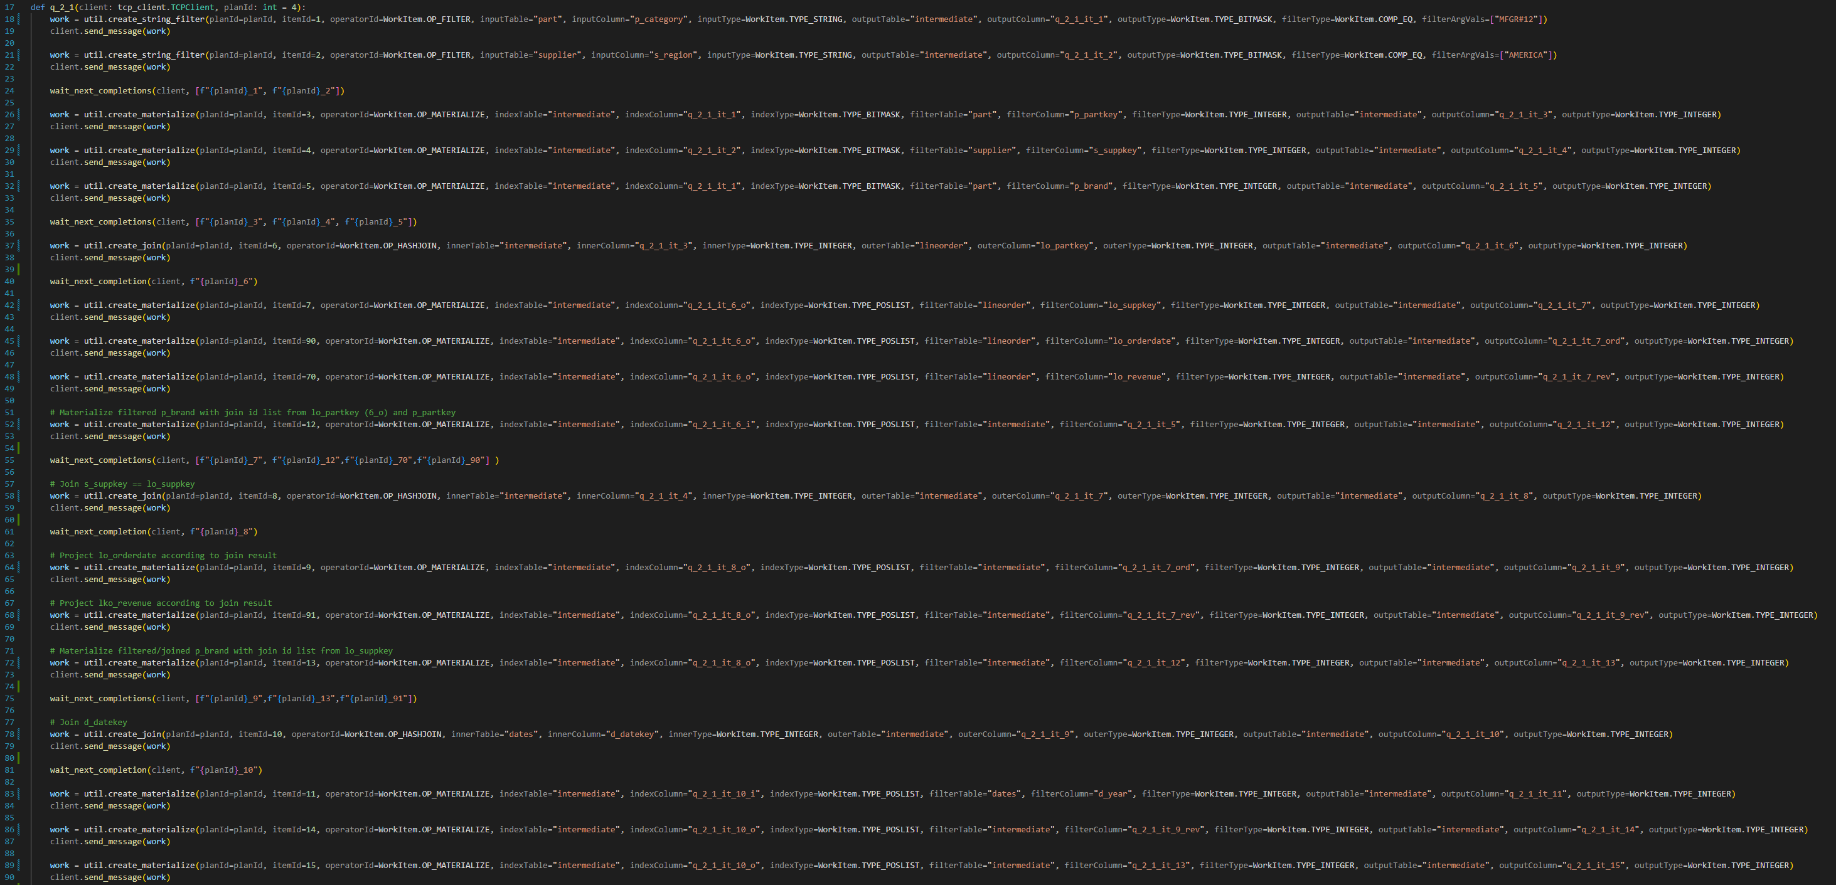
How it looks

