Slide 1
0. Kickoff
Practical Projects 2025

Slide 2
Disaggregation
Monolithic System Architecture
Disaggregated System Architecture
Compute Pool
RAM
Cache
Cache
RAM
Memory Pool
CPU
QPI
CPU
QPI
QPI
QPI
QPI
CPU
QPI
CPU
RAM
Cache
Cache
RAM
Storage Pool

Slide 3
System Architecture
Query
Input
Parser
/
Optimizer
Message
Broker
Compute
Unit
Memory
Unit
Parser
/
Optimizer
Compute
Unit
Frontend
/
Demo
Monitor
Unit
Memory
Unit
Compute
Unit
Meta
Unit
DB
Unit(s)
TCP-Messaging
(RDMA-)Data-Transport
DB
Unit(s)

Slide 4
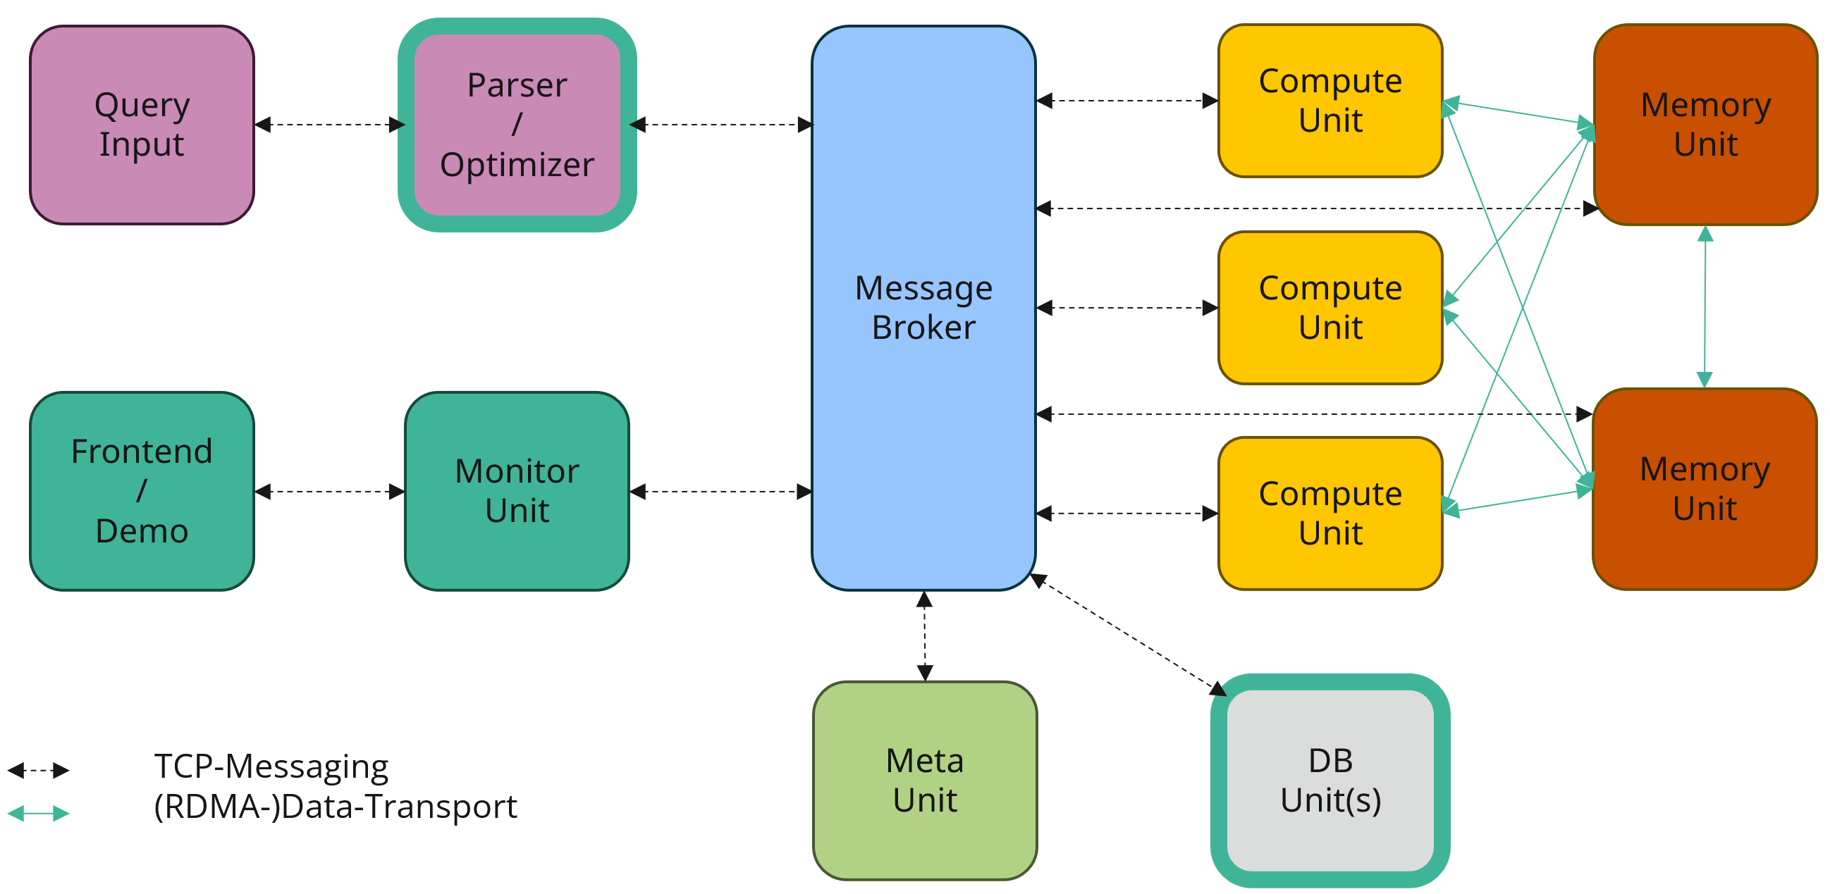
Projects
DB-Units
  Required:
    Working together as a group
    Interest in exploring different DBMS
    Programming in Python
C++/Rust4DB (Optimizer)
  Required:
    Working together as a group
    Interest in deep-diving DBMS optimizer
    Programming in C++/Rust

Slide 5
DB-Units

Slide 6

Details
DB-Unit
General
Specialized
TCP-Connect
(Protobuf)
Translation
Database Adapter
DBMS
(e.g. DuckDB)
PB-
Packages
PB-
Package
SQL
SQL

Slide 7
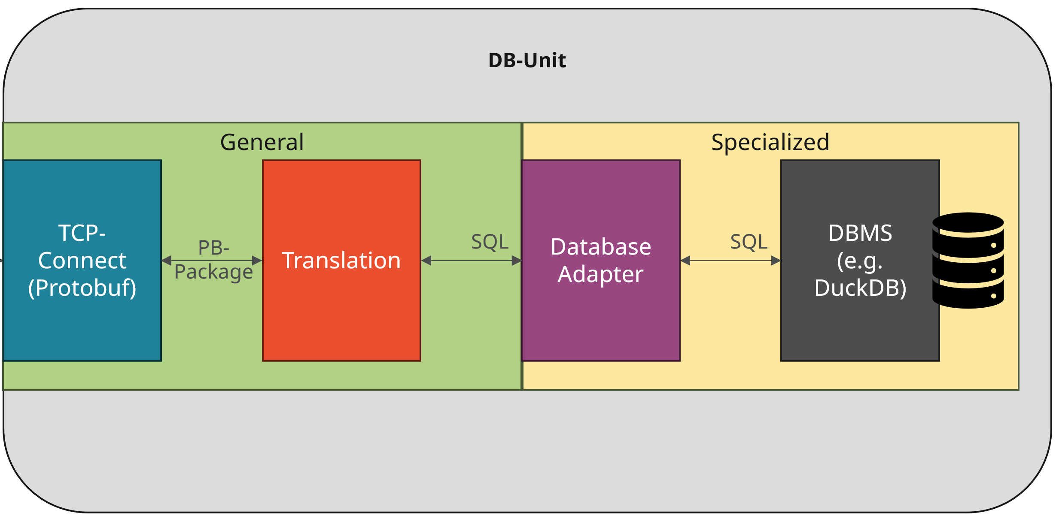
Expectations
Basic:
  TCP-Connect (Protobuf)
  Database Adapter for N different DBMS (N >= Participants/2)
  For a given PB-Package containing an SQL-Query, return the results from the DBMS
Intermediate:
  Translation from PB-Operator-Package into SQL
  Easy configuration of DB-Unit
Advanced:
  Exposing information about available data
  Sanity check arriving PB-Packages
  Write results to file instead of back via TCP
  Exposing performance measurements for Queries
  Your own creative ideas…

Slide 8
DBMS-Selection
„Heavy“ Standard DBMS
  PostgreSQL
  MariaDB
  …
„Lightweight“ DBMS
  DuckDB
  SQLite
  …
File-based DBMS/Data Lakehouse
  ??

Slide 9
Questions regarding DB-Units?

Slide 10
C++/Rust4DB (Optimizer)

Slide 11
Details
Parser / Optimizer
Parser
Optimizer
Translation
SQL
PB-
Packages

Slide 12
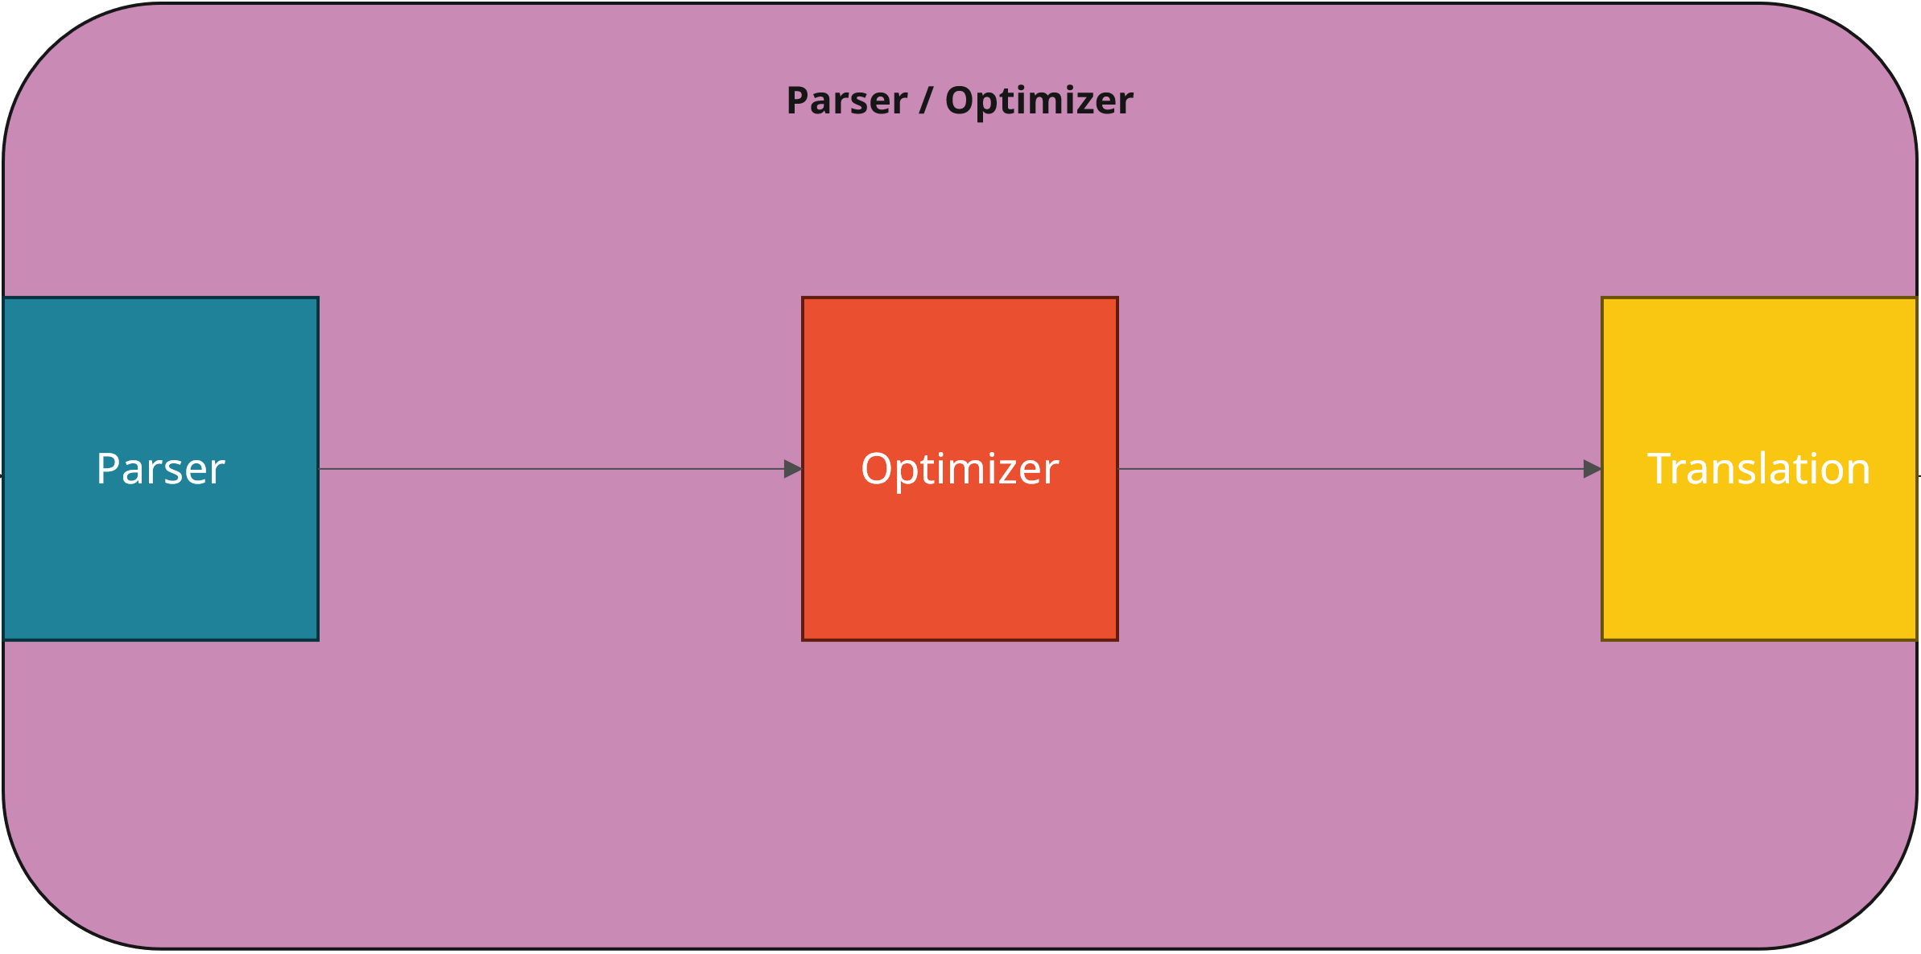
Expectations
Basic:
  Parsing and translation of an SQL-Query into system-specific PB-Packages
  Translation from Postgres-Plan to PB-Packages
  Multiple Queries at once (multi-threading)
Intermediate:
  Implementation of simple optimizations (e.g., simple Selection-Push-Down)
  Different physical operators are possible
Advanced:
  Creating statistics on queries/created packages
  UES (Explanation when necessary)
  Taking system capabilities into account
  Your own creative ideas…

Slide 13
Questions regarding Optimizer?

Slide 14
Disclaimer & Tools

Slide 15

Disclaimer AI Usage
You are NOT allowed to upload our code/papers/slides/etc. anywhere!
  This includes AI models like, e.g., ChatGPT.
You need to be transparent about your AI usage.
  For example, putting a disclaimer in the generated code.
You are allowed to use AI-Tools in general when you respect these simple rules.
  This includes, e.g., code generation.

Slide 16
Tools
We use GitLab for the projects
  Hosted by TU Chemnitz (login via Shibboleth → ZIH login) → https://gitlab.hrz.tu-chemnitz.de/users/sign_in
  I will create a GitLab repository for each group and invite you.
  Please use Issues, Merge Requests, and all the other cool features.
We use Matrix for communication
  Hosted by TU Dresden (login via Shibboleth → ZIH login) → https://matrix.tu-dresden.de/#/welcome
  I will create individual spaces for each group.
  There will be a room where you can communicate with me directly.
  You can create your own rooms for specific purposes (e.g., Bots)

Slide 17
Questions?

Slide 18
GroupBy

