Slide 1

Car Sales Dashboard Analysis
Comprehensive Sales, Customer & Company Performance Review

Slide 2

Executive Summary
• Strong overall financial performance (19.86bn annual income)
• Sales peak observed in Q4
• Automatic vehicles dominate revenue contribution
• Male customers represent majority segment
• Revenue concentrated among selected brands

Slide 3
Sales Performance Overview
Total Customers: 23.91K
Total Cars Sold: 23.906K
Average Car Price: 28.09K
Stable mid-range market positioning
Strong revenue generation performance

Slide 4
Monthly Sales Trends
Gradual increase in sales across the year
November recorded highest sales
February recorded lowest sales
Strong seasonal influence on performance

Slide 5
Revenue by Company
Revenue concentrated among top-performing brands
Performance gap between leading and lower-tier brands
Risk of over-reliance on few brands
Opportunity to strengthen underperforming brands

Slide 6

Regional Revenue Distribution
Balanced revenue contribution across regions
No single region dominates excessively
Geographic diversification reduces risk exposure

Slide 7

Transmission Type Analysis
Automatic vehicles generate higher revenue
Manual vehicles show lower contribution
Clear shift in consumer preference toward automatic

Slide 8
Customer Gender Distribution
Male customers significantly outnumber female customers
Gender imbalance across most brands
Untapped potential in female market segment

Slide 9

Customer Preferences
Most preferred colors: Pale White and Black
Red is least preferred
Inventory planning should align with color demand
Automatic vehicles preferred by both genders

Slide 10
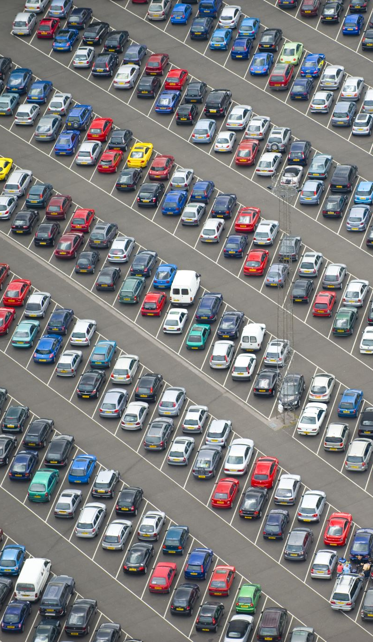
Key Strategic Insights
Strong Q4 performance drives annual results
Automatic vehicles dominate sales
Revenue concentration risk among top brands
Female segment presents growth opportunity

Slide 11
Future Recommendations
Introduce Q1 promotional campaigns
1
Expand marketing toward female buyers
2
Increase automatic vehicle inventory
3
Optimize stock based on color demand
4
Strengthen underperforming brands
5
Utilize predictive analytics for forecasting
6

