Slide 1
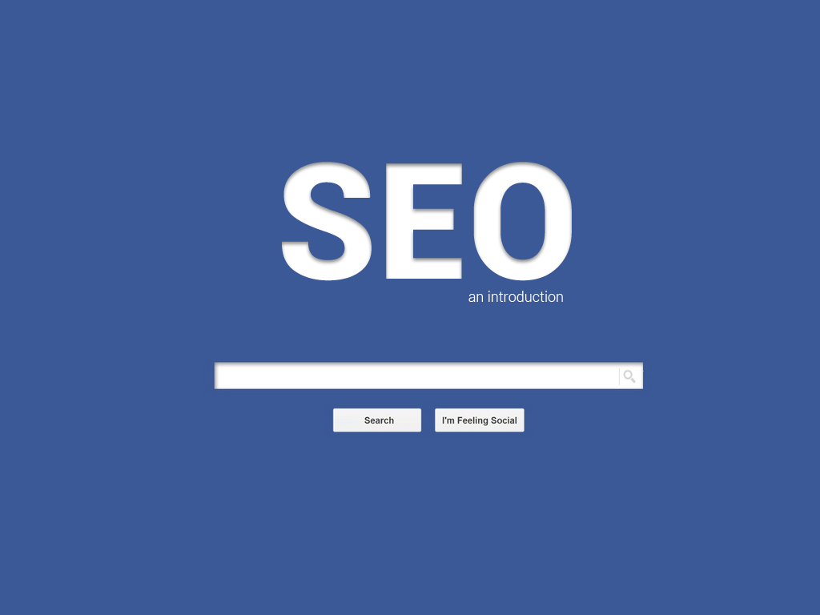

Slide 2
WHAT IS A SEARCH ENGINE?
It is an information retrieval system designed to help find information stored in a computer system

Slide 3

Search engines are the librarians of the web.

Slide 4
Search engine index
: collects, parses, and stores data to facilitate fast and accurate information retrieval.

Slide 5
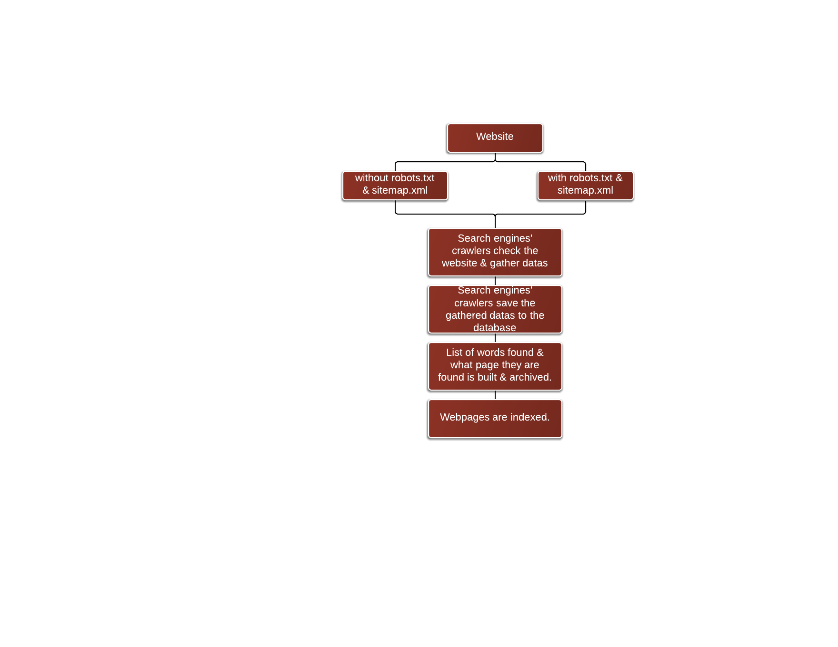
Site indexation process
You control
what pages
will be
indexed/crawled.
Website
will be crawled
naturally

Slide 6
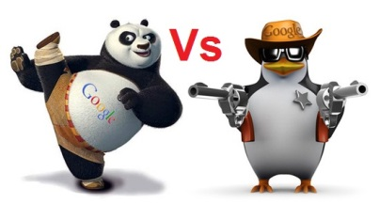
Penalize websites of low quality and those with low-quality content.
It was first introduced in 24thFebruary, 2011 as Farmer Update in USA.
Bring down websites that violate Google’s Webmaster Guidelines and use black-hat SEO techniques

Slide 7
PageRank
Is a scoring system that Google uses to determine the importance of a web page.
PageRank is scored on a logarithmic scale between 1 and 10.

Slide 8
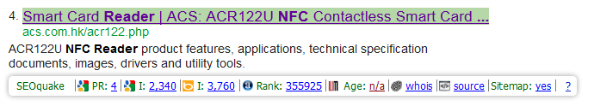
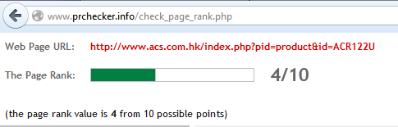
PR checkers

Slide 9
High Ranking Websites
twitter.com
addthis.com
leru.org
unesco.org
miibeian.gov.cn
hhs.gov
google.com
ipod.com
facebook.com
youtube.com
yahoo.com
baidu.com

Slide 10
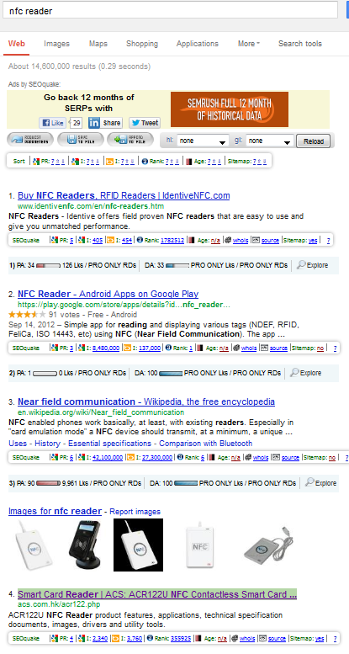
SERP
Search Engine Results Page

Slide 11

With Google, PageRank is one of the key factors to get a higher position in SERP.
Good SERP Position equals to a good traffic to your website.

Slide 12
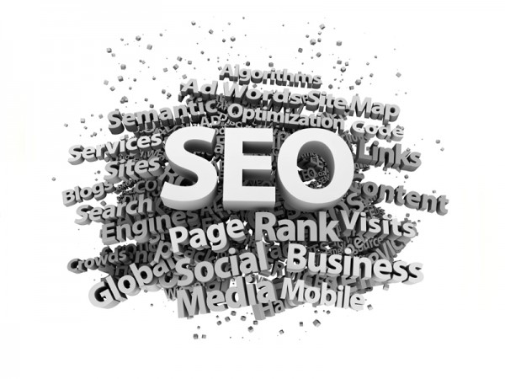
The key to a higher ranking
is making sure your website has the factors that search engines process with their algorithm.

Slide 13
SEO or Search engine optimization is the process of affecting the visibility of a website or a web page in a search engine's "natural" or unpaid (organic) search results.

Slide 14
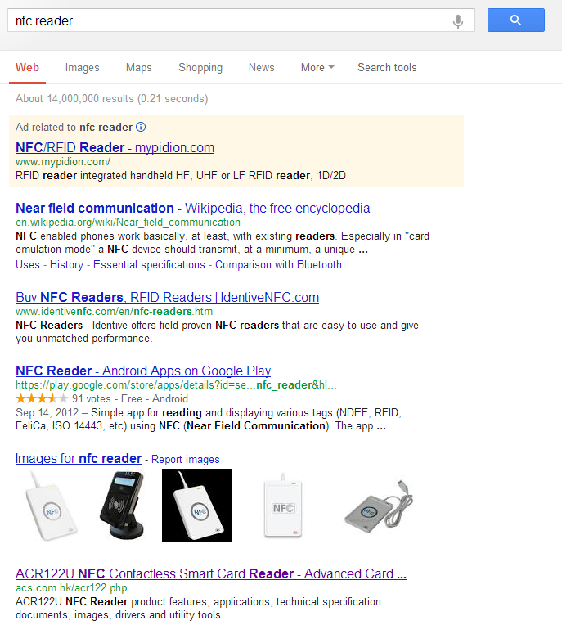
PAID Search result
}
Organic Search results

Slide 15
SEO perfectly fits into a company’s overall business strategy in several critical ways:
Visibility (branding)
Website Traffic
Lead Generation
Reputation Management
E-commerce Readiness

Slide 16
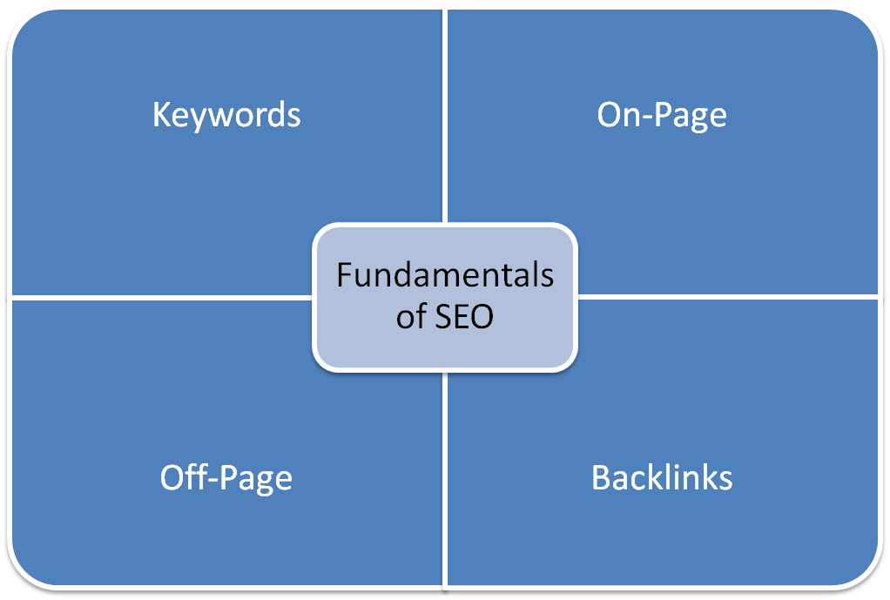

Slide 17
KEYWORDS

Slide 18
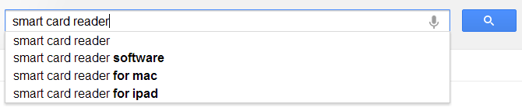
Why do KEYWORDS matter?
People are constantly using keywords whether they are in search of a specific product or just browsing to conduct personal research.
Keywords or key phrases are the search terms someone types into a search engine, when they are looking for certain information.

Slide 19
On-Page Optimization

Slide 20
The first rule of on-page SEO is
to think about what your target users might be searching for, and make sure the right
keywords are on the page.

Slide 21
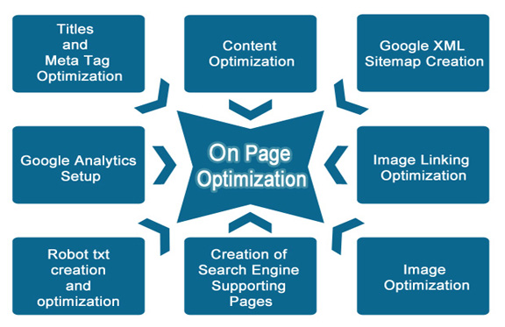
The Core Components of On-Page SEO

Slide 22
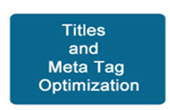
Meta tags are the official data tags for each web page that are found between the open and closing head tags in the HTML code.
These tags alert search engines with relevant information describing the content of the page, which helps the search engines decide if your website is an appropriate listing in response to a particular search query.
The most popular Meta tags are the title tag, meta description, and keyword tag.

Slide 23

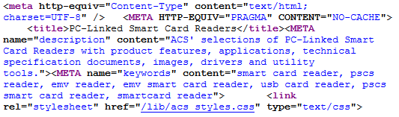
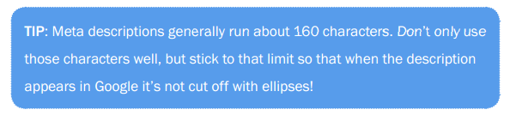
On SERP (Search Engine Results Page)
Website’s Meta data

Slide 24
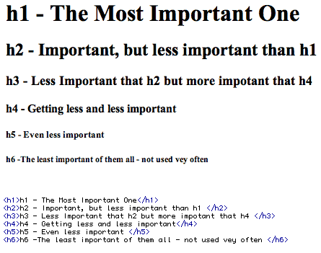
Header Tags are an important on-page SEO factor because they communicate to search engines what your website is about. Search engines consider the copy in your header tags more important than the rest.

Slide 25
Header Tags’ Important Notes:
Every page within your site should have at least one heading.
You should only put one h1 on a page.
Make sure your h1 is the first heading on the page.
Your h1 should contain your main keyword and be similar but not the same as the page title.
Style your headings with CSS, not inline styles.
Never skip heading levels. It isn’t logical to skip from h2 to h4. However, you can go from h2 to h3, then back to h2 if your content warrants this.
You can use more than one h2, h3, h4, h5, and h6 on your page.
All headings apart from h1 are subheadings.
You should use your headings consistently throughout your website.
Headings should be grammatically correct, logical and easy to scan.
Put keywords in if you can.
Your headings should be closely related to your text.

Slide 26
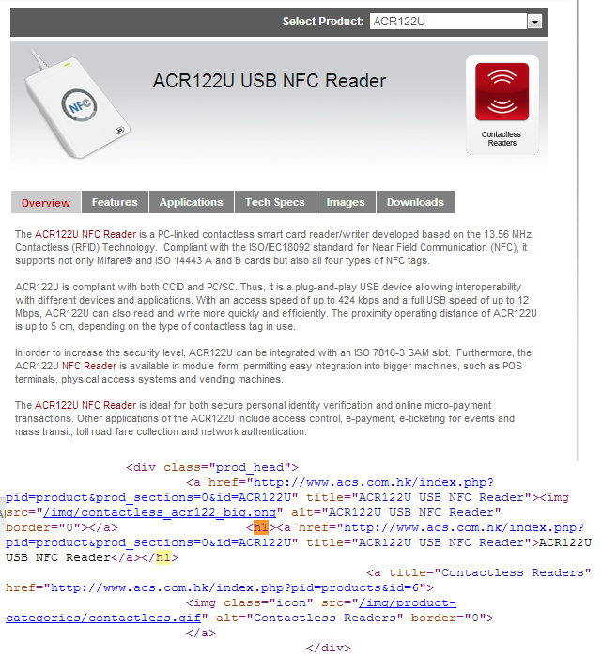

Slide 27
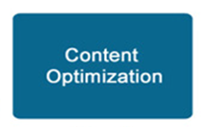

Content is what search engine crawlers need to associate your page with a set of keywords and/or key phrases.

Slide 28
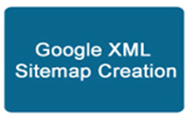
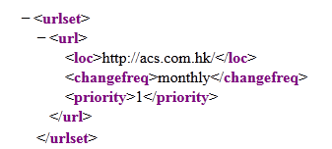
A sitemap is an xml page on your website that incorporates a list of links in every single page on your site.
It can also detail the hierarchy of pages on your site.
Sitemap content/code:
Note: Without a quality sitemap, pages that are buried more than a couple of clicks from the home page will take longer to get indexed and in some instances, Google (and other search engines) may not index them at all.

Slide 29
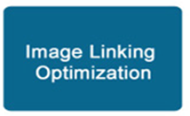
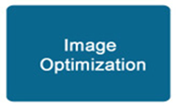
You need to ensure that your website’s images are optimized. It is easier for a search engine to comprehend these images if they are tagged with relevant information.
Why is image optimization
important?
If done correctly,
Images can be crawled easily and rank highly →

Slide 30
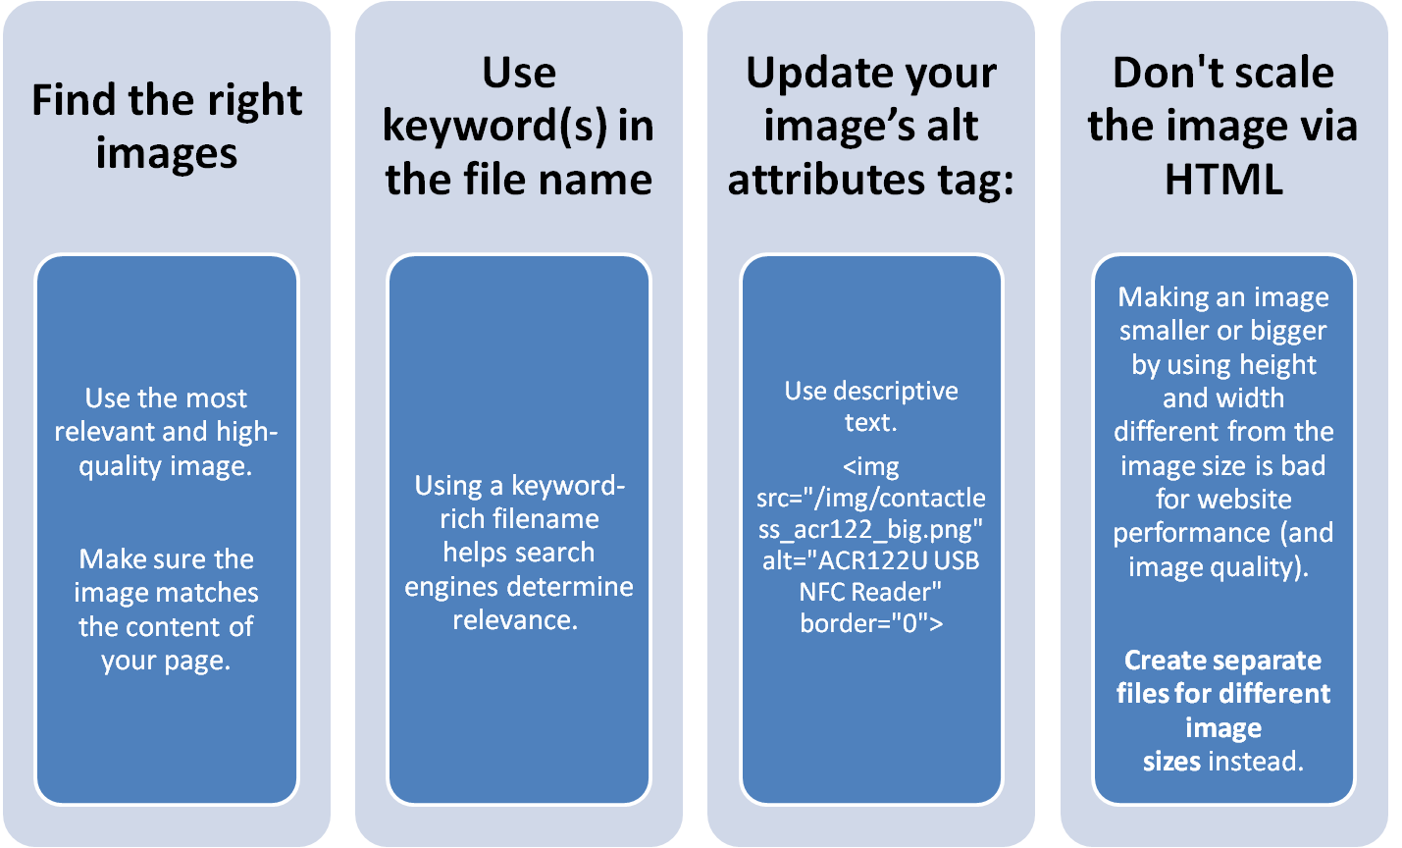
How to Optimize Images

Slide 31
Use SEO Friendly URL
SEO-friendly URLs are purely structural URLs
that do not contain a query string
[e.g., www.example.com/?p=578544]
but use keyword-rich naming conventions instead
[e.g., www.example.com/products/smartcardreader]

Slide 32
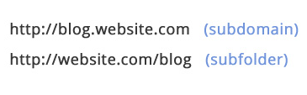
Subfolder(Subdirectory) or Subdomains?
Subdomains are often seen by Google as separate domains, which means you have to do twice the SEO work.

Slide 33
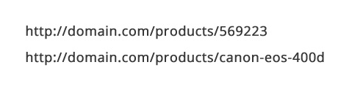
File Names (Page Address)
Implementing keywords in naming page address will help search engines have a clue about the content of your page.

Slide 34
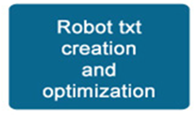
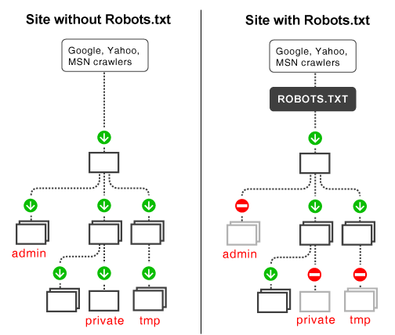
A Robots.txt file complements your XML sitemap by providing search engine crawlers with instructions on how to read and index your website.
Robots.txt tells search engines which pages to index and which to skip, so that private information stays protected.

Slide 35
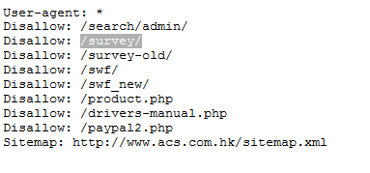
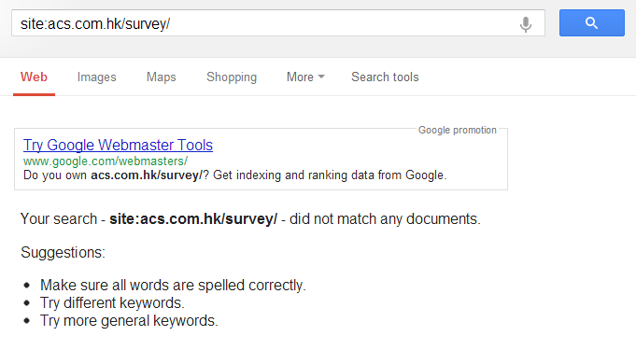
Inside ACS’ robots.txt file…
Not indexed by Google

Slide 36
Understanding Off-Page SEO

Slide 37
Off-page SEO is all about building online authority – trust and reputation – for your website.
It has been defined by the quantity, quality, and relevance of links to your website that establish your SEO authority and ultimately influence your search results ranking.

Slide 38

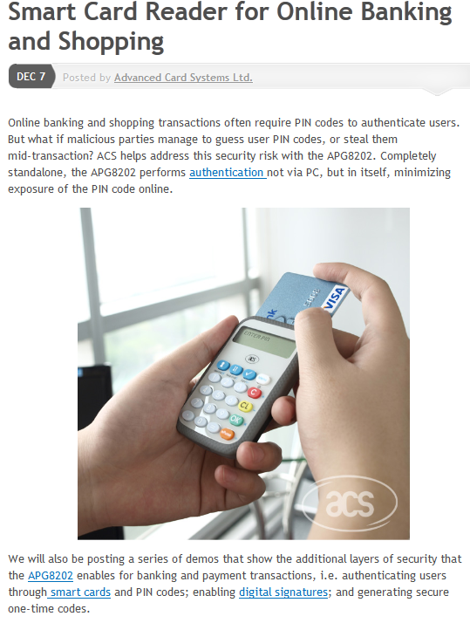
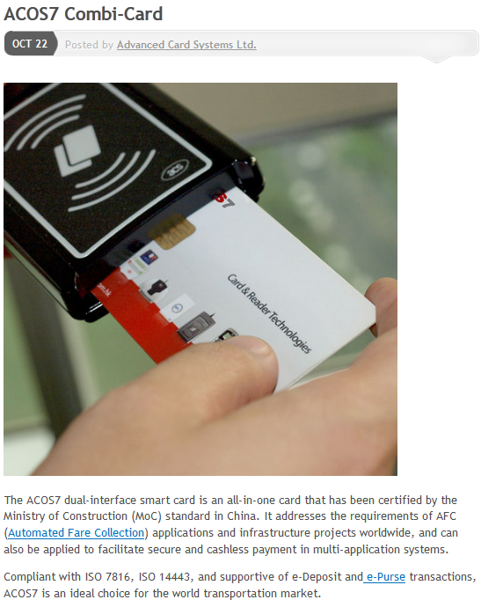
→ Is the practice of building inbound links to help give your website authority.

Slide 39
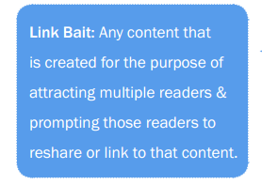
→ Content Creation for LINKS
Optimizing for off-page SEO is still about content marketing.
The best way to earn relevant links from other sites to yours is to create unique, relevant content that can quickly gain popularity online, particularly with your target audience.

Slide 40


→ is a new platform presenting an opportunity to connect and have real conversations with your audience.
Social media signals are
search engines’ signals as
natural ranking factors.

Slide 41
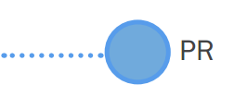
Press Releases boost exposure online and is usually recognized and indexed by all major search engines.
Press release is a good reputation management
and search engines’ ranking factor.

Slide 42
WHY SEARCH ENGINES CARE ABOUT LINKS

Slide 43


A page will show up in SERP because the website had mentioned keywords that were being searched for on the website page.
Search engines’ major ranking factors that is put into consideration :

Slide 44
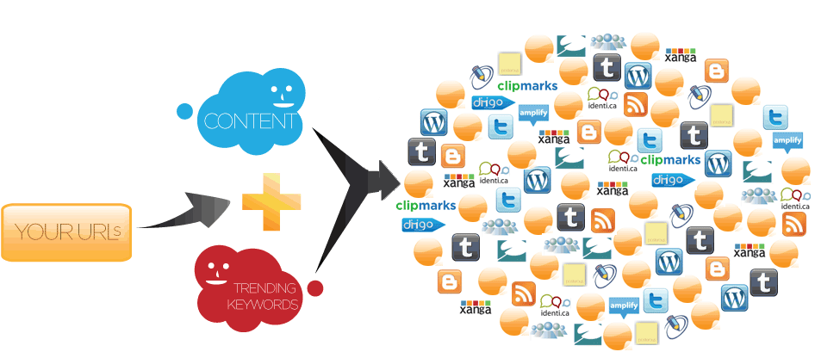
SEARCH ENGINE Ranking

Slide 45
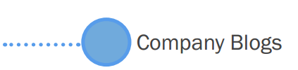



The Right Way to Build Links

Slide 46
Information graphics or infographics are visual representations of information, data or knowledge intended to present complex information quickly and clearly.

Slide 47
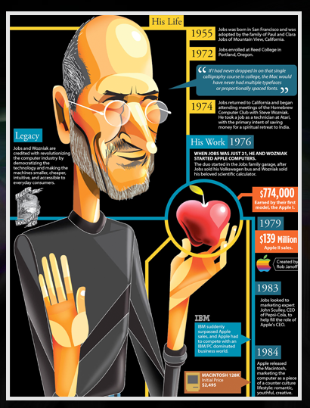
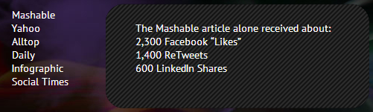
Infographic Case Study by Mashable → STEVE JOBS
Through a blogger network, an infographic memorializing Steve Jobs was picked up by the following websites within 24hrs:

Slide 48
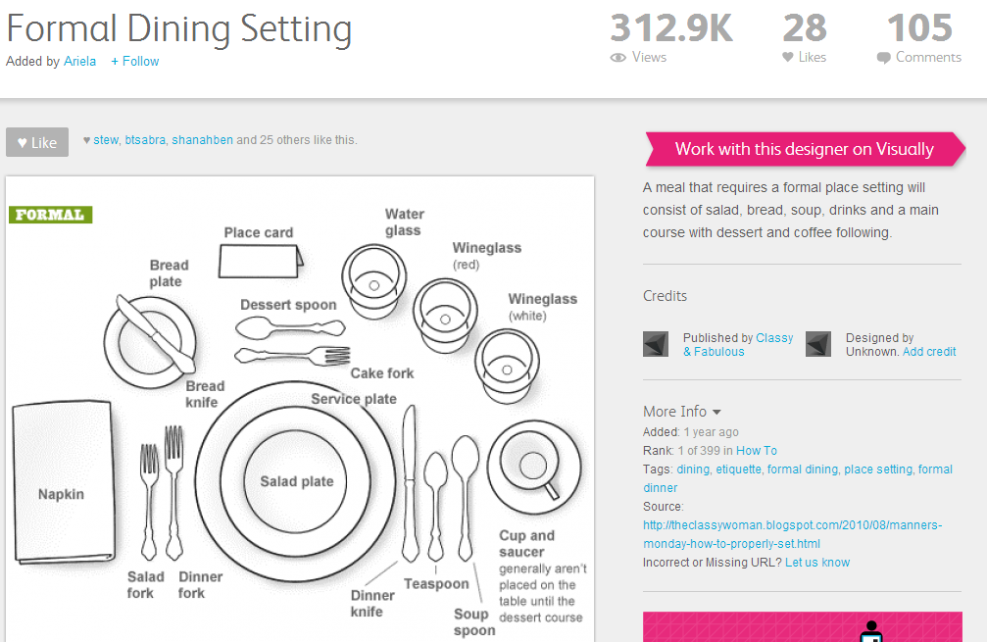

Slide 49
The Wrong Way to Build Links
Spamming
Buying a massive number of links
Publishing low-quality article
Over-using one article

Slide 50
Key Drivers of Good SEO
Relevancy
Authority
Quality

Slide 51
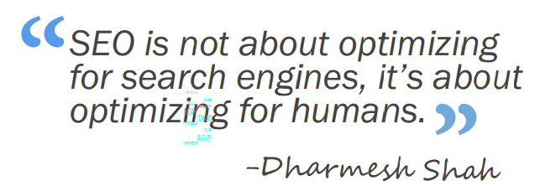

Slide 52
Sources:
Wikipedia.com
Advancedhtml.co.uk/robots-sitemaps.htm
Htmlbasictutor.ca
searchengineland.com
seo-creare.co.uk
Hubspot.com
w3schools.com
googleblog.blogspot.com
Thanks!
FIN

