Slide 1

Model pattern
MVC – Model View Controller pattern

Slide 2
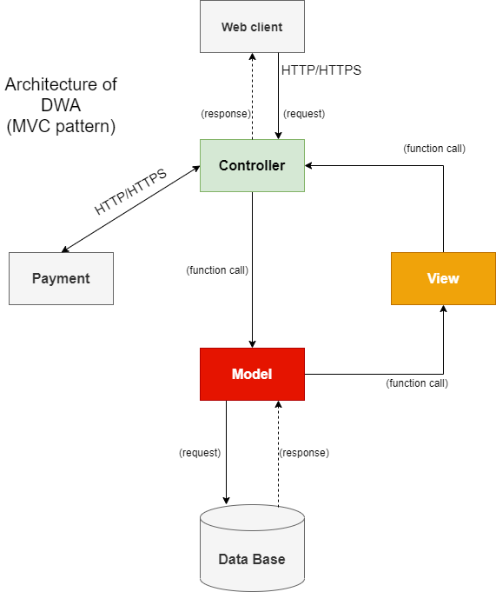
MVC model

Slide 3
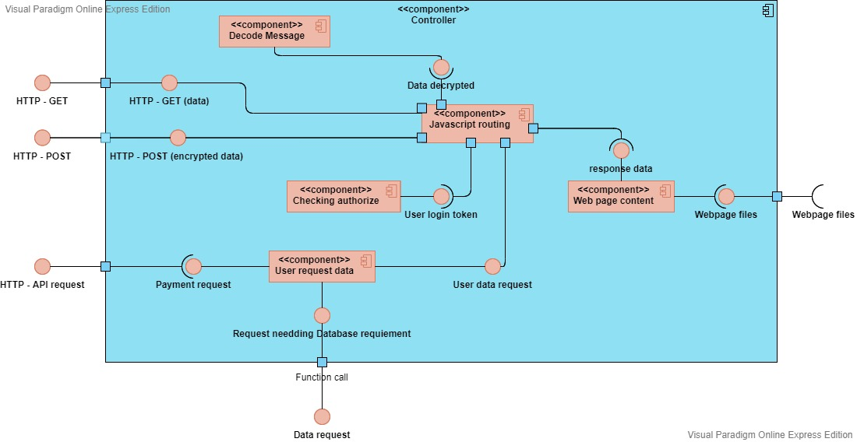
MVC (Controller)

Slide 4
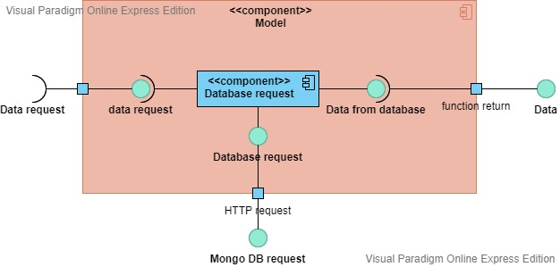
MVC (Model)

Slide 5
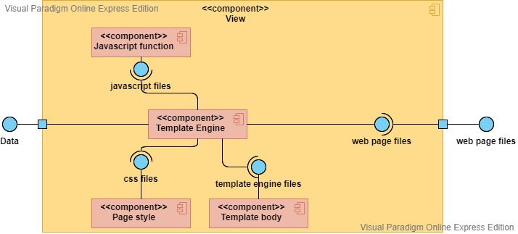
MVC (View)

Slide 6
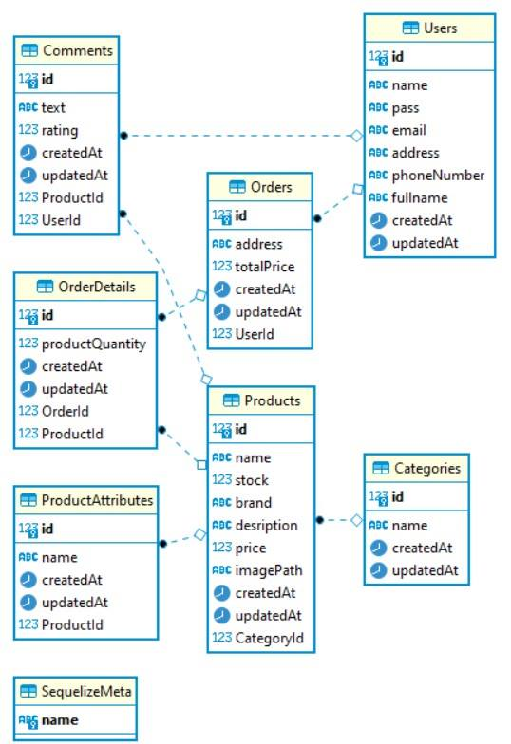
MVC (Database)

Slide 7
MVC (Payment)
Using third-party Payment API
Momo
01
POS payment
QR code payment
Zalopay
02
support user make a purchase through their ATM card.
Supporting for Vietnamese people, and have many vouchers to encourage customer/ user to buy more products.

