Slide 1
Group 06
18-CLC1
E-commerce Web Application Presentation

Slide 2
Project Management

Slide 3
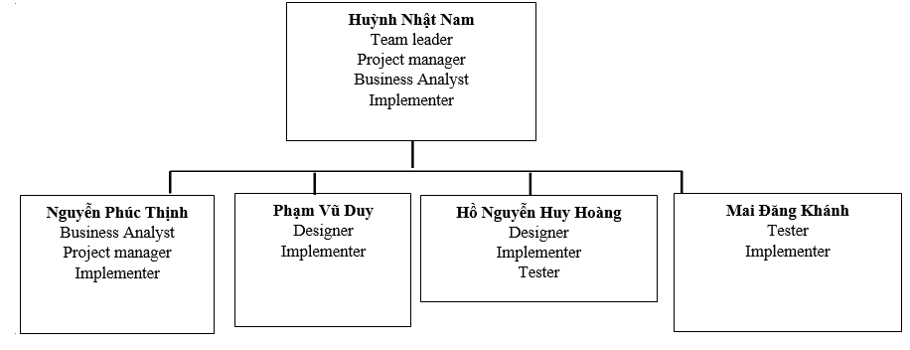
Team structure

Slide 4
responsibilities
1. Huỳnh Nhật Nam
- Write test plan, assigning tasks
- Monitor and control the project
- Write use case specification

Slide 5
responsibilities
2. Nguyễn Phúc Thịnh
Document requirements (vision document, use-case, etc…)
Communicate with team member about the requirements
Coordinate to review requirements

Slide 6
responsibilities
3. Phạm Vũ Duy
Design the system (Component, classes, databases,…)
Write Software Architecture Document
Design user interface

Slide 7
responsibilities
4. Hồ Nguyễn Huy Hoàng
Design the system (Component, classes, databases,…)
Write Software Architecture Document
Perform system test

Slide 8
responsibilities
5. Mai Đăng Khánh
Write test plan and test cases
Perform system test

Slide 9
Implementation
Huỳnh Nhật Nam: account, cart, checkout
Nguyễn Phúc Thịnh: browse product, sort product
Phạm Vũ Duy: comment, search product
Hồ Nguyễn Huy Hoàng: add product, edit product
Mai Đăng Khánh: view product detail

Slide 10
Architecture
Server – Client architecture

Slide 11

Server – Client
Server
Mobile browser
HTTPS
Desktop client
INTERNET
HTTPS
HTTPS

Slide 12
Hosting
At “Heroku” JSP server – hosted on Amazon’s data center, located in North America
Database
Central Database: Postgres provide by “Heroku” placed on Amazon’s data center
Benefit
Minimizing time on database setup and maintenance
Allowing server quickly access data
Security and privacy
- Only development team have full access to application level and database level
Two side encrypted password (DB and on communication)
Only shop owner can see customer information

Slide 13

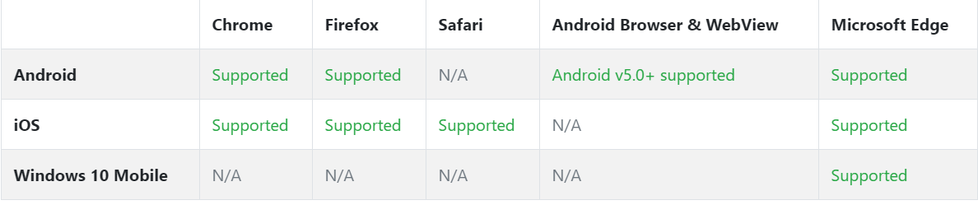
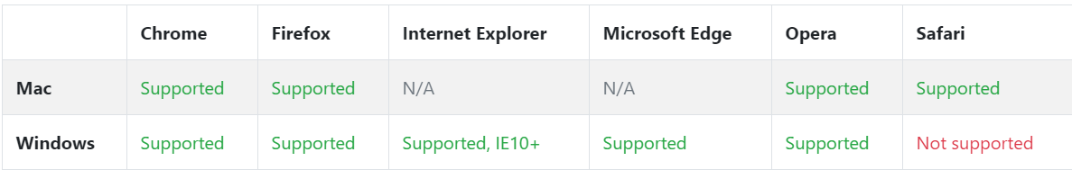
Connectivity
Must have internet connection
Mobile browser
Desktop browser
Client
Source: https://getbootstrap.com/docs/4.0/getting-started/browsers-devices/

Slide 14

Model pattern
MVC – Model View Controller pattern

Slide 15
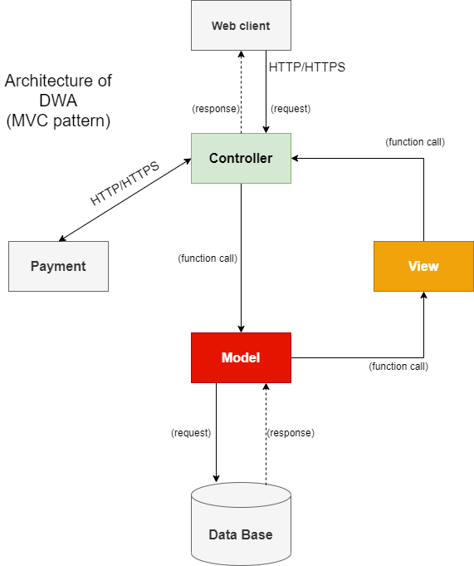
MVC model

Slide 16
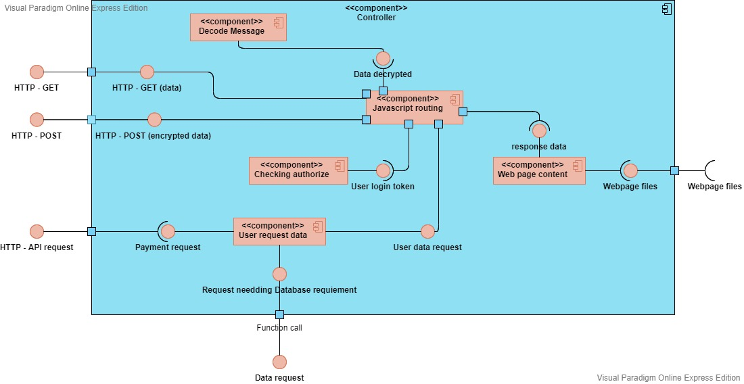
MVC (Controller)

Slide 17
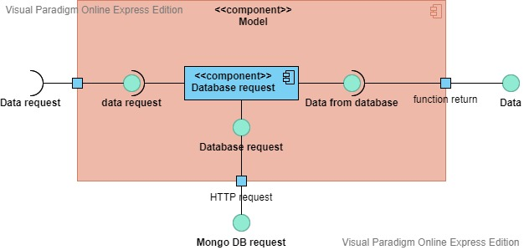
MVC (Model)

Slide 18
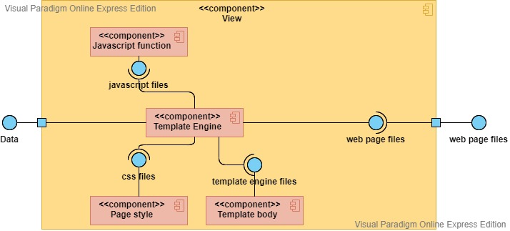
MVC (View)

Slide 19
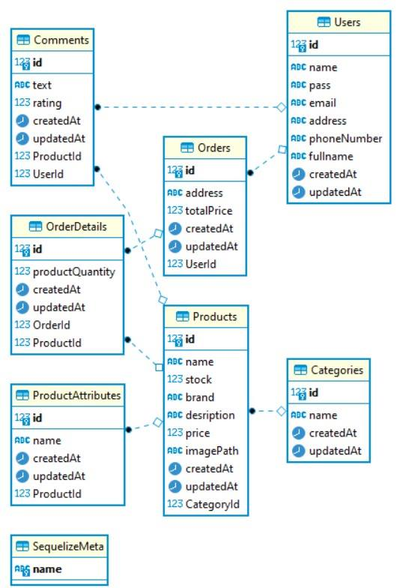
MVC (Database)

Slide 20
MVC (Payment)
Using third-party Payment API
Momo
01
POS payment
QR code payment
Zalopay
02
support user make a purchase through their ATM card.
Supporting for Vietnamese people, and have many vouchers to encourage customer/ user to buy more products.

Slide 21
Testing
Test plan, test environments, test result

Slide 22
Test Plan
E-COMMERCE
INTERNET SHOPPING
01
Functional testing
Unit testing
Integration testing
02
Non-functional testing
Usability testing
Performance testing
Security testing
03
Testing Strategy
System testing

Slide 23
Functional testing
Unit testing
01
Validate that each unit of the software code performs as expected. Unit testing is a White Box testing technique that is usually performed by the developer
Integration testing
02
Purpose of this level of testing is to expose defects in the interaction between these software modules when they are integrated

Slide 24
Non-functional testing
Usability testing
01
Determine how user-friendly, easy-to-use and intuitive the user interface is. The usability test is performed by tester and the end user of the website
Performance testing
02
Identify the performance bottlenecks in speed, response time, stability, reliability, scalability and resource usage of the application under testing workload
Security testing
03
Verify sensitive information such as passwords, e-mails, bank accounts, etc. of the user are encrypted. Prevent unauthorized action

Slide 25
System testing
The main testing strategy for our software
Our software is compiled as a whole and then tested as a whole at dangcompany.herokuapp.com
Most testing operation is performed on this website to check the functionality, security, portability, amongst others

Slide 26

Test enviroments
Browser
- Chrome 45+
- Firefox 38+
- Edge 12+
- Safari 9+
- Opera 30+
Hardware
Person computers running Windows 10
Smart phones running iOS, Android
Internet connection
Notes:
More browser: Android browser, IE, … but cannot be test cause lack of resources and time

Slide 27
Test result - Functional
Test case
Test Pass
Test Fail
Fixed
222
165
57
32
Notes:
Most failed cases are System not checking user input special characters. Few critical failure are that the webpage or function is not implement

Slide 28
Test result - Performance
Notes:
Cause the database is located away from server, every operation require data from database can take a long time

Slide 29
THANK YOU

