Slide 1

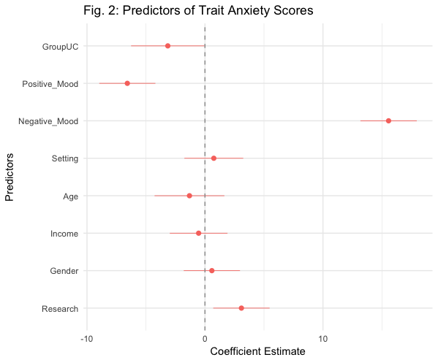
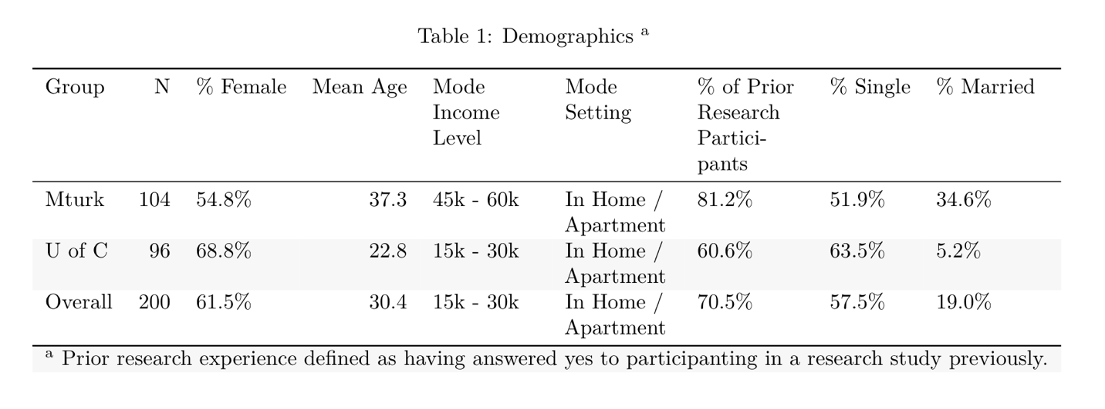
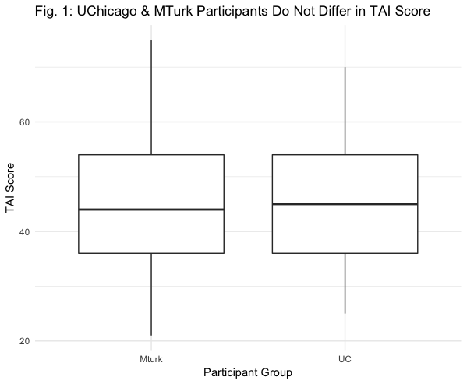
A comparative digital survey investigation of the construct validity of the Trait Anxiety Inventory within a UChicago community sample and an MTurk sample
Nora Nickels
Institute for Mind and Biology - The University of Chicago
Introduction
Data
Results
• In psychological and biological research, emotions are measured both in terms of acute states of arousal and in terms of individual differences in the propensity to experience that emotion.
Trait Anxiety
• Def: an individual measure of intensity and frequency of experienced anxiety, which involves these feelings of apprehension and heightened response of the autonomic nervous system¹.
• Seen as a relatively stable trait, and individuals who have higher trait anxiety tend to perceive situations as more dangerous or stressful over time¹.
Concerns of lab studies:
- Willing research participants coming from a primarily WEIRD population
- UofC may have higher than usual scores of trait anxiety
- May also have rapidly fluctuating rates of both state and trait anxiety throughout their academic experience.
- Use of digital data to remedy this concerns may introduce extraneous predictors, such as setting and acute mood.
Amazon Mturk
• Overall, there has been much discussion regarding the methodology of MTurk sampling and the MTurk population, as its promise of accessing high quality, inexpensive data is ground breaking to many lines of research
Research Questions
* Do distributions of trait anxiety scores differ in samples acquired from a University of Chicago community vs. the Amazon Mechanial Turk community?
* How strong is the construct validity of the Trait Anxiety Inventory in a sample drawn from these two populations; specifically, do setting and mood relate to trait anxiety responses of UChicago or MTurk community members when the T.A.I. is completed outside of a controlled laboratory setting?
• Data collected from two populations: UChicago community and Amazon Mturk community
• Surveyed 104 MTurk workers on Thursday, May 3rd 2018
- Paid; Restrictions: >18 yrs, U.S., 90% HIT approval rate
• Surveyed 96 UofC community members on Thursday, May 3rd 2018
- Recruited from UChicago Marketplace, UChicago private Facebook group, UChicago private listservs, and UChicago current student class email lists
• Multiple linear regression to predict TAI scores.
Results
A signification regression equation was found, such that positive acute mood, negative acute mood, and past research participation were all significant predictor of TAI scores, while controlling for setting, age, income, and gender.
Conclusion
Model
• Important to consider the effects of acute mood on stable personality and emotional traits.
• Negative acute mood in particular may affect stable traits of anxiety.
• In terms of overall TAI scores, further supports the validity of MTurk participants, along with demographics characteristics.
• Further supports the validity of the idea of Trait Anxiety and the STAI – normally distributed amongst multiple populations.
Limitations
• Confounding difference in motivation: MTurk participants paid, UofC participants unpaid.
• Encourage study of in lab vs. out of lab responses in MTurk participants.
Variables
• Trait Anxiety – Trait scale of the STAI
• Negative & Positive Mood – PANAS
• Age, Gender, Income, Research Experience, Setting
Compare TAI Scores
• Compare distributions of TAI score between UofC sample and MTurk Sample
Model
Y_{TAI} = f ( β₀ + β_{Group} + β_{Mood_P} + β_{Mood_N} + β_{Age} + β_{Setting} + β_{Income} + β_{Gender} + β_{Research} )
In comparing average Trait Anxiety Scores between UChicago (M = 45.68) and MTurk samples (M = 45.41), we found no difference in TAI Scores between the two groups (t = -0.155, p-value = 0.877). Figure 1 shows the average TAI score between groups.
Contact Information: Nora Nickels
nnickels@uchicago.edu

