Slide 1
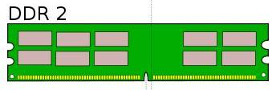
DDR2 Controller
L2 Cache
Arbitrator
L1 Cache
L1 Cache
Harp Core
Harp Core
Inst ROM
Inst ROM

