Slide 1






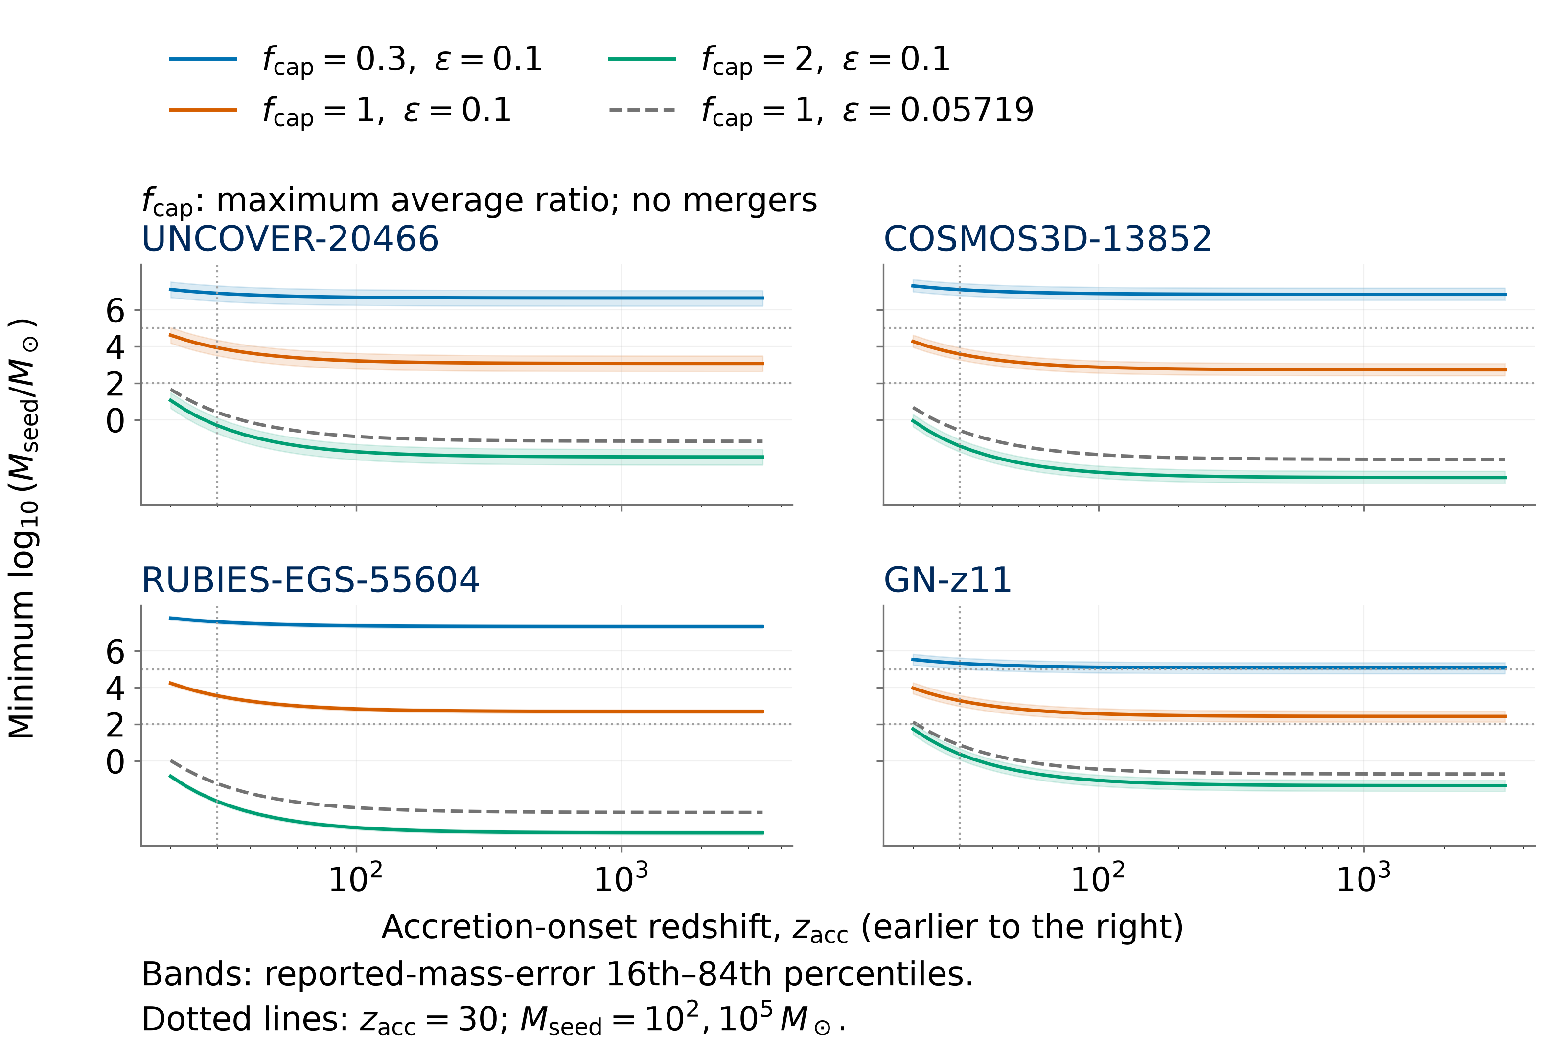
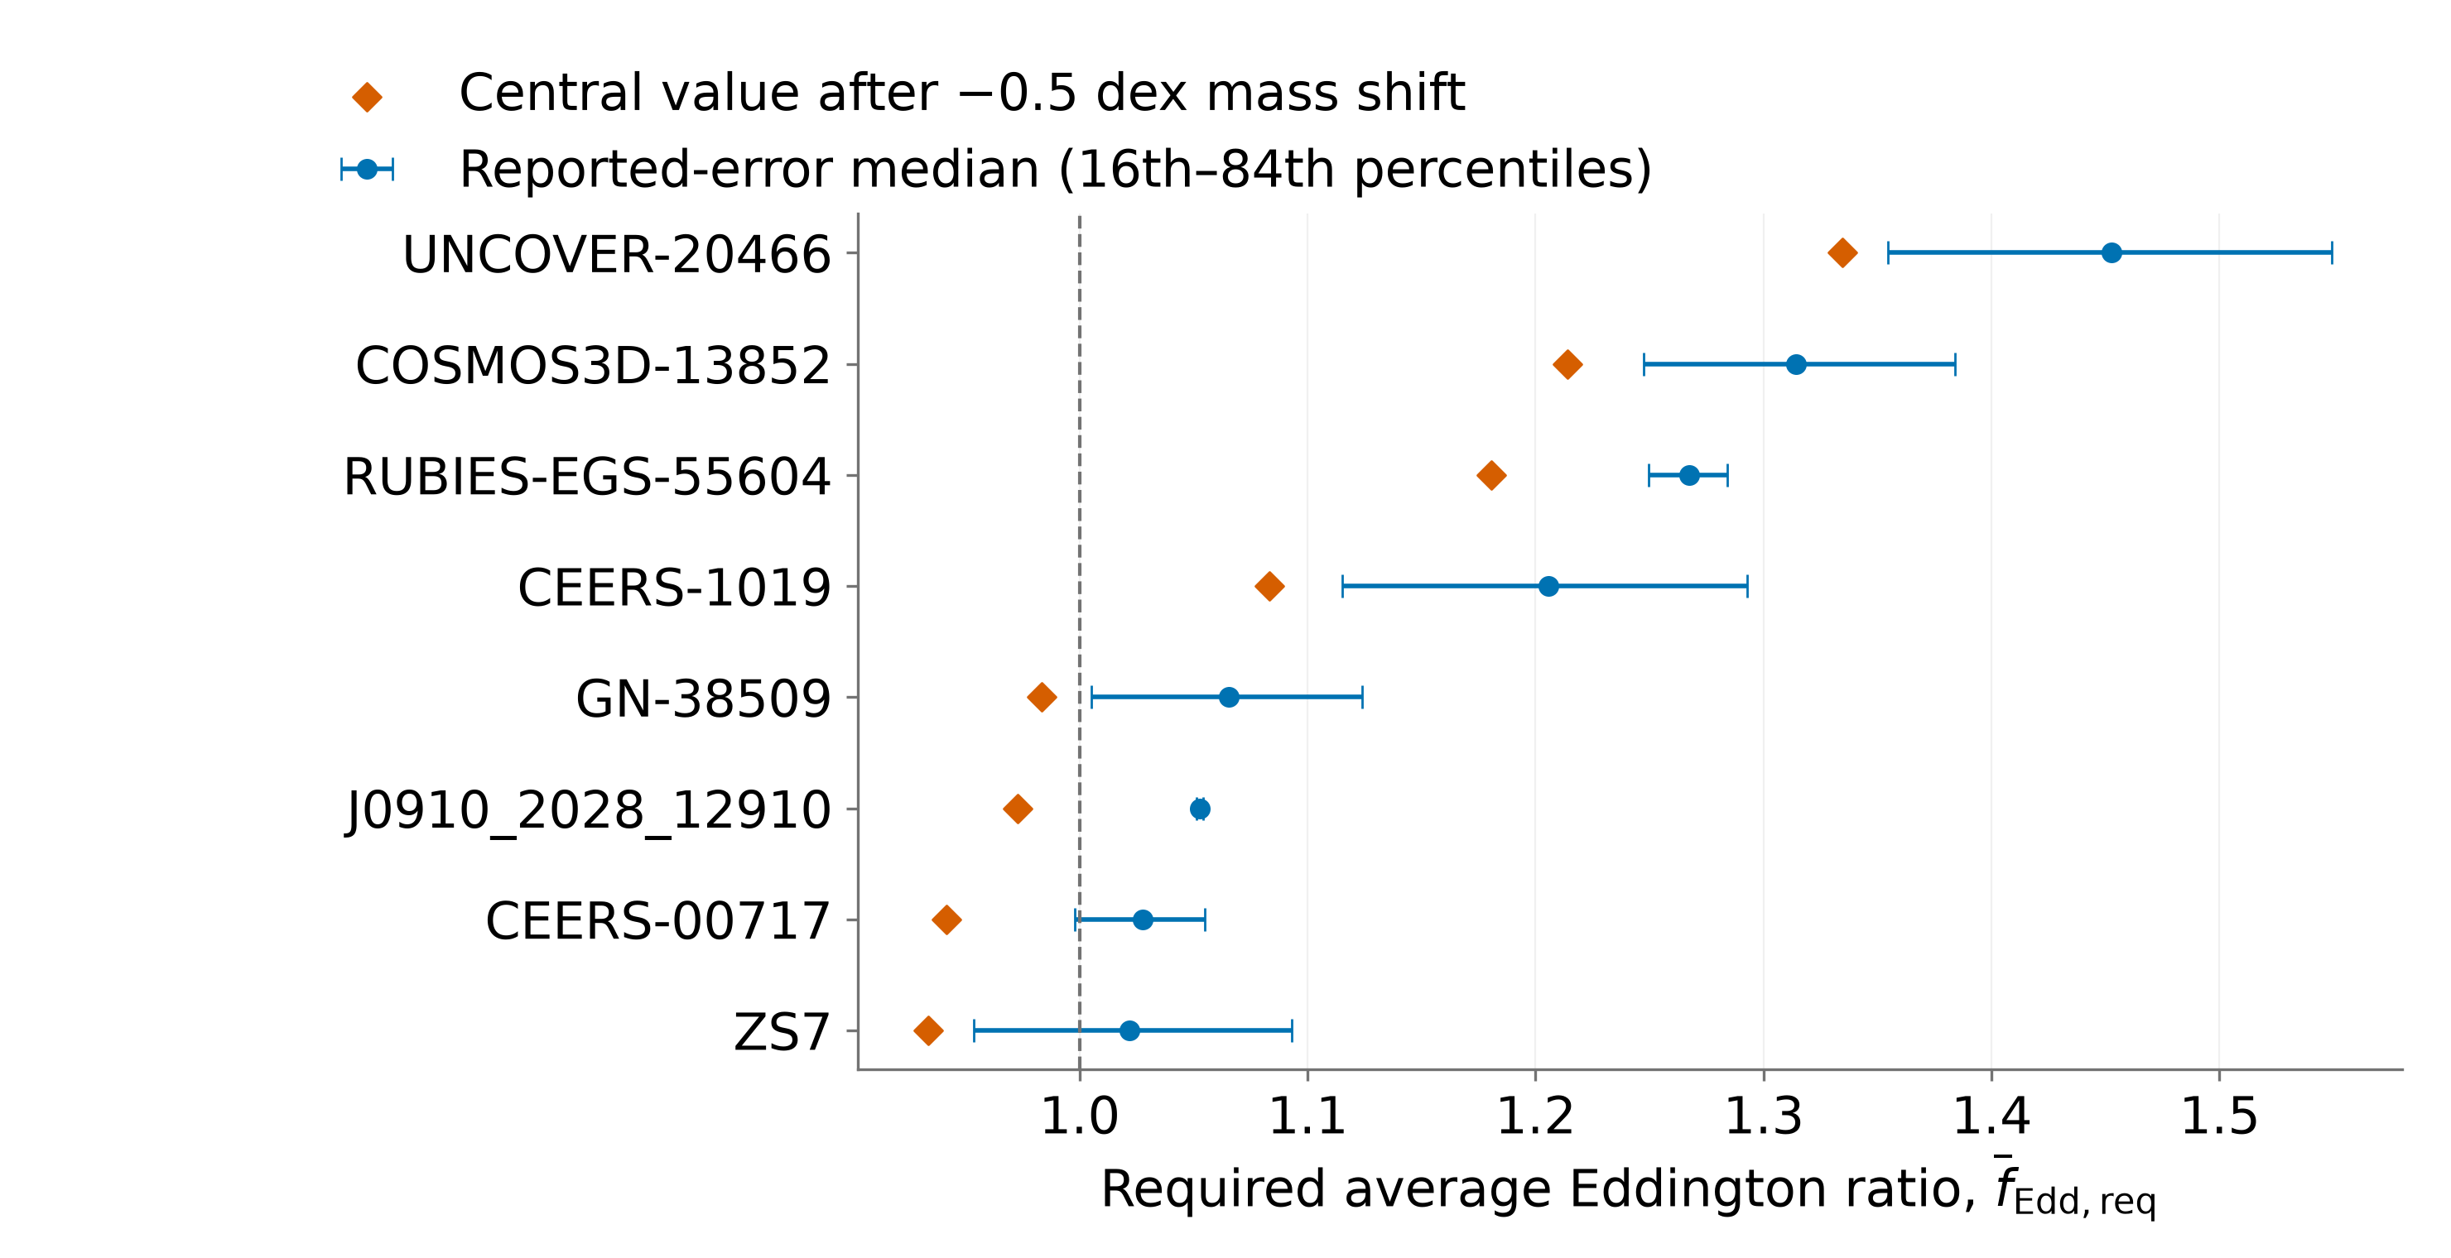
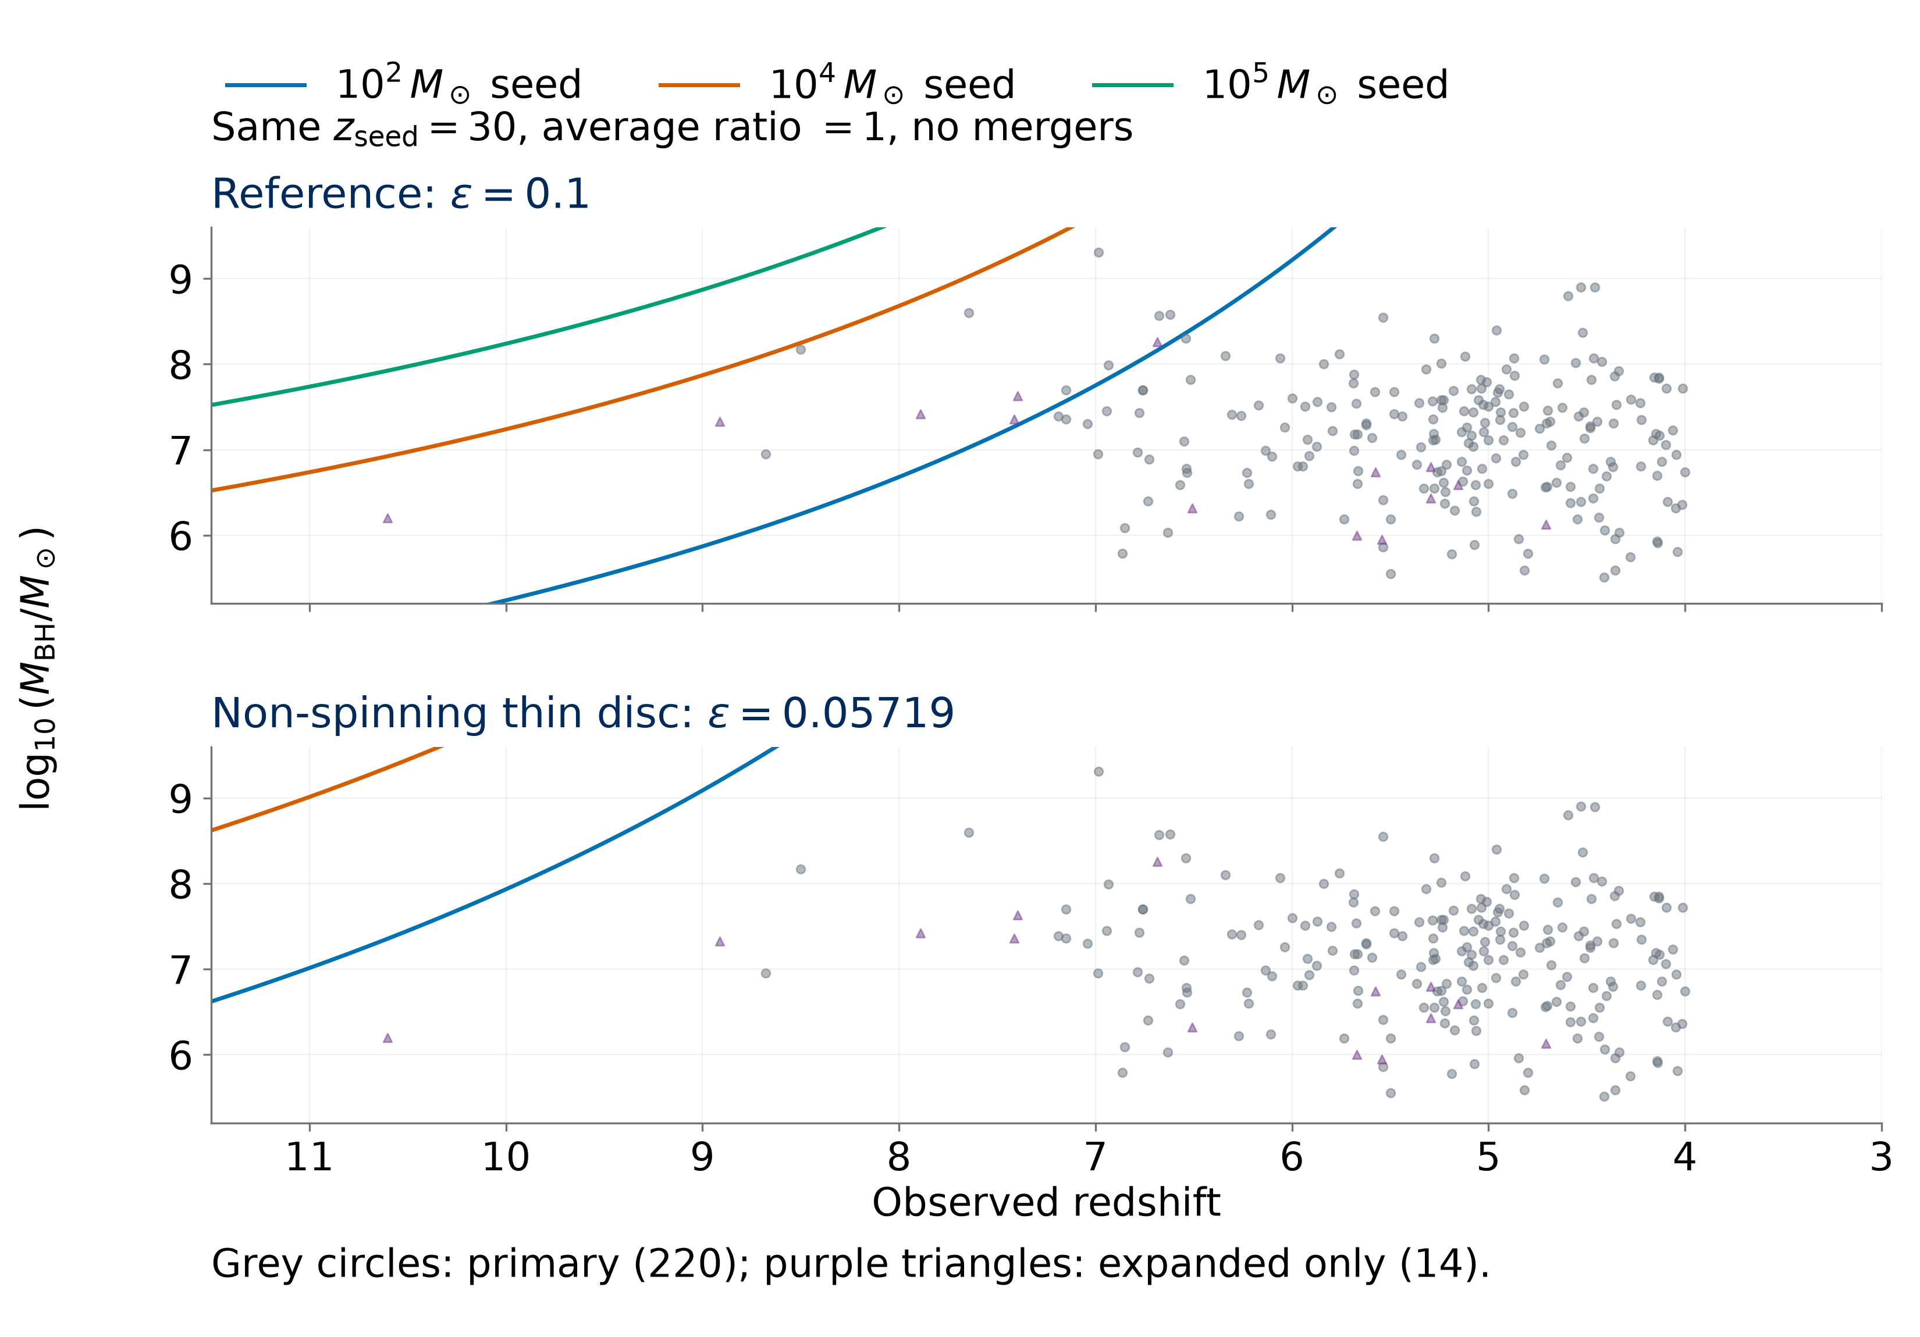
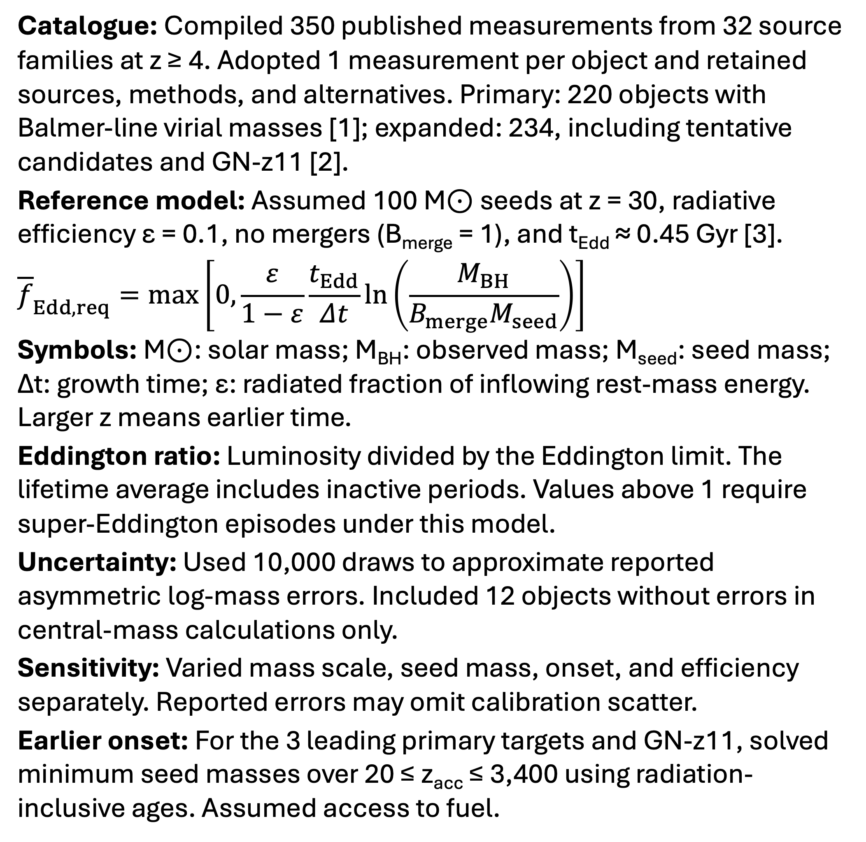
Early Black-Hole Growth Constraints from JWST
Nicole Jiang; University of Toronto
Introduction
Results
How did early black holes grow so big, so fast? The James Webb Space Telescope (JWST) has revealed massive black holes with little time to assemble. My research builds a standardized catalogue across studies, then tests objects against analytic growth models to identify the strongest constraints and how they depend on the assumptions.
Reference: 8/220 primary objects require an average ratio above 1; 5 do so in ≥ 95% of reported-mass-error draws.
Mass sensitivity: UNCOVER-20466, COSMOS3D-13852, and RUBIES-EGS-55604 retain ≥ 95% support after a 0.5 dex mass reduction (a factor of 3.2).
Seed mass: 1,000 M⊙ seeds leave 3/220 above 1; 100,000 M⊙ seeds leave 0 above 1 in either sample.
Formation time: Later seeding (z = 20) gives 18/220 primary objects above 1; GN-z11 has the highest requirement in the expanded sample.
Efficiency: At ε = 0.05719 (non-spinning thin disc) [4], all 234 central masses are reachable from 100 M⊙ seeds at z = 30 with an average ratio below 1.
Earlier-onset test: At matter–radiation equality (z = 3,400), the 3 leading primary targets plus GN-z11 require minimum seed masses of 270–1,200 M⊙ (ε = 0.1, average ratio ≤ 1, no mergers).
Methods
Catalogue: Compiled 350 published measurements from 32 source families at z ≥ 4. Adopted 1 measurement per object and retained sources, methods, and alternatives. Primary: 220 objects with Balmer-line virial masses [1]; expanded: 234, including tentative candidates and GN-z11 [2].
Reference model: Assumed 100 M⊙ seeds at z = 30, radiative efficiency ε = 0.1, no mergers (B_{merge} = 1), and t_{Edd} ≈ 0.45 Gyr [3].
Model tests: Calculated the average Eddington ratio required to reach each observed mass. Ranked these requirements and compared them with each model’s allowed average.
$${\overline{f}}_{Edd,req}=\max\left[0,\frac{ε}{1−ε}\frac{t_{Edd}}{Δt}\ln\left(\frac{M_{BH}}{B_{merge}M_{seed}}\right)\right]$$
Symbols: M⊙: solar mass; M_{BH}: observed mass; M_{seed}: seed mass; Δt: growth time; ε: radiated fraction of inflowing rest-mass energy. Larger z means earlier time.
Eddington ratio: f_{Edd}: luminosity/Eddington limit.
f̄_{Edd,req}: required lifetime average, including inactive periods. Values above 1 require super-Eddington episodes under this model.
Uncertainty: Used 10,000 draws to approximate reported asymmetric log-mass errors. Included 12 objects without errors in central-mass calculations only.
Sensitivity: Varied mass scale, seed mass, onset, and efficiency separately. Reported errors may omit calibration scatter.
Earlier onset: For the 3 leading primary targets and GN-z11, solved minimum seed masses over 20 ≤ z_{acc} ≤ 3,400 using radiation-inclusive ages. Assumed access to fuel.
Earlier starts reduce required seeds, with diminishing gains.
Independent mass check: A2744-QSO1’s dynamical mass raises the ratio from 0.929 to ≈ 1; uncertainty spans 1 [5].
After a −0.5 dex mass shift, 3 targets retain ≥ 95% reported-error support for a required average ratio above 1.
Growth tension depends on efficiency
Conclusions
Efficiency drives the tension: Some objects challenge the reference model. At ε = 0.05719, the ideal thin-disc efficiency for a non-spinning black hole, 100 M⊙ seeds at z = 30 reach all 234 central masses with an average ratio below 1.
Independent mass estimates: Tests of calibration, lensing, and scattering are essential to establish which objects are most challenging.
Catalogue contribution: Documented measurement choices and retained alternatives support consistent comparisons and follow-up. Sample counts describe the literature sample, not population fractions.
Earlier onset offers limited relief: Earlier onset alone cannot rescue 100 M⊙ seeds for the 4 targets at ε = 0.1, average ratio ≤ 1, and no mergers. Gains diminish at earlier onset. Growth compatibility does not establish primordial black hole (PBH) formation or abundance viability.
References
[1] Shen (2013), BASI, 41, 61.
[2] Maiolino et al. (2024), Nature, 627, 59.
[3] Dayal (2024), A&A, 690, A182.
[4] Bardeen et al. (1972), ApJ, 178, 347.
[5] Juodzbalis et al. (2025), arXiv:2508.21748.
Catalogue sources and code: QR link above.
Only efficiency changes between panels. Points below a curve can be reached with a lower average Eddington ratio.
Notes:
Poster figure inputs: results/manuscript/tables/publication_object_selection.csv; mass_offset_object_sensitivity.csv; results/v3/tables/v3_object_point_ranking.csv and v3_object_uncertainty_ranking.csv; results/v4/tables/v4_minimum_seed_mass.csv. Controlled growth comparison uses src.models.predicted_log_mbh with mean ratio 1, z_seed=30, B_merge=1 and efficiencies 0.1 and 1-sqrt(8/9). Independent dynamical mass: https://arxiv.org/abs/2508.21748.

