Slide 1






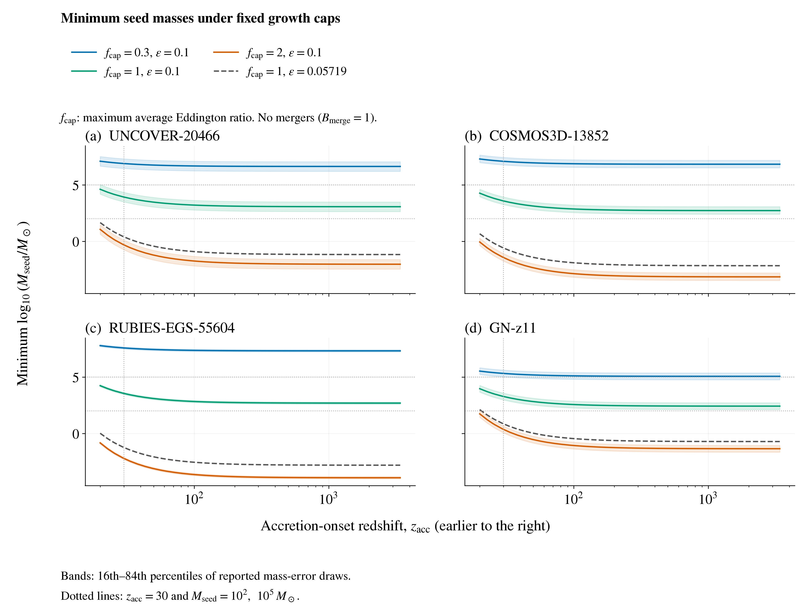
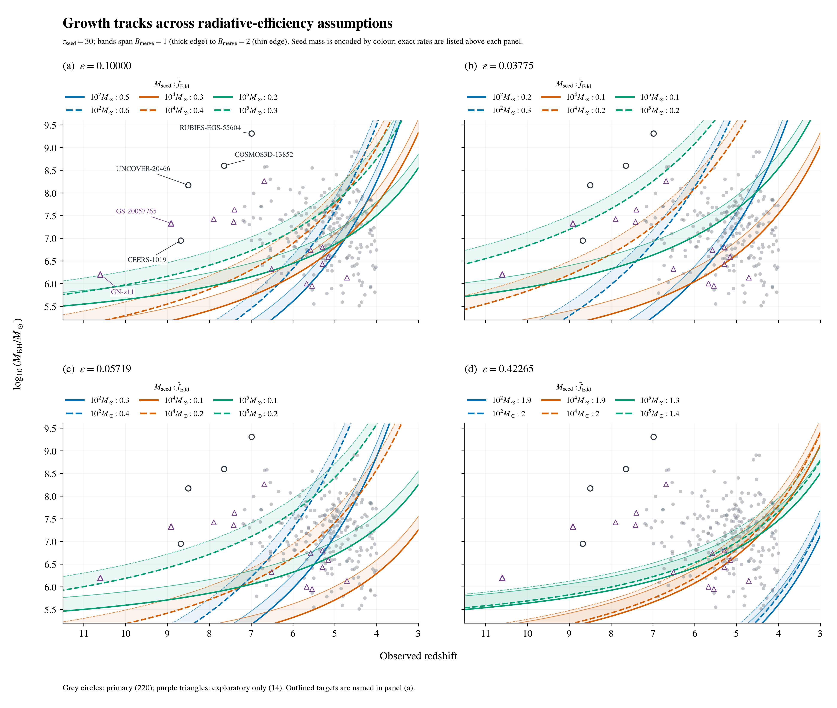
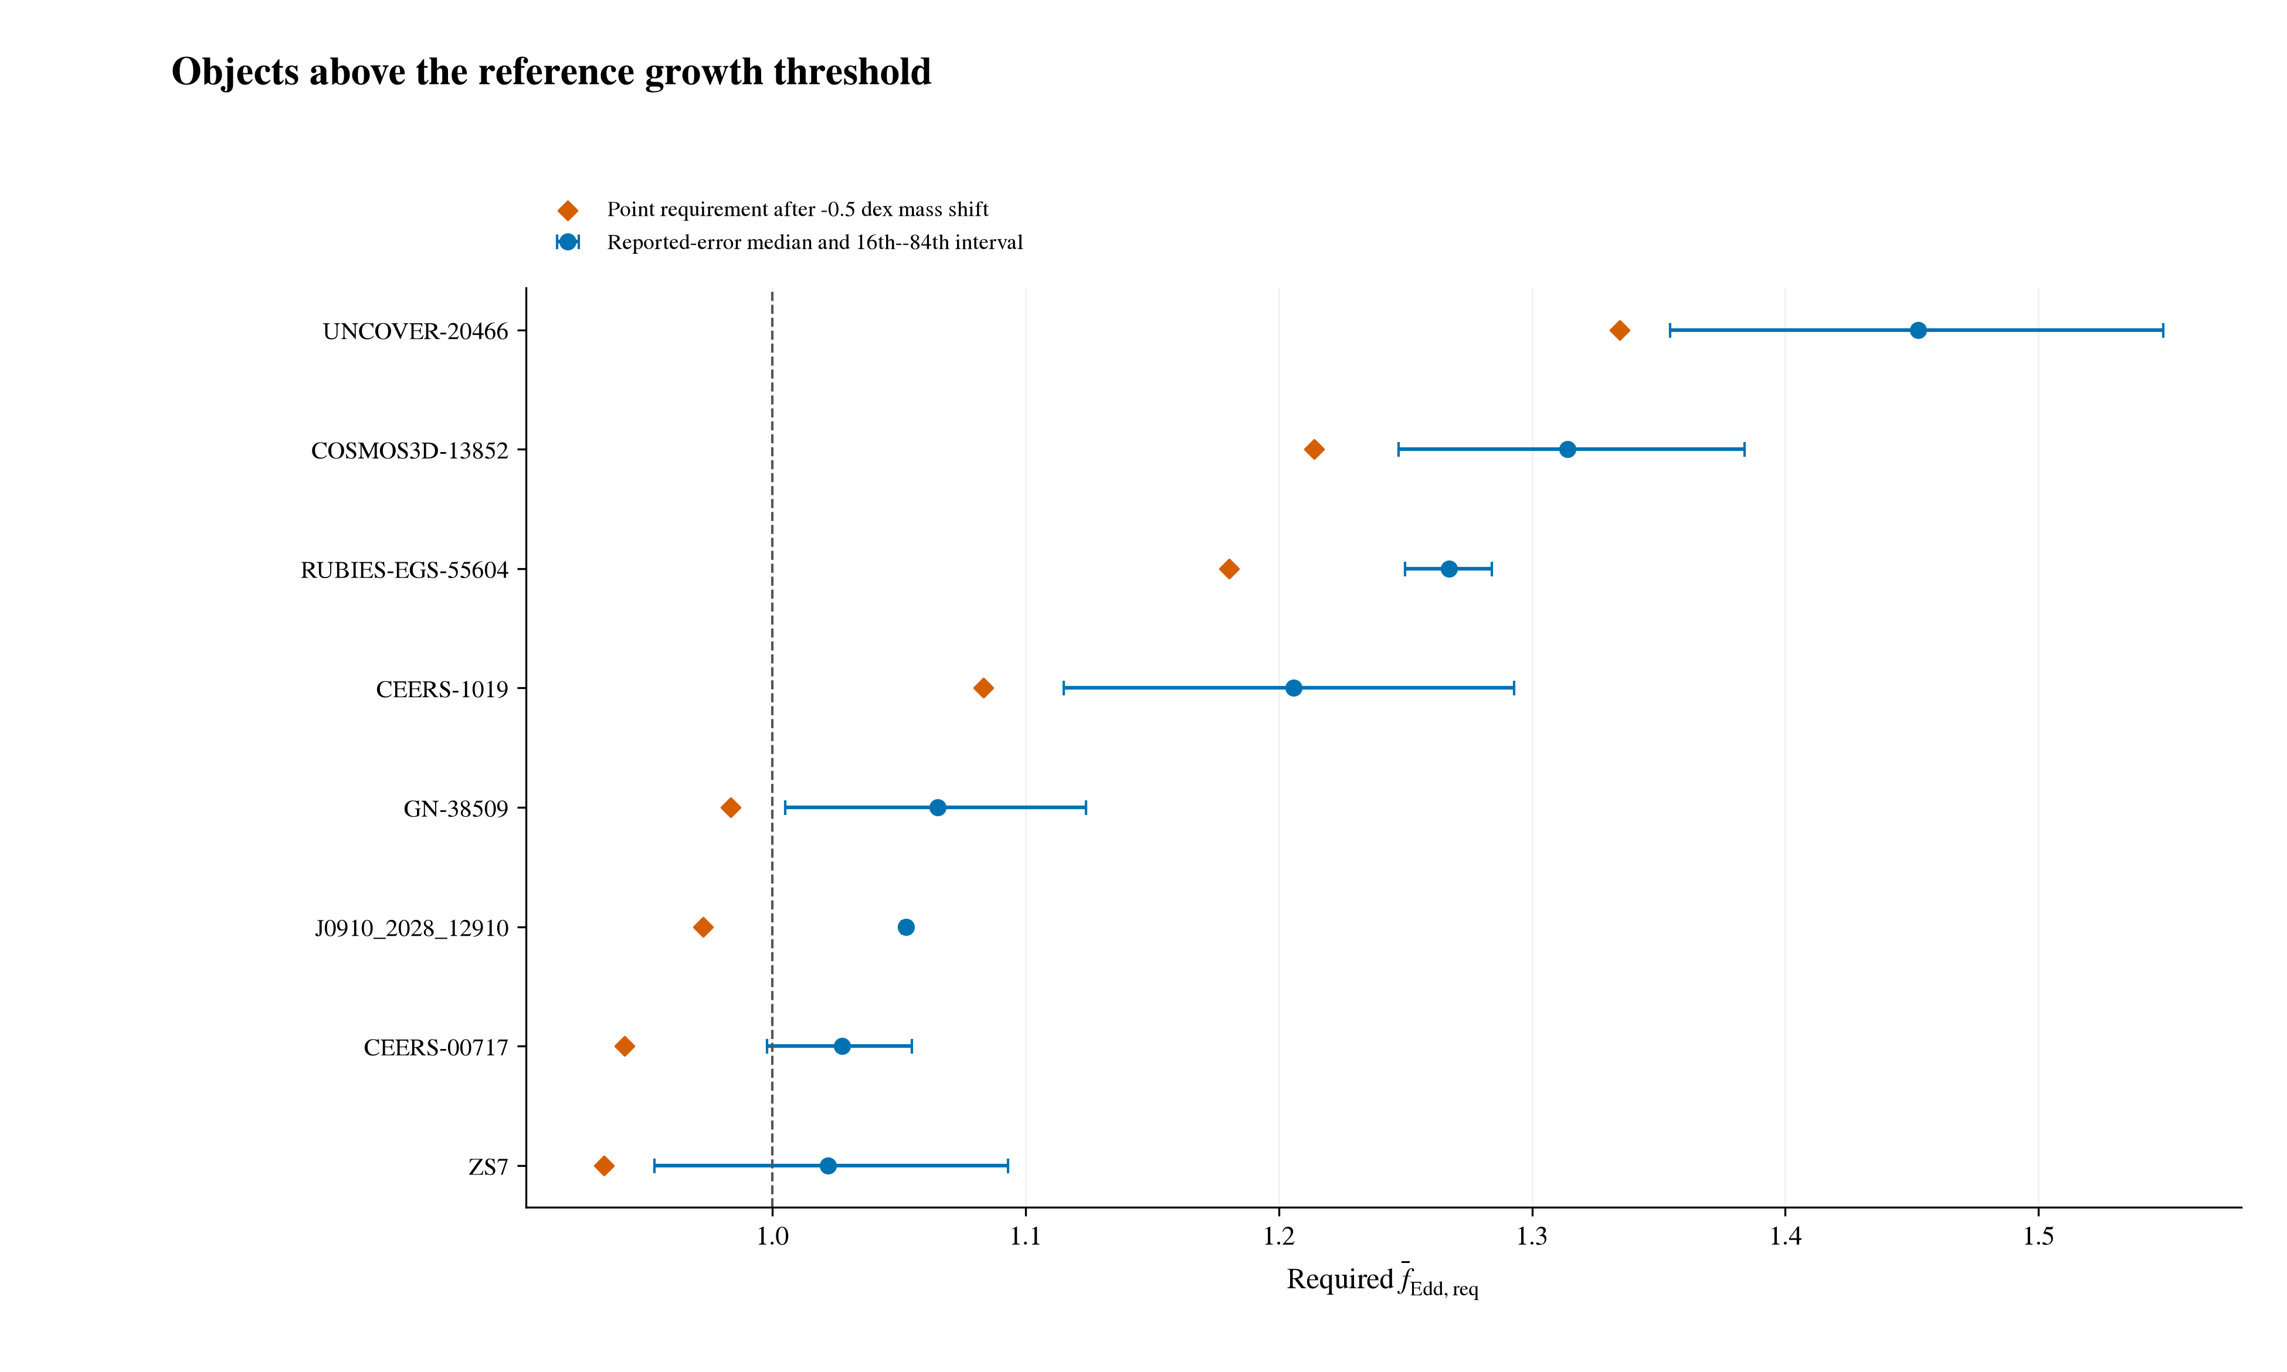
Early Black-Hole Growth Constraints from JWST
Nicole Jiang; University of Toronto
Introduction
Results (continued)
How did early black holes grow so big, so fast?
JWST has revealed massive black holes with little time to assemble. My research builds a standardized catalogue across published studies for consistent comparison, then tests objects against analytic growth models. I identify which objects most strongly constrain early black-hole growth, and how those constraints depend on the assumptions.
Earlier-onset test: At matter–radiation equality (z = 3400), the three leading primary targets plus GN-z11 need 270–1,200 M⊙ seeds (ε = 0.1, average ratio ≤1, no mergers). Independent mass check: A2744-QSO1’s dynamical mass raises its required ratio from 0.929 to ≈1; uncertainty spans unity.
Methods
Catalogue: Compiled 350 measurements from 32 source families at z ≥ 4, retaining provenance and alternatives. Primary sample: 220 Balmer-line virial masses [1]; expanded sample: 234 objects, including tentative candidates and GN-z11 [2].
Growth model: Reference assumptions: a 100 M⊙ seed at z = 30, ε = 0.1, and no mergers. Required average Eddington ratio [3]:
$${\overline{f}}_{Edd,req}=\max\left[0,\frac{ε}{1−ε}\frac{t_{Edd}}{Δt}\ln\left(\frac{M_{BH}}{B_{merge}M_{seed}}\right)\right]$$
Testing and comparison: Rank objects by their required average Eddington ratio and compare with allowed average rates. Assess robustness using the fraction of Monte Carlo draws above unity, repeating across growth assumptions.
Uncertainty and sensitivity: 10,000 Monte Carlo draws per object; varied mass scale and growth assumptions separately. Reported errors may omit calibration scatter.
Earlier-onset test: For the three leading primary targets and GN-z11, calculate minimum seed masses across onset redshifts 20 ≤ z_{acc} ≤ 3400, average-rate caps, and efficiencies, using radiation-inclusive cosmic ages.
Conclusions
Conditional growth constraints: Some objects challenge the reference stellar-seed model, but the tension depends strongly on growth assumptions. Lower efficiency permits 100 M⊙ seeds to reach all four selected targets’ central masses.
Independent mass estimates remain essential: Calibration, lensing, and scattering uncertainties can affect which objects appear most challenging.
The catalogue enables consistent comparisons: Traceable measurements identify targets for growth-model testing and follow-up as observations improve.
Earlier onset offers limited relief: Even onset at matter–radiation equality requires 270–1,200 M⊙ seeds for the four targets at ε = 0.1, average Eddington ratio ≤1, and no mergers. Hypothetical PBH seeds shift the challenge toward explaining their formation and abundance, which this growth analysis does not establish.
Results
Reference: 8/220 primary objects require an average ratio above 1; five do so in ≥95% of reported-mass-error draws. Mass sensitivity: UNCOVER-20466, COSMOS3D-13852, and RUBIES-EGS-55604 retain this criterion after a 0.5 dex mass reduction [1]. Seed-mass sensitivity: 1,000 M⊙ seeds reduce the count to 3/220; 100,000 M⊙ seeds leave none in either sample. Formation time: Later seeding (z = 20) gives 18/220 and makes GN-z11 highest-ranked. Efficiency: At ε = 0.05719 [4], all 234 central masses are reachable from 100 M⊙ seeds at z = 30 with an average ratio below 1.
References
[1] Shen (2013), BASI, 41, 61.
[2] Maiolino et al. (2024), Nature, 627, 59.
[3] Dayal (2024), A&A, 690, A182.
[4] Bardeen et al. (1972), ApJ, 178, 347.
Catalogue sources and code: QR link above.

Slide 2
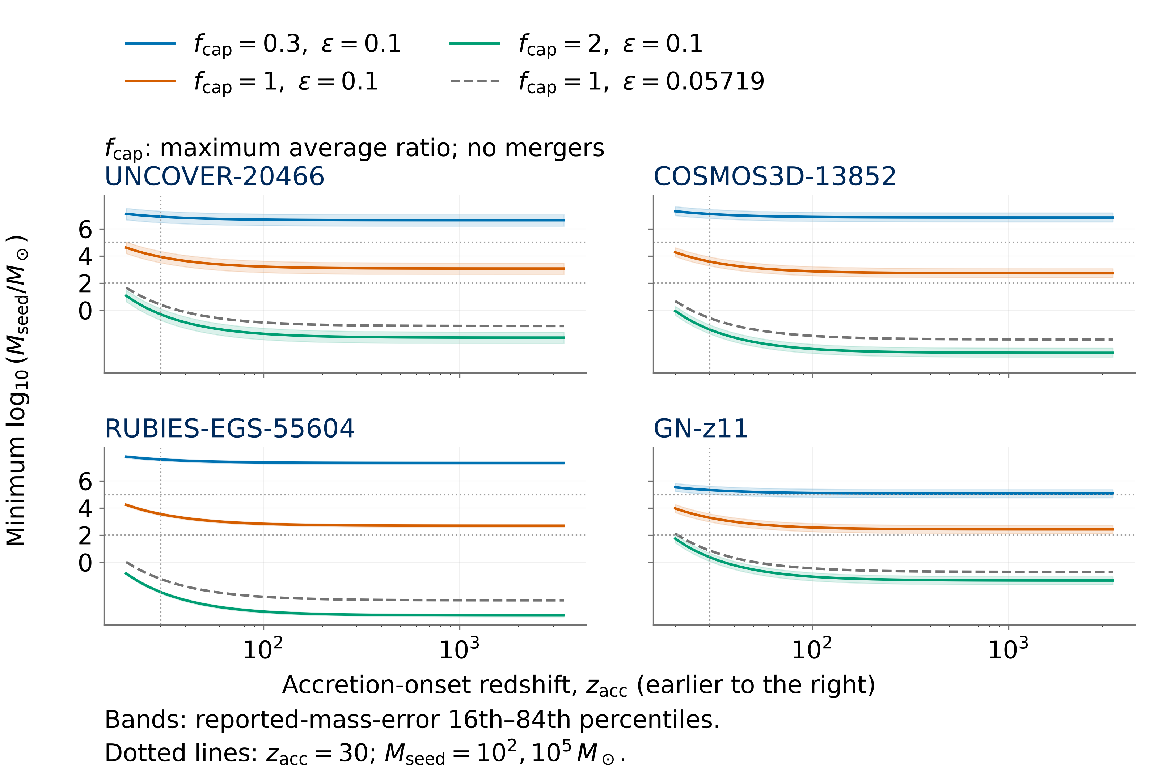
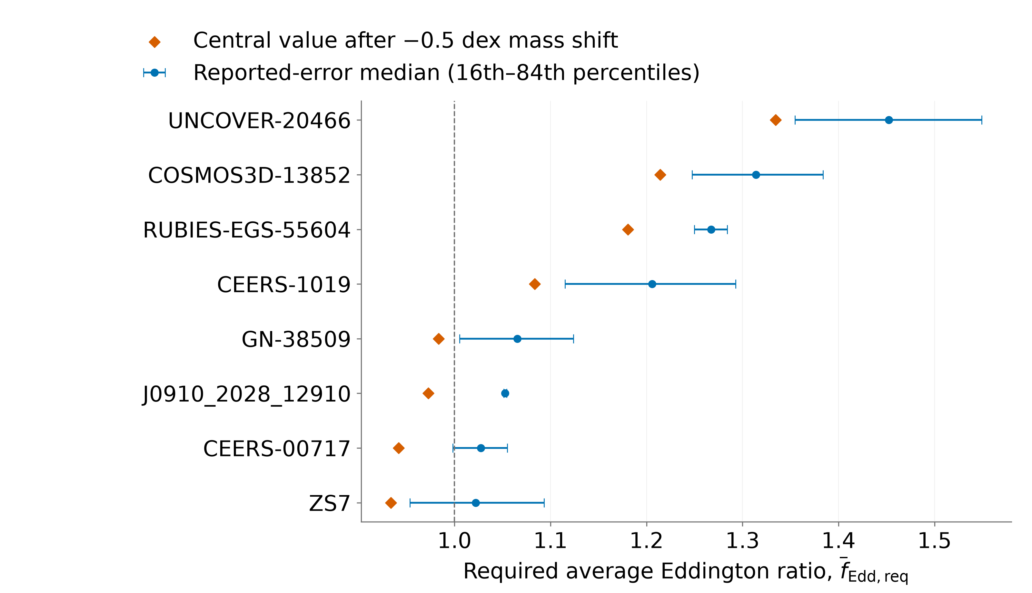
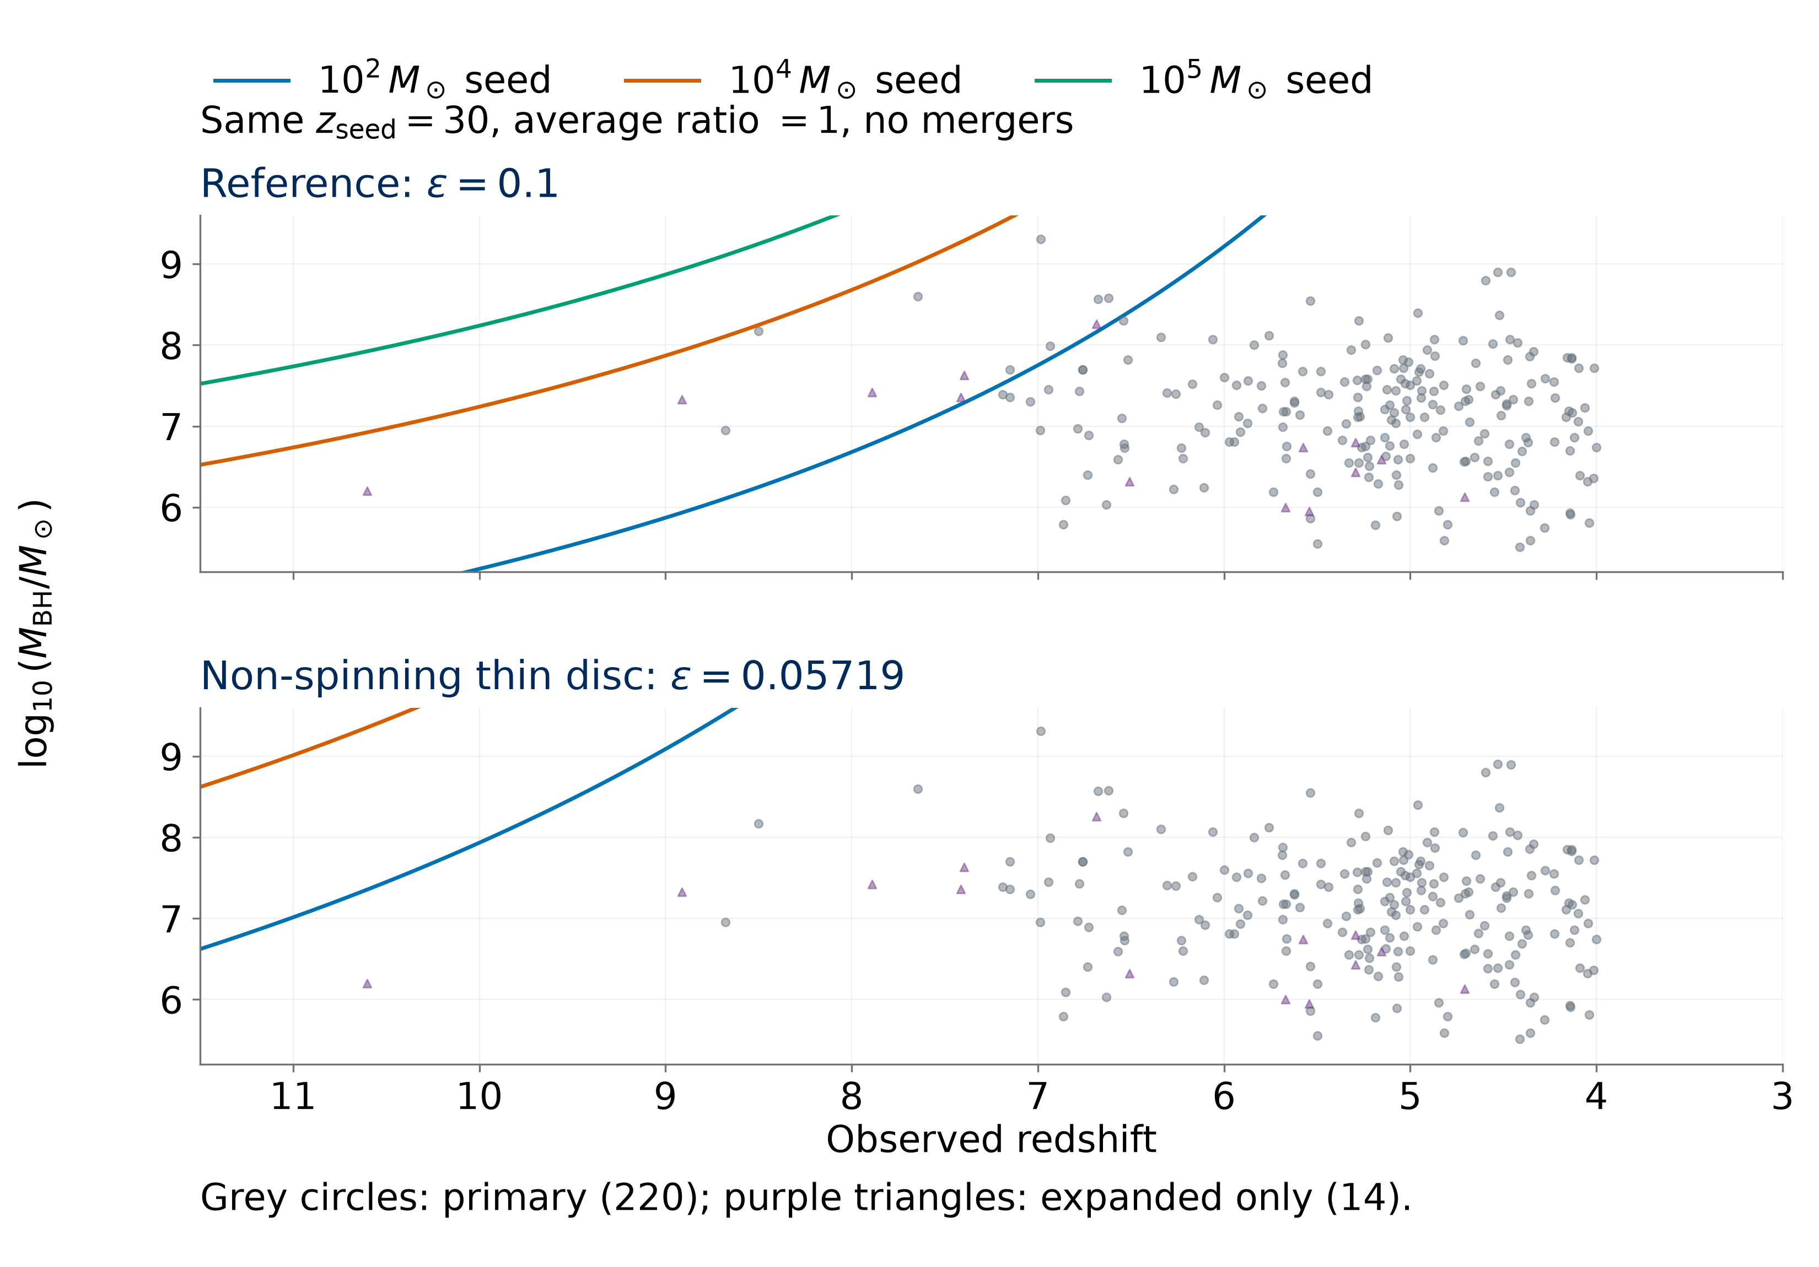
Early Black-Hole Growth Constraints from JWST
Nicole Jiang; University of Toronto
Introduction
Results
How did early black holes grow so big, so fast? The James Webb Space Telescope (JWST) has revealed massive black holes with little time to assemble. My research builds a standardized catalogue across studies, then tests objects against analytic growth models to identify the strongest constraints and how they depend on the assumptions.
Reference: 8/220 primary objects require an average ratio above 1; five do so in ≥95% of reported-mass-error draws.
Mass sensitivity: UNCOVER-20466, COSMOS3D-13852, and RUBIES-EGS-55604 retain ≥95% support after a 0.5 dex mass reduction (a factor of 3.2).
Seed mass: 1,000 M⊙ seeds leave 3/220 above unity; 100,000 M⊙ seeds leave none in either sample.
Formation time: Later seeding (z = 20) gives 18/220 primary objects above unity; GN-z11 has the highest requirement in the expanded sample.
Efficiency: At ε = 0.05719 (non-spinning thin disc) [4], all 234 central masses are reachable from 100 M⊙ seeds at z = 30 with an average ratio below 1.
Earlier-onset test: At matter–radiation equality (z = 3400), the three leading primary targets plus GN-z11 require minimum seed masses of 270–1,200 M⊙ (ε = 0.1, average ratio ≤1, no mergers).
Methods
Catalogue: 350 published measurements from 32 source families at z ≥ 4. Adopt one measurement per object and retain sources, methods, and alternatives. Primary: 220 objects with Balmer-line virial masses [1]; expanded: 234, including tentative candidates and GN-z11 [2].
Reference model: 100 M⊙ seeds at z = 30, radiative efficiency ε = 0.1, no mergers (B_{merge} = 1), and t_{Edd} ≈ 0.45 Gyr [3].
$${\overline{f}}_{Edd,req}=\max\left[0,\frac{ε}{1−ε}\frac{t_{Edd}}{Δt}\ln\left(\frac{M_{BH}}{B_{merge}M_{seed}}\right)\right]$$
Symbols: M⊙: solar mass; M_{BH}: observed mass; M_{seed}: seed mass; Δt: growth time; ε: radiated fraction of inflowing rest-mass energy. Larger z means earlier time.
Eddington ratio: Luminosity divided by the Eddington limit. The lifetime average includes inactive periods. Values above 1 require super-Eddington episodes under this model.
Uncertainty: 10,000 draws approximate reported asymmetric log-mass errors. Twelve objects without errors enter central-mass calculations only.
Sensitivity: Vary mass scale, seed mass, onset, and efficiency separately. Reported errors may omit calibration scatter.
Earlier onset: For the three leading primary targets and GN-z11, solve minimum seed masses over 20 ≤ z_{acc} ≤ 3400 using radiation-inclusive ages. Access to fuel is assumed.
Earlier starts reduce required seeds, with diminishing gains.
Independent mass check: A2744-QSO1’s dynamical mass raises its required ratio from 0.929 to ≈1; uncertainty spans unity [5].
Three targets retain ≥95% reported-error support for a required average ratio above unity after a −0.5 dex mass shift.
Growth tension depends on efficiency
Conclusions
Efficiency drives the tension: Some objects challenge the reference model. At ε = 0.05719, the ideal thin-disc efficiency for a non-spinning black hole, 100 M⊙ seeds at z = 30 reach all 234 central masses with an average ratio below 1.
Independent mass estimates: Tests of calibration, lensing, and scattering are essential to establish which objects are most challenging.
Catalogue contribution: Documented measurement choices and retained alternatives support consistent comparisons and follow-up. Sample counts describe the literature sample, not population fractions.
Earlier onset offers limited relief: Earlier onset alone cannot rescue 100 M⊙ seeds for the four targets at ε = 0.1, average ratio ≤1, and no mergers. Gains diminish at earlier onset. Growth compatibility does not establish primordial black hole (PBH) formation or abundance viability.
References
[1] Shen (2013), BASI, 41, 61.
[2] Maiolino et al. (2024), Nature, 627, 59.
[3] Dayal (2024), A&A, 690, A182.
[4] Bardeen et al. (1972), ApJ, 178, 347.
[5] Juodzbalis et al. (2025), arXiv:2508.21748.
Catalogue sources and code: QR link above.
Only efficiency changes between panels. Points below a curve can be reached with a lower average Eddington ratio.
Notes:
Poster figure inputs: results/manuscript/tables/publication_object_selection.csv; mass_offset_object_sensitivity.csv; results/v3/tables/v3_object_point_ranking.csv and v3_object_uncertainty_ranking.csv; results/v4/tables/v4_minimum_seed_mass.csv. Controlled growth comparison uses src.models.predicted_log_mbh with mean ratio 1, z_seed=30, B_merge=1 and efficiencies 0.1 and 1-sqrt(8/9). Independent dynamical mass: https://arxiv.org/abs/2508.21748.

