Slide 1






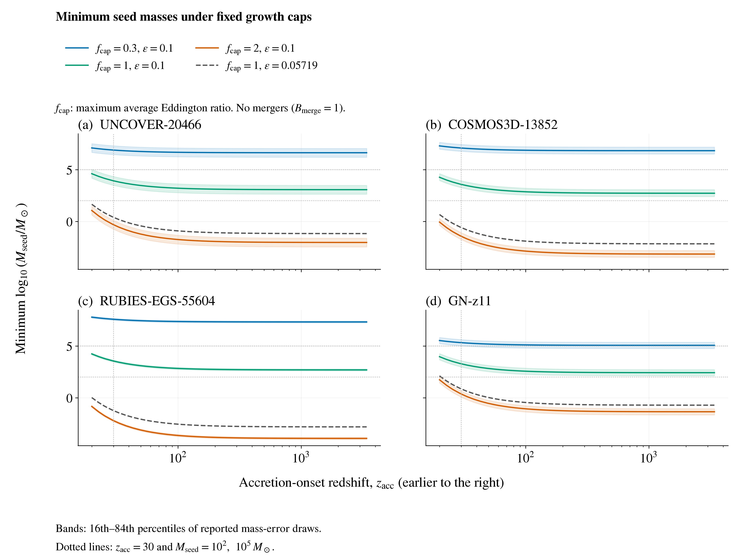
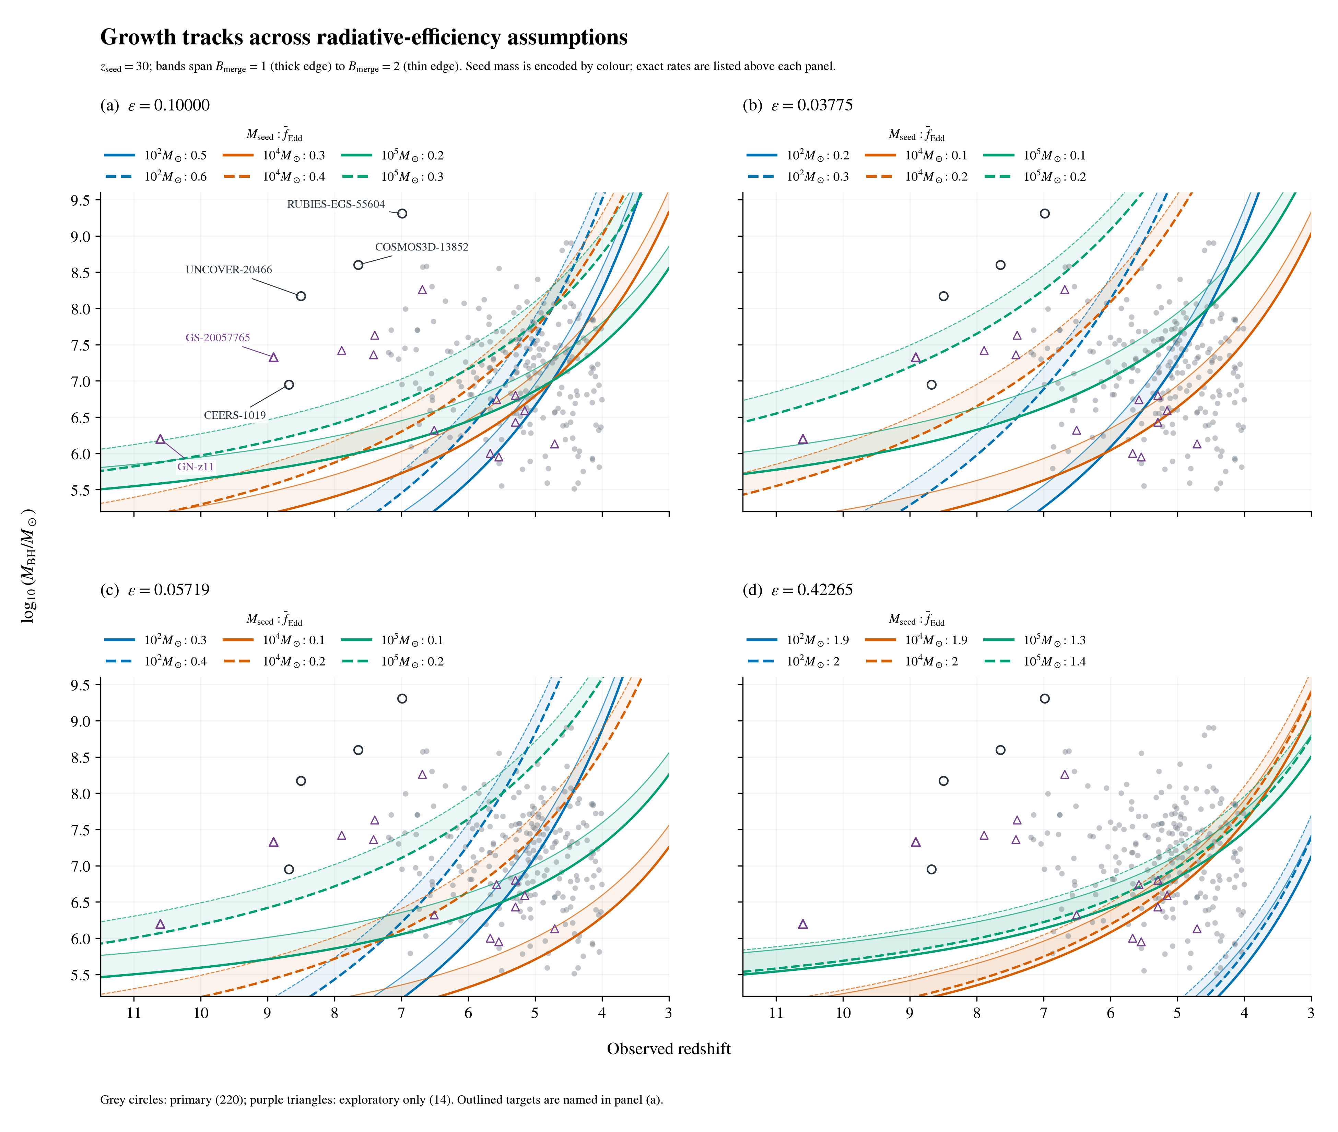
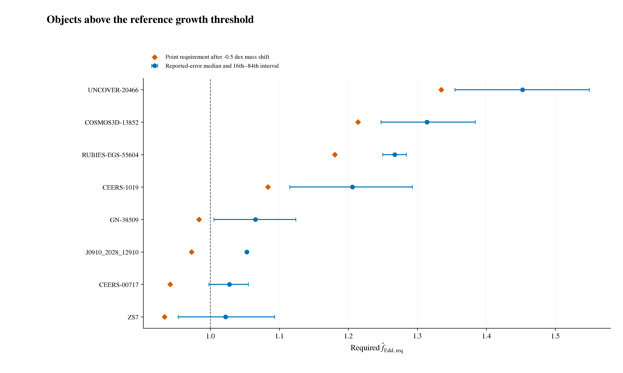
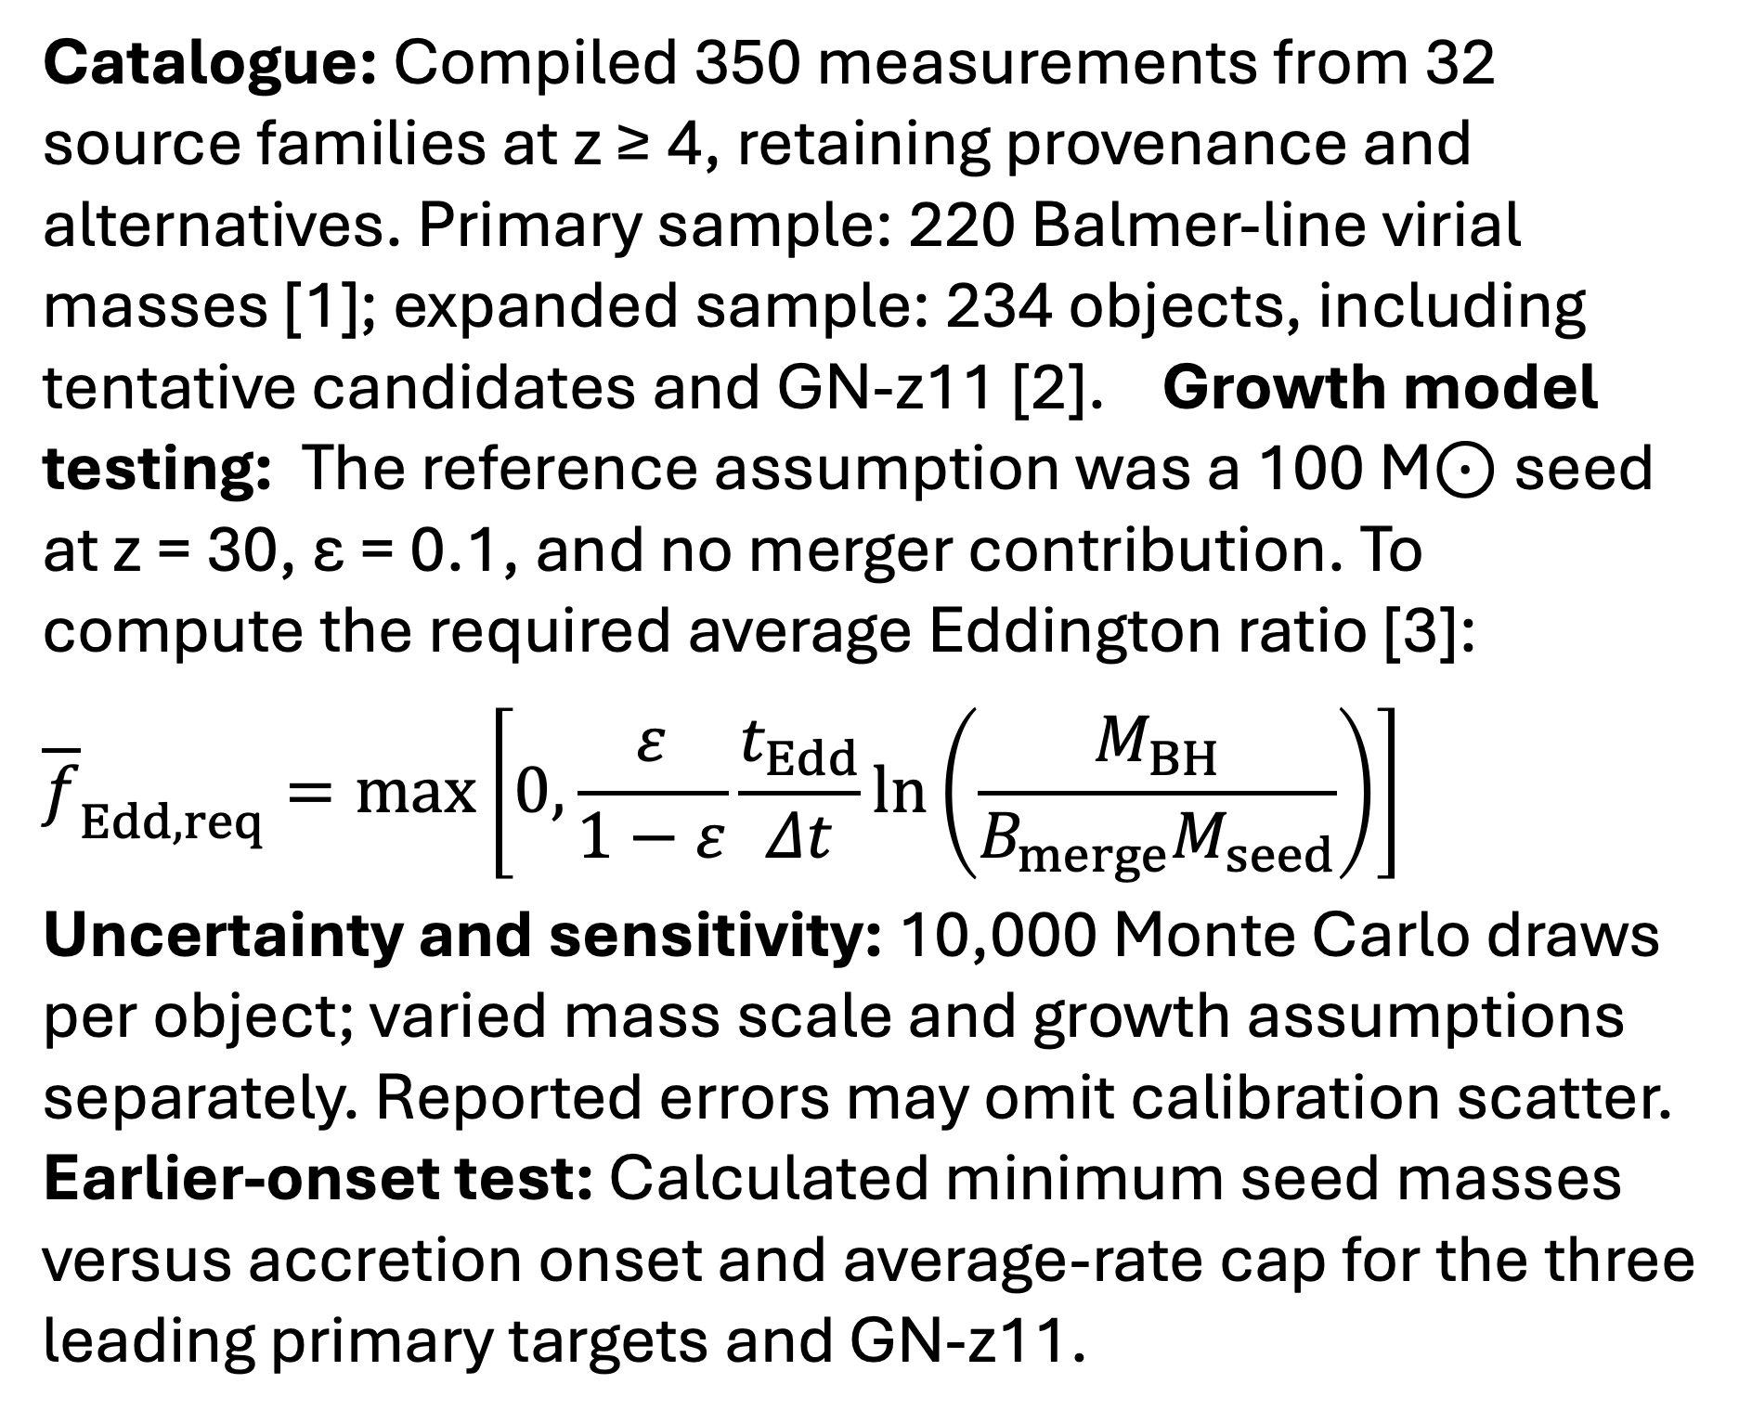
Early Black-Hole Growth Constraints from JWST
Nicole Jiang; University of Toronto
Introduction
Results (continued)
How did early black holes grow so big, so fast?
JWST has revealed massive black holes with little time to assemble. My research builds a standardized catalogue across published studies for consistent comparison, then tests objects against analytic growth models. I identify which objects most strongly constrain early black-hole growth, and how those constraints depend on the assumptions.
Earlier-onset test: At matter–radiation equality (z = 3400), the three leading primary targets plus GN-z11 need 270–1,200 M⊙ seeds (ε = 0.1, average ratio ≤1, no mergers). Independent mass check: A2744-QSO1’s dynamical mass raises its required ratio from 0.929 to ≈1; uncertainty spans unity.
Methods
Catalogue: Compiled 350 measurements from 32 source families at z ≥ 4, retaining provenance and alternatives. Primary sample: 220 Balmer-line virial masses [1]; expanded sample: 234 objects, including tentative candidates and GN-z11 [2].
Growth model: Reference assumptions: a 100 M⊙ seed at z = 30, ε = 0.1, and no mergers. Required average Eddington ratio [3]:
$${\overline{f}}_{Edd,req}=\max\left[0,\frac{ε}{1−ε}\frac{t_{Edd}}{Δt}\ln\left(\frac{M_{BH}}{B_{merge}M_{seed}}\right)\right]$$
Testing and comparison: Rank objects by their required average Eddington ratio and compare with allowed average rates. Assess robustness using the fraction of Monte Carlo draws above unity, repeating across growth assumptions.
Uncertainty and sensitivity: 10,000 Monte Carlo draws per object; varied mass scale and growth assumptions separately. Reported errors may omit calibration scatter.
Earlier-onset test: For the three leading primary targets and GN-z11, calculate minimum seed masses across onset redshifts 20 ≤ z_{acc} ≤ 3400, average-rate caps, and efficiencies, using radiation-inclusive cosmic ages.
Conclusions
Conditional growth constraints: Some objects challenge the reference stellar-seed model, but the tension depends strongly on growth assumptions. Lower efficiency permits 100 M⊙ seeds to reach all four selected targets’ central masses.
Independent mass estimates remain essential: Calibration, lensing, and scattering uncertainties can affect which objects appear most challenging.
The catalogue enables consistent comparisons: Traceable measurements identify targets for growth-model testing and follow-up as observations improve.
Earlier onset offers limited relief: Even onset at matter–radiation equality requires 270–1,200 M⊙ seeds for the four targets at ε = 0.1, average Eddington ratio ≤1, and no mergers. Hypothetical PBH seeds shift the challenge toward explaining their formation and abundance, which this growth analysis does not establish.
Results
Reference: 8/220 primary objects require an average ratio above 1; five do so in ≥95% of reported-mass-error draws. Mass sensitivity: UNCOVER-20466, COSMOS3D-13852, and RUBIES-EGS-55604 retain this criterion after a 0.5 dex mass reduction [1]. Seed-mass sensitivity: 1,000 M⊙ seeds reduce the count to 3/220; 100,000 M⊙ seeds leave none in either sample. Formation time: Later seeding (z = 20) gives 18/220 and makes GN-z11 highest-ranked. Efficiency: At ε = 0.05719 [4], all 234 central masses are reachable from 100 M⊙ seeds at z = 30 with an average ratio below 1.
References
[1] Shen (2013), BASI, 41, 61.
[2] Maiolino et al. (2024), Nature, 627, 59.
[3] Dayal (2024), A&A, 690, A182.
[4] Bardeen et al. (1972), ApJ, 178, 347.
Catalogue sources and code: QR link above.

Slide 2
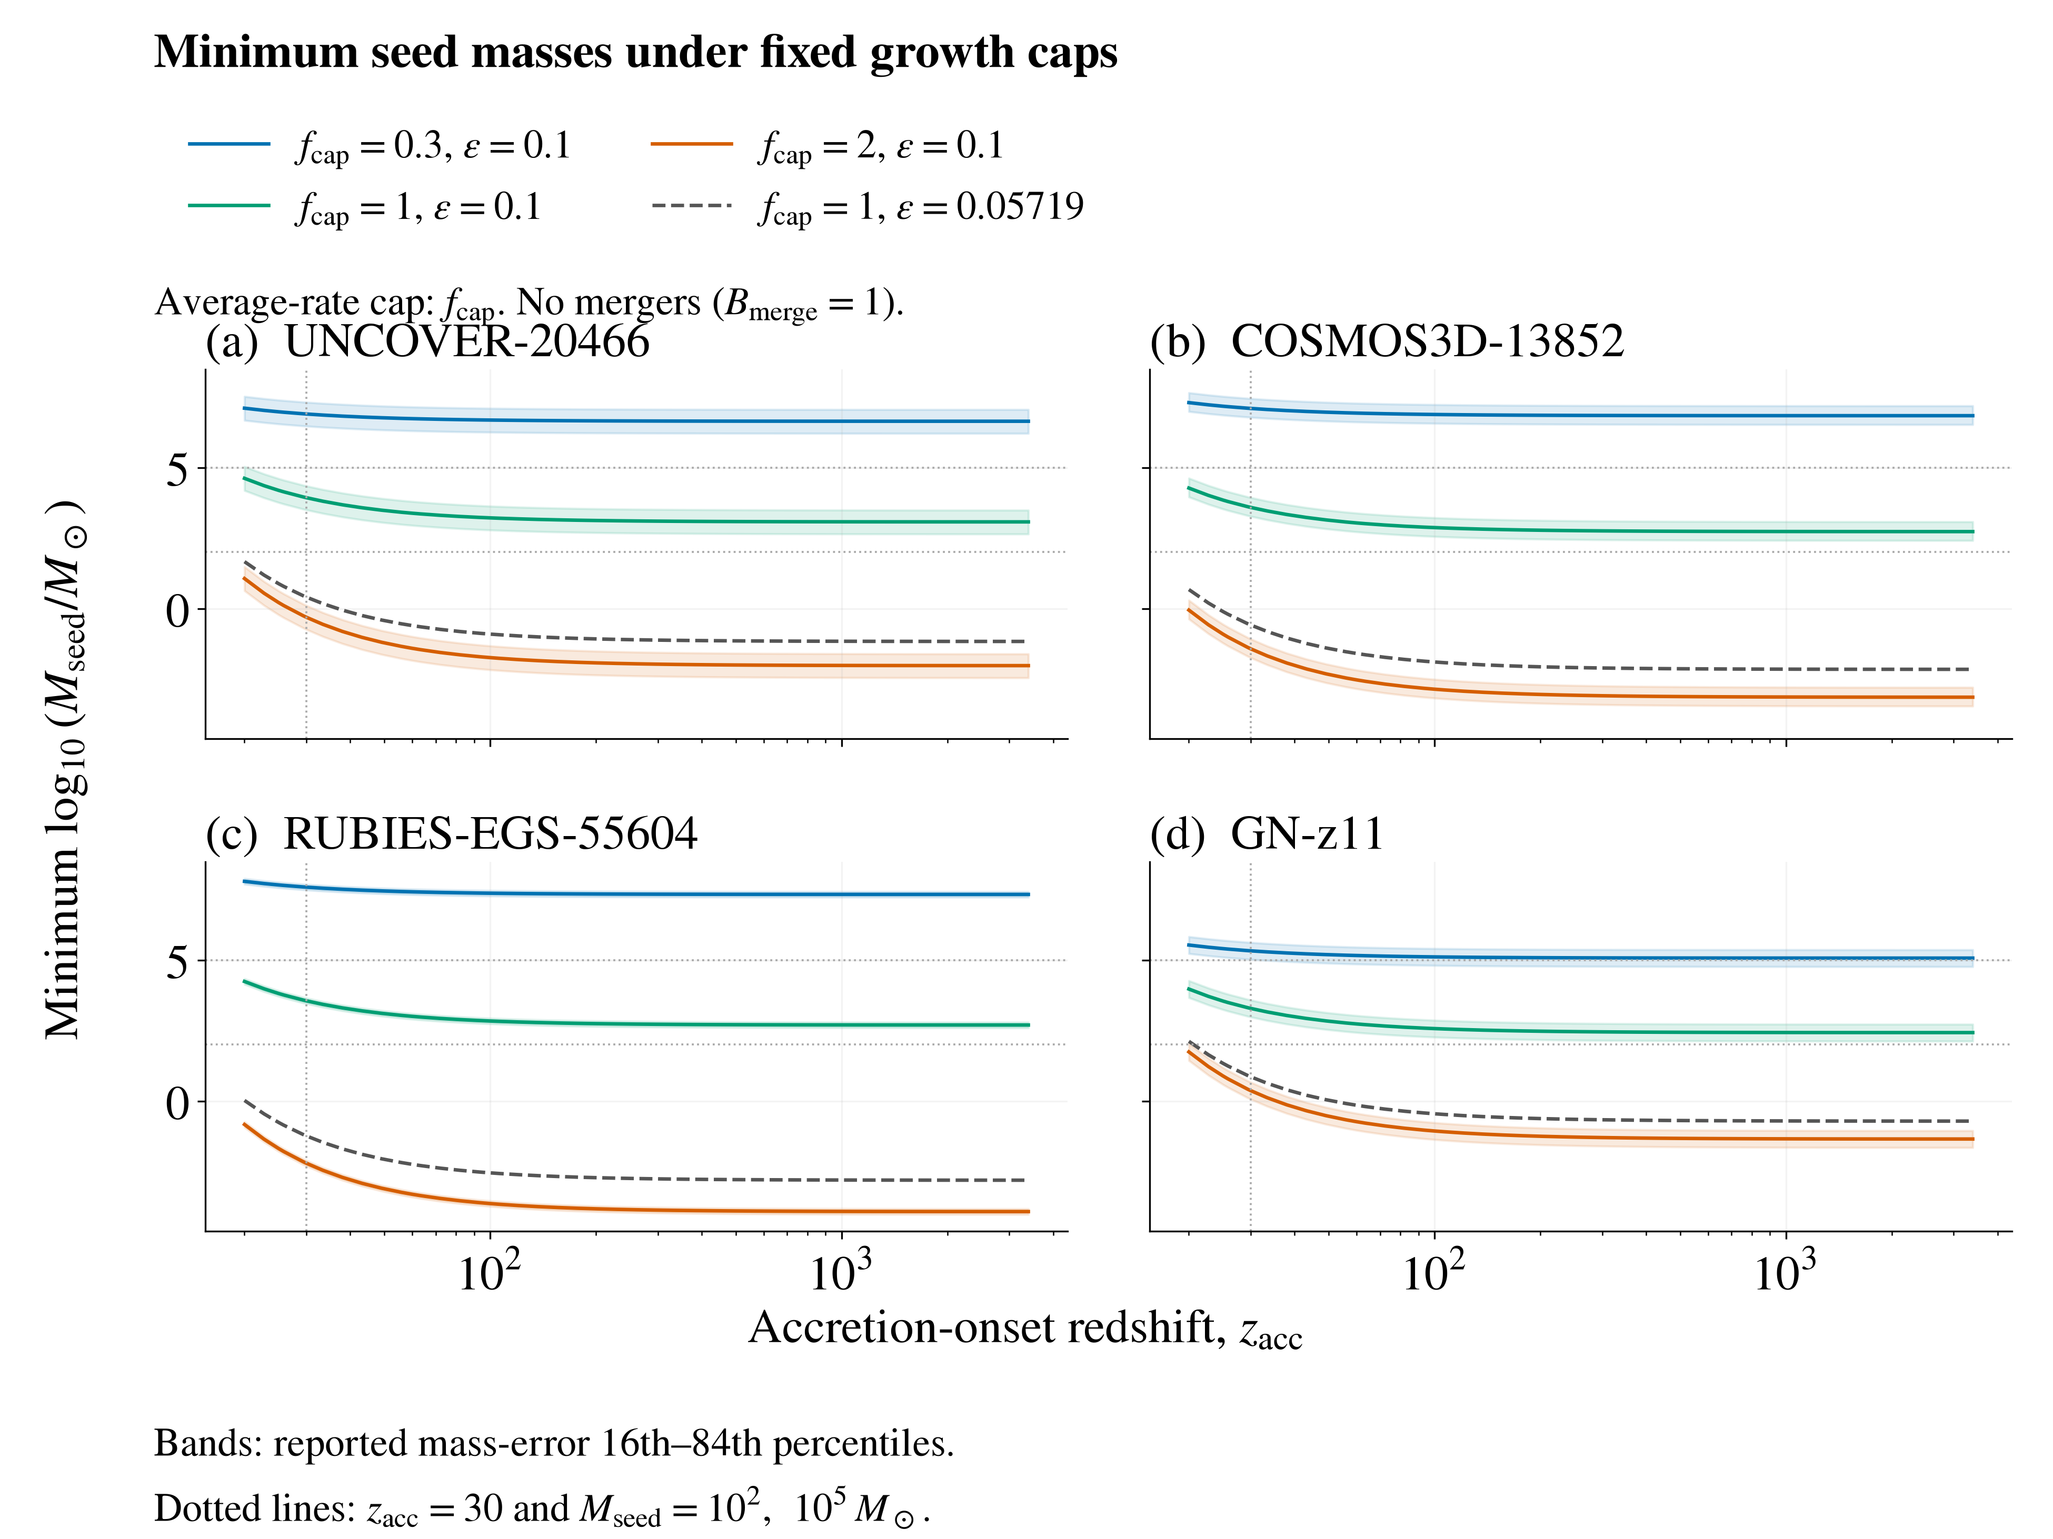
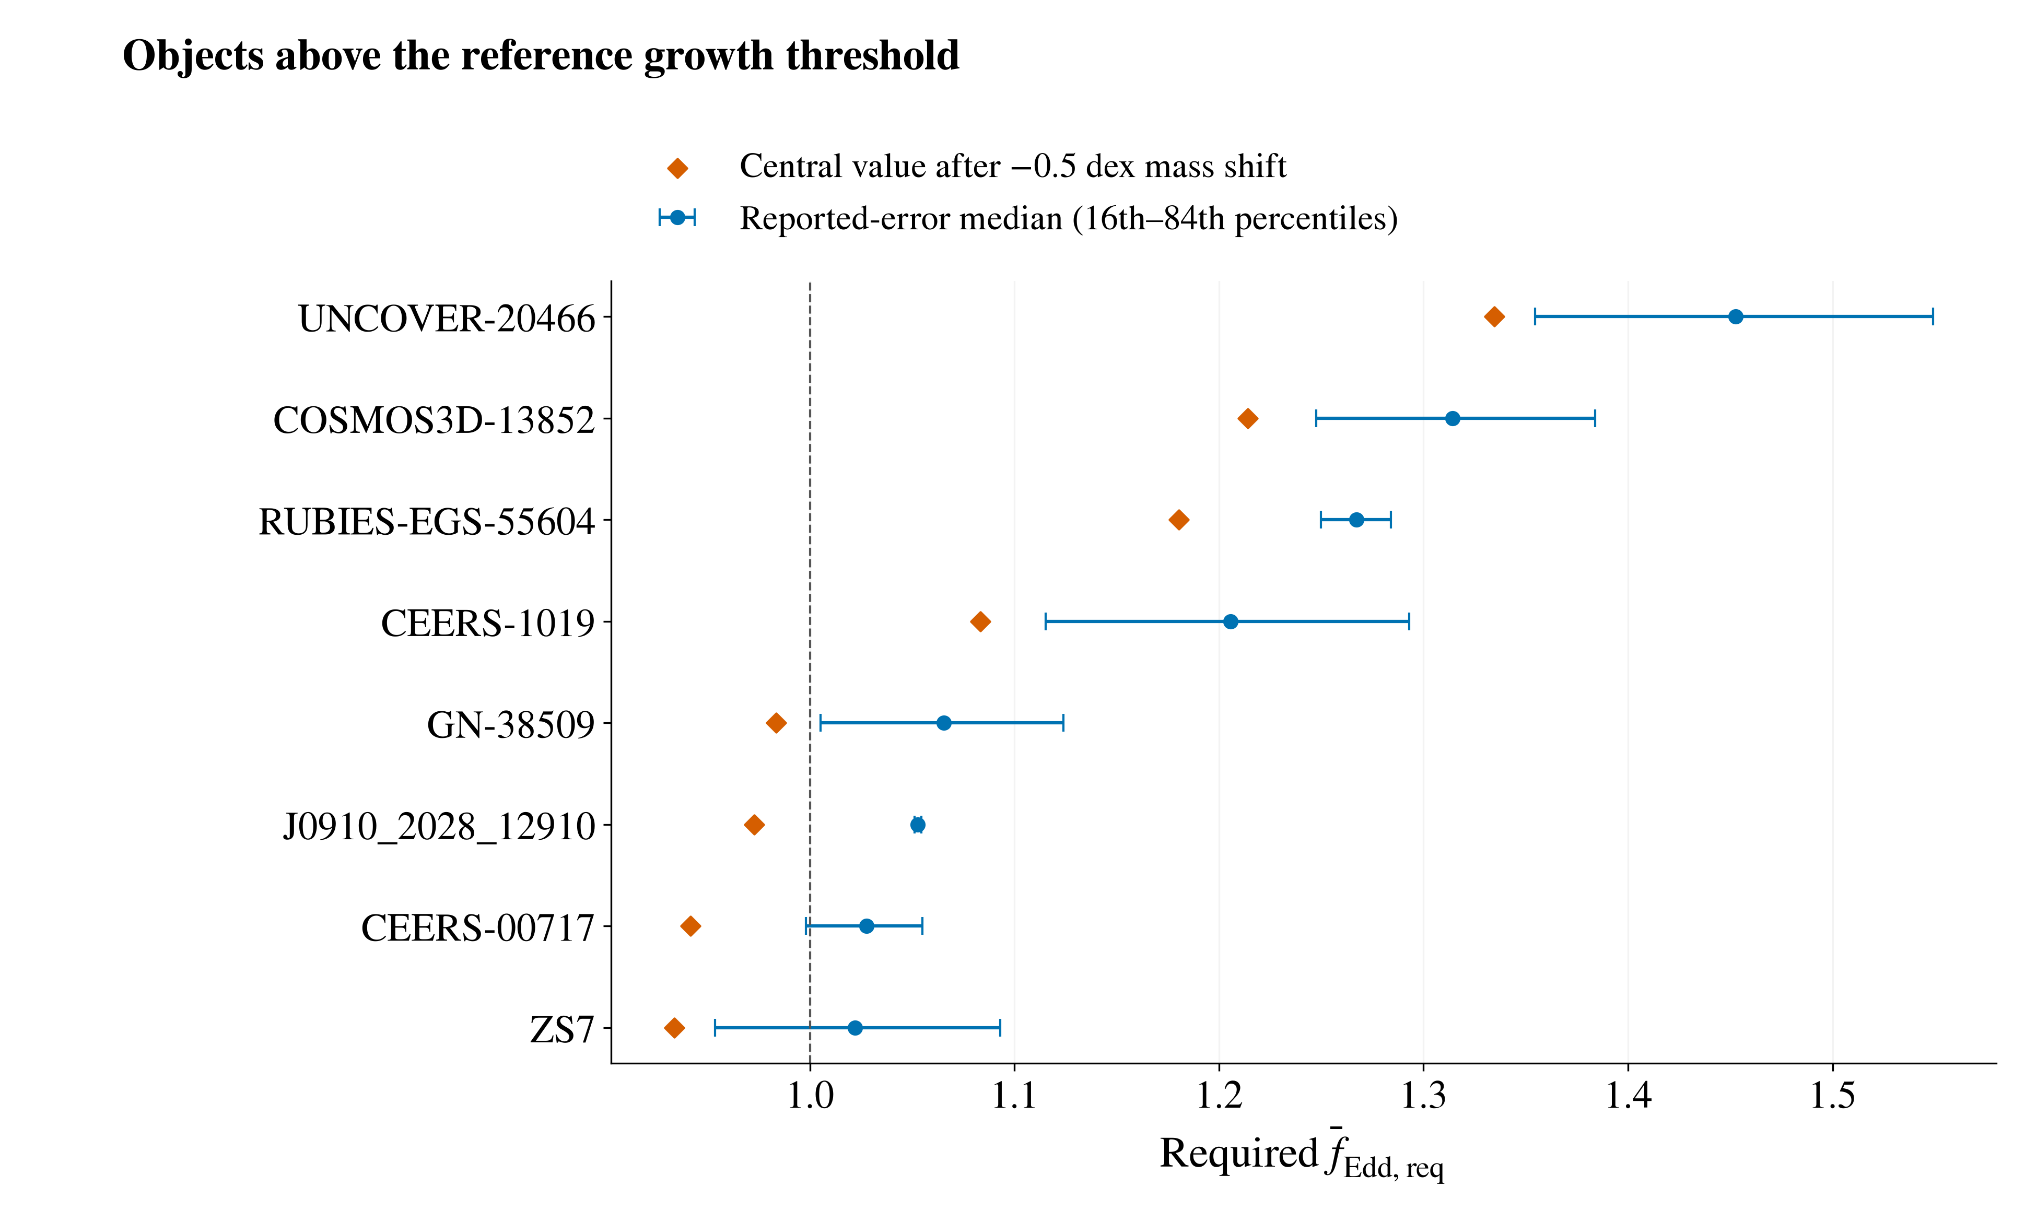
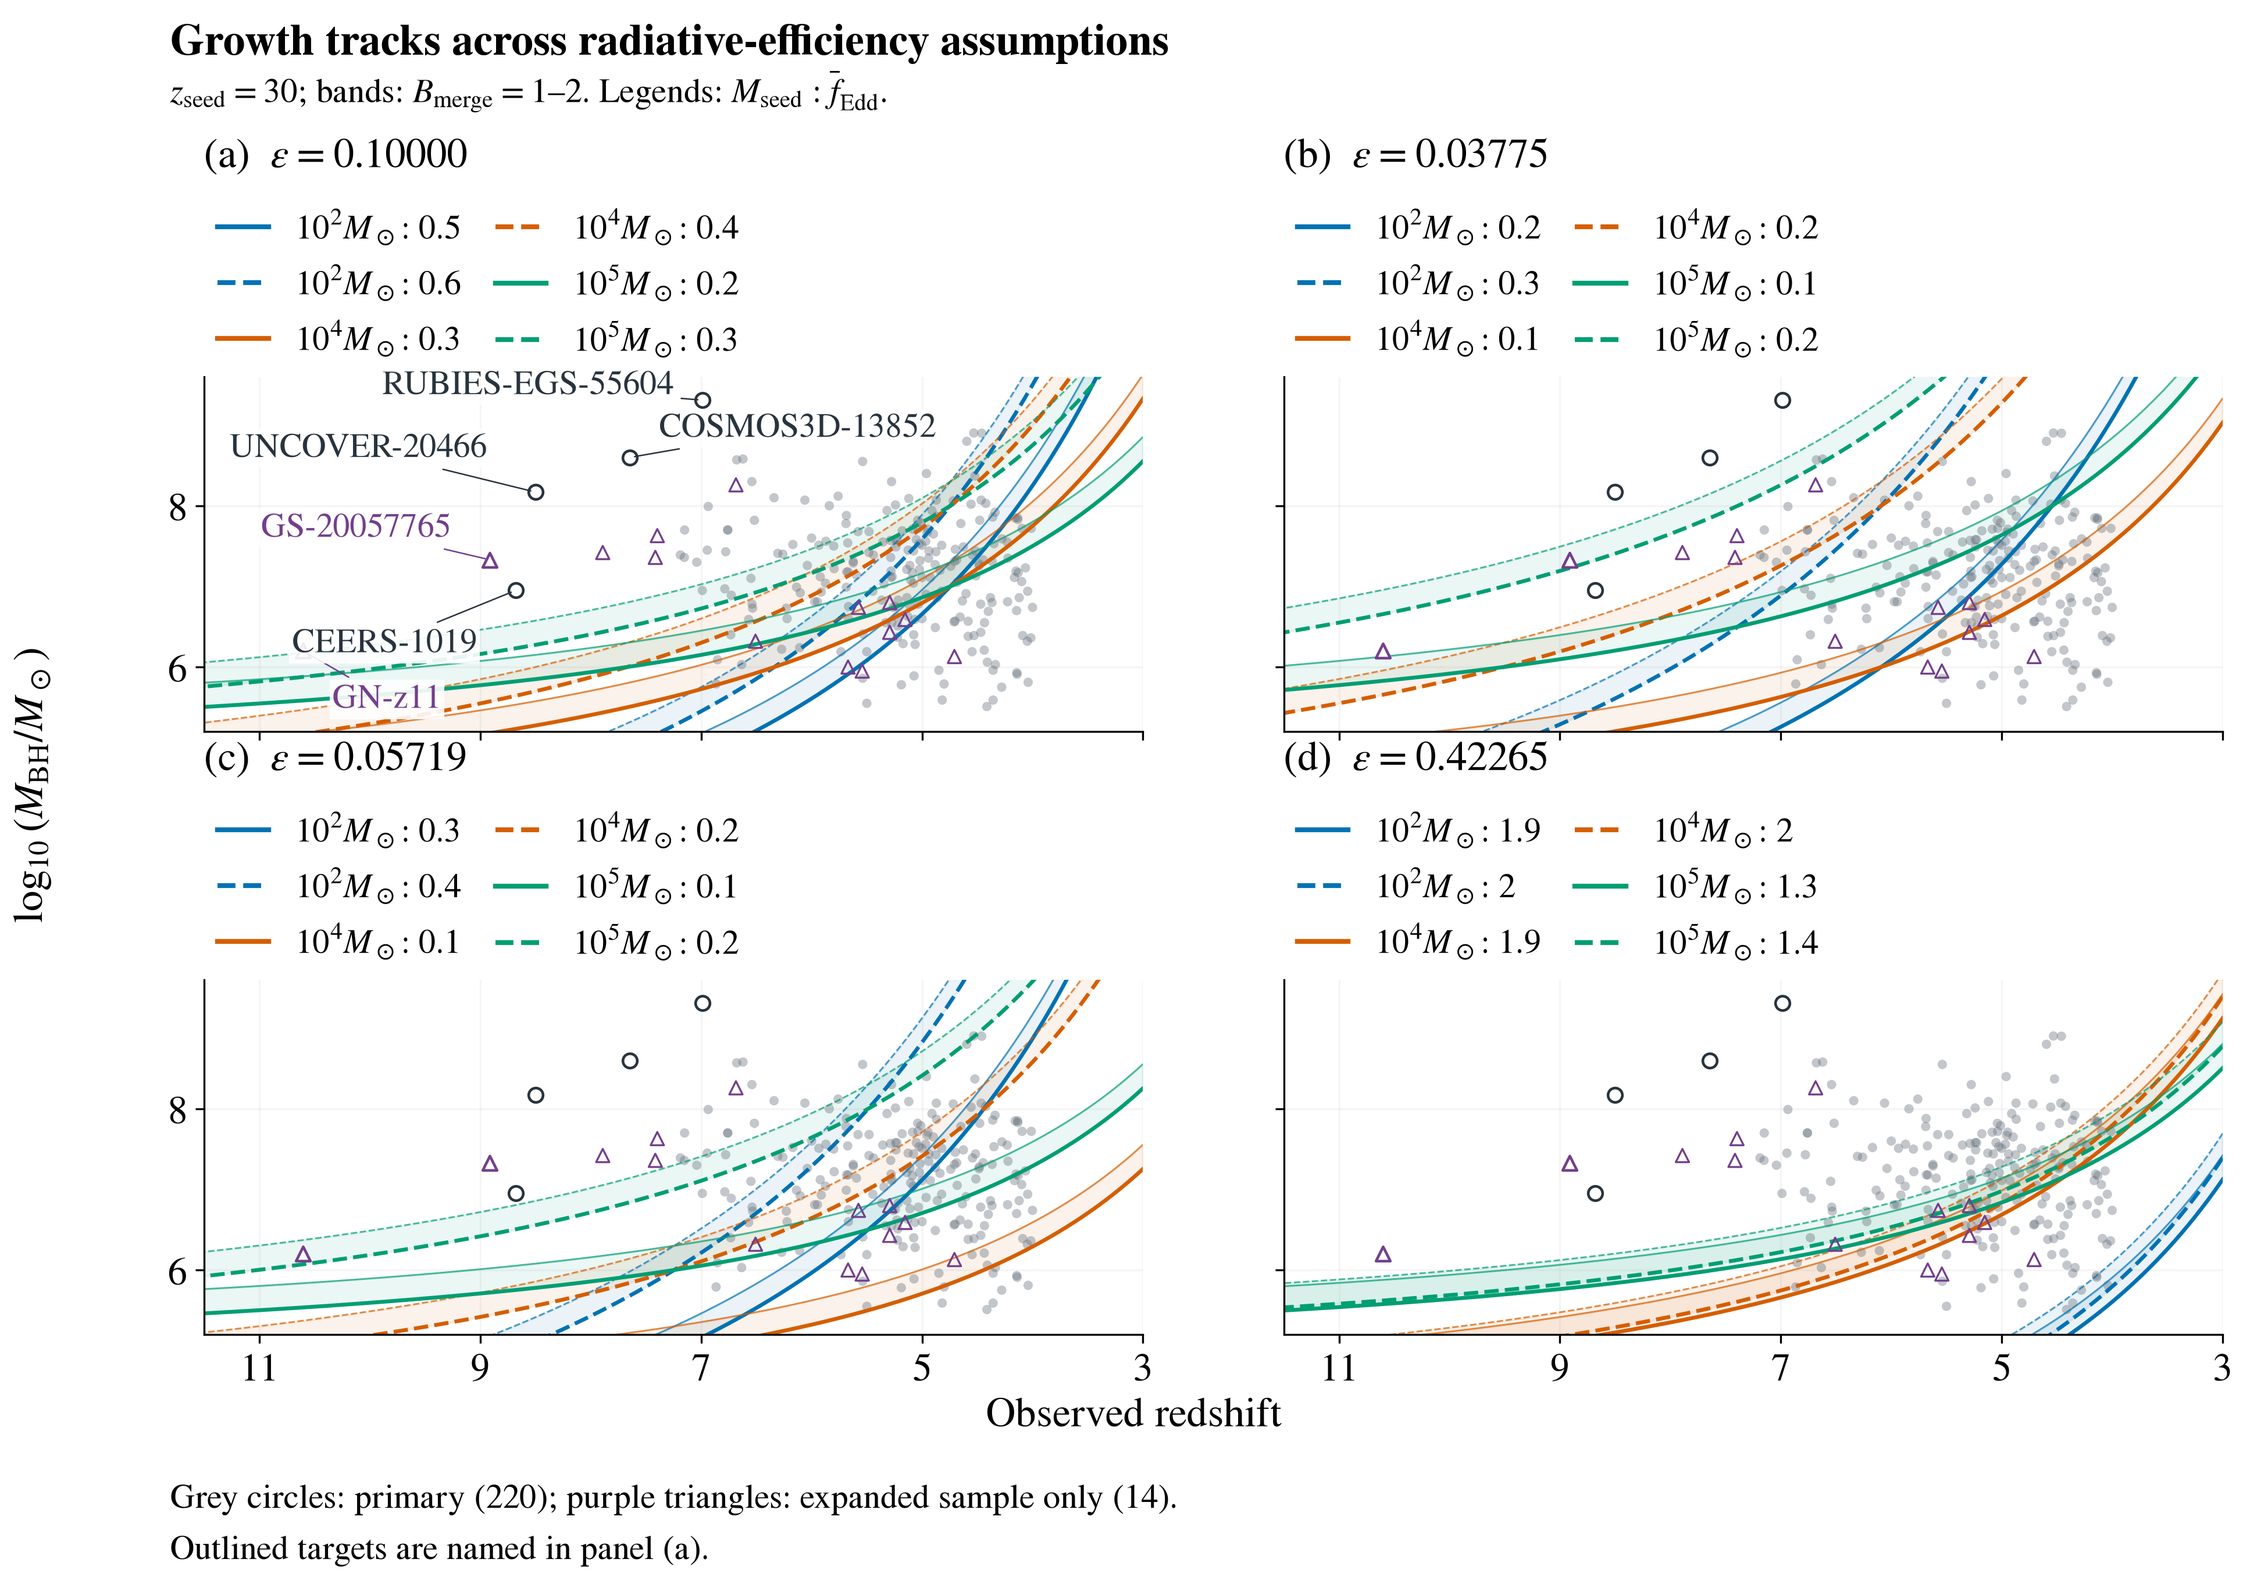
Early Black-Hole Growth Constraints from JWST
Nicole Jiang; University of Toronto
Introduction
Results (continued)
How did early black holes grow so big, so fast?
The James Webb Space Telescope (JWST) has revealed massive black holes with little time to assemble. My research builds a standardized catalogue across studies, then tests objects against analytic growth models to identify the strongest constraints and how they depend on the assumptions.
Earlier-onset test: At matter–radiation equality (z = 3400), the three leading primary targets plus GN-z11 need 270–1,200 M⊙ seeds (ε = 0.1, average ratio ≤1, no mergers). Independent mass check: A2744-QSO1’s dynamical mass raises its required ratio from 0.929 to ≈1; uncertainty spans unity.
Methods
Catalogue: 350 measurements from 32 source families at z ≥ 4. Documented adopted values, methods, provenance, and alternatives. Primary: 220 Balmer-line virial masses [1]; expanded: 234 objects, including tentative candidates and GN-z11 [2].
Reference model: 100 M⊙ seeds (initial black holes) at z = 30, constant radiative efficiency ε = 0.1, no merger boost (B_{merge} = 1), and t_{Edd} ≈ 0.45 Gyr. Required average Eddington ratio [3]:
$${\overline{f}}_{Edd,req}=\max\left[0,\frac{ε}{1−ε}\frac{t_{Edd}}{Δt}\ln\left(\frac{M_{BH}}{B_{merge}M_{seed}}\right)\right]$$
Symbols: M⊙: solar mass; M_{BH}: observed mass; M_{seed}: initial mass; Δt: growth time; ε: fraction of inflowing rest-mass energy radiated. Larger z means earlier cosmic time.
Testing and uncertainty: Rank required lifetime-average ratios; values above 1 require super-Eddington episodes under the model. The Eddington ratio is luminosity relative to the Eddington limit. Sample asymmetric log-mass errors with 10,000 Monte Carlo draws per object.
Sensitivity: Separately vary mass scale, seed mass, onset, and efficiency. Reported errors may omit calibration scatter.
Earlier onset: For the three leading primary targets and GN-z11, solve minimum seed masses over 20 ≤ z_{acc} ≤ 3400 and varied caps and efficiencies, using radiation-inclusive ages.
Earlier starts reduce required seeds, with diminishing gains.
Conclusions
Conditional constraints: Some objects challenge the reference stellar-seed model. At ε = 0.05719, 100 M⊙ seeds starting at z = 30 reach all four selected central masses with an average ratio below 1.
Independent mass estimates: Tests of calibration, lensing, and scattering are essential to establish which objects are most challenging.
Catalogue contribution: Documented measurement choices and retained alternatives support consistent comparisons and follow-up. Sample counts describe the literature sample, not population fractions.
Earlier onset offers limited relief: Earlier onset alone cannot rescue 100 M⊙ seeds for the four targets at ε = 0.1, average ratio ≤1, and no mergers. Gains diminish at earlier onset. Growth compatibility does not establish primordial black hole (PBH) formation or abundance viability.
Three targets remain above unity after a −0.5 dex mass shift.
Results
Reference: 8/220 primary objects require an average ratio above 1; five do so in ≥95% of reported-mass-error draws.
Mass sensitivity: UNCOVER-20466, COSMOS3D-13852, and RUBIES-EGS-55604 retain ≥95% support after a 0.5 dex mass reduction [1].
Seed mass: 1,000 M⊙ seeds leave 3/220 above unity; 100,000 M⊙ seeds leave none in either sample.
Formation time: Later seeding (z = 20) gives 18/220 above unity and makes GN-z11 highest-ranked.
Efficiency: At ε = 0.05719 [4], all 234 central masses are reachable from 100 M⊙ seeds at z = 30 with an average ratio below 1.
References
[1] Shen (2013), BASI, 41, 61.
[2] Maiolino et al. (2024), Nature, 627, 59.
[3] Dayal (2024), A&A, 690, A182.
[4] Bardeen et al. (1972), ApJ, 178, 347.
Catalogue sources and code: QR link above.
Tracks vary seed mass and average rate within each efficiency panel.

