Slide 1






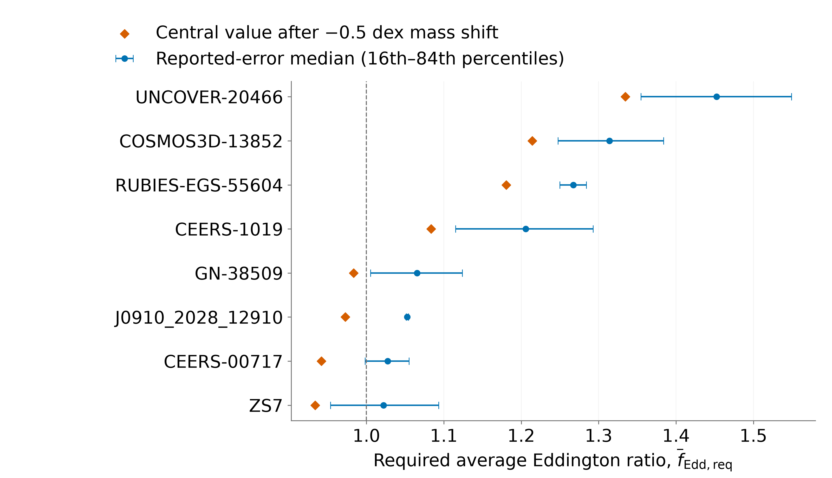
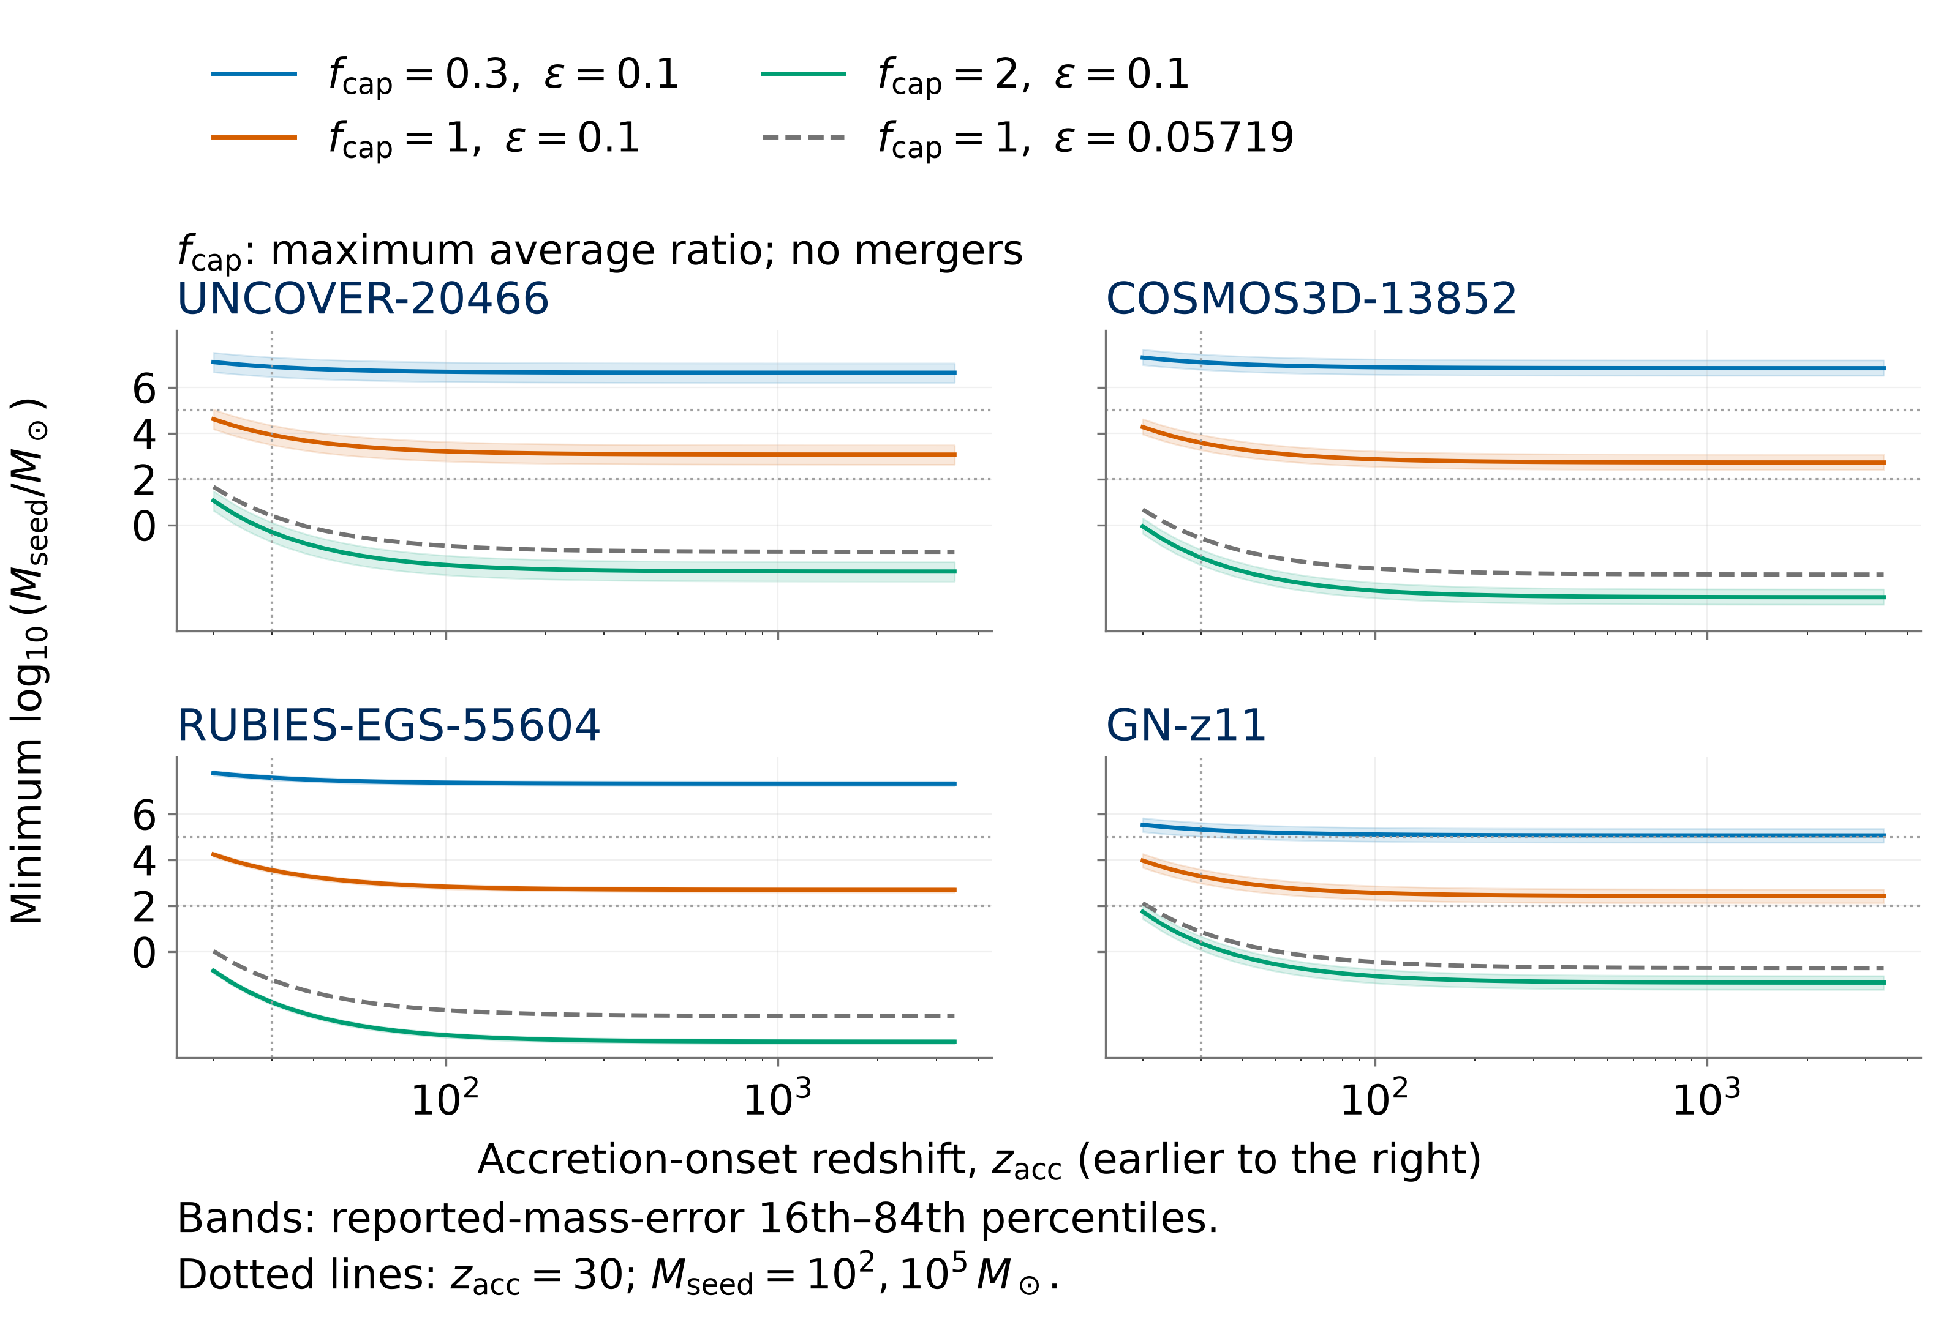
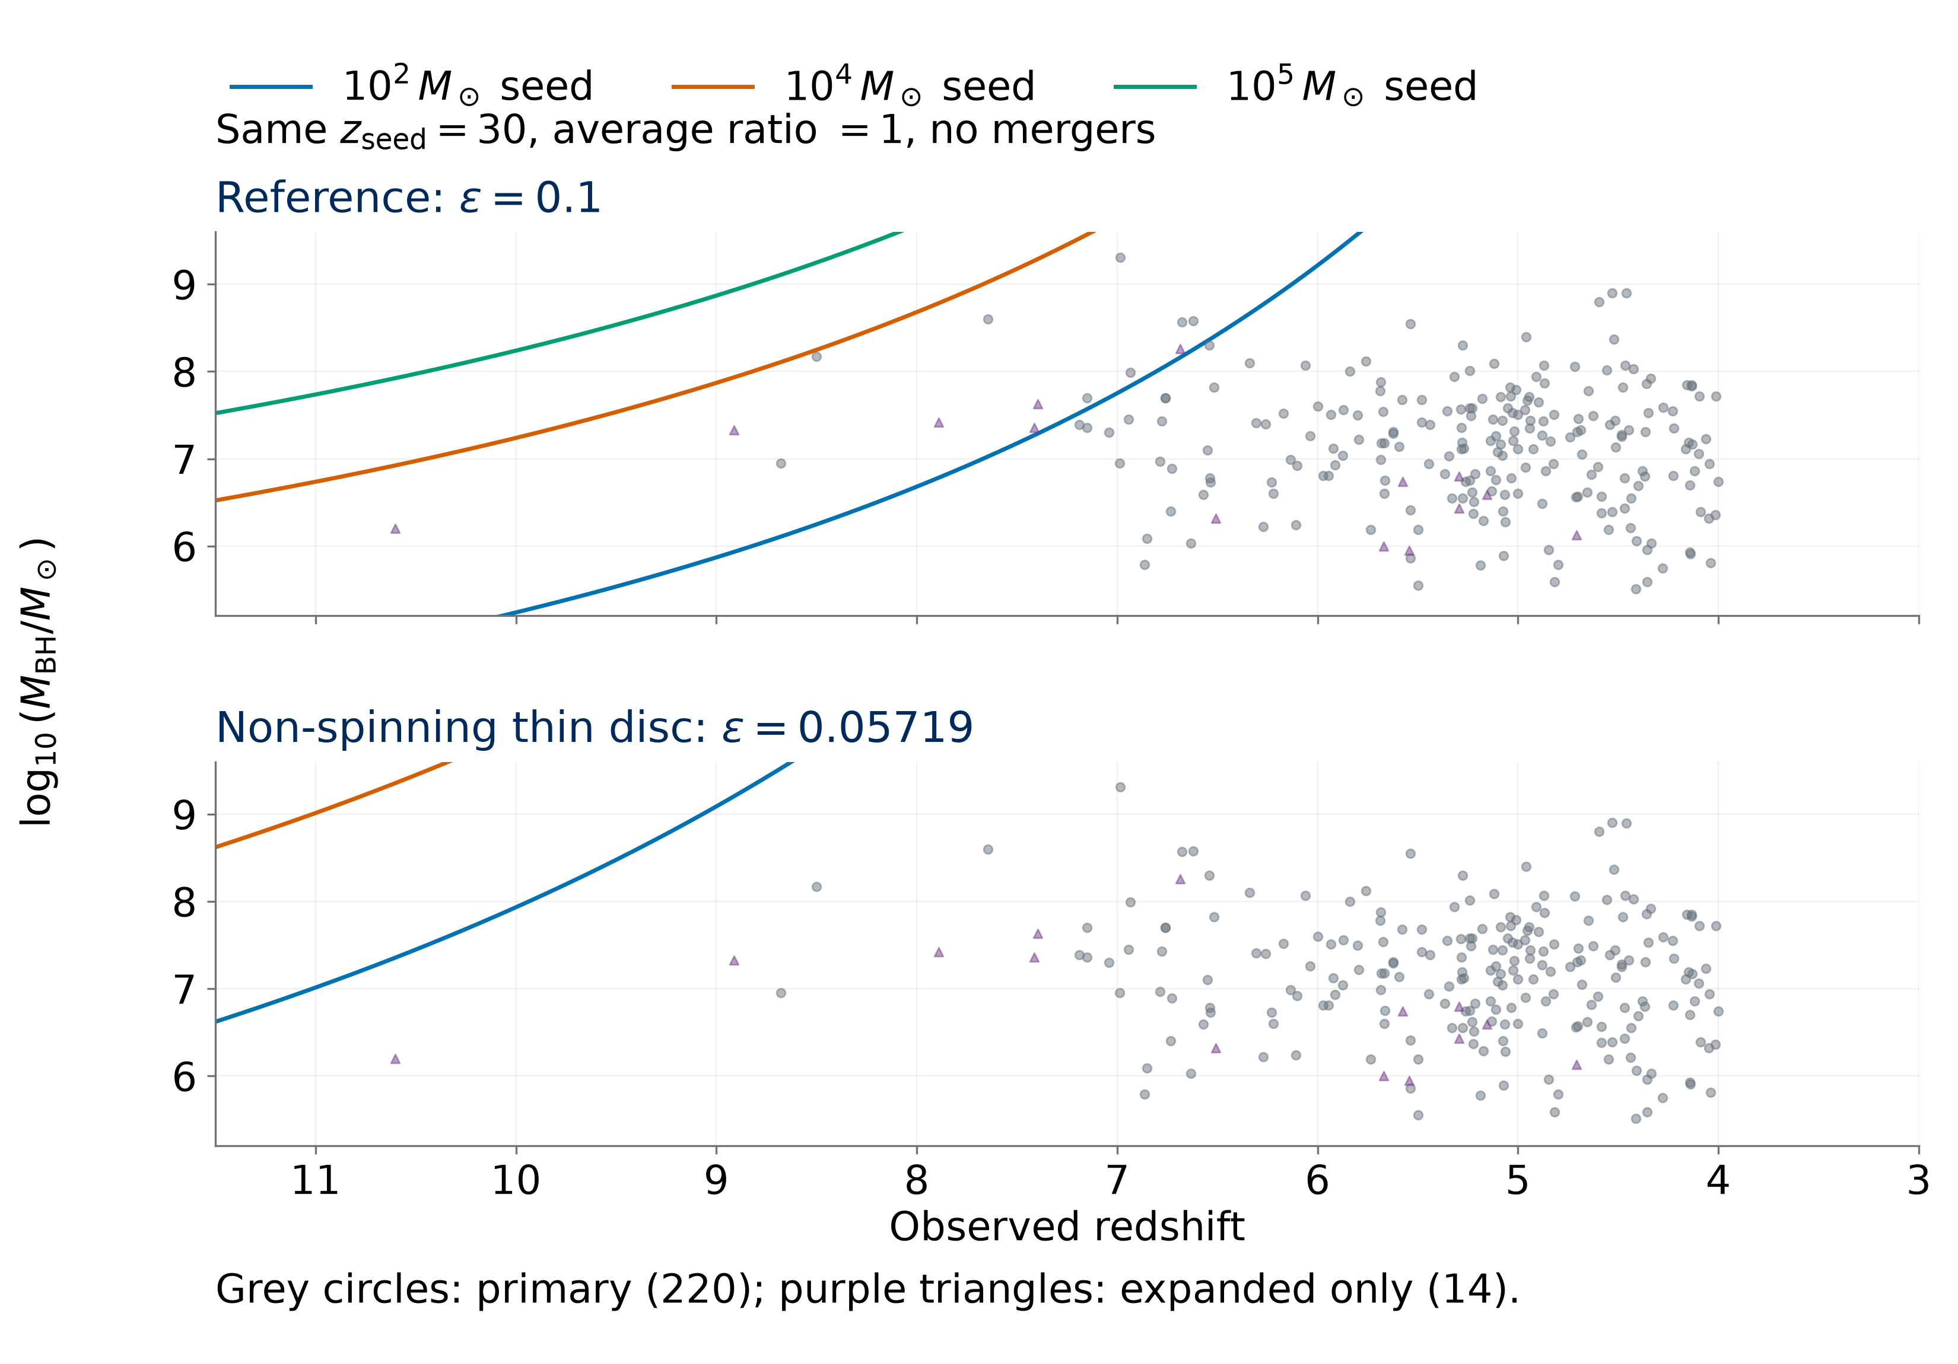
Early Black-Hole Growth
Constraints from JWST
Nicole Jiang; University of Toronto
Introduction
Results
How did early black holes grow so big, so fast? The James Webb Space Telescope (JWST) has revealed massive black holes with little time to assemble. My research builds a standardized catalogue across studies, then tests objects against analytic growth models to identify the strongest constraints and how they depend on the assumptions.
Reference: 8/220 primary objects require an average ratio above 1; five do so in ≥95% of reported-mass-error draws.
Mass sensitivity: UNCOVER-20466, COSMOS3D-13852, and RUBIES-EGS-55604 retain ≥95% support after a 0.5 dex mass reduction (a factor of 3.2).
Seed mass: 1,000 M⊙ seeds leave 3/220 above unity; 100,000 M⊙ seeds leave none in either sample.
Formation time: Later seeding (z = 20) gives 18/220 primary objects above unity; GN-z11 has the highest requirement in the expanded sample.
Efficiency: At ε = 0.05719 (non-spinning thin disc) [4], all 234 central masses are reachable from 100 M⊙ seeds at z = 30 with an average ratio below 1.
Methods
Catalogue: 350 published measurements from 32 source families at z ≥ 4. Adopt one measurement per object and retain sources, methods, and alternatives. Primary: 220 objects with Balmer-line virial masses [1]; expanded: 234, including tentative candidates and GN-z11 [2].
Reference model: 100 M⊙ seeds at z = 30, radiative efficiency ε = 0.1, no mergers (B_{merge} = 1), and t_{Edd} ≈ 0.45 Gyr [3].
$${\overline{f}}_{Edd,req}=\max\left[0,\frac{ε}{1−ε}\frac{t_{Edd}}{Δt}\ln\left(\frac{M_{BH}}{B_{merge}M_{seed}}\right)\right]$$
Symbols: M⊙: solar mass; M_{BH}: observed mass; M_{seed}: seed mass; Δt: growth time; ε: radiated fraction of inflowing rest-mass energy. Larger z means earlier time.
Eddington ratio: Luminosity divided by the Eddington limit. The lifetime average includes inactive periods. Values above 1 require super-Eddington episodes under this model.
Uncertainty: 10,000 draws approximate reported asymmetric log-mass errors. Twelve objects without errors enter central-mass calculations only.
Sensitivity: Vary mass scale, seed mass, onset, and efficiency separately. Reported errors may omit calibration scatter.
Earlier onset: For the three leading primary targets and GN-z11, solve minimum seed masses over 20 ≤ z_{acc} ≤ 3400 using radiation-inclusive ages. Access to fuel is assumed.
Three targets retain ≥95% reported-error support for a required average ratio above unity after a −0.5 dex mass shift.
Earlier-onset test: At matter–radiation equality (z = 3400), the three leading primary targets plus GN-z11 require minimum seed masses of 270–1,200 M⊙ (ε = 0.1, average ratio ≤1, no mergers).
Growth tension depends on efficiency
Earlier starts reduce required seeds, with diminishing gains.
Independent mass check: A2744-QSO1’s dynamical mass raises its required ratio from 0.929 to ≈1; uncertainty spans unity [5].
Only efficiency changes between panels. Points below a curve can be reached with a lower average Eddington ratio.
Conclusions
Efficiency drives the tension: Some objects challenge the reference model. At ε = 0.05719, the ideal thin-disc efficiency for a non-spinning black hole, 100 M⊙ seeds at z = 30 reach all 234 central masses with an average ratio below 1.
Independent mass estimates: Tests of calibration, lensing, and scattering are essential to establish which objects are most challenging.
Catalogue contribution: Documented measurement choices and retained alternatives support consistent comparisons and follow-up. Sample counts describe the literature sample, not population fractions.
Earlier onset offers limited relief: Earlier onset alone cannot rescue 100 M⊙ seeds for the four targets at ε = 0.1, average ratio ≤1, and no mergers. Gains diminish at earlier onset. Growth compatibility does not establish primordial black hole (PBH) formation or abundance viability.
References
[1] Shen (2013), BASI, 41, 61.
[2] Maiolino et al. (2024), Nature, 627, 59.
[3] Dayal (2024), A&A, 690, A182.
[4] Bardeen et al. (1972), ApJ, 178, 347.
[5] Juodzbalis et al. (2025), arXiv:2508.21748.
Catalogue sources and code: QR link above.
Notes:
Poster figure inputs: results/manuscript/tables/publication_object_selection.csv; mass_offset_object_sensitivity.csv; results/v3/tables/v3_object_point_ranking.csv and v3_object_uncertainty_ranking.csv; results/v4/tables/v4_minimum_seed_mass.csv. Controlled growth comparison uses src.models.predicted_log_mbh with mean ratio 1, z_seed=30, B_merge=1 and efficiencies 0.1 and 1-sqrt(8/9). Independent dynamical mass: https://arxiv.org/abs/2508.21748.

